Slide 1
Evaluation Metrics
and Feature Impotances
in Machine Learning
Phạm Quang Hưng | Data Scientist

Slide 2
Table of Contents
1
Problem statement
Some important concepts.
2
Regression metrics
R2, MAE and MSE.
3
Classification metrics
Accuracy, Precision, Recall, AUROC, Gains and Lift.
4
Feature importances
Understanding feature importances in some Machine Learning algorithms.

Slide 3

1
Problem statement

Slide 4

Problem statement
Every supervised Machine Learning algorithm can be summarized into a function f that maps input variables X into the output variable y:
ALIASES
The function, f
model
The input variables, X = (x₁, x₂,..., x_{n})
features
dimensions
independent variables
The output variable, y
label
target
dependent variable
x₁ | x₂ | ... | x_{n} | y_pred | y_true

Slide 5
Types of forecasting problems
Binary
Classification
Multi-class
Classification
Multi-label
Classification
Regression
x | y
 | 1.45
 | 8.54
 | 0.91
 | 2.81
 | 5.12
 | 3.32
 | 4.27
x | y
 | True
 | True
 | False
 | False
 | True
 | False
 | False
x | y
 | Apple
 | Mango
 | Mango
 | Orange
 | Apple
 | Apple
 | Orange
x | y1 | y2 | y3
 | 1 | 1 | 1
 | 1 | 0 | 0
 | 0 | 0 | 0
 | 0 | 1 | 1
 | 1 | 0 | 0
 | 0 | 0 | 1
 | 0 | 0 | 0

Slide 6
2
Regression metrics

Slide 7
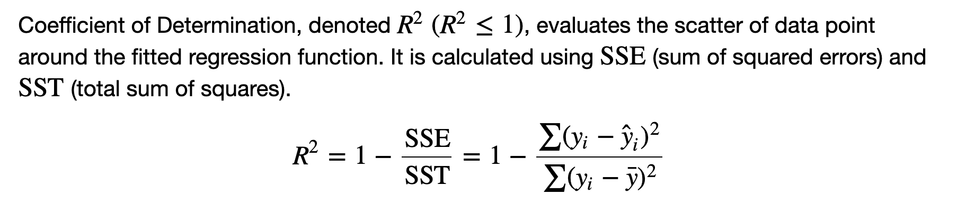
Coefficient of Determination

Slide 8
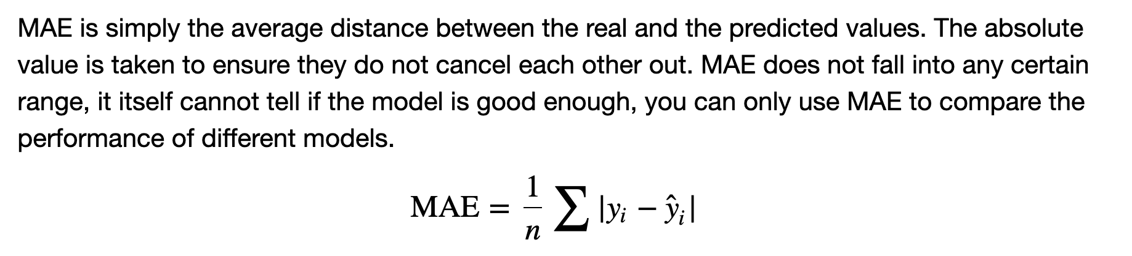
Mean Absolute Error

Slide 9
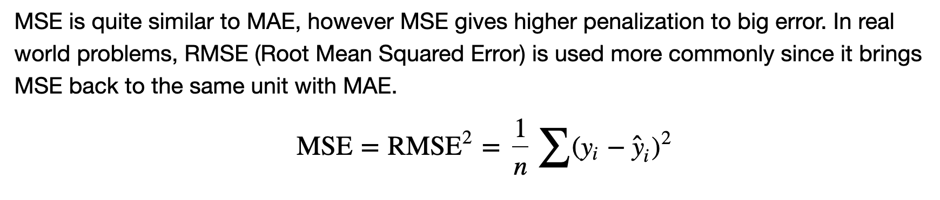
Mean Squared Error

Slide 10
3
Classification metrics

Slide 11
Classification output
By default, threshold = 0.5
x₁ | x₂ | ... | x_{n} | y_pred | prob | y_true
 |  |  |  | 0 | 0.004 | 0
 |  |  |  | 0 | 0.417 | 1
 |  |  |  | 0 | 0.115 | 0
 |  |  |  | 0 | 0.017 | 0
 |  |  |  | 1 | 0.694 | 0
 |  |  |  | 0 | 0.219 | 0
 |  |  |  | 1 | 0.784 | 1

Slide 12
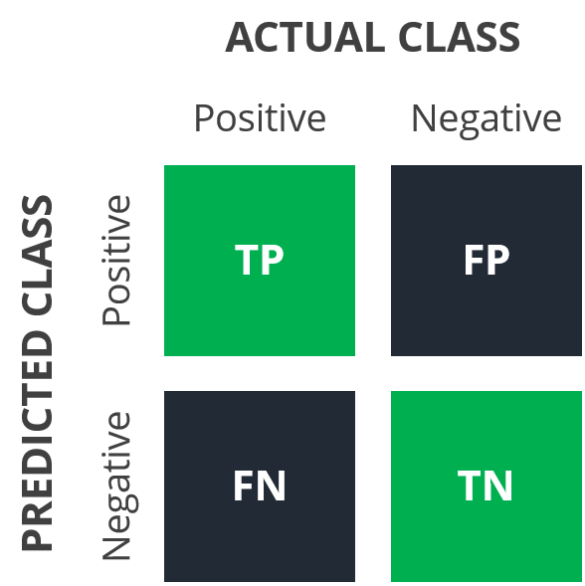
Confusion matrix

Slide 13
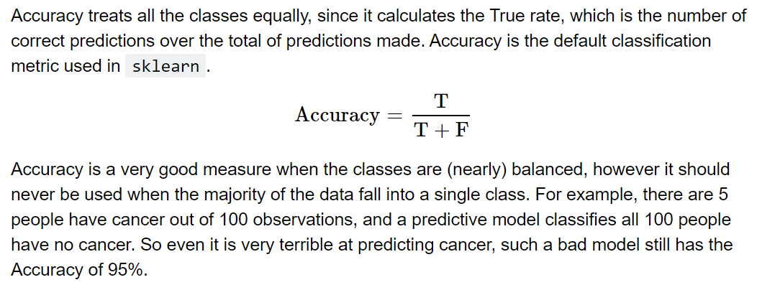
Accuracy

Slide 14
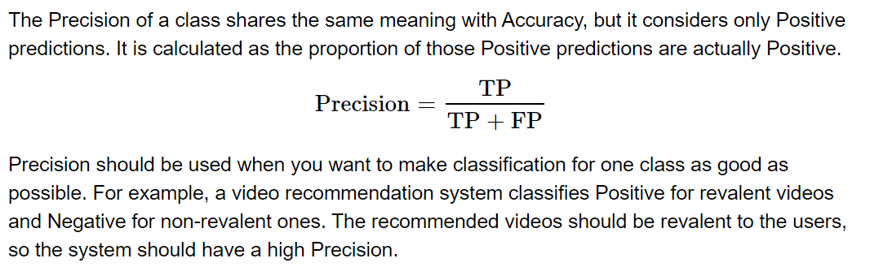
Precision

Slide 15
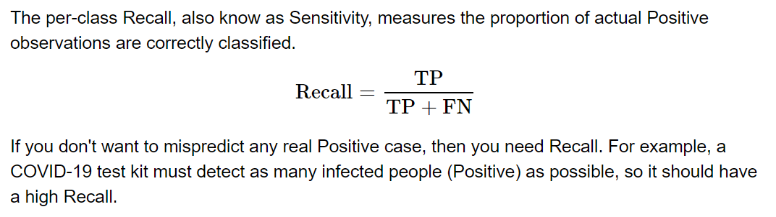
Recall

Slide 16
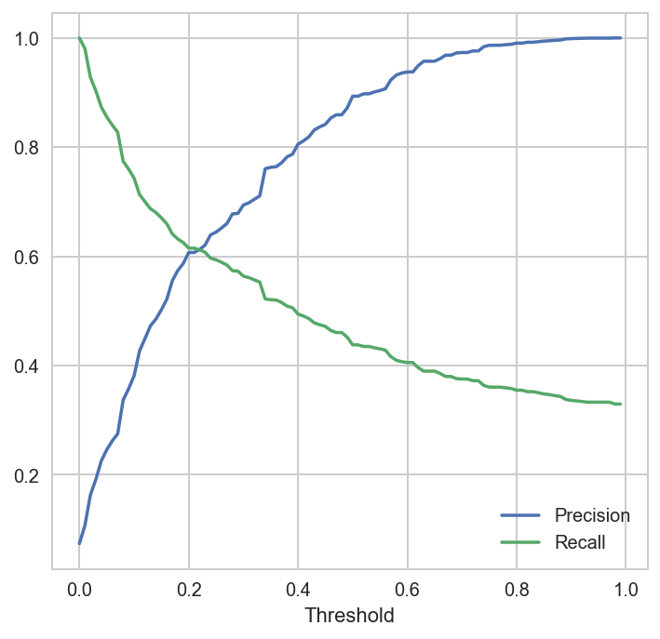
Precision-Recall chart

Slide 17
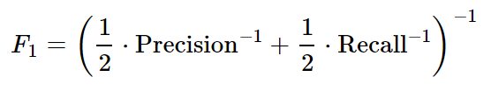
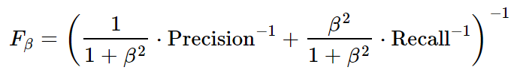
F-score
Harmonic mean
Add weights so that Recall is β times more important than Precision.
Example: Precision = 10%, Recall = 90%
→ Average = 50%
→ Harmonic mean = 18%

Slide 18
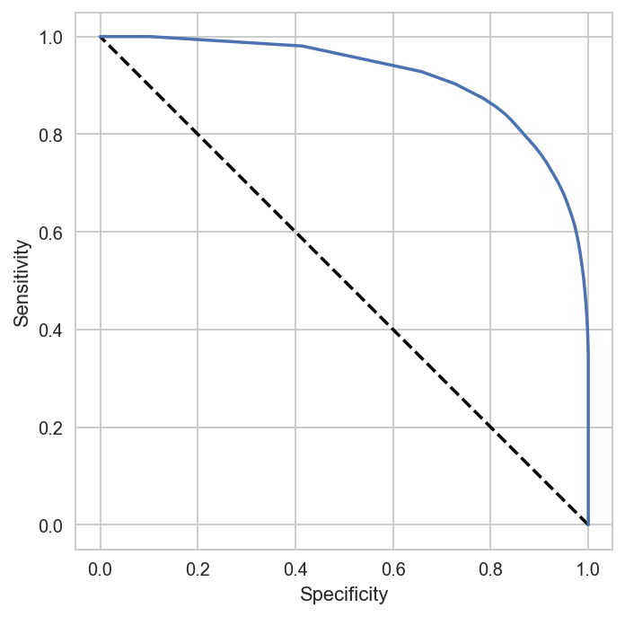


Receiver Operating Characteristics
Comaparing the quality of different models. The more convex the curve is, the more predictive power it has.
Determining the optimal threshold.
Calculating the AUROC (Area Under the ROC), which is a single value summarizes the overall performance of the model.

Slide 19
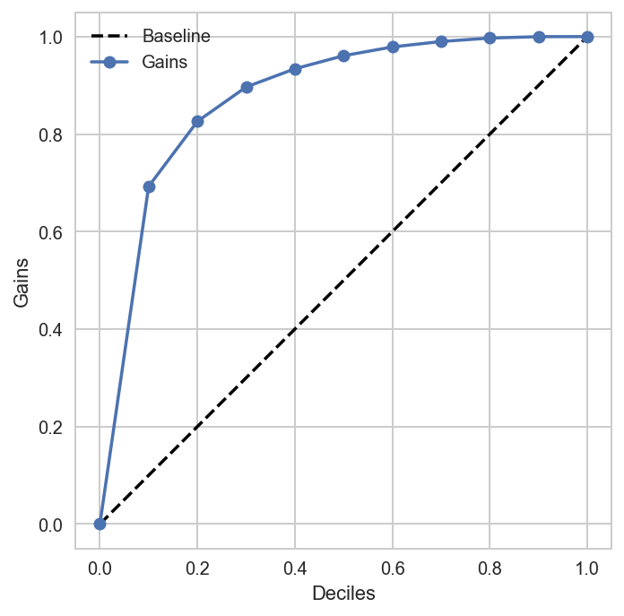
Cumulative gains
In many business problems, resources are limited, thus only the most potential targets are visited. So it is really important for the model to cover a high ratio of positive instances only by visiting a small part of the dataset, and this is where Cumulative Gains is used.
Cumulative Gains shows the overall positive percentage gained by targeting a top fraction of all observations. A popular method determining the fractions of observations is deciles (10-quantiles). The diagonal in the chart represents the baseline model, which targets observations at random. A good model should have a high gain value at the very first decile.

Slide 20
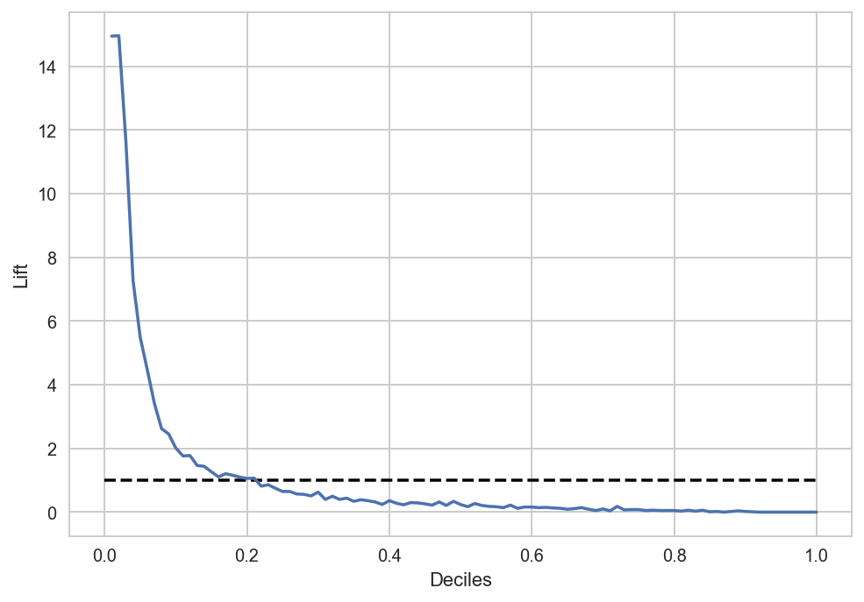
Lift curve
Besides Cumulative Gains, Lift Curve is also a powerful tool being widely used in marketing campaigns. It helps analyzing the overall positive percentage in each bin, comparing to bin size. Notice that bin size represents the expected percent of positive instances if targeting randomly. For example, assume there are total of 70 positive instances and the bin size is choosen of 10% (deciles), then each bin is expected to contains 70⋅10%=770⋅10%=7 positive instances.
The Lift Curve for an ideal model should have very high values at first, then drop significantly to the point that lift values are below the baseline. This proves the vast majority of positive instances are in first bins.

Slide 21
Lift curve
Dự đoán khả năng churn 1 (có)/0 (không): AUC = 0.877426
Dự đoán khả năng nợ cước 1 (có)/0 (không): AUC = 0.882672
Dự đoán khả năng dht sang cdt 1 (có)/0 (không): AUC = 0.931172
Dự đoán khả năng thay đổi sản phẩm 1 (có)/0 (không): AUC = 0.72886
Dự đoán tiềm năng mua gói xem tv trên TV360: R2 = 0.412253, MAE = 0.157781, RMSE = 0.423224
Dự đoán số lần vào app myvt: MAE = 0.347264, RMSE = 1.156481, R2 = 0.478473
Dự đoán số ngày mua vietlott trên myvtt: MAE = 0.003477, RMSE = 0.13334, R2 = 0.194169

Slide 22
3
Feature importances

Slide 23
Definition
Feature importance refers to techniques that assign a score to input features based on how useful they are at predicting a target variable.
Feature importances are value-added output. Some algorithms do not return feature importances, eg: Multi-Layer Perceptron.
Some methods have been developed to calculate feature importances indirectly, however they requires a lot of computational resources.

Slide 24
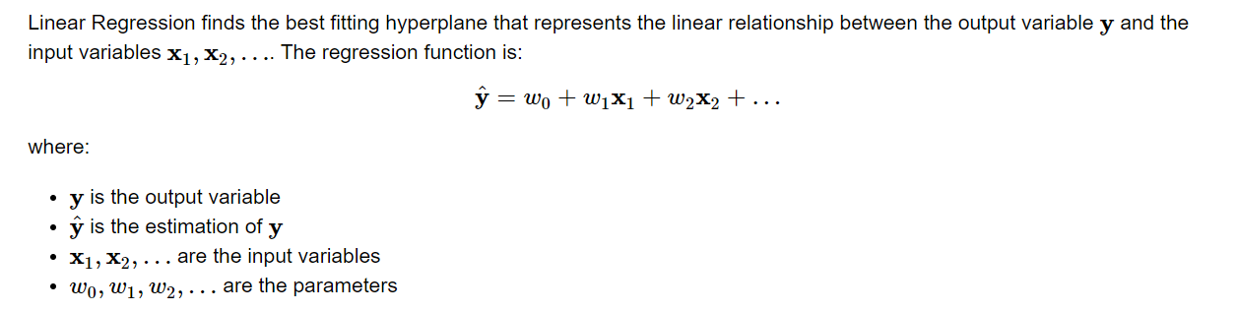
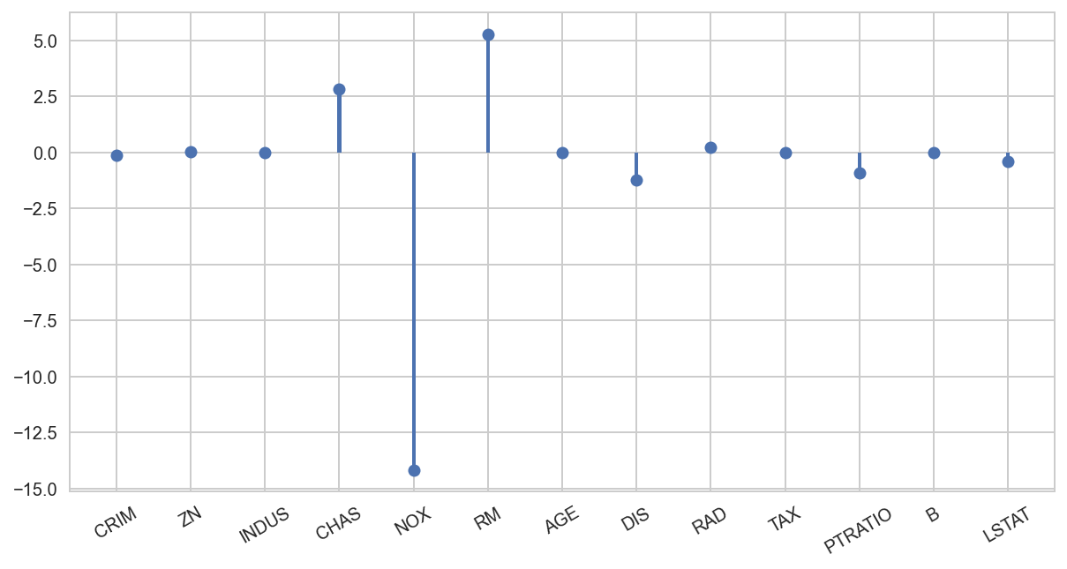
Linear Regression

Slide 25
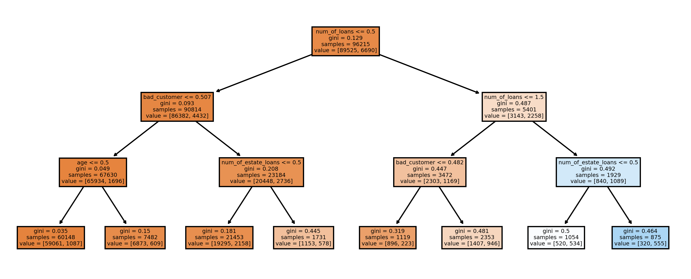
Decision Tree

Slide 26

Gini index
Let's say at a node, the data has the possible lables of y₁, y₂,… The probability that an obvervation falls into the class y_{i} is p_{i}
y
0
1
0
0
0
0
0
0
0
0
y
0
1
0
0
1
0
0
1
0
1
Gini = 0.18
Gini = 0.48

Slide 27
Questions?
Write something about your main title here

