Slide 1
ERROR TRACING IN DEEP LEARNING
Lê Hoàng Ngân

Slide 2
PRESENT CONTENTS
Active Learning
01
02
03
1.1. Introduction about Active Learning
1.2. Scenarios
1.3. Query Strategy Frameworks
Error Tracing Methods
2.1. Nearest Neighbor Method
2.2. Influence Function Method
Gradient-based variations
3.1.Gradient Dot and Gradient Cosine Similarity
3.2. RelatIF method
3.3. TracIn method.

Slide 3
01
ACTIVE LEARNING

Slide 4
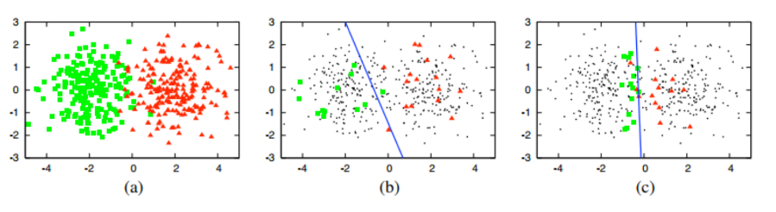
Introduction about Active Learning

Slide 5
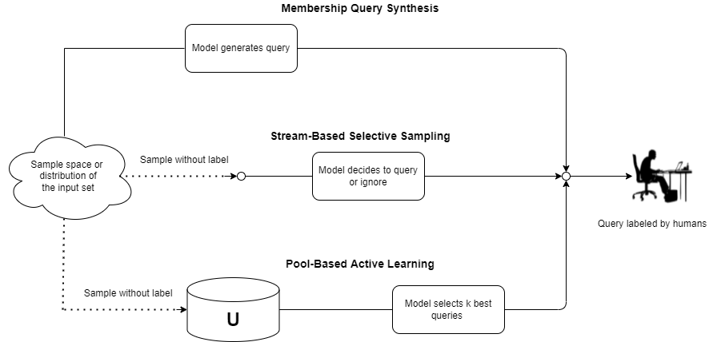
Scenarios

Slide 6
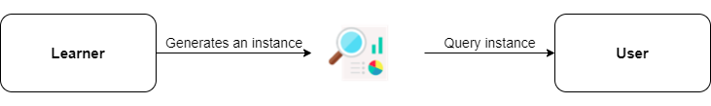
Membership Query Synthesis

Slide 7
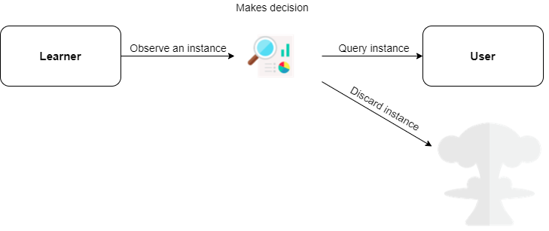
Pool-Based Sampling

Slide 8
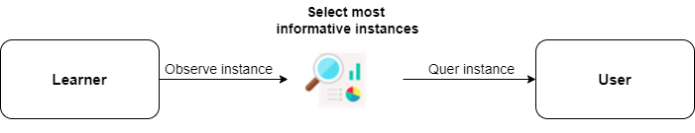
Stream-Based Selective Sampling

Slide 9
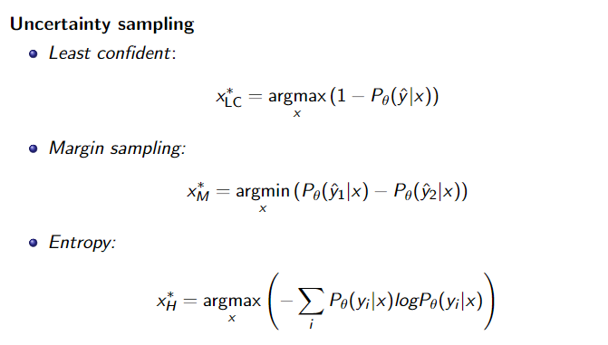
Query Strategy Frameworks

Slide 10
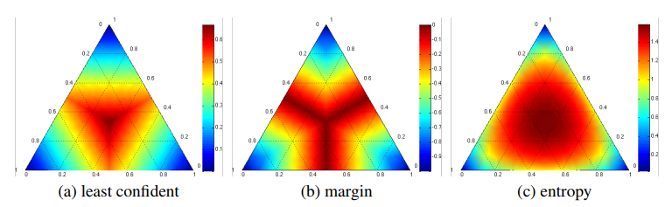
Query Strategy Frameworks

Slide 11
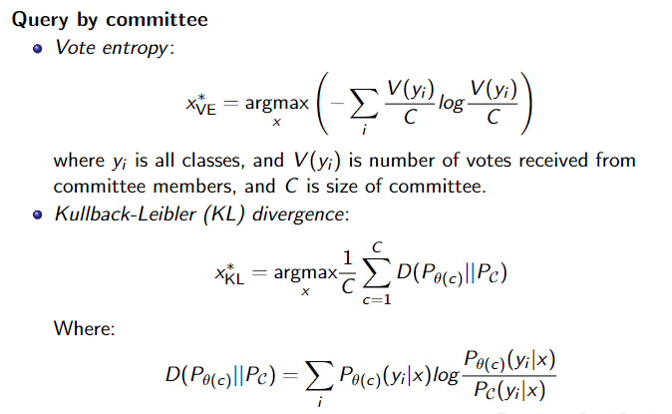
Query Strategy Frameworks

Slide 12
02
Error Tracing Methods

Slide 13
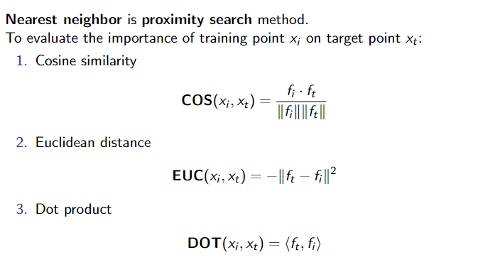
Nearest neighbor method

Slide 14
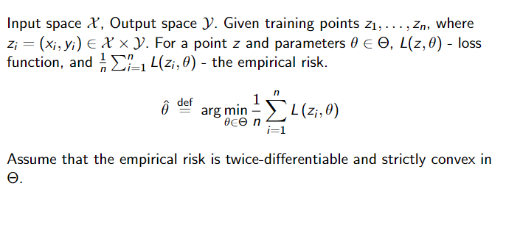
Influence function method

Slide 15
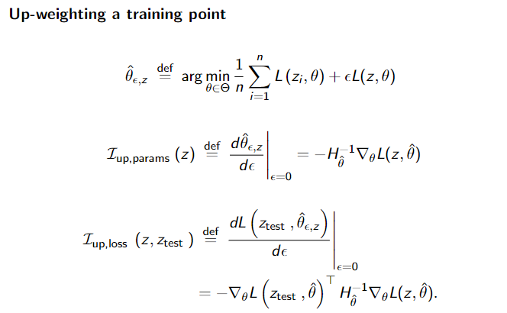
Influence function method

Slide 16
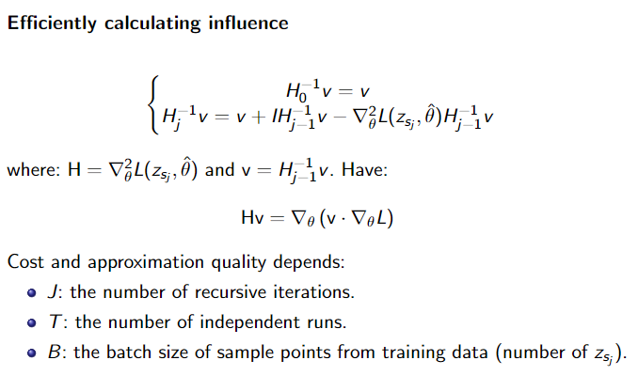
Influence function method

Slide 17
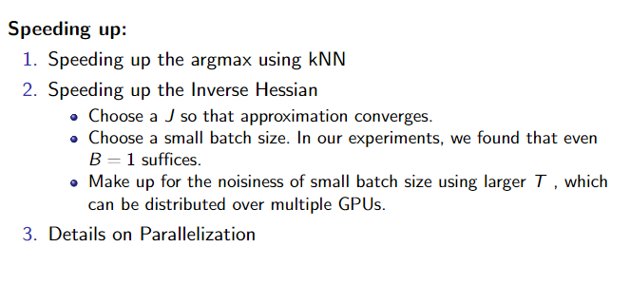
Influence function method

Slide 18
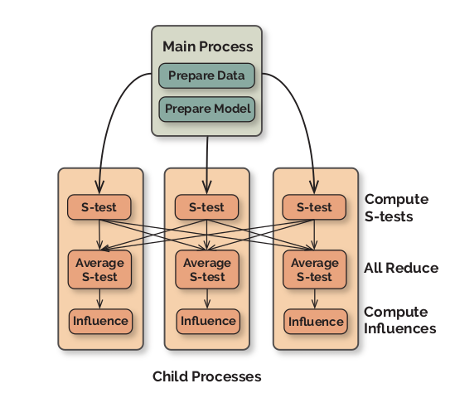
Influence function method

Slide 19
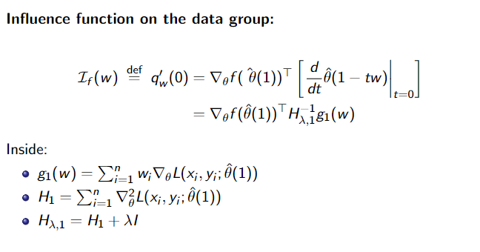
Influence function method

Slide 20
03
Gradient-based variations

Slide 21
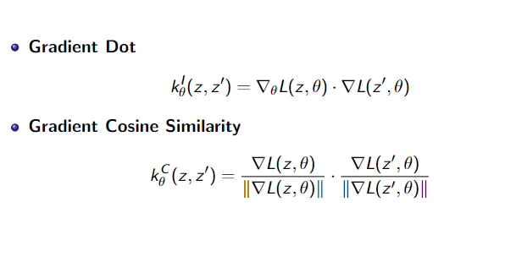
Gradient Dot and Gradient Cosine Similarity

Slide 22
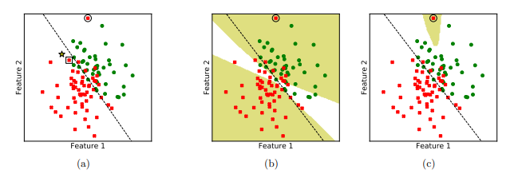
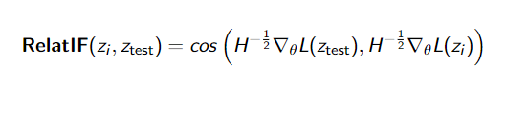
RelatIF method

Slide 23
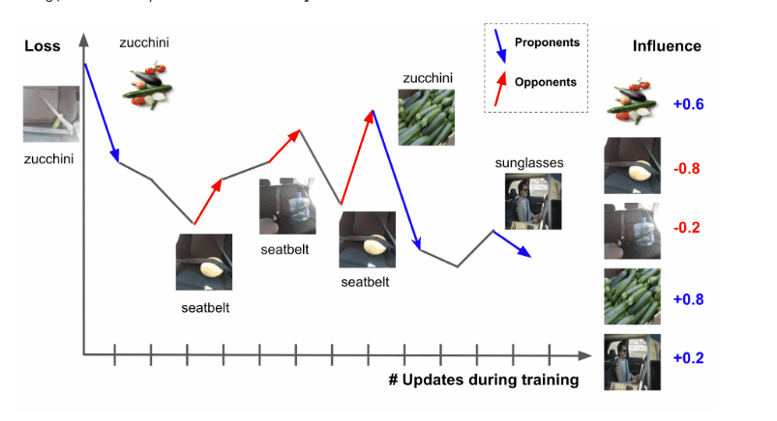
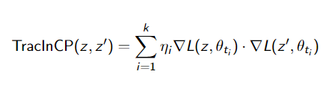
TracIn method

Slide 24
Cảm ơn mọi người đã lắng nghe!
Lê Hoàng Ngân

