Slide 1
SGD
adaptive gradient
adaptive learning rate
Momentum
AdaGrad
Nesterov
RMSProp
AdaDelta
Adam
Nadam
AMSGrad
AdaMax

Slide 2
All data
Training data
Test data
Fold 1
Fold 2
Fold 3
Fold 4
Fold 5
Iteration 1
Validation
Training
Training
Training
Training
Iteration 2
Training
Validation
Training
Training
Training
Iteration 3
Training
Training
Validation
Training
Training
Iteration 4
Training
Training
Training
Validation
Training
Iteration 5
Training
Training
Training
Training
Validation

Slide 3
ACTUAL CLASS
Positive
Negative
TP
FP
Positive
PREDICTED CLASS
FN
TN
Negative

Slide 4
ACTUAL CLASS
Apple
Orange
Mango
89
7
7
Apple
5
73
2
PREDICTED CLASS
Orange
1
0
85
Mango

Slide 5
Root node
Edge
Branch
Leaf node
Internal node
Leaf node
Leaf node

Slide 6

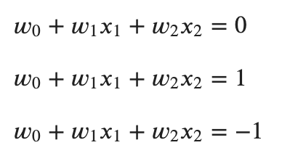
support vectors
margin
margin

Slide 7




Slide 9
p₁
KD_{n1}
KD_{n2}
p_{n}
p₂

Slide 10


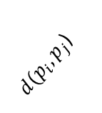


$$p_{j}$$
$$p_{j}$$
$d(p_{i},p_{j}$)
K-distance
$$p_{i}$$
$$K=3$$
$$\left|N_{p}\right|=4$$

Slide 11
Internal-node
External-node

Slide 12



$$e_{3}$$
$$e_{2}$$
$$e_{1}$$

Slide 13



I
K
I
I
R
P
Q^{T}
B
K
q_{i}
i
U
$$=$$
$$×$$
$$+$$
r_{ui}
p_{u}
b_{u} + b_{i}
u
u
u
i
i

Slide 14
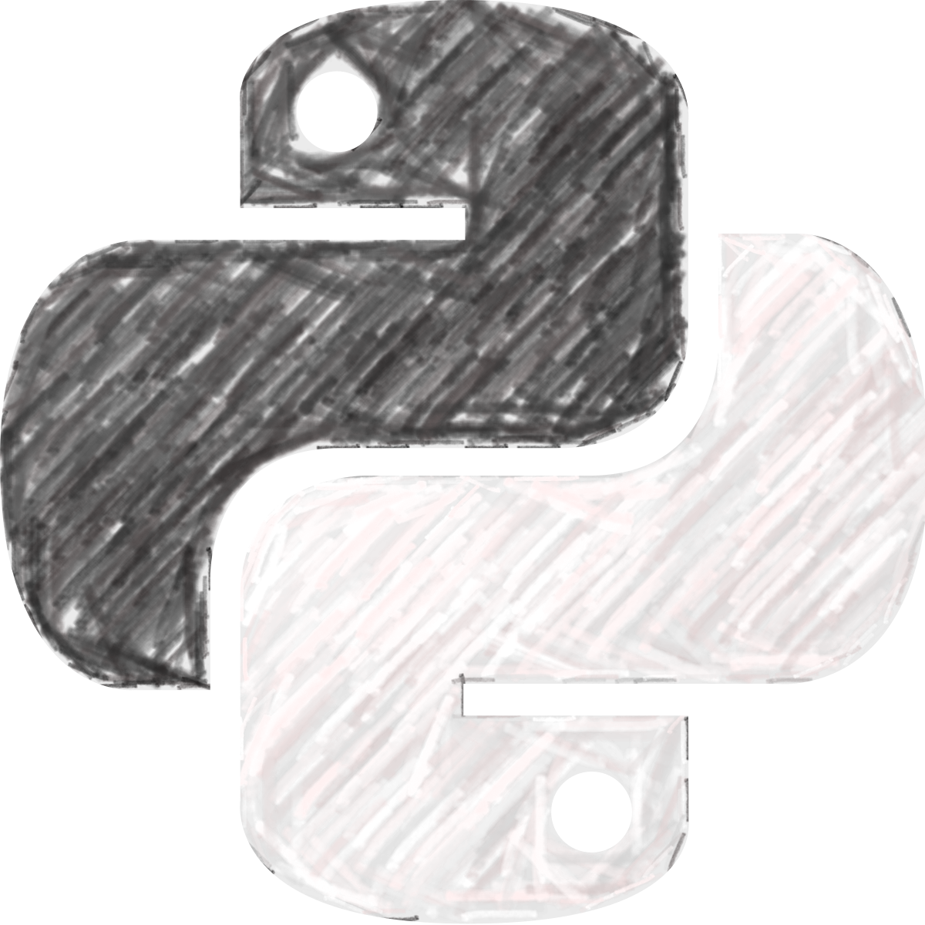
Data
Chilly
DataChilly
Chill with Data

