Slide 1


Part 5: Software Test Documentation
Tested vs not tested
Unit testing
Integration Testing
System Testing
Acceptance Testing
Performance Testing

Slide 2
Part 5: Software Test Documentation
HUMAN RESOURCE
Worker/Doer | Specific Responsibilities/Comments
Tran Thi Bich | Test lead: Responsible for designing test plan and test cases for 2 major modules: Public Facing and Administrator modules. Attend in review of other test cases. Execute integration test, system test, performance testing and security test. Generate test report.
DEV team | Execute Unit testing
All team | Execute System testing
All team | Execute Acceptance testing

Slide 3
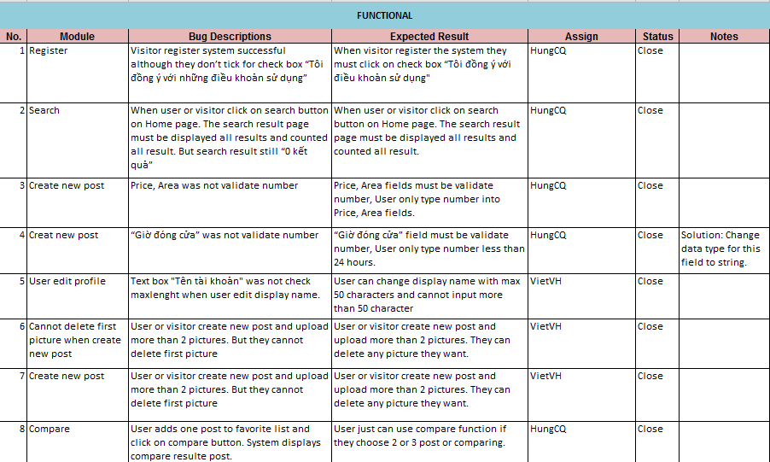
Bug Lists
Part 5: Software Test Documentation

Slide 4
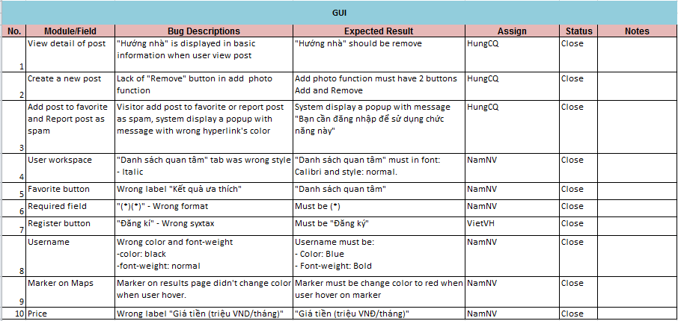
Bug Lists
Part 5: Software Test Documentation

Slide 5
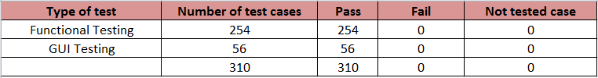
Part 5: Software Test Documentation
Test result:
Number of fail test cases: 18 (fix all)

