Slide 1

postgresql

Slide 2
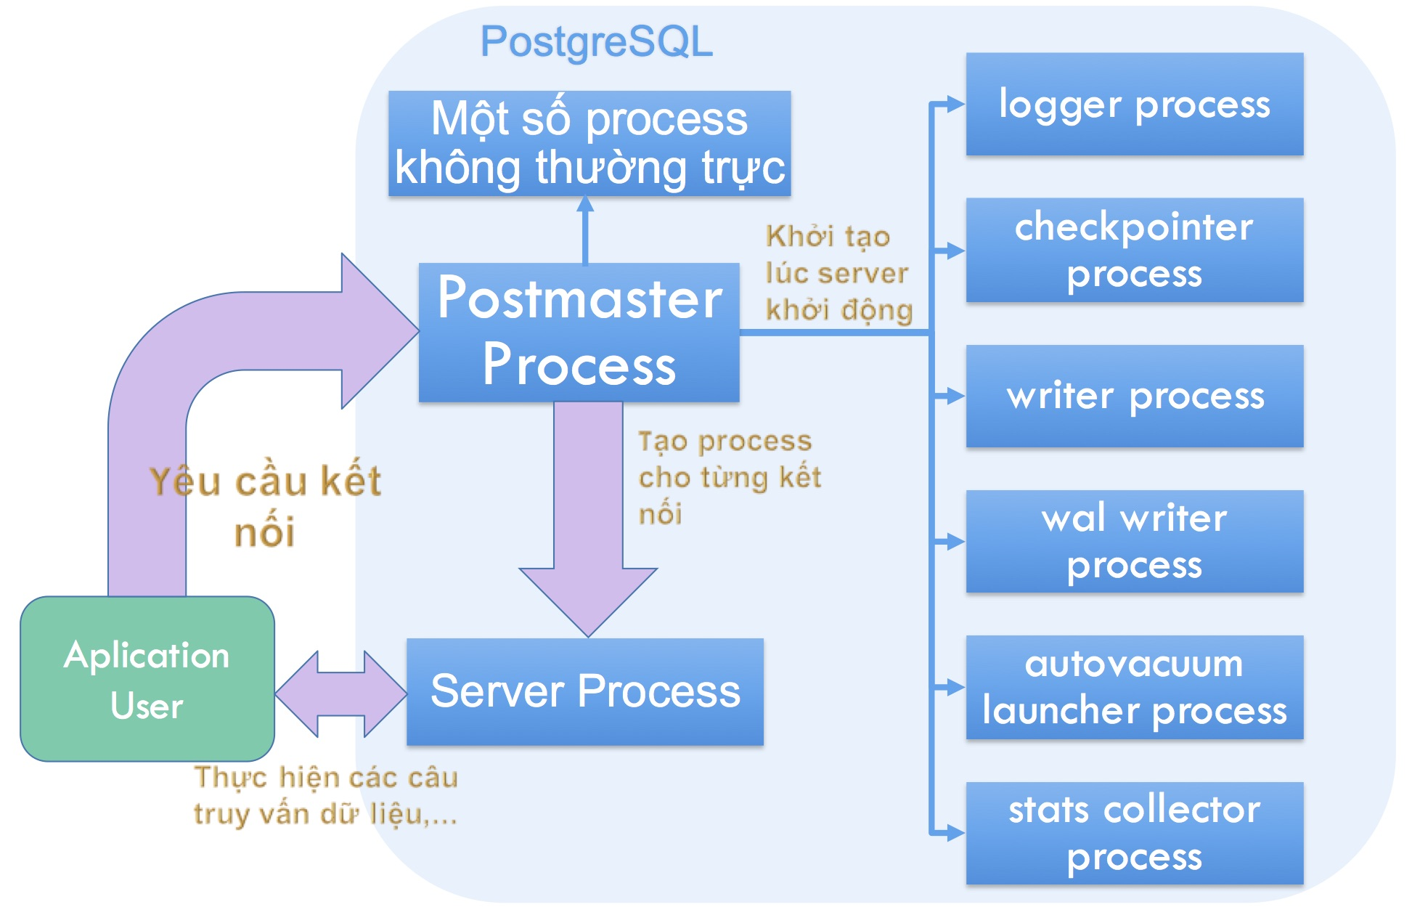
Processes are always running in the background in postgresql

Slide 3

i. VACUUM
NGUỒN THAM KHẢO: https://hocdevops.com/database/tong-quan-ve-xu-ly-vacuum-trong-postgresql/

Slide 4
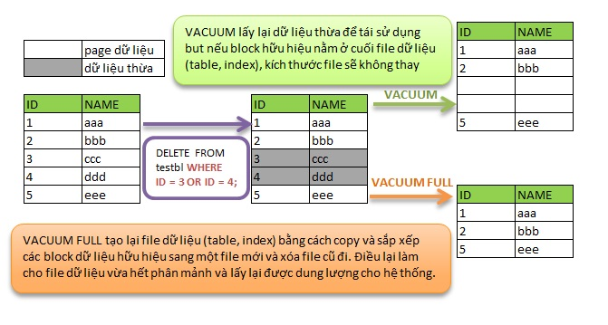
vacuum

Slide 5
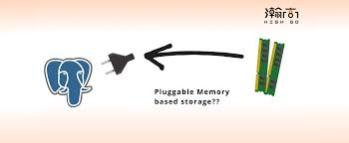
ii. Memory with postgresql
NGUỒN THAM KHẢO: https://trungquan710.com/postgresql/kien-truc-server-postgresql.html

Slide 6
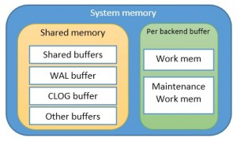
Kiến trúc memory

Slide 7
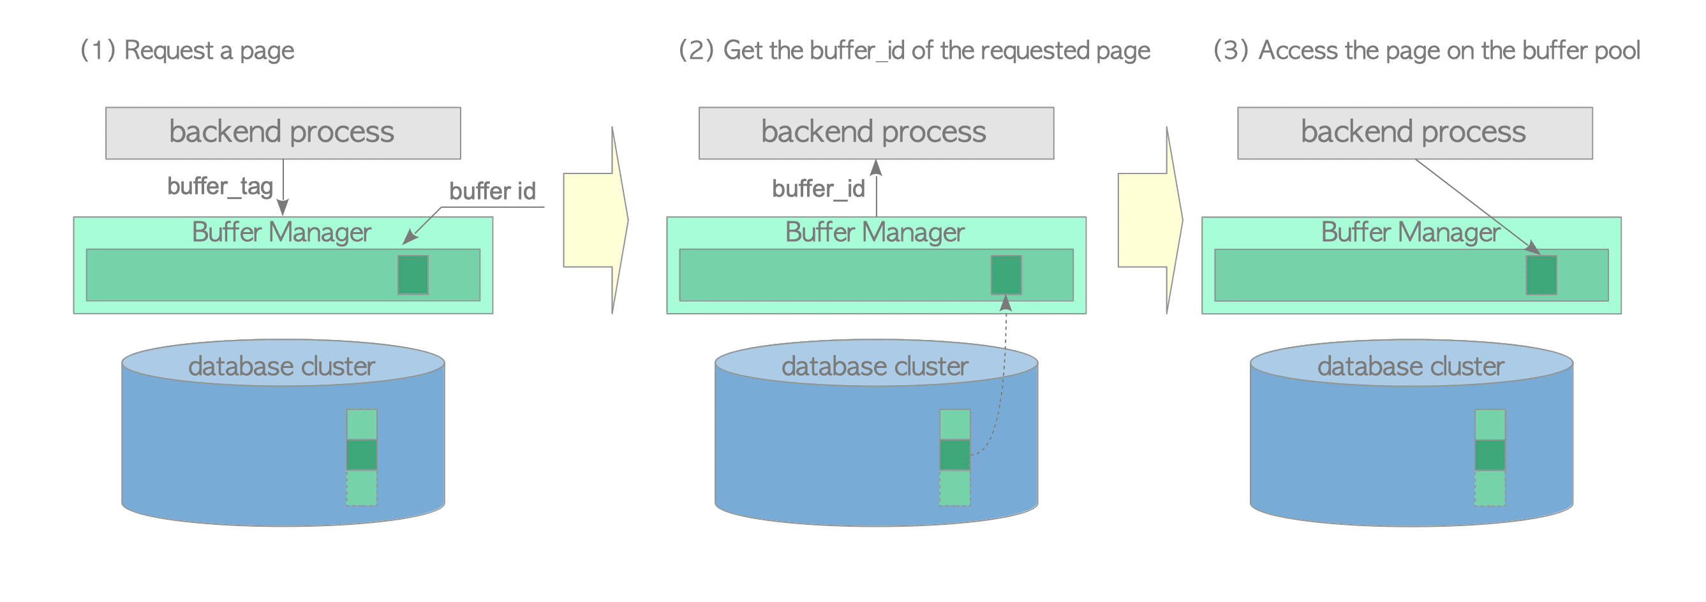
Share buffer

Slide 8
