Slide 1
Automated stock analysis
12/4/23
Buck Osegueda
MIS695 Business Systems Analysis and Design
Notes:
For my project I created an automated stock analysis tool.

Slide 2


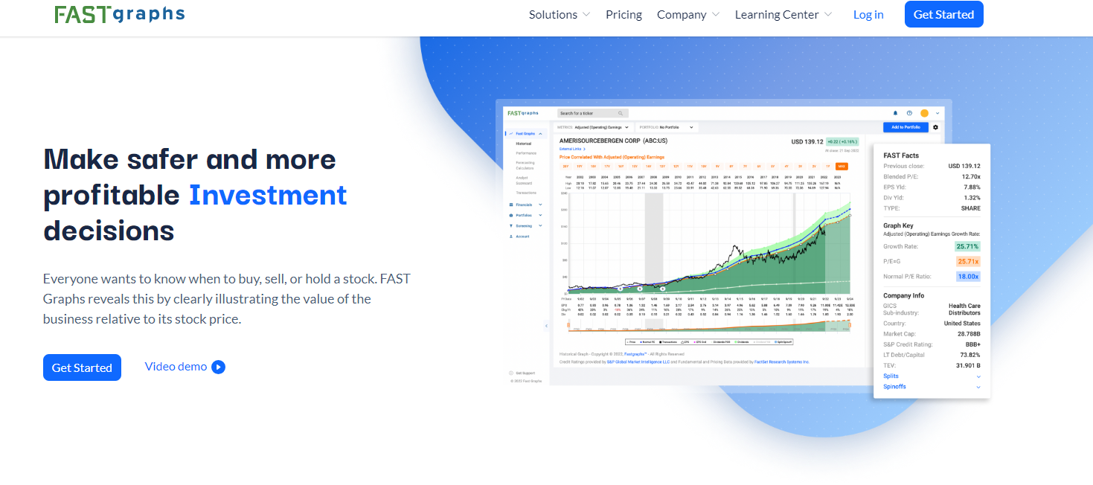
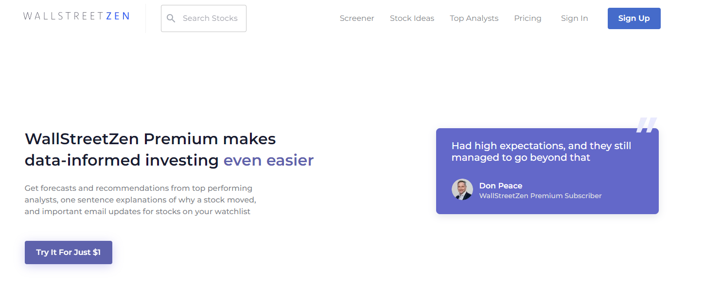
Problems
Current analysis tools are locked behind paywalls.
Current analysis is a multi-step arduous process.
Current analysis can lead to errors.
Not automated
Current analysis can be tricky to understand.
Notes:
I got the idea while working on a project for my seminar in investments class.
I found analysis steps such as downloading data, calculating beta, sharp ratios, and market covariance etc., to be a bit arduous and repetitive.
Additionally, since I was manually repeating these tasks, I was exposed to more errors and ended up having to replicate work unnecessarily.
Tasks like this tend to be lend themselves towards automation.
Lastly, existing tools are locked behind prohibitively expensive paywalls and can be tricky to interpret.

Slide 3
Project Goals
Create a tool that can provide insight into stock and portfolio performance.
Requirements:
Must have a GUI for greater accessibility
Must be able to analyze more than one security
Must automate the analysis
Present data in an understandable and appealing way
Notes:
So since I had to make a project for this class, I decided to create my own tool.
The overarching goal being to make a tool that retrieved stock data, automate the analysis of the data and to help the user make investment decisions.
For this project to make any sense it had to be able to handle more than one security at a time and automate the analysis to prevent manual errors.
Lastly, the tool had to have an accessible GUI that presented the data in an understandable way to prevent errors in interpretation of the data.

Slide 4
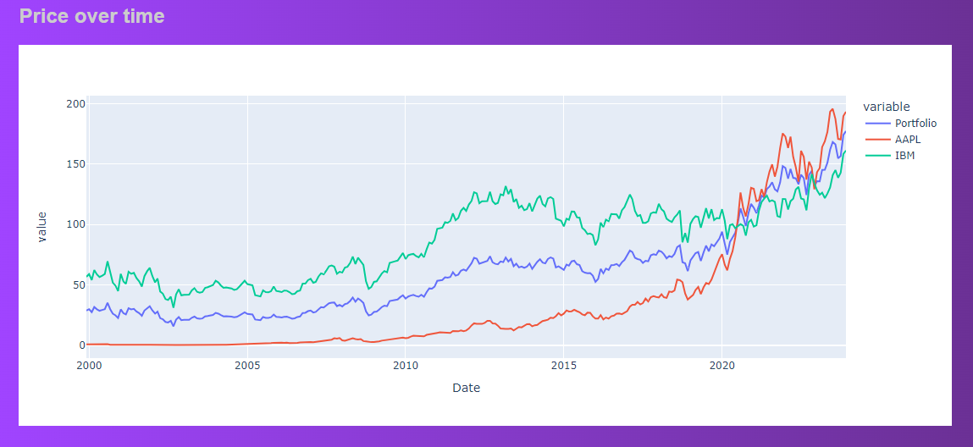
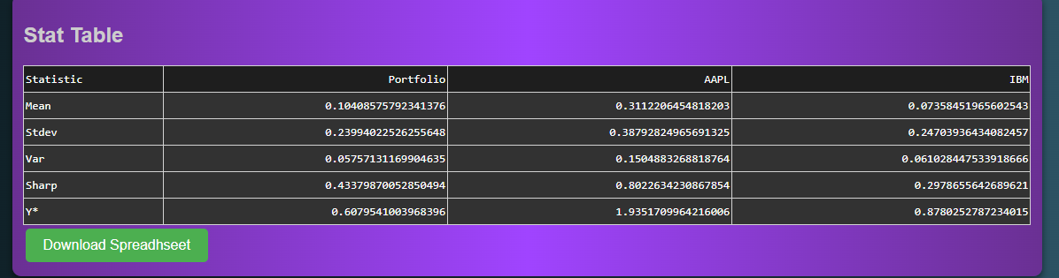
Stonker capabilities
Retrieve up to 20 years of adjusted monthly returns on anything with a ticker.
Consolidate all requested information and provide portfolio returns.
Provide summary statistics on all tickers and the portfolio.
Provide Terminal wealth and price over time graphs of all data.
Conduct historic performance analysis using the CAPM, and Fama French 3 and factor methods.
Notes:
I decided to name this tool Stonker.
While it is still very much in the “Alpha” stage of development I believe I’m well on the way to accomplishing these goals.
Currently Stonker uses the Alpha Vantage API to retrieve the history of returns a user requested.
As of right now, that only allows for over 20 years of data to be returned for any ticker symbol.
It then successfully consolidates, analyzes and displays the data in tables and graphs.
Users can change the tickers being analyzed, weight of each ticker in the portfolio and their own risk aversion level.

Slide 5
challenges
Learning how to use Dash by Plotly.
Dash is a python framework which displays the GUI.
Dash is built on top of flask and translates python commands into JavaScript and HTML.
Has a unique syntax for displaying the results of function calls that had to be learned.
Integrating OOP
Early on, I moved from just a chain of functions to custom classes with built in methods.
While this replicated some work, ultimately it made things easier and more automated.
Notes:
While this is going great so far, there have been several challenges developing this tool. The largest so far has been learning how to work with the Dash framework developed by Plotly. Dash is the engine that creates a local server and displays all the GUI elements. It does this by translating python code into HTML and Javascript, all while integrating a separate css file and your python project files. It also automatically deploys a flask application.
While this is all great, the logic behind dash is a bit unintuitive and it seems to be a bit buggy with hit and miss documentation. I chose it because it’s a framework purpose built for creating dashboards in python, which is essentially what this project is.
The other large challenge to overcome occurred about halfway through my project. I changed my approach from a linear mindset that was a chain of functions to an object-oriented approach. I did this because the code was becoming unwieldly, and integration with dash seemed like it was going to be even more complicated than it already was. While this change I believe ultimately paid off, it did cause me to rewrite about half of my code and wrap my head around new logic.

Slide 6
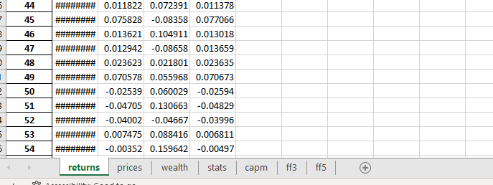
Highlights
Ability to change risk aversion.
Ability to customize weights of securities in your portfolio.
Download provides not only the statistics, but all the returns and other data that has been computed.
Really simple to use.
Written entirely in Python and CSS.
Is distributable.
Notes:
I think the interactivity of Stonker is one of the bigger highlights.
Ability to change your risk aversion level and the weights of each security is somewhat unique in the market.
Additionally, the ability to download all the data already formatted and accessible is unique likely due to licensing issues.
The tool is entirely written in Python and CSS which makes it easy to modify. Lastly, thanks to Dash, it is easily distributable and deployable to other people if need be.

Slide 7
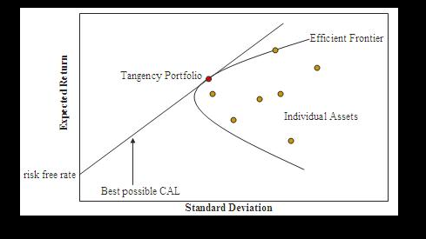
opportunities
Add in an efficiency frontier graph with capital allocation line.
Add in a table of suggested weights based on maximizing the Sharp ratio of selected stocks.
Make my tables and graphs selectable via a drop-down.
Add tool-tips with explanatory information.
More efficiently store portfolio data in between calls.
Deploy to a website.
Notes:
With all of that being said, there are still more things I’d like to accomplish and just did not have time for.
Namely, more graphs and more analysis such as the efficiency frontier and recommended risk weighted weights for each portfolio.
There are also some GUI tweaks such as selecting tables via dropdown vs the long scroll that exists currently.

Slide 8
citations
Chandra, R. V., & Varanasi, B. S. (2015). Python requests essentials. Packt Publishing Ltd.
Harris, C. R., Millman, K. J., van der Walt, S. J., Gommers, R., Virtanen, P., Cournapeau, D., … Oliphant, T. E. (2020). Array programming with NumPy. Nature, 585, 357–362. https://doi.org/10.1038/s41586-020-2649-2
Inc., P. T. (2015). Collaborative data science. Montreal, QC: Plotly Technologies Inc. Retrieved from https://plot.ly
McKinney, W., & others. (2010). Data structures for statistical computing in python. In Proceedings of the 9th Python in Science Conference (Vol. 445, pp. 51–56).
Seabold, S., & Perktold, J. (2010). statsmodels: Econometric and statistical modeling with python. In 9th Python in Science Conference.
Virtanen, P., Gommers, R., Oliphant, T. E., Haberland, M., Reddy, T., Cournapeau, D., … SciPy 1.0 Contributors. (2020). SciPy 1.0: Fundamental Algorithms for Scientific Computing in Python. Nature Methods, 17, 261–272. https://doi.org/10.1038/s41592-019-0686-2

