Slide 1
Các thẻ cơ bản
Chương 2

Slide 2
Mục tiêu
Dùng các thẻ cơ bản
Chèn hình ảnh vào tài liệu HTML

Slide 3
Các phần tử HTML cơ bản
Thẻ tiêu đề (H1 đến H6)
Thẻ mức đoạn
Thẻ khối
Thẻ định dạng ký tự
Danh sách
Đường kẻ ngang – Thẻ <HR>
Thẻ Font
Thẻ IMG

Slide 4
Tiêu đề -1
<HTML>
<HEAD>
<TITLE>Introduction to HTML</TITLE>
</HEAD>
<H1>Introduction to HTML</H1>
<H2>Introduction to HTML</H2>
<H3>Introduction to HTML</H3>
<H4>Introduction to HTML</H4>
<H5>Introduction to HTML</H5>
<H6>Introduction to HTML</H6>
</HTML>
Chữ lớn
Chữ nhỏ

Slide 5
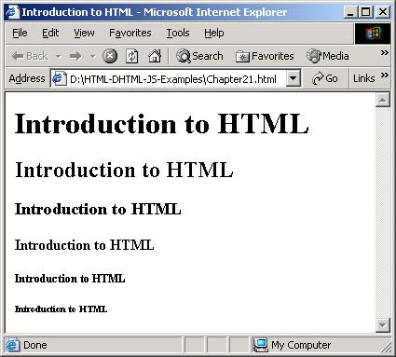
Sử dụng tiêu đề
<H1>Introduction to HTML</H1>
<H2>Introduction to HTML</H2>
<H3>Introduction to HTML</H3>
<H4>Introduction to HTML</H4>
<H5>Introduction to HTML</H5>
<H6>Introduction to HTML</H6>
Web Page Programming with HTML,DHTML & JavaScript/Session 2/ <number> of 22

Slide 6
Thẻ <Address>
Nó có thể chứa một hoặc một số phần sau:
Liên kết đến trang chủ
Đặc tính chuỗi tìm kiếm
Thông tin bản quyền
Web Page Programming with HTML,DHTML & JavaScript/Session 2/ <number> of 22
Notes:
Thường chữ sẽ in nghiêng

Slide 7
Thẻ <Address> [Ví dụ 2]
<HTML>
<HEAD>
<TITLE>Welcome to HTML</TITLE>
</HEAD>
<BODY BGCOLOR = lavender>
<H3>My first HTML document</H3>
<P>This is going to be real fun
<H2>Using another heading</H2>
<P> Another paragraph element
<ADDRESS>
<P><A href=”http://utehy.edu.vn”>
Click here to register for a free newsletter
</A>
</ADDRESS>
</BODY>
</HTML>
Web Page Programming with HTML,DHTML & JavaScript/Session 2/ <number> of 22

Slide 8
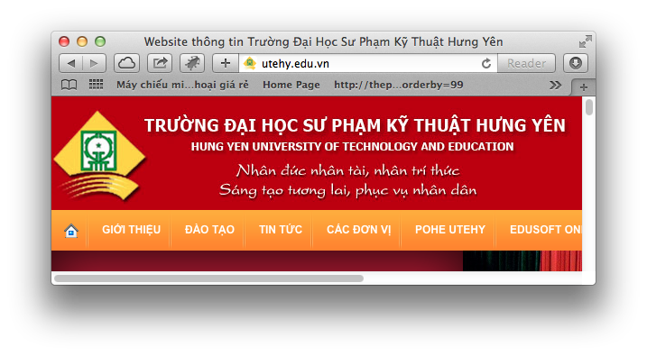
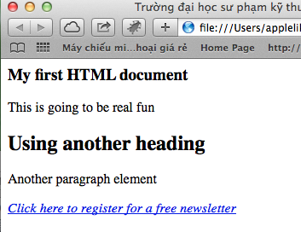
Kết quả
click
Web Page Programming with HTML,DHTML & JavaScript/Session 2/ <number> of 22

Slide 9
Các thẻ mức đoạn
Sử dụng trích dẫn
  <BLOCKQUOTE >
Văn bản được định dạng trước.
  <PRE>
Phần tử nhóm
  <DIV>…</DIV> mức khối (block-level)
  <SPAN>…</SPAN>trong dòng (in-line)
Web Page Programming with HTML,DHTML & JavaScript/Session 2/ <number> of 22
Notes:
Blockquote: chèn thêm 1 khoảng trắng vào trước và sau trích dẫn, thường là trích dẫn dài
Pre: Tự định nghĩa 1 đoạn VB, phông chữ Courier

Slide 10
Ví dụ thẻ <BLOCKQUOTE -3>
<HTML>
<HEAD>
<TITLE>Introduction to HTML</TITLE>
</HEAD>
The blockquote tag defines the start of a long quotation.
<BODY>
<p>
Ambassador Eduardo Ferrero Costa,
<BLOCKQUOTE>
In this respect, there are three fundamental instruments of IHL dealing with this issue: the Hague Convention of 1954 for the Protection of Cultural Property in the Event of Armed Conflict
</BLOCKQUOTE>
The forerunner of this meeting was the meeting of experts
</BODY>
</HTML>
Web Page Programming with HTML,DHTML & JavaScript/Session 2/ <number> of 22

Slide 11
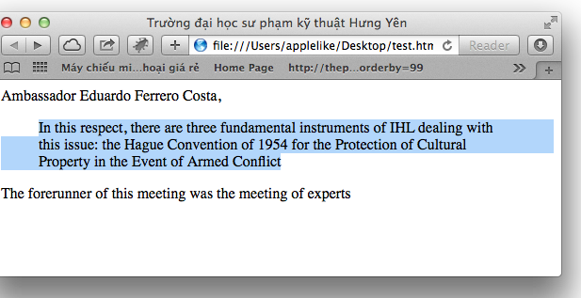
Kết quả
Web Page Programming with HTML,DHTML & JavaScript/Session 2/ <number> of 22

Slide 12
Ví dụ thẻ <PRE -4>
<HTML>
<HEAD>
<TITLE>Introduction to HTML</TITLE>
</HEAD>
<BODY>
<p> The PRE tag maintains a text format - line breaks and tabs without you having to change anything.
<pre>
text file stuff here
complete with line breaks and things.
</pre>
</BODY>
</HTML>
Web Page Programming with HTML,DHTML & JavaScript/Session 2/ <number> of 22

Slide 13
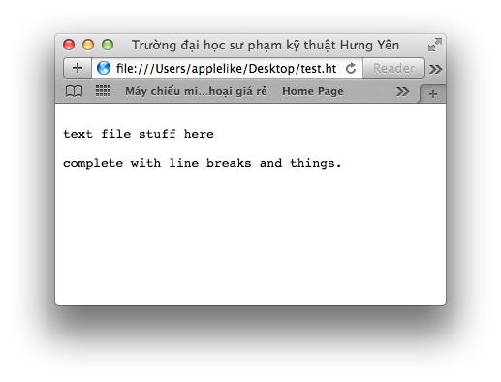
Kết quả
2 dòng
Web Page Programming with HTML,DHTML & JavaScript/Session 2/ <number> of 22

Slide 14
Thẻ <DIV -5>
<HTML>
<HEAD>
<TITLE>Introduction to HTML</TITLE>
</HEAD>
<BODY>
The div tag defines a division/section in a document.
<div style="color:#FF0000;">
<h4>This is a header in a div section</h4>
<p>This is a paragraph in a div section</p>
</div>
</BODY>
</HTML>
Web Page Programming with HTML,DHTML & JavaScript/Session 2/ <number> of 22

Slide 15
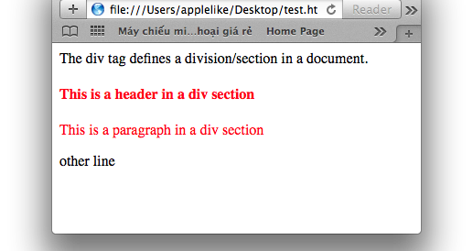
Quan sát kết quả
Div 1
Div 2
Web Page Programming with HTML,DHTML & JavaScript/Session 2/ <number> of 22

Slide 16
Thẻ <SPAN -6>
<HTML>
<HEAD>
<TITLE>Introduction to HTML</TITLE>
</HEAD>
<BODY>
The span tag is used to group inline-elements in a document.
<p>This is a paragraph <span style="color:#0000FF;">This is a paragraph</span> This is a paragraph</p>
<p>
<span style="color:#00DD45;">
This is another paragraph
</span>
</p>
</BODY>
</HTML>
Web Page Programming with HTML,DHTML & JavaScript/Session 2/ <number> of 22

Slide 17
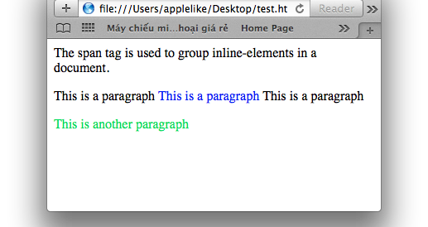
Span 1 dòng
Web Page Programming with HTML,DHTML & JavaScript/Session 2/ <number> of 22

Slide 18
Định dạng
Thẻ định dạng mức vật lý: là định rõ hoặc thay đổi đặc điểm của văn bản mà ta áp dụng thẻ.
Thẻ định dạng mức logic: là thẻ mô tả “hiệu ứng cần thiết” của văn bản”. Sự hiển thị thực sự do trình duyệt điều khiển.
Web Page Programming with HTML,DHTML & JavaScript/Session 2/ <number> of 22

Slide 19
Thẻ định dạng mức vật lý
<B> In đậm </B><br>
<i> In nghiêng </i><br>
<u> Gạch chân </u><br>
<TT> cố định độ rộng văn bản </TT>
<p>X<SUP>2</SUP>+2X+1=0</p>
<p>H<SUB>2</SUB>O
Web Page Programming with HTML,DHTML & JavaScript/Session 2/ <number> of 22

Slide 20
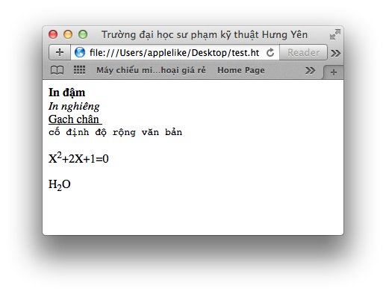
Thẻ <B>
Thẻ <i>
Thẻ <u>
Thẻ <TT>
Thẻ <sup>
Thẻ <sub>
Web Page Programming with HTML,DHTML & JavaScript/Session 2/ <number> of 22

Slide 21
Thẻ định dạng mức logic
<EM> nhấn mạnh văn bản</EM>
<CODE>trích của mã chương trình</CODE>
<VAR>sử dụng các biến trong chương trình
</VAR>
<CITE>trích dẫn và tham chiếu</CITE>
Web Page Programming with HTML,DHTML & JavaScript/Session 2/ <number> of 22

Slide 22
Ví dụ thẻ định dạng -7
<HTML>
<HEAD>
<TITLE>Introduction to HTML</TITLE>
</HEAD>
<BODY>
<P><EM>Introduction to HTML</EM>
<P><CODE> x = x +1<BR> Y= Y +1 </CODE>
<p>It is the mark of an educated mind to be able to entertain a thought without accepting it
<p><CITE> Aristotle </CITE>
</BODY>
</HTML>
Web Page Programming with HTML,DHTML & JavaScript/Session 2/ <number> of 22

Slide 23
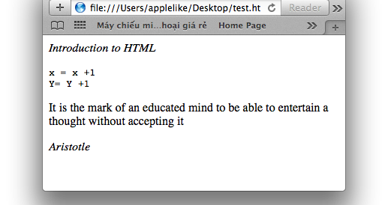
Thẻ <EM>
Thẻ <code>
Thẻ <CITE>
Web Page Programming with HTML,DHTML & JavaScript/Session 2/ <number> of 22

Slide 24
Danh sách
Danh sách không thứ tự
Danh sách có thứ tự
Danh sách định nghĩa
Web Page Programming with HTML,DHTML & JavaScript/Session 2/ <number> of 22

Slide 25
Danh sách không thứ tự -8
<HTML>
<HEAD>
<TITLE>Learning HTML</TITLE>
</HEAD>
<BODY>
<UL>
  <LI>Monday
  <LI>Tuesday
  <LI>Wednesday
  <LI>Thursday
  <LI>Friday
</UL>
</BODY>
</HTML>
Web Page Programming with HTML,DHTML & JavaScript/Session 2/ <number> of 22

Slide 26
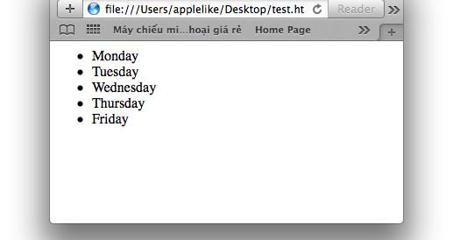
Web Page Programming with HTML,DHTML & JavaScript/Session 2/ <number> of 22

Slide 27
Chọn kiểu Bullet
<LI TYPE = SQUARE> bullets hình vuông
<LI TYPE = DISC> bullets hình đĩa
<LI TYPE = CIRCLE> bullets hình tròn
<LI TYPE = NONE> bullets không hoa thị
Web Page Programming with HTML,DHTML & JavaScript/Session 2/ <number> of 22

Slide 28
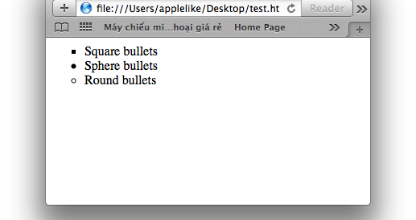
Web Page Programming with HTML,DHTML & JavaScript/Session 2/ <number> of 22

Slide 29
Bullet -9
<HTML>
<HEAD>
<TITLE>Learning HTML</TITLE>
</HEAD>
<BODY>
<UL>
<LI TYPE = SQUARE> Square bullets
<LI TYPE = DISC> Sphere bullets
<LI TYPE = CIRCLE> Round bullets
</UL>
</BODY>
</HTML>
Web Page Programming with HTML,DHTML & JavaScript/Session 2/ <number> of 22
Notes:
UL: Unordered List:Danh sách không thứ tự
LI: List: mục của danh sách

Slide 30
Danh sách có thứ tự -10
<HTML>
<HEAD>
<TITLE>Learning HTML</TITLE>
</HEAD>
<BODY>
<OL>
<LI>Monday
<LI>Tuesday
<LI>Wednesday
<LI>Thursday
<LI>Friday
</OL>
</BODY>
</HTML>
Web Page Programming with HTML,DHTML & JavaScript/Session 2/ <number> of 22
Notes:
OL: Ordered List: Danh sách có thứ tự
LI: List

Slide 31

Web Page Programming with HTML,DHTML & JavaScript/Session 2/ <number> of 22

Slide 32
Chọn kiểu đánh số
Upper Roman
  <LI TYPE = I>
Lower Roman
  <LI TYPE = i>
Uppercase
  <LI TYPE = A>
Lowercase
  <LI TYPE = a>
Bắt đầu với một số khác 1
  <OL START = n> [ Mặc định ]
Web Page Programming with HTML,DHTML & JavaScript/Session 2/ <number> of 22

Slide 33


Chọn kiểu -11
<HTML>
<HEAD>
<TITLE>Learning HTML</TITLE>
</HEAD>
<BODY>
<OL>
<LI>Monday
<LI>Tuesday
<LI>Wednesday
<LI>Thursday
<LI>Friday
</OL>
<OL start=30>
<LI>Monday
<LI>Tuesday
</OL>
<OL>
<LI TYPE=I>Monday
<LI TYPE=I>Tuesday
</OL>
<OL>
<LI TYPE=i>Monday
<LI TYPE=i>Tuesday
</OL>
<OL>
<LI TYPE=A>Monday
<LI TYPE=A>Tuesday
</OL>
</BODY>
</HTML>
Web Page Programming with HTML,DHTML & JavaScript/Session 2/ <number> of 22

Slide 34
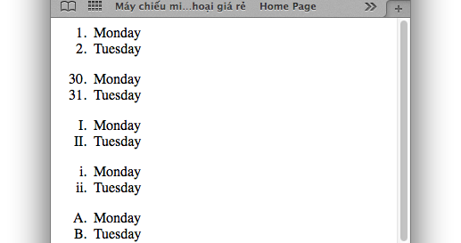
Web Page Programming with HTML,DHTML & JavaScript/Session 2/ <number> of 22

Slide 35
Danh sách định nghĩa -12
<HTML>
<HEAD>
<TITLE>Definition List</TITLE>
</HEAD>
<BODY>
<DL>
<DT> Title for Group 1
<DD> First in Group 1
<DD> Second in Group 1
<DT> Title for Group 2
<DD> First in Group 2
<DD><IMG SRC="Flower.jpg"> First in Group 1
</DL>
</BODY>
</HTML>
Web Page Programming with HTML,DHTML & JavaScript/Session 2/ <number> of 22
Notes:
DL: definition list: Định nghĩa danh sách
DT: defines an item: định nghĩa một mục
DD: defines describe an item: mô tả một mục

Slide 36
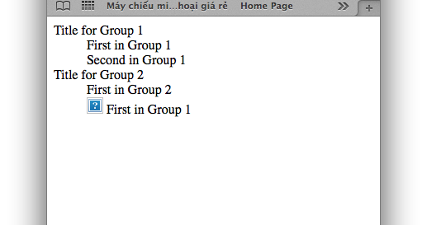
Web Page Programming with HTML,DHTML & JavaScript/Session 2/ <number> of 22

Slide 37
Đường kẻ ngang
Thuộc tính của <HR>
  align
  width
  size
  noshade
Web Page Programming with HTML,DHTML & JavaScript/Session 2/ <number> of 22

Slide 38
Đường kẻ ngang - 13
<HTML>
<HEAD>
<TITLE>Introduction to HTML</TITLE>
</HEAD>
<BODY>
<HR width="200">
You'll get the nifty little line below:
<HR width="200" size="7">
<HR width="200" noshade>
Now, remember when I said to try changing the size to 70?
<HR width="200" size="70" noshade>
<HR width="200" color="red" noshade>
</BODY>
</HTML>
Web Page Programming with HTML,DHTML & JavaScript/Session 2/ <number> of 22

Slide 39
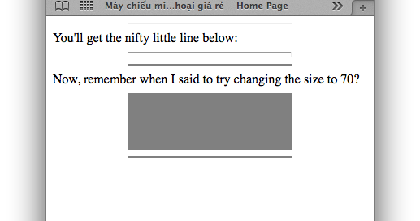
Web Page Programming with HTML,DHTML & JavaScript/Session 2/ <number> of 22

Slide 40
Sử dụng thẻ Font
<FONT> … </FONT>
  Color
  Size
  Face
Web Page Programming with HTML,DHTML & JavaScript/Session 2/ <number> of 22

Slide 41
Thêm màu -14
<HTML>
<HEAD>
<TITLE>Learning HTML</TITLE>
</HEAD>
<BODY BGCOLOR=lavender>
<H2><FONT COLOR = LIMEGREEN>Welcome to HTML</FONT></H2>
<P><FONT COLOR = RED>This is good fun</FONT></P>
</BODY>
</HTML>
Web Page Programming with HTML,DHTML & JavaScript/Session 2/ <number> of 22

Slide 42
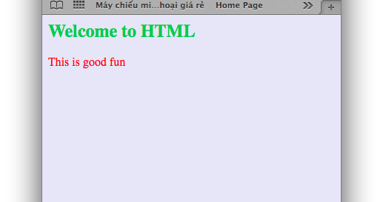
Web Page Programming with HTML,DHTML & JavaScript/Session 2/ <number> of 22

Slide 43
Ảnh trong tài liệu HTML
Ảnh GIF (Graphics Interchange Format) (.GIF)
  Định dạng GIF xen kẽ
  Ảnh GIF trong suốt
Ảnh JPEG (Joint Photographic Expert Group) (.JPEG)
PNG (Portable Network Graphics)
Web Page Programming with HTML,DHTML & JavaScript/Session 2/ <number> of 22

Slide 44
Chèn ảnh
<IMG SRC=”URL”>
<IMG ALIGN=position SRC=”PICTURE.GIF”>
<IMG SRC=Flowers.jpg ALT=”Beautiful Flowers”>
<BODY BACKGROUND=bgimage.gif>
<BODY BACKGROUND=bgimage.gif BGPROPERTIES=FIXED>
Web Page Programming with HTML,DHTML & JavaScript/Session 2/ <number> of 22

Slide 45
Chèn ảnh - 15
<HTML>
<HEAD>
<TITLE>Learning HTML</TITLE>
</HEAD>
<BODY BACKGROUND=bgimage.gif>
<img src="flower.jpg" alt="Flower" height="200" width="200">
<IMG SRC="../images/Flower.jpg" ALT=”Beautiful_Flowers” height="300" width="300">
<p>
<p>
The Attributes
</BODY>
</HTML>
Web Page Programming with HTML,DHTML & JavaScript/Session 2/ <number> of 22

