Slide 1
Evaluating Modular Representation & Recognizer Pipelines for ASL Alphabet Recognition
Computer Vision Capstone Project — 2025.2
Tran Quang Hung - 20235502
Do Dang Vu - 20235578
Le Hoang Tung - 20235572
School of Information and Communication Technology — Hanoi University of Science and Technology

Slide 2
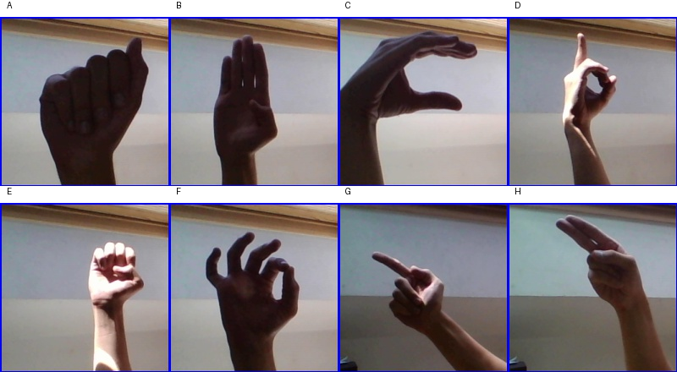
Motivation
Introduction
• ASL is the primary communication medium for millions of Deaf and hard-of-hearing people.
• Real-time recognition with only a webcam — no specialized hardware.
• Core question: does a “smarter” representation (hand-crop, landmarks, enhancement) actually improve recognition — or just add complexity and a new point of failure?
8 of the 26 ASL alphabet classes (A–H), test_split samples
1

Slide 3
Objective & Contributions
Introduction
Research question:
– Do better representations (hand-crop, landmarks, enhancement) really improve A–Z recognition, or do they only add complexity without adding value?
1. Modular framework
Representation and Recognizer are decoupled and freely swappable — 13 distinct pipelines evaluated under one protocol.
2. Multi-criteria evaluation
Not just clean accuracy — macro-F1, robustness under 7–8 corruption types, hand-detection failure rate.
3. Deep visual analysis
Grad-CAM inside the CNN, UMAP/t-SNE of the feature space, step-by-step qualitative grids.
2

Slide 4
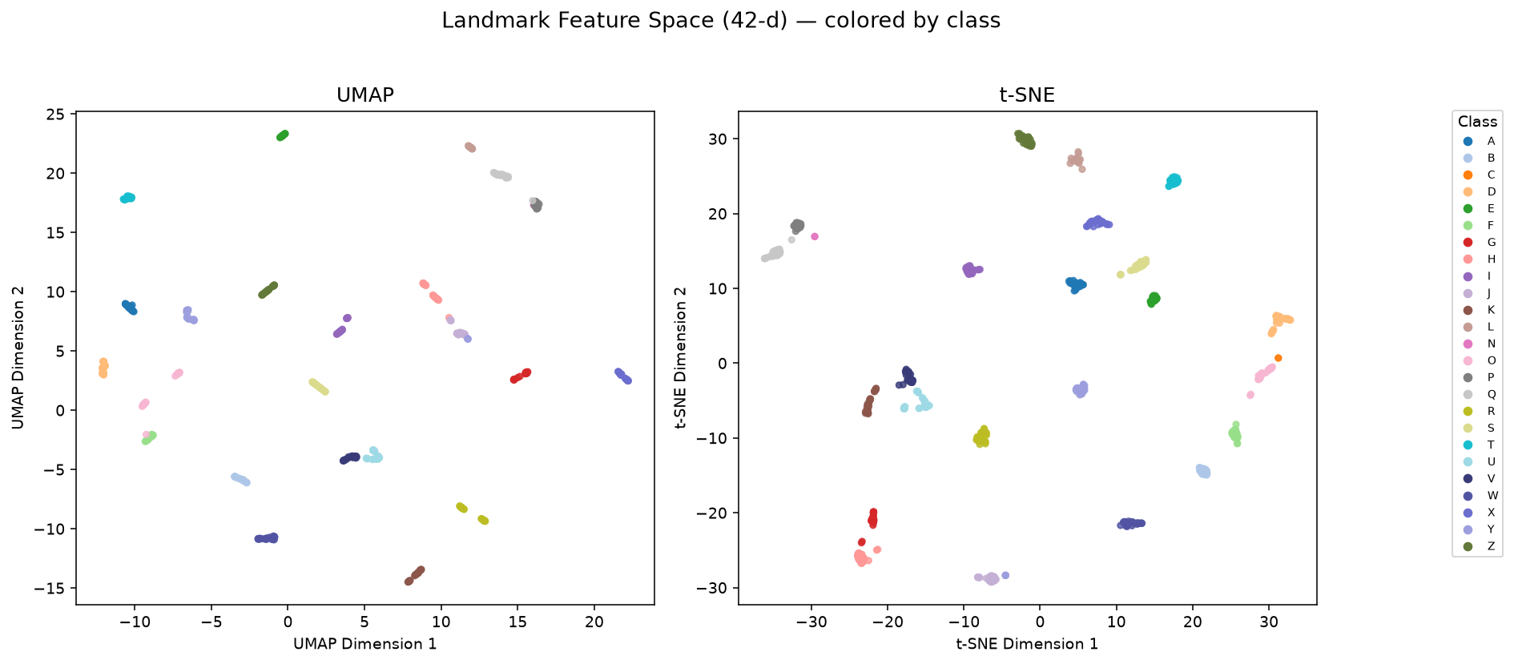
Dataset Overview
Dataset
Dataset | Role | Scale
ASL Alphabet (Kaggle) - train | Train classifier / landmark MLP | 26 classes, ~78,000 img
ASL Alphabet - test_split | Clean + robustness evaluation | 26 classes, 2,600 img
• Studio photos, clean background, even lighting → an “easy” dataset.
• Many pipelines reach 99–100% clean accuracy — robustness benchmarks, not clean accuracy, actually differentiate pipelines.
UMAP / t-SNE of 42-d landmark features: the 26 classes form well-separated clusters.
3

Slide 5
Methodology: A Two-Module Architecture
Methodology
RGB image → [ Representation Module ] → [ Recognizer Module ] → A–Z label
Module 1: Representation
Turns the raw image into something the recognizer can use: a cropped image, an enhanced image, or a landmark feature vector.
Module 2: Recognizer
Takes the representation's output and returns one of 26 A–Z labels with top-k confidence.
• 13 pipelines = valid (Representation × Recognizer) combinations, evaluated under one protocol on the same test set.
4

Slide 6
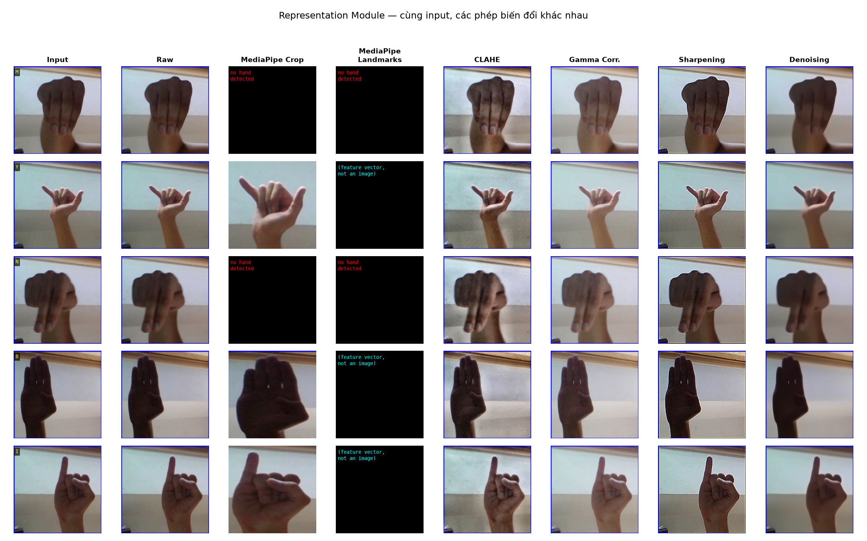
Module 1 — Representation (4 types)
Methodology
• Raw — resize only. MediaPipe Crop — 21 keypoints → bbox → crop. Landmarks — 42-d pose vector, no texture. Enhancement — CLAHE/Gamma/Sharpen/Denoise.
• If MediaPipe finds no hand → representation returns None → recognizer outputs “Unknown” (always wrong).
5

Slide 7
Module 2 — Recognizer (5 types)
Methodology
Recognizer | Model type | Input
ResNet18 (torchvision / resnet18_asl) | CNN, fine-tuned on ASL | 224×224 image
SigLIP ViT (HuggingFace) | Vision Transformer, pretrained | 224×224 image
Landmark MLP | Small MLP | 42-d vector
Landmark SVM | Support Vector Machine | 42-d vector
Landmark RF | Random Forest | 42-d vector
• ViT/SigLIP are pretrained on large-scale data — theoretical expectation: more accurate and more robust to noise than a small from-scratch-finetuned ResNet18.
6

Slide 8
Evaluation Metrics: How Accuracy Is Actually Computed
Evaluation Protocol
• The problem: the codebase's “standard” accuracy is computed only over images where a hand WAS detected — it drops “Unknown” images from both numerator and denominator.
clean_accuracy = correct / (images WITH a detected hand) real_accuracy = correct / (ALL images, Unknown = wrong)
• hand_detection_failure_rate = fraction of images where the representation returned None (only applies to MediaPipe-based pipelines).
• worst_corruption_accuracy = minimum accuracy across 7–8 corruption types (low-light, overexposure, motion-blur, gaussian-noise, rotation, scale-shift, partial-occlusion, crop-shift).
• Consequence: a pipeline can have very high clean_accuracy but a much lower real accuracy — see the case study in the Results section.
7

Slide 9
Quantitative Results — 13 Pipelines
Results
Pipeline | Clean Acc | Macro-F1 | Worst-case | Hand-fail | FPS
raw_siglip | 1.0000 | 1.0000 | 0.8912 | 0.0% | 6.3
enhancement_gamma_vit | 1.0000 | 1.0000 | 0.8927 | 0.0% | 22.9
enhancement_clahe_vit | 0.9996 | 0.9996 | 0.8629 | 0.0% | 9.3
raw_resnet18 | 0.9985 | 0.9985 | 0.9202 | 0.0% | 222.3
enhancement_gamma_resnet18 | 0.9985 | 0.9985 | 0.9135 | 0.0% | 21.8
enhancement_sharpen_resnet18 | 0.9965 | 0.9965 | 0.1010 | 0.0% | 244.6
enhancement_clahe_resnet18 | 0.9954 | 0.9954 | 0.7356 | 0.0% | 16.7
enhancement_denoise_resnet18 | 0.9954 | 0.9954 | 0.7012 | 0.0% | 7.9
mediapipe_crop_vit | 0.9851 | 0.9707 | 0.0000 | 17.15% | 11.2
mediapipe_landmarks_rf | 0.9741 | 0.9552 | 0.0000 | 17.15% | 16.6
mediapipe_landmarks_svm | 0.9706 | 0.9723 | 0.0000 | 17.15% | 19.8
mediapipe_landmarks_mlp | 0.9705 | 0.9556 | 0.0000 | 17.15% | 35.0
mediapipe_crop_resnet18 | 0.8859 | 0.8627 | 0.0000 | 17.15% | 18.9
Every MediaPipe-based pipeline collapses to 0% accuracy on the worst corruption — even pipelines with high clean accuracy.
8

Slide 10
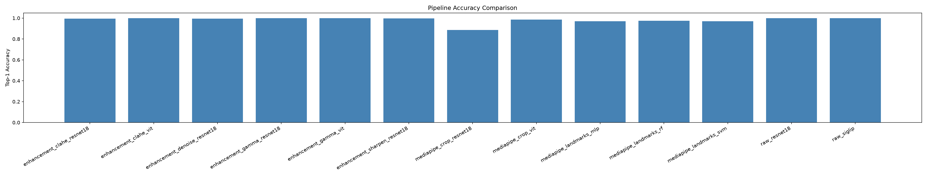
Accuracy Comparison Across Pipelines
Results
9

Slide 11
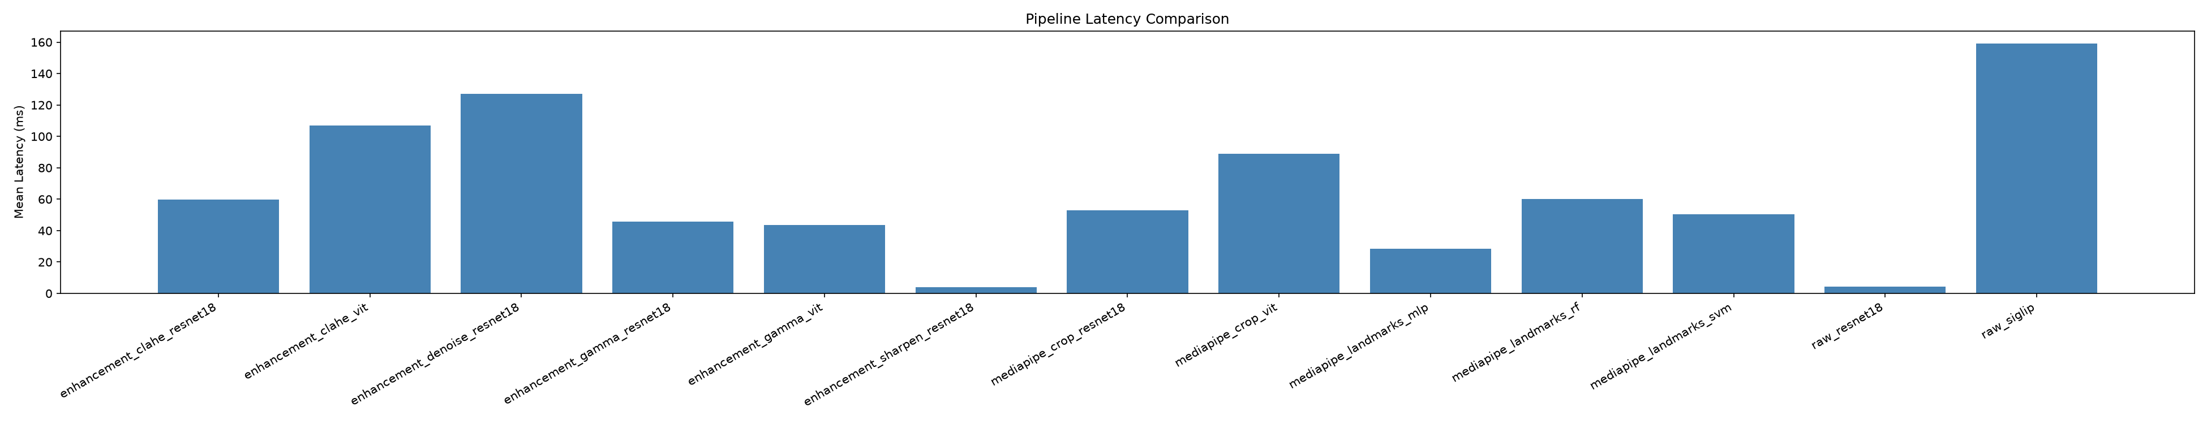
Latency / FPS Trade-off
Results
Landmark-based (MLP/SVM/RF) and ResNet18-on-raw reach the highest FPS — suitable for real-time use.
10

Slide 12
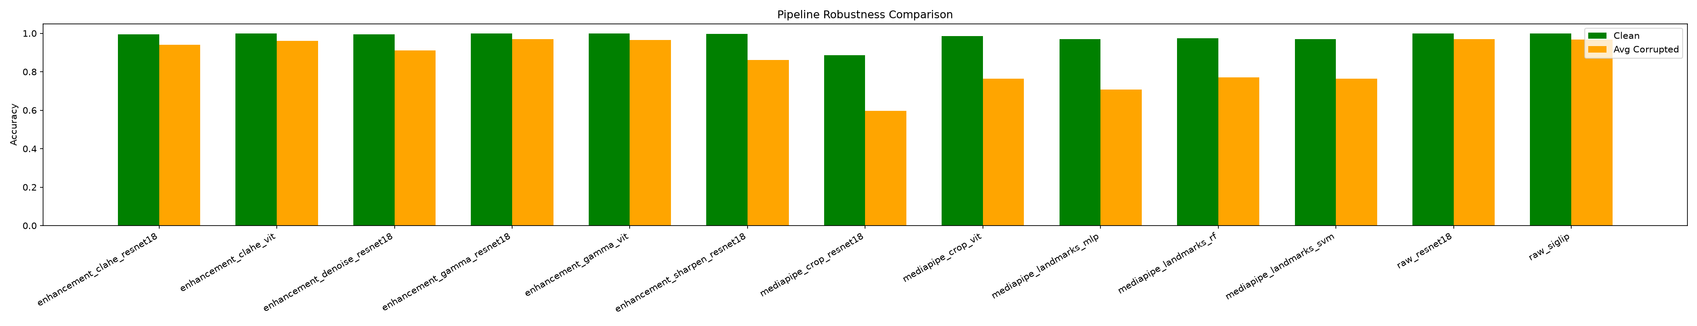
Robustness Under Corruption
Results
11

Slide 13
Qualitative — Representation Module
Results
Same 5 sample images, 7 transformations. The MediaPipe Crop/Landmarks columns are black on 3/5 rows — the hand was not detected in those (dark) images.
12

Slide 14
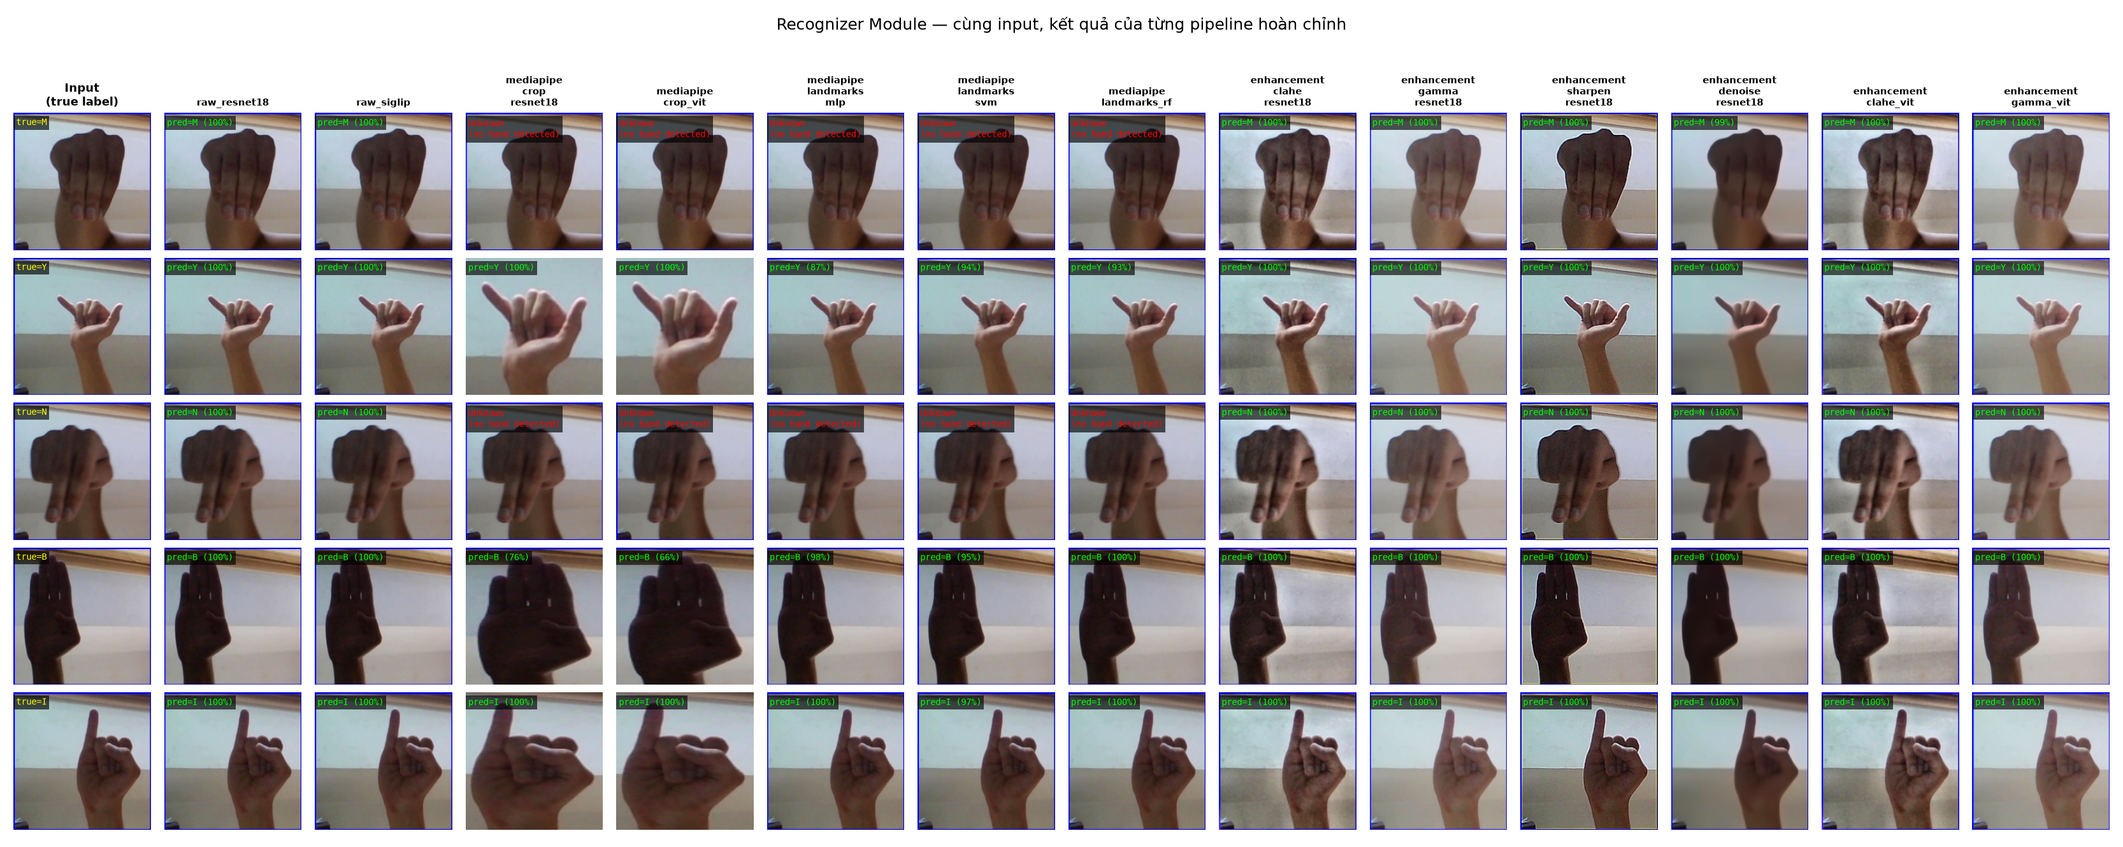
Qualitative — Recognizer Module (All 13 Pipelines)
Results
Green = correct, red = wrong. Every MediaPipe-based pipeline is wrong on the exact same 3 dark images — the failure propagates from the shared representation stage.
13

Slide 15
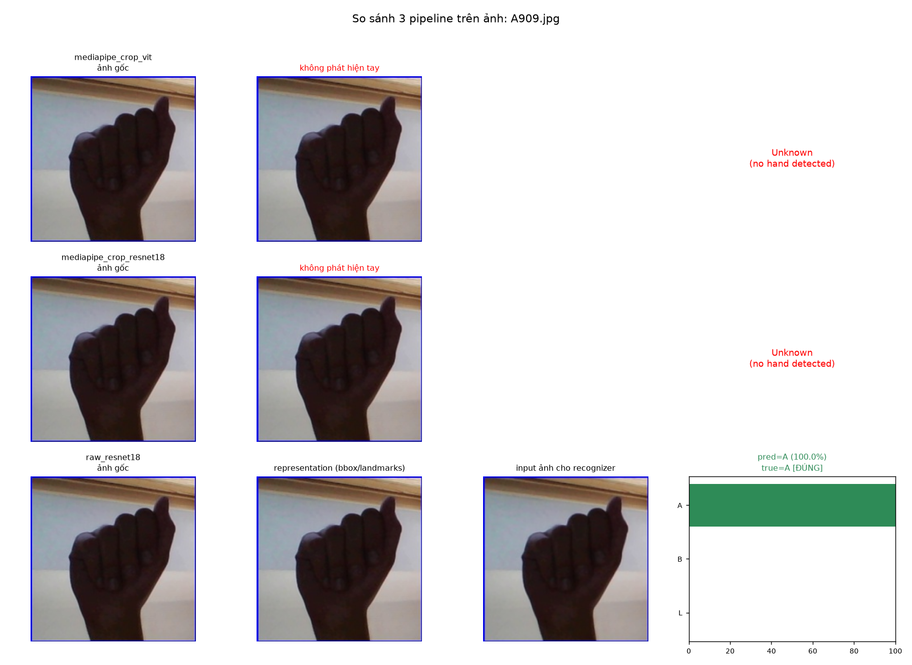
Case Study — “High Accuracy, Yet It Still Collapses”
Results
mediapipe_crop_vit: Clean Accuracy = 98.5%
But the real accuracy (counting Unknown as wrong):
2110 / 2600 = 81.15%
17 percentage points lower than the headline number — because 17.15% of images where MediaPipe missed the hand are excluded from the standard accuracy.
raw_resnet18 (no detection step) still correctly predicts “A” with 100% confidence on this exact image.
14

Slide 16
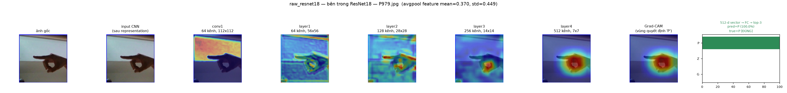
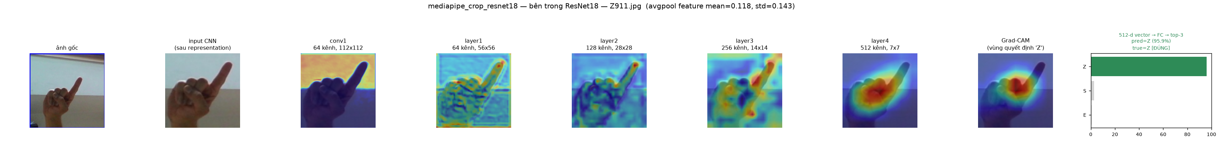
Looking Inside the CNN — Grad-CAM
Results
raw_resnet18
mediapipe_crop_resnet18
Activation maps shrink from conv1 to layer4 (224→7), channels grow 64→512. Grad-CAM correctly highlights the hand region driving the prediction.
15

Slide 17
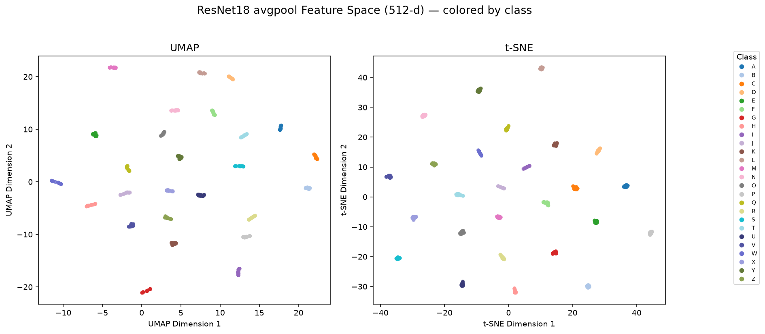
Feature Space — CNN Embeddings by Class
Results
512-d ResNet18 avgpool embeddings, 30 images/class. Classes separate just as clearly in deep feature space as in raw landmark space (compare to the Dataset slide).
16

Slide 18
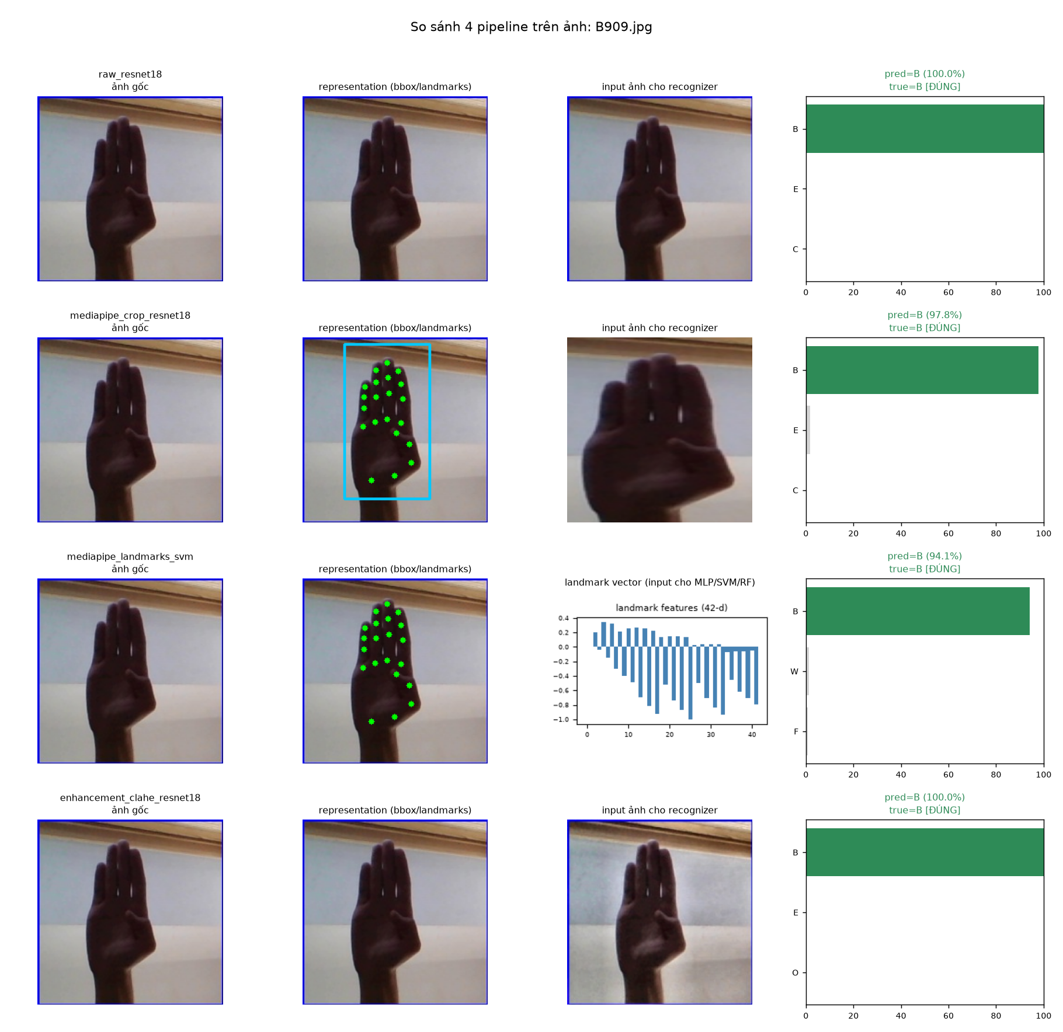
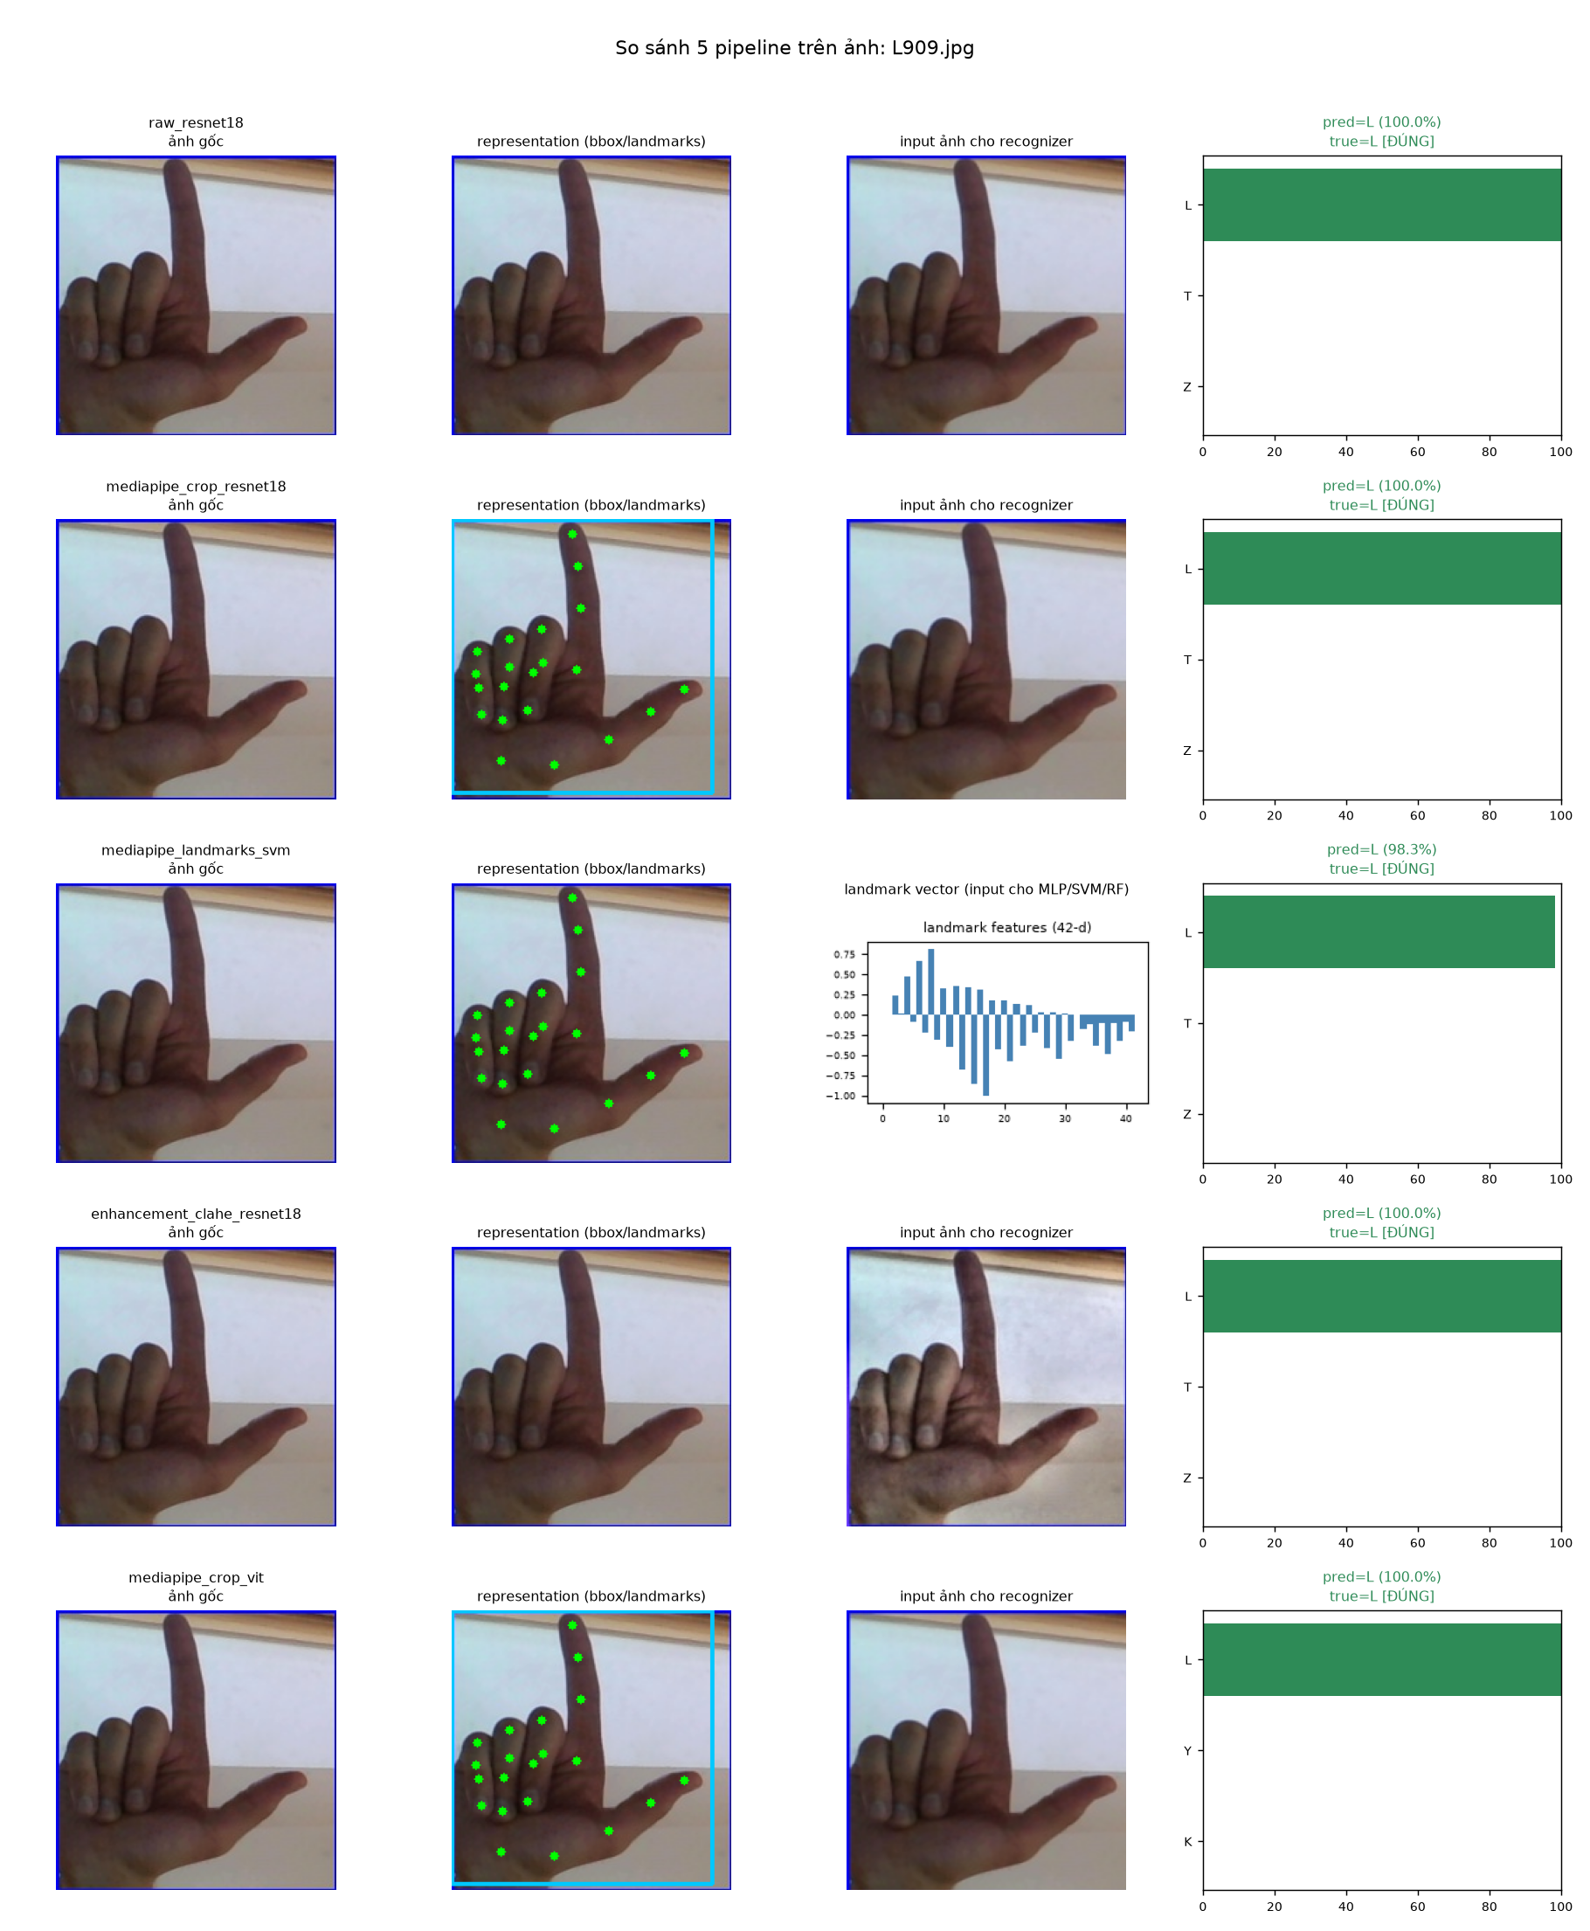
More Qualitative Examples — B and L
Results
Easy cases: good lighting → every pipeline (raw, crop, landmark, enhancement, ViT) predicts correctly.
17

Slide 19
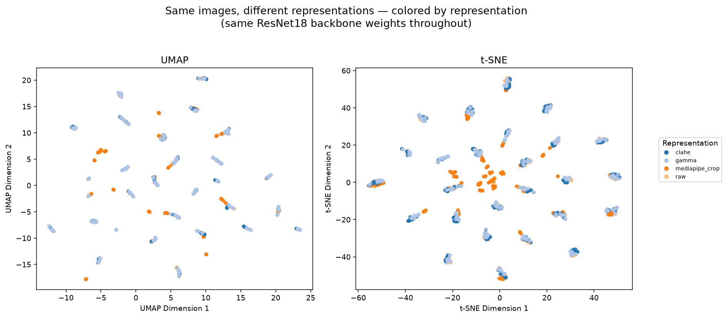
Feature Space — Does Representation Shift It?
Results
Same images, 4 representations, same ResNet18 backbone. CLAHE/Gamma/Raw land in nearly the same tiny cluster (mild enhancement barely shifts the feature space) — MediaPipe Crop (orange) lands in a clearly different region: changing representation, not just enhancement, truly moves the feature space.
18

Slide 20
Conclusion
Conclusion
Measure the right metric
Standard “clean accuracy” can hide real-world failure — always also report accuracy counting Unknown as wrong.
Two-stage errors compound
Adding a hand-detection step (MediaPipe) adds a new point of failure — robustness collapses to 0% even with a strong backbone.
Simpler can be more robust
Raw/enhancement + ResNet18/ViT never drops below ~70% accuracy even under the worst corruption.
Limitations
Some representations are unfinished stubs (YOLO-crop, segmentation-mask, fusion); evaluation uses a single dataset (ASL Alphabet, studio photos).
Future Work
Finish YOLO-crop/segmentation/fusion representations; evaluate on real-world (non-studio) webcam footage; add a raw-image fallback when MediaPipe fails to detect a hand.
19

Slide 21
Work Assignment
Appendix
Member | Responsibilities
Tran Quang Hung - 20235502 | YOLOv8 pipeline, dataset preparation, hand detection
Do Dang Vu - 20235578 | Classifier (ResNet/MobileNet) & transforms, robustness evaluation, visualization
Le Hoang Tung - 20235572 | Demo (OpenCV/Gradio), evaluation pipeline, report
20

Slide 22
References
Appendix
• [1] C. Lugaresi et al., “MediaPipe: A Framework for Building Perception Pipelines,” arXiv:1906.08172, 2019.
• [2] K. He, X. Zhang, S. Ren, J. Sun, “Deep Residual Learning for Image Recognition,” CVPR, 2016.
• [3] X. Zhai et al., “Sigmoid Loss for Language Image Pre-Training (SigLIP),” ICCV, 2023.
• [4] Kaggle, “ASL Alphabet Dataset,” kaggle.com/datasets/grassknoted/asl-alphabet.
• [5] L. McInnes, J. Healy, J. Melville, “UMAP: Uniform Manifold Approximation and Projection,” arXiv:1802.03426, 2018.
• [6] L. van der Maaten, G. Hinton, “Visualizing Data using t-SNE,” JMLR, 2008.
• [7] R. Selvaraju et al., “Grad-CAM: Visual Explanations from Deep Networks via Gradient-based Localization,” ICCV, 2017.
21

Slide 23
Thank You — Questions Welcome
Contact
Key takeaway:
• Always report accuracy that counts detection failures as wrong, and validate robustness — not just clean-image accuracy — before claiming a pipeline is “better.”
Team:
• Computer Vision Capstone — Hanoi University of Science and Technology
• Github: https://github.com/
22

