Slide 1

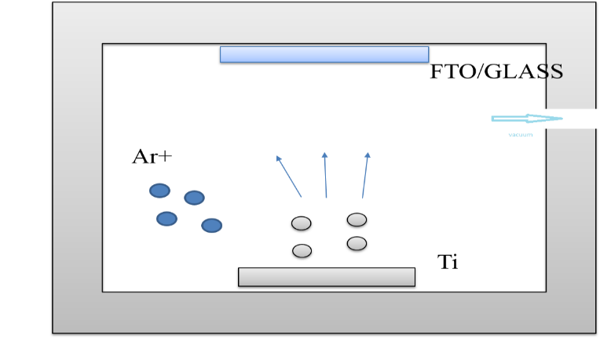
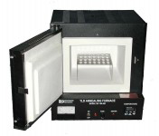
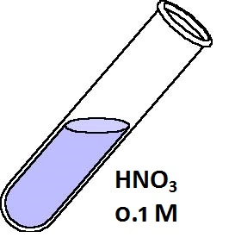
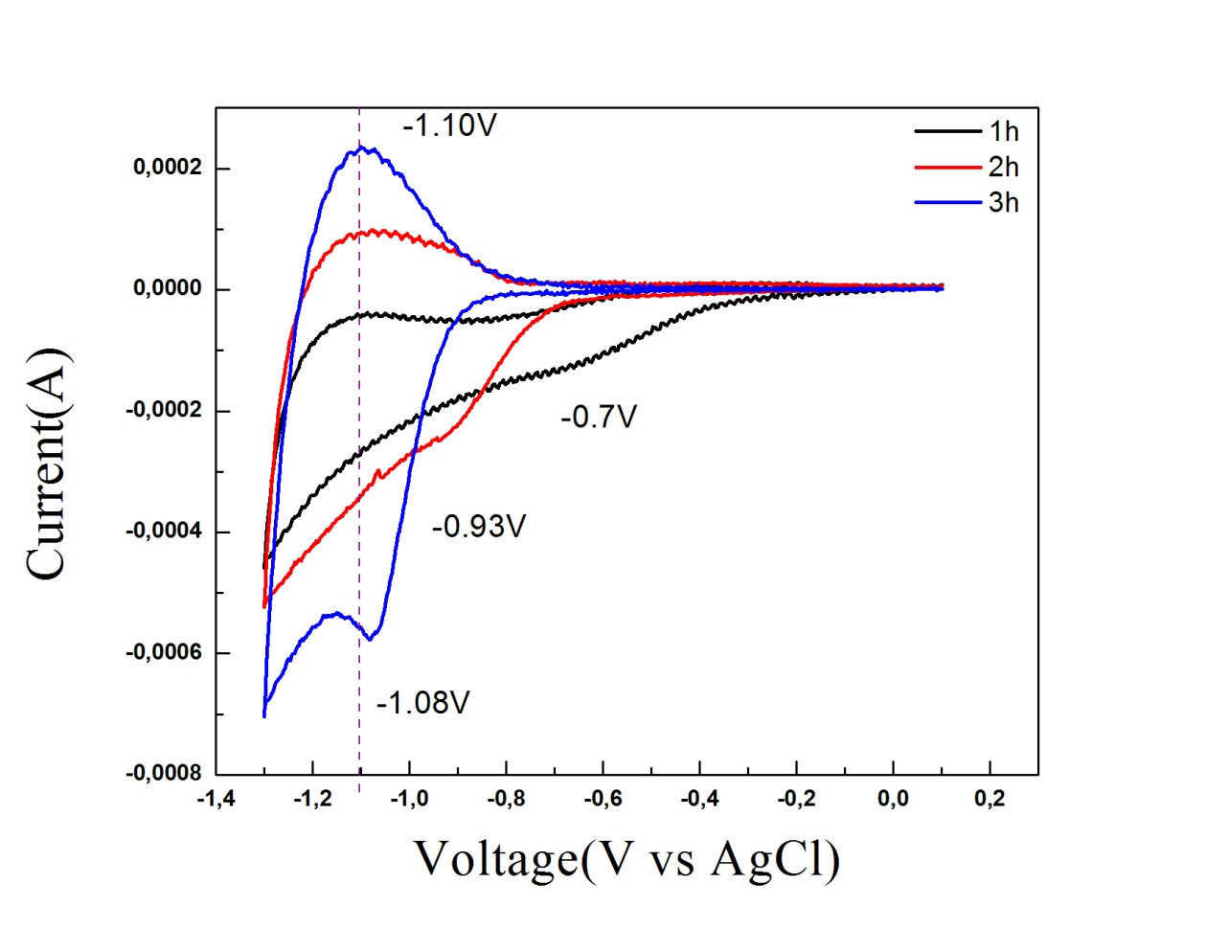
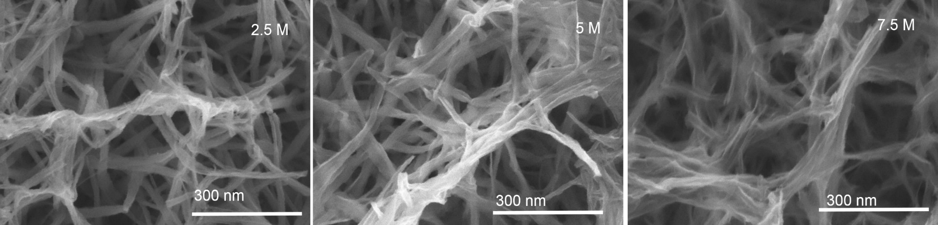
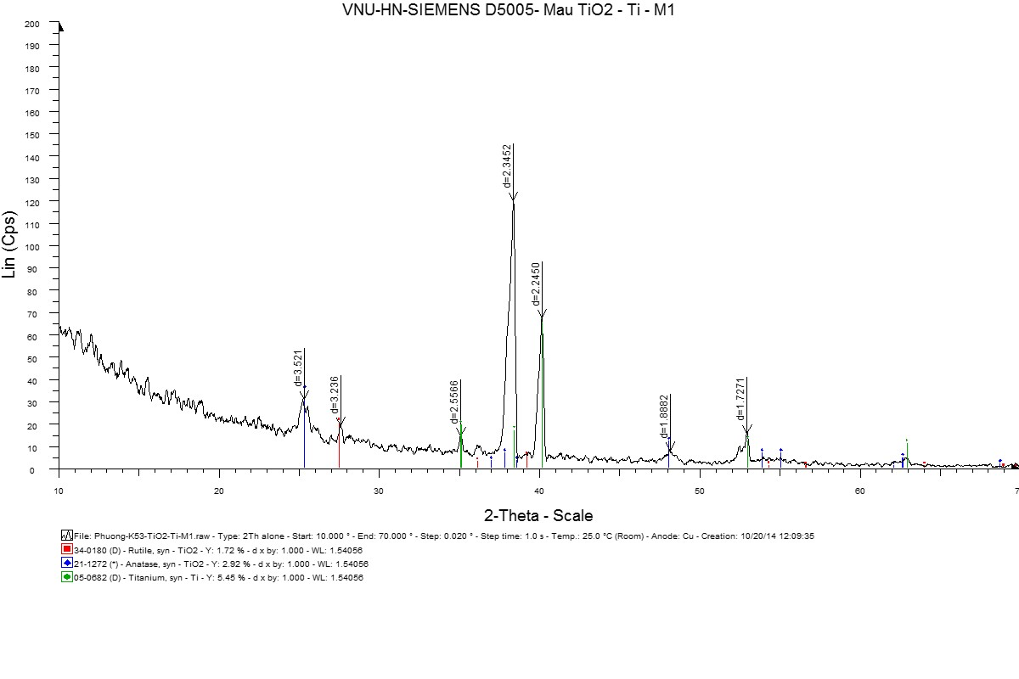
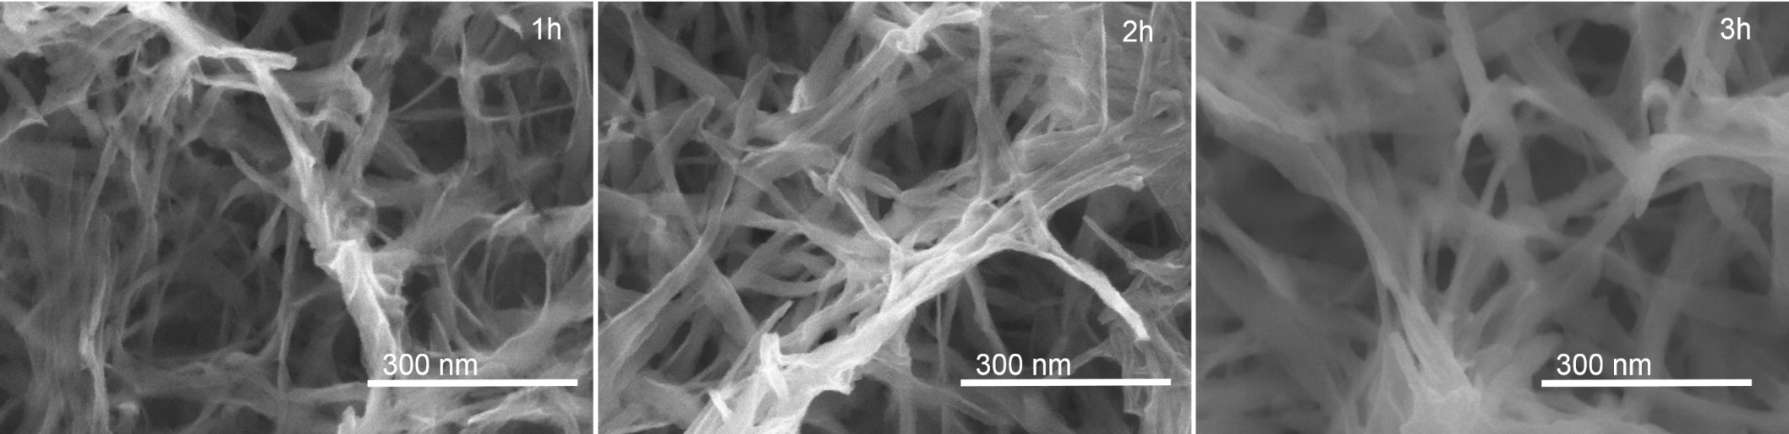
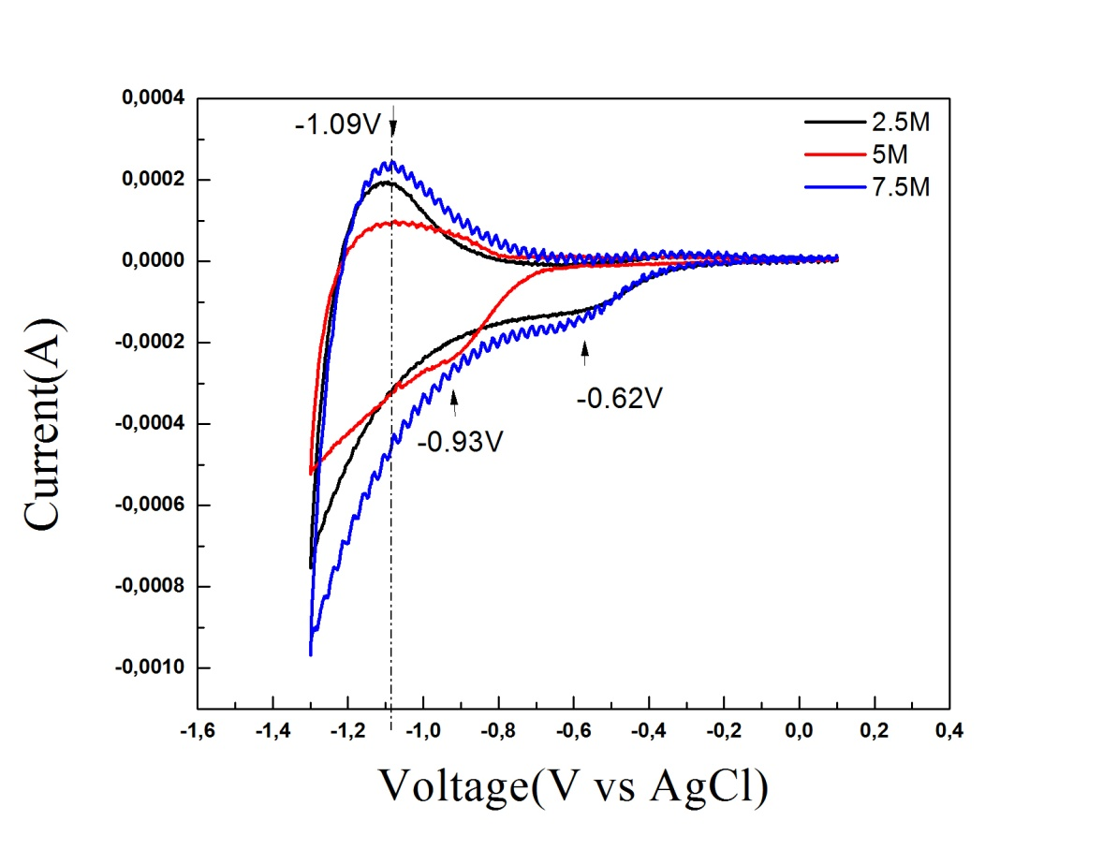
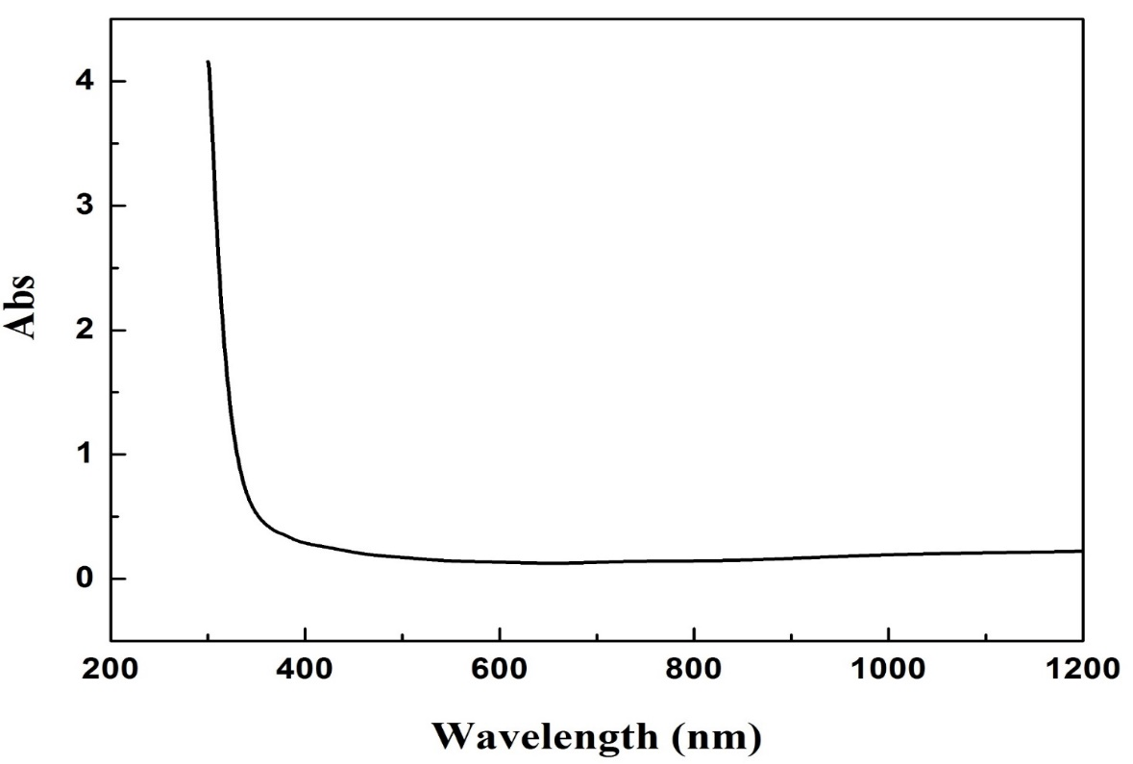
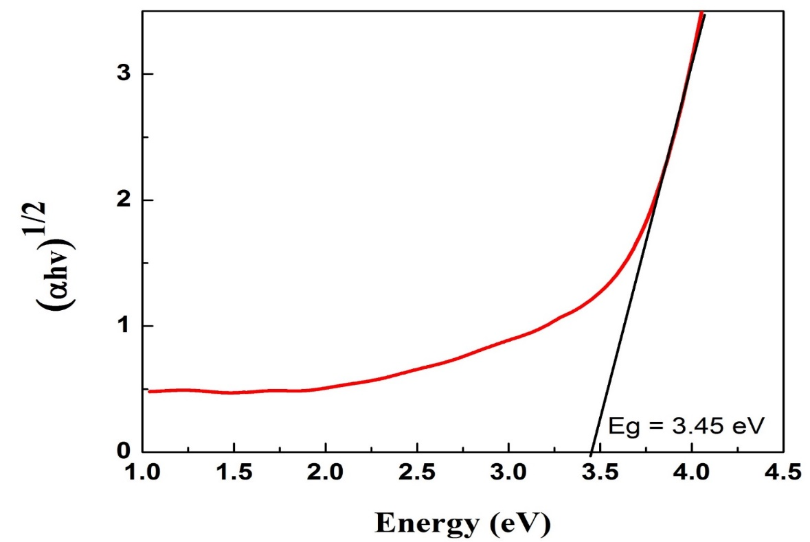
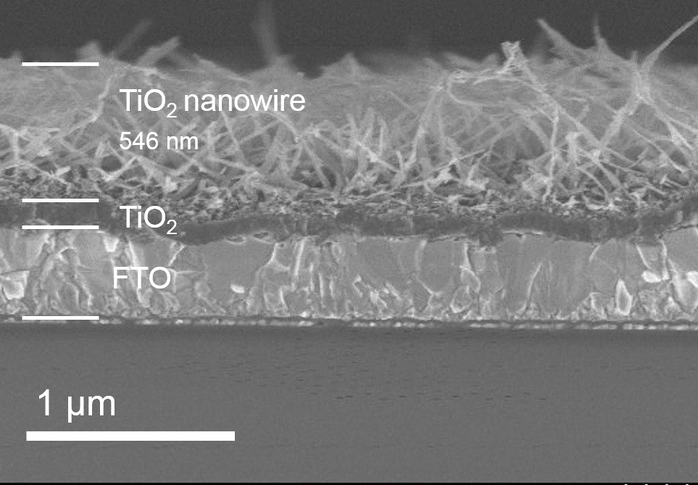
Fabrication and Electrochemical Properties of TiO₂ Nanowire Electrodes by Hydrothermal Method
Hung V. TRAN^{1,2} and Long D. PHAM¹
¹Institute of Materials Science, Vietnam Academy of Science and Technology
Address: 18 Hoang Quoc Viet st., Hanoi, VIetnam
²Vietnam National University, University of Engineering and Technology.
Address: 144 Xuan Thuy st., Hanoi, Vietnam
E-mail: hungtv_560@vnu.edu.vn
LABORATORY OF ENERGY
MATERIALS AND DEVICES
INTRODUCTION
TiO₂ nanostructure has been the most intensively investigated in recently because of their prominent characters such as low cost, large surface area, nontoxicity. Nearly all these functional applications of TiO₂ fall in the scope of energy, environment, and health, which are definitely the three most important and challenging themes facing the human race that need to be addressed in this century. For the energy, it have their application such as optoelectronics, photocatalysis, photovoltaics, sensors, and energy storage. TiO₂ exists in different polymorphic forms, including rutile, anatase, and bronze. Nanowires TiO₂ materials with large surface areas have proved to be excellent candidates for these applications. The properties and operational performance of nanowires TiO₂ are largely dependent on its crystal phase, crystallinity, surface area, porosity, morphology, and architecture; in this regard, TiO₂ nanowires with porous architectures are promising candidates for a wide range of applications. Herein, we report on nanowire TiO₂ synthesis by facial hydrothermal method of titanium film in alkaline solution with special porous structure. To explain the effect of growth parameters on the structure of nanowire, we studied the effect of several parameters such as different time and NaOH concentration. Li⁺ ion exchange and storage properties of TiO₂ electrodes were examined by AutoLab PGSTAT30 system in the three electrode configuration. In this work, report also have been indicated optical properties.
The sample was put into autoclave with NaOH solution at a temperature of 80 ⁰C and for 2h
EXPERIMENT
The sample was washed with 0.1 M HNO₃ aqueous solution. Then washed in deionized water
Ti film was sputtered on the FTO/glass substrate with condition 50w, 1h
The sample was baked in air at 450 ⁰C for 4h
FTO/glass was cleaned in an ultrasonic bath with: ethanol, acetone, and DI waster in sequence
Nanowire TiO2 film
RESULTS AND DISCUSSION
Figure 1. FE-SEM images of TiO₂ nanowire films depend on concentration. of NaOH solutions
Figure 7: Cyclic voltammograms of TiO₂ nanowire electrode depend on the time
The time for increasing current density of oxidation and reduction => enhance the ability to transfer and restore ion.
Peak position of oxidation spectrum locate at -1.10 V and mostly unchange via hydrothermal time. Peak position of reduction spectrum remarkably change via time, from -0.7 V to -0.93 V and -1.08 V corresponding to hydrothermal time 1h, 2h and 3h respectively.
Sample of 3h shows highest current density of oxidation and reduction and the best of gap between oxidation and reduction potentials. (increase hydrothermal time => increase thickness of film => increase ability of transferring ion => increase current density)
⇒ Increase hydrothermal time as wall as increase imparity between oxidation and reduction potentials => enhance ionic interchanged rate (this relate to the perfect of structure and the bonding charateristic of TiO₂ nanowires)
Figure 2. FE-SEM images of TiO₂ nanowire films depend on the time of hydrothermal process
Figure 4: XDR spectrum of the TiO₂ nanowire film on FTO/glass substrate
Nanowire with diameters of 15 nm to 20 nm. And length of hundreds nm
The resulting films were several nm hundred and have porous networks structure.
Alteration of hydrothermal solution concentration not changed much to wires dimension.
Except for the diffraction peaks from FTO substrate, the XRD spectrum in indicate that the diffraction peaks of the neat TiO₂ could be exclusively ascribed to TiO₂ crystal with the anatase and rutile phases.
Figure 3: Cross-section FE-SEM image of hydrothermal sample in 5M NaOH solution for 1 hours
Figure 5: UV-visible spectrum of the TiO₂ nanowire
Figure 6: Plot of (αhν)² as a function of photon energy (hν) for the TiO₂ nanowire
Figure 8: Cyclic voltammograms of TiO₂ nanowire electrode depend on concentration. of NaOH solutions
UV spectrum indicate fabricated titanium dioxide adsorb under 380 nm wavelength.
The fabricated film has estimated Eg = 3.45 eV.
Concentration of 2.5 and 7.5 M give equivalent current density, this is higher as compared to sample 5M. The imparity between oxidation and reduction potentials at sample 5M give remarkably lower value (oxiadtion and reducttion potential is -1.09V and -0.93 V respectively while these are -1.09V and -0.62V at concentration 2.5 and 7.5 respectively).
Hydrothermally reactive rate at 2.5 M and 7.5 M is higher => thicker film => enhance current density
At 5M, hydrothermal rate is low, however the imparity between oxiadtion and reduction potential is low => good reversiblity.
CONCLUSIONS
REFERENCES
ACKNOWLEDGEMENTS
TiO₂ nanowire films were successfully synthesized by a facile hydrothermal method by reaction of sputtered Ti films with high concentrated NaOH solution. The structure, morphology, and optical properties have been investigated.
The films were formed with TiO₂ nanowire with diameters of 15 nm to 20 nm. And length of hundreds nm and linked together into networks
The influences of the time and hydrothermal solution concentration on the formation of TiO₂ nanowire film. Were investigated and indicated that the wires dimension and porous networks structure was not effected so much.
Fabricated film attribute to lithium insertion/extraction.
[1] Jing-Zhi Chen, Wen-Yin Ko, Yin-Cheng Yen, Po-Hung Chen, and Kuan-Jiuh Lin, ACS Nano 6 (8), 6633, 6639 (2012).
[2] Wu-Qiang Wu, Bing-Xin Lei, Hua-Shang Rao, Yang-Fan Xu, Yu-Fen Wang, Cheng-Yong Su, and Dai-Bin Kuang, Sci. Rep. 3 (2013).
. This work is supported in part by the Science and Technology Research Projects of Vietnam Academy of Science and Technology, the project, code: VAST03.05/13-14. A part of the work was done with the help of the Key Laboratory in Electronic Materials and Devices, Institute of Materials Science, Vietnam Academy of Science and Technology. We would like to thank the colleagues for their contribution to the work.

