Slide 1

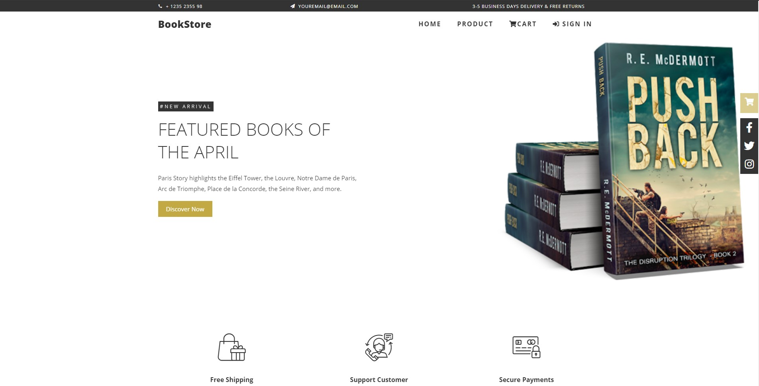
01
&BOOKSTORE – eCommerce Website
PRN292 – SE1413 – Team 2
TRỊNH HOÀNG HƯNG
HE140042
NGÔ THANH PHÚ AN
HE140186
TRẦN VIỆT HUY
HE140202
TỪ VĂN KHẢ
HE140457
45%

Slide 2

Background
02
52%
82%
Covid 19

Slide 3

Background
03

Slide 4
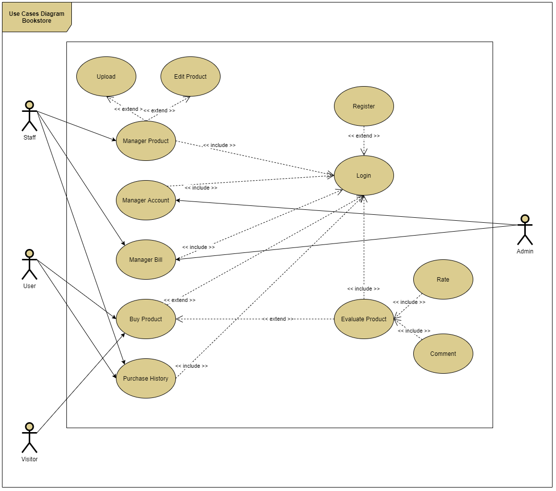
Use Case
04

Slide 5




Technology
05
BACK-END
FRONT-END
.NET Framework 4.7.2
Vue.js 2.6.11
DATABASE
DATA
Entity Framework 6.0

Slide 6
NuGet Library
06
BCrypt
IDGen
Encrypt Password
Generate ID
LINQ
PagedList
Language-Integrated Query
Page List

Slide 7
Timeline
07
Idea
Developing
05/01
04/02
20/03
02/04
Today
Training

Slide 8
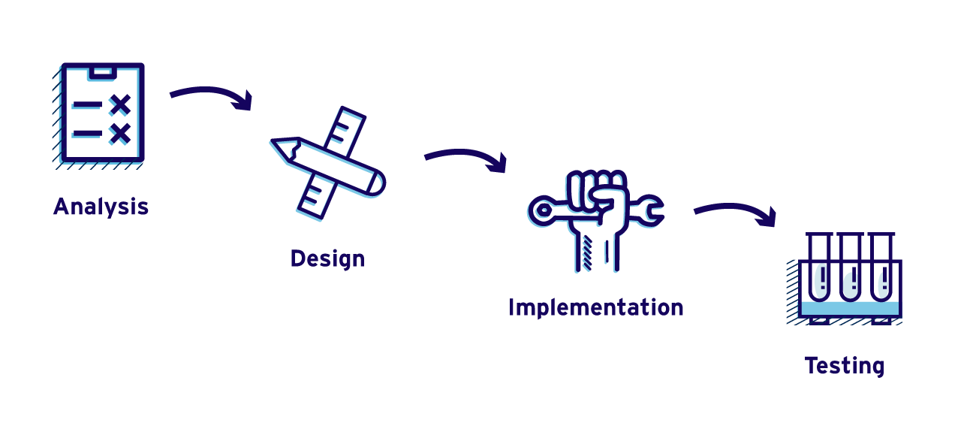


Timeline
07

Slide 9
08
Bring to the table win-win survival strategies to ensure proactive domination at the.
Bring to the table win-win survival strategies to ensure proactive domination at the.
02
04
D
M
¹
E
O
01
03
05
Bring to the table win-win survival strategies to ensure proactive domination at the.
Bring to the table win-win survival strategies to ensure proactive domination at the.
Bring to the table win-win survival strategies to ensure proactive domination at the.

