Slide 1
Geo-Routing Beaconless routing – Contention-based
By hungtt28

Slide 2
Contents
Overview
Beaconless Routing – Contention-based (2003)
Beaconless Forwarder Planarization (2008)
Alpha-shape boundary (1980s - 2009)
Rotational Sweep Algorithm (2012)
ALBA-R (2014)

Slide 3
Overview
Neighborhood-based
Each node must know their 1-hop neighbor’s position
Next hop decision is computed locally
GPSR, BoundHole, …
HELLO message
Construct NeighborTable
Send back position
Request
Broadcast position

Slide 4
Overview
Hello message scheme
Request on routing
Broadcast periodically
Advantages
Disadvantages
Need more energy for broadcast position information
Locally computation
Out of date NeighborTable

Slide 5

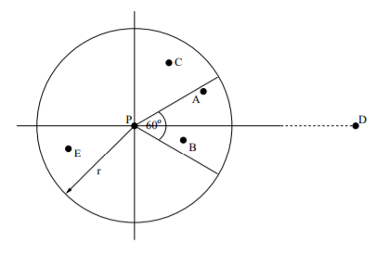
Beaconless Routing
Beaconless
Don’t use NeighborTable, each neighbor decides to be nexthop.
Delay function
“A novel position-based and beacon-less routing algorithm for mobile ad-hoc networks” - 2003
candidate
Broadcast message forwarded
forwarder

Slide 6
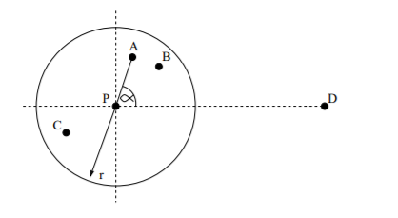

Beaconless Routing
Basic mode
Backup mode / Recovery mode
If no further forwarding
Request neighbor’s position
Clockwise-relaying
forwarder
A
forward
P
C
B
drop

Slide 7
Beaconless Routing
Advantages
No Hello message, no NeighborTable
Disadvantages
Duplicate packet
Inefficient in Backup mode

Slide 8
Contention-based
Improve Beaconless
Use RTS/CTS scheme
RTS – Request to Send
CTS – Clear to Seed
Scheme
Forwarder broadcast RTS
Candidate compute delay function
SetTimer to reply CTS
If timer expired candidate send CTS
If candidate receive CTS from other candidate then discard the timer
Forwarder receive CTS, forward DATA to nexthop
“MACA - A New Channel Access Method for Packet Radio” – 1990
IEEE 802.11
candidate
Broadcast RTS
forwarder

Slide 9
Contention-based
Delay function
“the advance” – to compute delay function
Distance to destination
Angle of candidate and forwarder with destination
… (depend on variant algorithm)
Require
Current position
Destination position
Forwarder position
… (depend on algorithm)
Add_delay = Max_delay * “the advance”

Slide 10

Contention-based
Position-based
Like Greedy
Problem – stuck node
Recovery mode – face routing
nexthop
A
forwarder
C
P
CTS
D
discard
CTS discarded
C
B

Slide 11
Beaconless Forwarder Planarization
BFP (2008)
Basic mode
Contention-based – like greedy
Beaconless recovery
Use RTS/CTS scheme to construct planar graph
Locally select next hop
Planar node will return
candidate
Broadcast RTS
forwarder

Slide 12
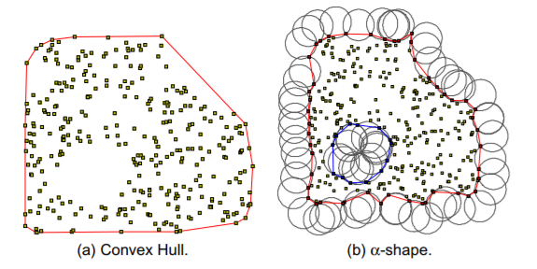
Alpha-shape boundary
Alpha-shape – planar graph
Rolling ball
Reuleaux triangle
“On the shape of a set of points in the plane” - IEEE Transactions on Information Theory, vol. IT-29(4), pp. 551–559, 1983

Slide 13
Alpha-shape boundary
“Rolling ball” vs TENT Rule
Rolling ball | TENT Rule
- Target: Find nexthop by clockwise or counter-clockwise
- Nexthop is on planar graph - No loop, 1 alpha-shape for each hole | - Nexthop maybe not on planar graph - Maybe loop, maybe existe many boundhole

Slide 14
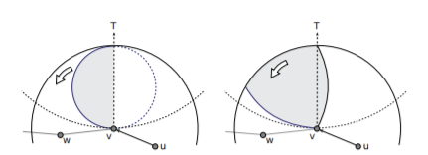
Rotational Sweep Algorithm
“Optimizing Communication Overhead while Reducing Path Length in Beaconless Georouting with Guaranteed Delivery for Wireless Sensor Networks” - Stefan Ruehrup and Ivan Stojmenovic - 2012 IEEE
Rotational Sweep
Sweep Circle – like rolling ball
Twisting triangle
Advantages
Beaconless totally
Compute alpha-boundary on candidate

Slide 15
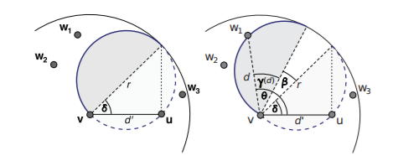

Rotational Sweep Algorithm
Sweep Circle
Delay function

Slide 16
ALBA-R
Routing
Contention-based
Load balancing
Queue priority index (QPI)
Geographic priority index (GPI)
Rainbow table

Slide 17
THANK YOU

