Slide 1
Geo-Routing Beaconless routing – Contention-based
By hungtt28

Slide 2
Contents
Overview
Beaconless Routing – Contention-based (2003)
Beaconless Forwarder Planarization (2008)
Alpha-shape boundary (1980s - 2009)
Rotational Sweep Algorithm (2012)
ALBA-R (2014)

Slide 3
Overview
Neighborhood-based
Each node must know their 1-hop neighbor’s position
Next hop decision is computed locally
GPSR, BoundHole, …
HELLO message
Construct NeighborTable
Send back position
Request
Broadcast position

Slide 4
Overview
Hello message scheme
Request on routing
Broadcast periodically
Advantages
Disadvantages
Need more energy for broadcast position information
Locally computation
Out of date NeighborTable

Slide 5

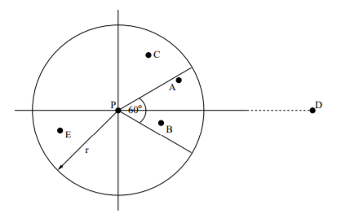
Beaconless Routing
Beaconless
Don’t use NeighborTable, each neighbor decides to be nexthop.
Delay function
“A novel position-based and beacon-less routing algorithm for mobile ad-hoc networks” - 2003
candidate
Broadcast message forwarded
forwarder

Slide 6
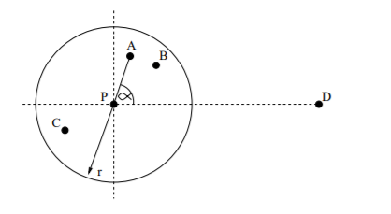

Beaconless Routing
Basic mode
Backup mode / Recovery mode
If no further forwarding
Request neighbor’s position
Clockwise-relaying
forwarder
A
forward
P
C
B
drop

Slide 7
Beaconless Routing
Advantages
No Hello message, no NeighborTable
Disadvantages
Duplicate packet
Inefficient in Backup mode

Slide 8
Contention-based
Improve Beaconless
Use RTS/CTS scheme
RTS – Request to Send
CTS – Clear to Seed
Scheme
Forwarder broadcast RTS
Candidate compute delay function
SetTimer to reply CTS
If timer expired candidate send CTS
If candidate receive CTS from other candidate then discard the timer
Forwarder receive CTS, forward DATA to nexthop
“MACA - A New Channel Access Method for Packet Radio” – 1990
IEEE 802.11
candidate
Broadcast RTS
forwarder

Slide 9
Contention-based
Delay function
“the advance” – to compute delay function
Distance to destination
Angle of candidate and forwarder with destination
… (depend on variant algorithm)
Require
Current position
Destination position
Forwarder position
… (depend on algorithm)
Add_delay = Max_delay * “the advance”

Slide 10

Contention-based
Position-based
Like Greedy
Problem – stuck node
Recovery mode – face routing
nexthop
A
forwarder
C
P
CTS
D
discard
CTS discarded
C
B

Slide 11
Beaconless Forwarder Planarization
BFP (2008)
Beaconless recovery
Use RTS/CTS scheme to construct planar graph
Locally select next hop

Slide 12
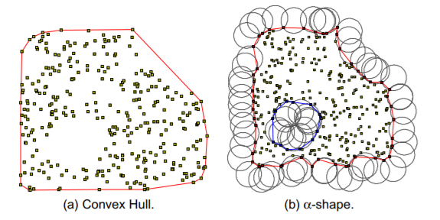
Alpha-shape boundary
Alpha-shape – planar graph
Rolling ball

Slide 13
Rotational Sweep Algorithm
Rotational Sweep
Sweep Circle – like rolling ball
Twisting triangle
Advantages
Beaconless totally
Compute alpha-boundary on candidate

Slide 14
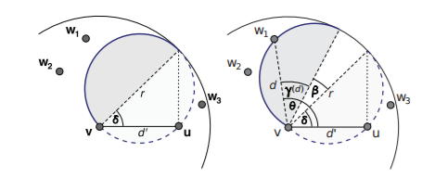

Rotational Sweep Algorithm
Sweep Circle
Delay function

Slide 15
ALBA-R
Routing
Contention-based
Load balancing
Queue priority index (QPI)
Geographic priority index (GPI)
Rainbow table

Slide 16
THANK YOU

