Slide 1
GeoRouting by Castalia
Demo by hungtt28

Slide 2
Contents
Castalia Overview
Adding new GeoRouting
Demo

Slide 3
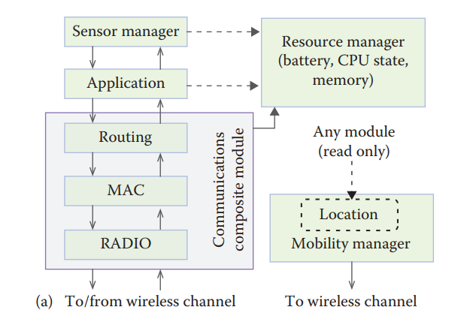
Castalia
Node
cMessage

Slide 4
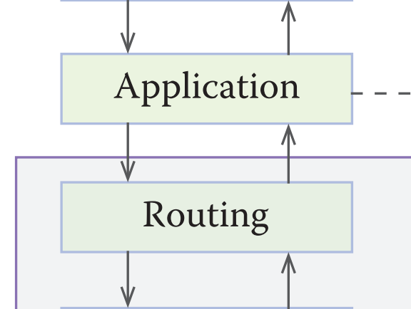
Castalia
NETWORK_CONTROL_COMMAND
cMessage(NETWORK_CONTROL_COMMAND)
handleNetworkControlCommand()

Slide 5
Castalia
APPLICATION_PACKET
fromNetworkLayer()
cMessage(APPLICATION_PACKET)
fromApplicationLayer()
toApplicationLayer()

Slide 6
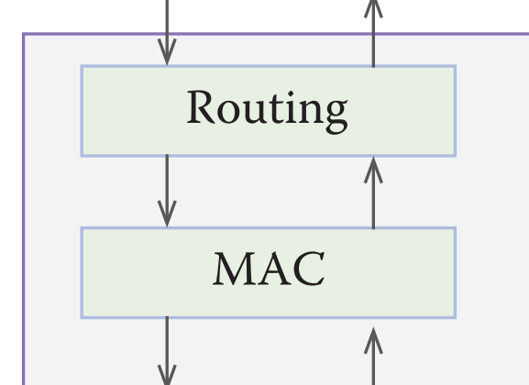
Castalia
NETWORK_LAYER_PACKET
cMessage(NETWORK_LAYER_PACKET)
toMacLayer()
fromMacLayer()

Slide 7
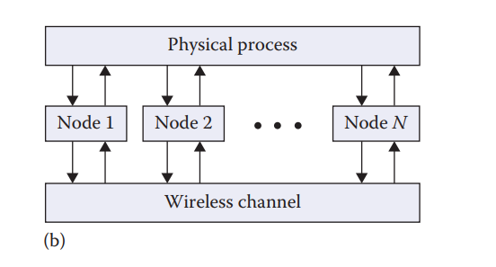
Castalia

Slide 8
Adding new GeoRouting
New Simulation
Simuation (omnetini)
Application (routingTest)
Routing (new GeoRouting)

Slide 9
GeoRouting
Simulation (omnetpp.ini)
Radio range (Radion, wirelessChannel)
MAC
Routing (GeoRouting)
Application (routingTest)
numNodes
Coordinates
Source, destination
Sim-time-limit, startupDelay

Slide 10
GeoRouting
routingTest
SET_GEO_NODE_POS: update current location of node to routing layer
If (Source)
Send APPLICATION_PACKET to MAC layer
If (Received)
Stop

Slide 11
GeoRouting
GeoRouting
sendHelloMessage
forwardDataPacket
fromMacLayer
toMacLayer

Slide 12
Demo
OMNet
1. Download omnet++ 4.6 from https://omnetpp.org/
2. Extract omnetpp-4.6-src-windows.zip
3. Run mingwenv.cmd
4. ./configure
5. make

Slide 13
Demo
Castalia + GeoRouting
1. Run mingwend.cmd
2. cd path/to/Castalia
3. make clean
4. makemake
5. make depend
6. make

Slide 14
Demo
Run
1. cd Simulations/routingTest
2. ../../Castalia.exe

Slide 15
THANK YOU

