Slide 1
Basic Introduction
Data Mining & Business Intelligence
Lecture 1
by
Prof. Chih-Hsuan Wang (王志軒)

Slide 2
Overview
10大最具影響力的資料採礦演算法：C4.5, K-means, SVM, Apriori, EM, PageRank, AdaBoost, KNN, Naïve Bayes, CART
http://cran.csie.ntu.edu.tw/bin/windows/base/
https://www.rstudio.com/products/rstudio/download/
https://joe11051105.gitbooks.io/r_basic/content/environment_settings/RStudio_introduction.html
以下指令設定工作路徑，在讀取或寫入檔案時，可以省掉很多麻煩---
setwd("C:\\Users\\Chih-Hsuan Wang\\Desktop\\R檔案\\")
setwd("C:/Users/chtti/Desktop/R檔案")
先將個人檔案存成DAT、CSV或TXT檔，在R環境下可用以下指令抓取
heart<- read.table("heart.dat", header=T, sep=" ")
glass<- read.table("glass.txt", header=T, sep=",")
bank<- read.table("bank.csv", header=T, sep=";")

Slide 3
What’s data mining?
Y=f(x1, x2, x3, ….,xn), Y is a dependent outcome, xi are predictors
Clustering: seeking which objects are more similar to form distinct groups
Association: searching for which items are frequently shown in a transaction database (co-occurrence)
Classification: given independent features, predict class labels like patients will die or not, companies will become bankrupt or not,
Regression: given independent features, estimate the values of dependent outcomes, such as next-year’s product sale, earning per share, etc.

Slide 4

What is Data?
Collection of data objects and their attributes
An attribute is a property or characteristic of an object
  Examples: eye color of a person, temperature, etc.
  Attribute is also known as variable, field, characteristic, or feature
A collection of attributes describe an object
  Object is also known as record, point, case, sample, entity, or instance
Attributes
Objects

Slide 5
Types of Attributes
There are different types of attributes
  Nominal (名目)
    Examples: ID numbers, eye color, zip codes
  Ordinal (順序)
    Examples: rankings (e.g., taste of potato chips on a scale from 1-10), grades, height in {tall, medium, short}
  Interval (區間)
    Examples: calendar dates, temperatures in Celsius or Fahrenheit.
  Ratio (比率)
    Examples: temperature in Kelvin, length, time, counts

Slide 6
Properties of Attribute Values
The type of an attribute depends on which of the following properties it possesses:
  Distinctness: = ≠
  Order: < >
  Addition: + -
  Multiplication: * /
  Nominal attribute: distinctness
  Ordinal attribute: distinctness & order
  Interval attribute: distinctness, order & addition
  Ratio attribute: all of 4 properties

Slide 7
Attribute Type
Description
Examples
Operations
Nominal
The values of a nominal attribute are just different names, i.e., nominal attributes provide only enough information to distinguish one object from another. (=, ≠)
zip codes, employee ID numbers, eye color, sex: {male, female}
mode, entropy, contingency correlation, χ² test
Ordinal
The values of an ordinal attribute provide enough information to order objects. (<, >)
hardness of minerals, {good, better, best},
grades, street numbers
median, percentiles, rank correlation, run tests, sign tests
Interval
For interval attributes, the differences between values are meaningful, i.e., a unit of measurement exists.
(+, - )
calendar dates, temperature in Celsius or Fahrenheit
mean, standard deviation, Pearson's correlation, t and F tests
Ratio
For ratio variables, both differences and ratios are meaningful. (*, /)
temperature in Kelvin, monetary quantities, counts, age, mass, length, electrical current
geometric mean, harmonic mean, percent variation

Slide 8
Attribute Level
Transformation
Comments
Nominal
Any permutation of values
If all employee ID numbers were reassigned, would it make any difference?
Ordinal
An order preserving change of values, i.e.,
new_value = f(old_value)
where f is a monotonic function.
An attribute encompassing the notion of good, better best can be represented equally well by the values {1, 2, 3} or by { 0.5, 1, 10}.
Interval
new_value =a * old_value + b where a and b are constants
Thus, the Fahrenheit and Celsius temperature scales differ in terms of where their zero value is and the size of a unit (degree).
Ratio
new_value = a * old_value
Length can be measured in meters or feet.

Slide 9
Discrete and Continuous Attributes
Discrete Attribute
  Has only a finite or countable infinite set of values
  Examples: zip codes, counts, or the set of words in a collection of documents
  Often represented as integer variables.
  Note: binary attributes are a special case of discrete attributes
Continuous Attribute
  Has real numbers as attribute values
  Examples: temperature, height, or weight.
  Practically, real values can only be measured and represented using a finite number of digits.
  Continuous attributes are typically represented as floating-point variables.

Slide 10
Types of data sets
Record
  Data Matrix
  Document Data
  Transaction Data
Graph
  World Wide Web
  Molecular Structures
Ordered
  Spatial Data
  Temporal Data
  Sequential Data
  Genetic Sequence Data

Slide 11
Important Characteristics of Structured Data
  Dimensionality
    Curse of Dimensionality
  Sparsity
    Only presence counts
  Resolution
    Patterns depend on the scale

Slide 12
Record Data
Data that consists of a collection of records, each of which consists of a fixed set of attributes

Slide 13
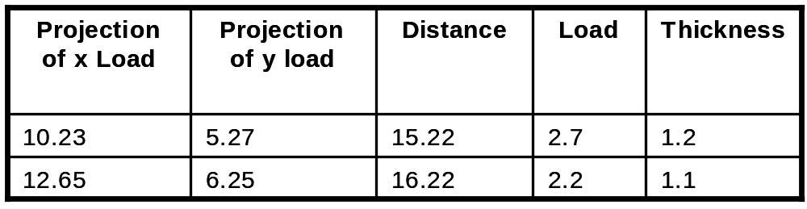
Data Matrix
If data objects have the same fixed set of numeric attributes, then the data objects can be thought of as points in a multi-dimensional space, where each dimension represents a distinct attribute
Such data set can be represented by an m by n matrix, where there are m rows, one for each object, and n columns, one for each attribute

Slide 14

Document Data
Each document becomes a `term' vector,
  each term is a component (attribute) of the vector,
  the value of each component is the number of times the corresponding term occurs in the document.

Slide 15

Transaction Data
A special type of record data, where
  each record (transaction) involves a set of items.
  For example, consider a grocery store. The set of products purchased by a customer during one shopping trip constitute a transaction, while the individual products that were purchased are the items.

Slide 16
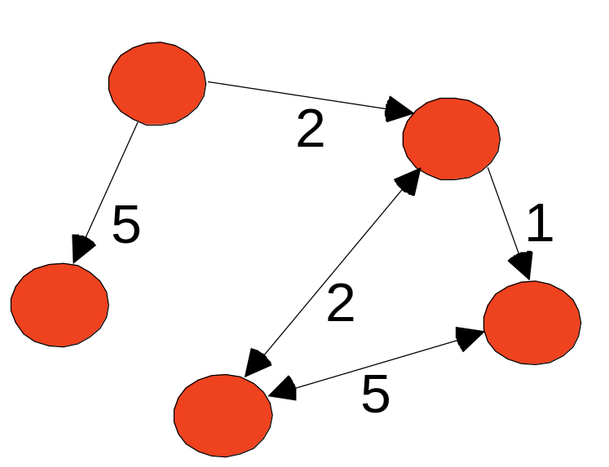
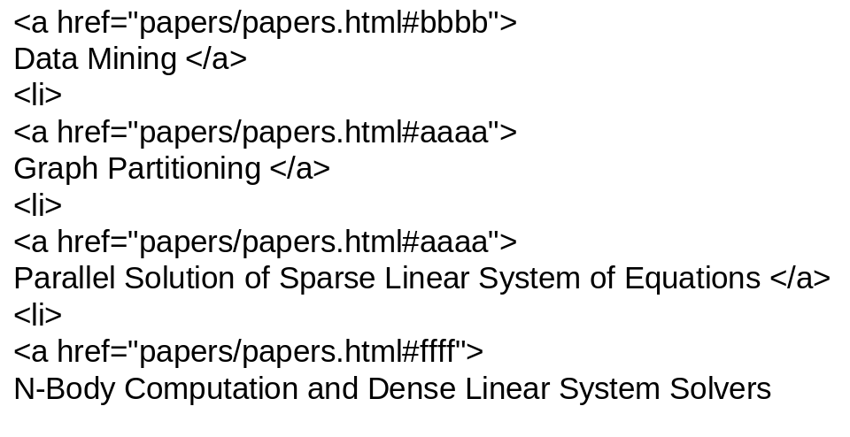
Graph Data
Examples: Generic graph and HTML Links

Slide 17
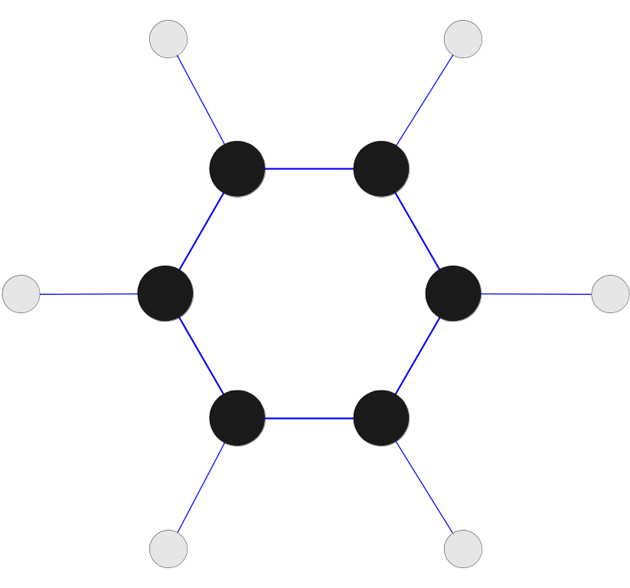
Chemical Data
Benzene Molecule: C₆H₆ (烷類)

Slide 18
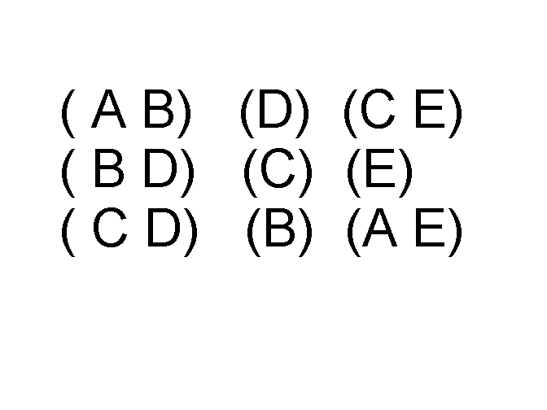
Ordered Data
Sequences of transactions
Items/Events
An element of the sequence

Slide 19
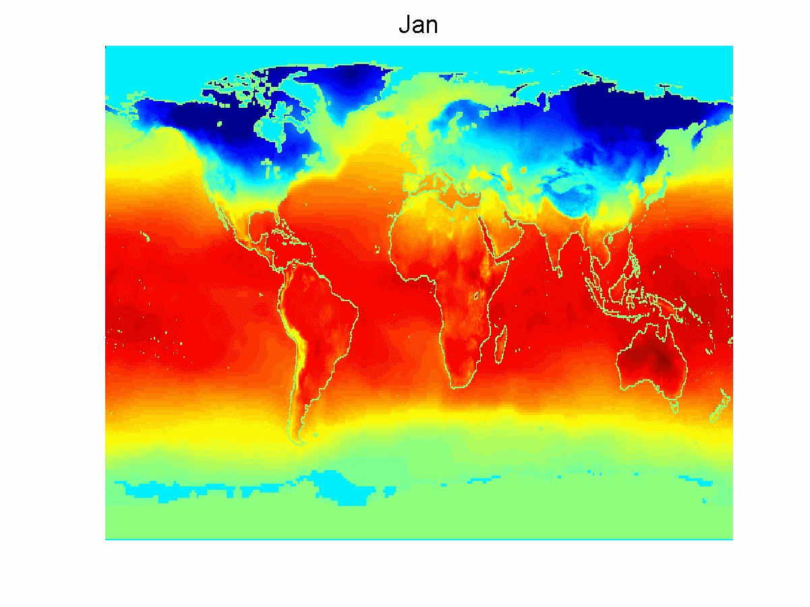
Ordered Data
Spatio-Temporal Data
Average Monthly Temperature of land and ocean

Slide 20
Data Quality
What kinds of data quality problems?
How can we detect problems with the data?
What can we do about these problems?
Examples of data quality problems:
  noise and outliers
  missing values
  duplicate data

Slide 21


Noise
Noise refers to modification of original values
  Examples: distortion of a person’s voice when talking on a poor phone and “snow” on television screen
Two Sine Waves
Two Sine Waves + Noise

Slide 22

Outliers
Outliers are data objects with characteristics that are considerably different than most of the other data objects in the data set

Slide 23
Missing Values
Reasons for missing values
  Information is not collected
  (e.g., people decline to give their age and weight)
  Attributes may not be applicable to all cases
  (e.g., annual income is not applicable to children)
Handling missing values
  Eliminate Data Objects
  Estimate Missing Values
  Ignore the Missing Value During Analysis
  Replace with all possible values (weighted by their probabilities)

Slide 24
Duplicate Data
Data set may include data objects that are duplicates, or almost duplicates of one another
  Major issue when merging data from heterogeous sources
Examples:
  Same person with multiple email addresses
Data cleaning (ETL in data warehousing)
  Process of dealing with duplicate data issues

Slide 25
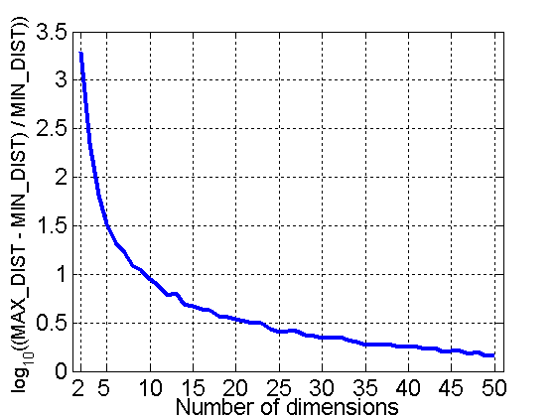
Curse of Dimensionality
When dimensionality increases, data becomes increasingly sparse in the space that it occupies
Definitions of density and distance between points, which is critical for clustering and outlier detection, become less meaningful
Randomly generate 500 points
Compute difference between max and min distance between any pair of points

Slide 26
Dimensionality Reduction
Purpose:
  Avoid curse of dimensionality
  Reduce amount of time and memory required by data mining algorithms
  Allow data to be more easily visualized
  May help to eliminate irrelevant features or reduce noise
Techniques
  Principle Component Analysis (PCA)
  Singular Value Decomposition (SVD)
  Multi-dimensional scaling (MDS)

Slide 27
Feature Subset Selection
Another way to reduce dimensionality of data
Redundant features
  duplicate much or all of the information contained in one or more other attributes
  Example: purchase price of a product and the amount of sales tax paid
Irrelevant features
  contain no information that is useful for the data mining task at hand
  Example: students' ID is often irrelevant to the task of predicting students' GPA

Slide 28
Feature Subset Selection
Techniques:
  Brute-force approach:
    Try all possible feature subsets as input to data mining algorithm
  Embedded approaches:
    Feature selection occurs naturally as part of the data mining algorithm
  Filter approaches:
    Features are selected before data mining algorithm is run
  Wrapper approaches:
    Use the data mining algorithm as a black box to find best subset of attributes

Slide 29
Feature Creation
Create new attributes that can capture the important information in a data set much more efficiently than the original attributes
Three general methodologies:
  Feature Extraction (PCA, ICA, SVD)
    domain-specific
  Mapping Data to New Space (SVM)
  Feature Construction
    combining features

Slide 30
Similarity and Dissimilarity
Similarity
  Numerical measure of how alike two data objects are.
  Is higher when objects are more alike.
  Often falls in the range [0,1]
Dissimilarity
  Numerical measure of how different are two data objects
  Lower when objects are more alike
  Minimum dissimilarity is often 0
  Upper limit varies
Proximity refers to a similarity or dissimilarity

Slide 31
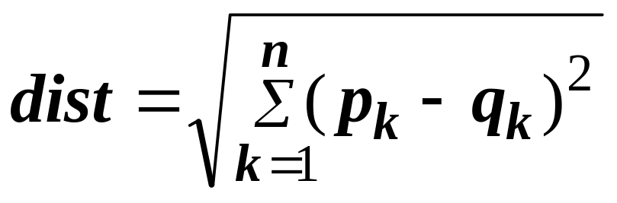
Euclidean Distance
Euclidean Distance
  Where n is the number of dimensions (attributes) and p_{k} and q_{k} are, respectively, the k^{th} attributes (components) or data objects p and q.
Standardization is necessary, if scales differ.

Slide 32
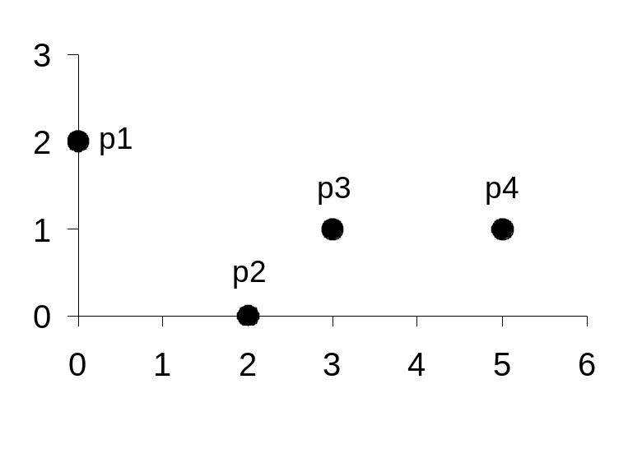
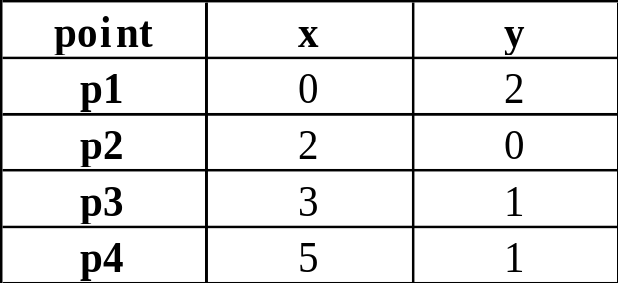
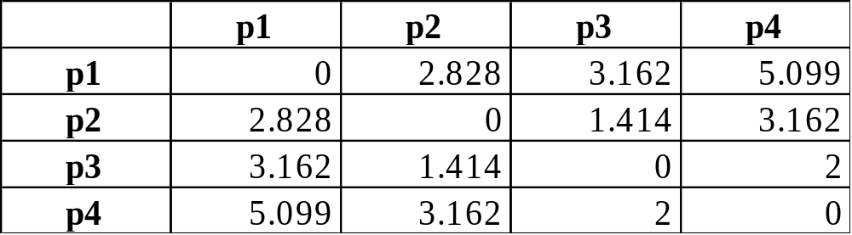
Euclidean Distance
Distance Matrix

Slide 33
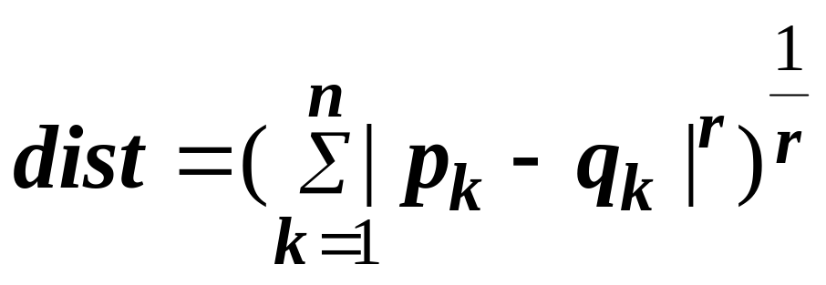
Minkowski Distance
Minkowski Distance is a generalization of Euclidean Distance
  Where r is a parameter, n is the number of dimensions (attributes) and p_{k} and q_{k} are, respectively, the kth attributes (components) or data objects p and q.

Slide 34
Minkowski Distance: Examples
[chapter 2 . 4 . 3 page 70 ]
r = 1. City block (Manhattan, taxicab, L₁ norm) distance.
  A common example of this is the Hamming distance, which is just the number of bits that are different between two binary vectors
r = 2. Euclidean distance
r → ∞. “Supremum” (L_{max} norm, L∞ norm) distance.
  This is the maximum difference between any component of the vectors
Do not confuse r with n, i.e., all these distances are defined for all numbers of dimensions.

Slide 35
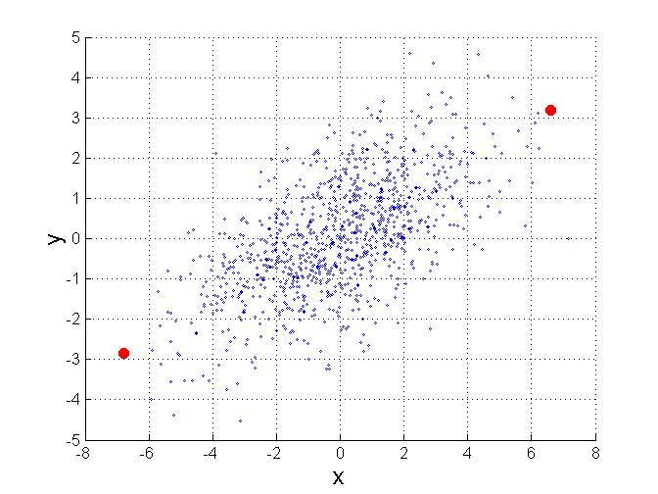
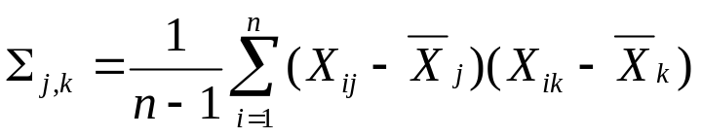
Mahalanobis Distance
Σ is the covariance matrix of the input data X
For red points, the Euclidean distance is 14.7, Mahalanobis distance is 6.

Slide 36
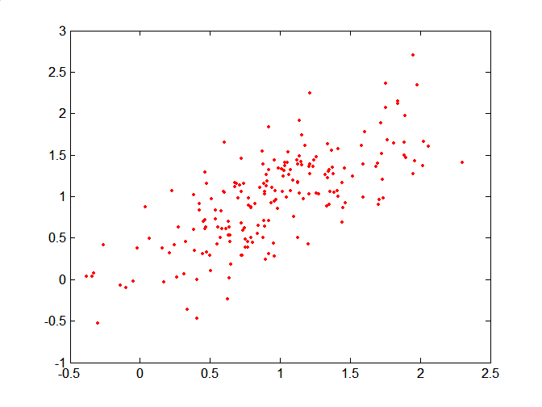
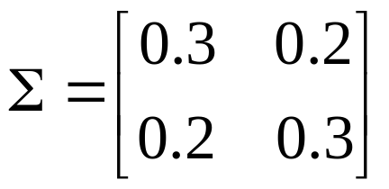
Mahalanobis Distance
Covariance Matrix:
C
B
A: (0.5, 0.5)
B: (0, 1)
C: (1.5, 1.5)
Mahal(A,B) = 5
Mahal(A,C) = 4
A

Slide 37
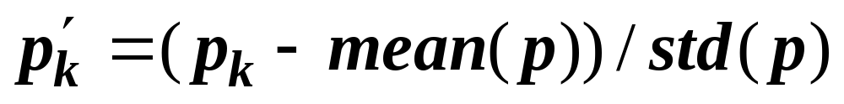
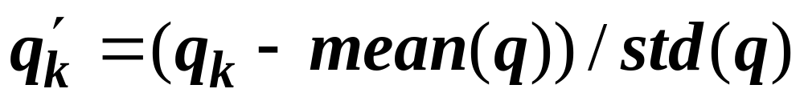
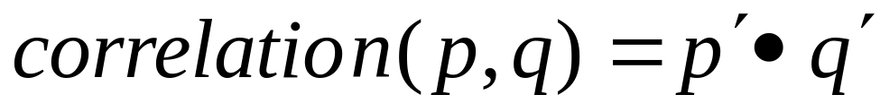
Correlation
Correlation measures the linear relationship between objects
To compute correlation, we standardize data objects, p and q, and then take their dot product
(inner product)

Slide 38

Visually Evaluating Correlation
Scatter plots showing the similarity from –1 to 1.

Slide 39
Density
Density-based clustering require a notion of density
Examples:
  Euclidean density
    Euclidean density = number of points per unit volume
  Probability density
  Graph-based density

Slide 40
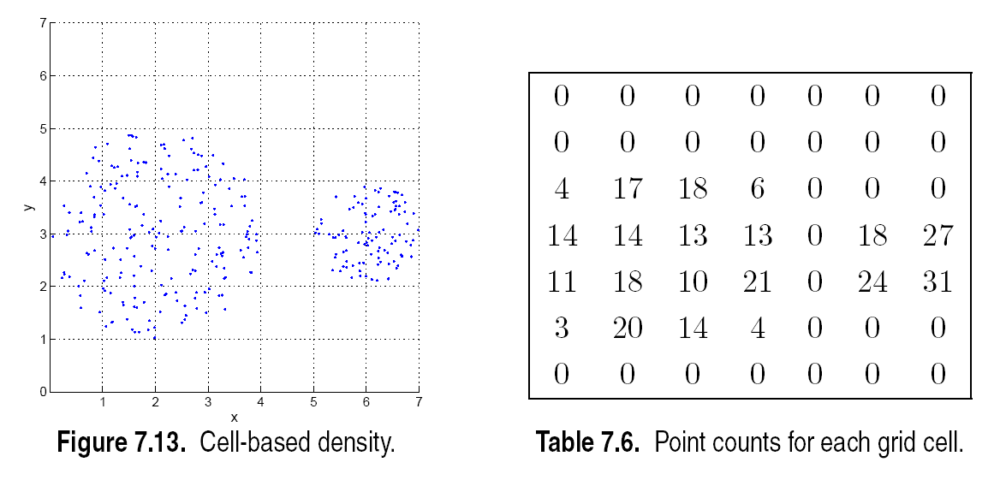
Euclidean Density – Cell-based
Simplest approach is to divide region into a number of rectangular cells of equal volume and define density as # of points the cell contains

Slide 41
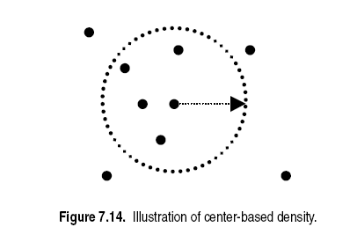
Euclidean Density – Center-based
Euclidean density is the number of points within a specified radius of the point

Slide 42
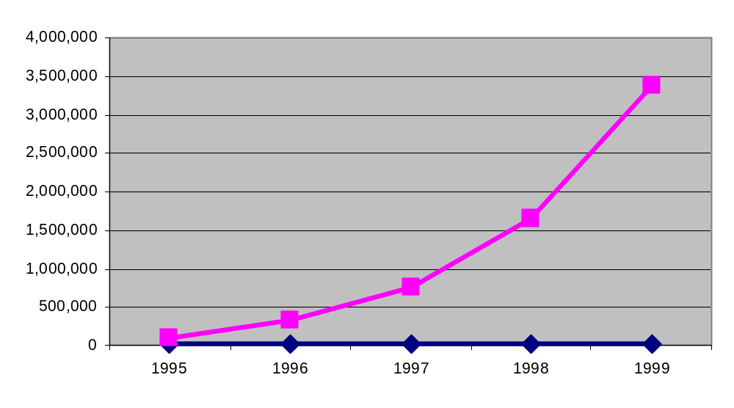
Mining Large Data Sets – Motivation
There is often information “hidden” in the data that is
not readily evident
Human analysts may take weeks to discover useful information
Much of the data is never analyzed at all
The Data Gap
Total new disk (TB) since 1995
Number of analysts
From: R. Grossman, C. Kamath, V. Kumar, “Data Mining for Scientific and Engineering Applications”

Slide 43
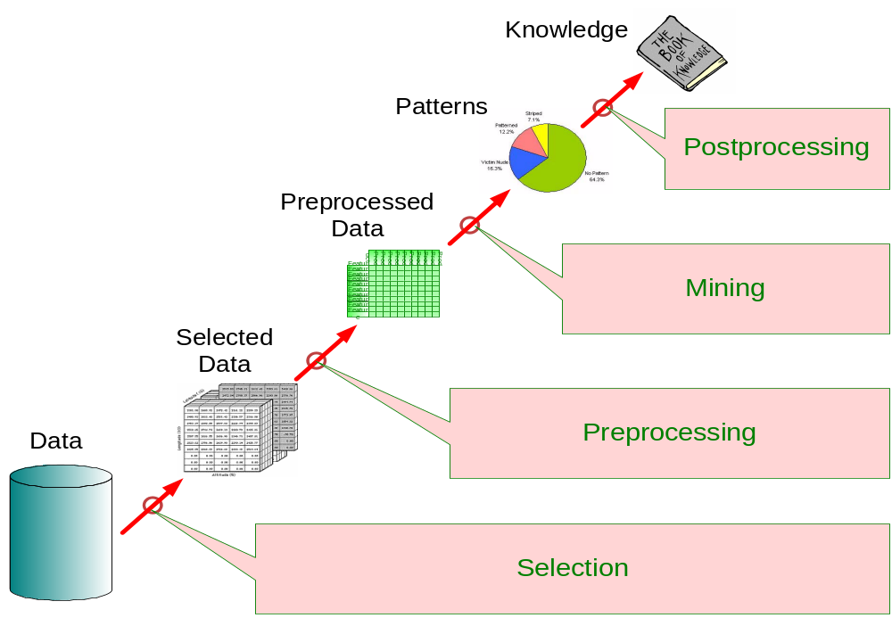
What is data mining?
Interestingness Measures

Slide 44
Challenges of Data Mining
Scalability
Dimensionality
Complex and Heterogeneous Data
Data Quality
Data Ownership and Distribution
Privacy Preservation
Streaming Data

Slide 45
Origins of Data Mining
Draws ideas from machine learning/AI, pattern recognition, statistics, and database systems
Traditional Techniques
may be unsuitable due to
  Enormity of data
  High dimensionality
  of data
  Heterogeneous,
  distributed nature
  of data
Statistics/
Artificial Intelligence
Machine Learning/
Pattern
Recognition
Data Mining
Database systems

Slide 46
Data Mining Tasks (unsupervised vs. supervised)
Classification [Predictive]
Clustering [Descriptive]
Association Rule Discovery [Descriptive]
Sequential Pattern Discovery [Descriptive]
Regression [Predictive]
Novelty Detection [Predictive]

Slide 47
Classification: Definition
Given a collection of records (training set )
  Each record contains a set of attributes, one of the attributes is the class.
Find a model for class attribute as a function of the values of other attributes.
Goal: previously unseen records should be assigned a class as accurately as possible.
  A testing set is used to determine the accuracy of the model. Usually, the given data set is divided into training and test sets, with training set used to build the model and test set used to validate it.

Slide 48


Classification Example
categorical
categorical
continuous
class
Testing
Set
Learn
Classifier
Training
Set
Model

Slide 49
Classification: Application 1
Direct Marketing
  Goal: Reduce cost of mailing by targeting a set of consumers likely to buy a new cell-phone product.
  Approach:
    Use the data for a similar product introduced before.
    We know which customers decided to buy and which decided otherwise. This {buy, don’t buy} decision forms the class attribute.
    Collect various demographic, lifestyle, and company-interaction related information about all such customers.
      Type of business, where they stay, how much they earn, etc.
    Use this information as input attributes to learn a classifier model.
From [Berry & Linoff] Data Mining Techniques, 1997

Slide 50
Classification: Application 2
Fraud Detection
  Goal: Predict fraudulent cases in credit card transactions.
  Approach:
    Use credit card transactions and the information on its account-holder as attributes.
      When does a customer buy, what does he buy, how often he pays on time, etc
    Label past transactions as fraud or fair transactions. This forms the class attribute.
    Learn a model for the class of the transactions.
    Use this model to detect fraud by observing credit card transactions on an account.

Slide 51
Classification: Application 3
Customer Attrition/Churn:
  Goal: To predict whether a customer is likely to be lost to a competitor.
  Approach:
    Use detailed record of transactions with each of the past and present customers, to find attributes.
      How often the customer calls, where he calls, what time-of-the day he calls most, his financial status, marital status, etc.
    Label the customers as loyal or disloyal.
    Find a model for loyalty.
From [Berry & Linoff] Data Mining Techniques, 1997

Slide 52
Classification: Application 4
Sky Survey Cataloging
  Goal: To predict class (star or galaxy) of sky objects, especially visually faint ones, based on the telescopic survey images (from Palomar Observatory).
      3000 images with 23,040 x 23,040 pixels per image.
  Approach:
    Segment the image.
    Measure image attributes (features) - 40 of them per object.
    Model the class based on these features.
    Success Story: Could find 16 new high red-shift quasars, some of the farthest objects that are difficult to find!
From [Fayyad, et.al.] Advances in Knowledge Discovery and Data Mining, 1996

Slide 53



Classifying Galaxies
Courtesy: http://aps.umn.edu
Early
Class:
Stages of Formation
Attributes:
Image features,
Characteristics of light waves received, etc.
Intermediate
Late
Data Size:
72 million stars, 20 million galaxies
Object Catalog: 9 GB
Image Database: 150 GB

Slide 54
Clustering Definition
Given a set of data points, each having a set of attributes, and a similarity measure among them, find clusters such that
  Data points in one cluster are more similar to one another.
  Data points in separate clusters are less similar to one another.
Similarity Measures:
  Euclidean distance if attributes are continuous.
  Other problem-specific measures.

Slide 55
Illustrating Clustering
Euclidean Distance Based Clustering in 3-D space.
Intra-cluster distances
are minimized
Inter-cluster distances
are maximized

Slide 56
Clustering: Application 1
Market Segmentation:
  Goal: subdivide a market into distinct subsets of customers where any subset may conceivably be selected as a market target to be reached with a distinct marketing mix.
  Approach:
    Collect different attributes of customers based on their geographical and demographic information.
    Find clusters of similar customers.
    Measure the clustering quality by observing buying patterns of customers in the same cluster vs. those from different clusters.

Slide 57
Clustering: Application 2
Document Clustering:
  Goal: To find groups of documents that are similar to each other based on the important terms (key words) appearing in them.
  Approach: To identify frequently occurring terms in each document. Form a similarity measure based on the frequencies of different terms. Use it to cluster.
  Gain: Information Retrieval can utilize the clusters to relate a new document or search term to clustered documents.

Slide 58
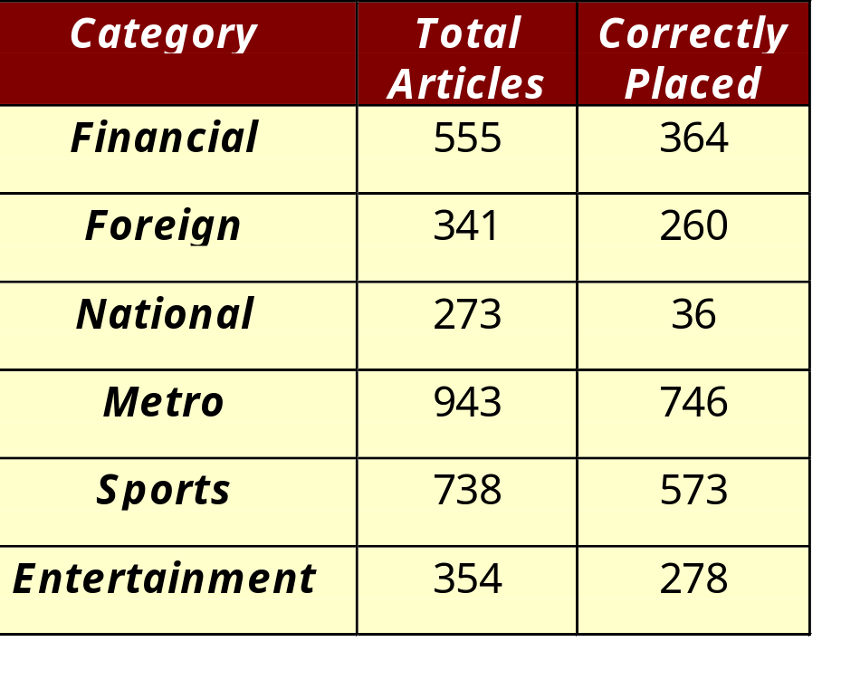
Illustrating Document Clustering
Clustering Points: 3204 Articles of Los Angeles Times.
Similarity Measure: How many words are common in these documents (after some word filtering).

Slide 59
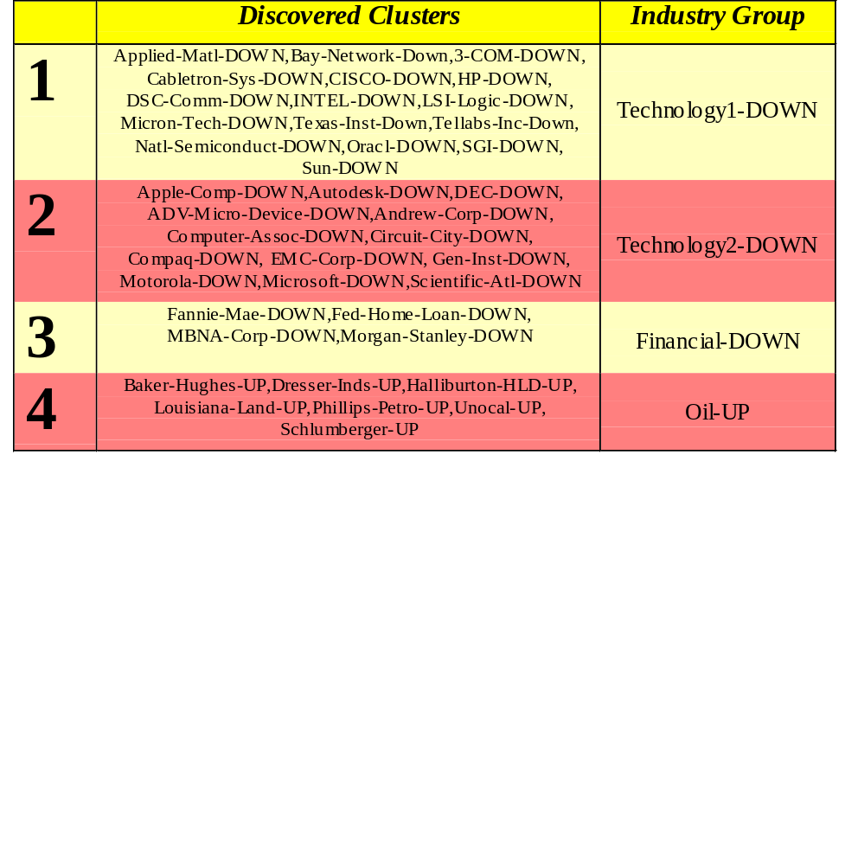
Clustering of S&P 500 Stock Data
Observe Stock Movements every day.
Clustering points: Stock-{UP/DOWN}
Similarity Measure: Two points are more similar if the events described by them frequently happen together on the same day.
We used association rules to quantify a similarity measure.

Slide 60

Association Rule Discovery: Definition
Given a set of records each of which contain some number of items from a given collection;
  Produce dependency rules which will predict occurrence of an item based on occurrences of other items.
Rules Discovered:
{Milk} --> {Coke}
{Diaper, Milk} --> {Beer}

Slide 61
Association Rule Discovery: Application 1
Marketing and Sales Promotion:
  Let the rule discovered be
  {Bagels, … } --> {Potato Chips}
  Potato Chips as consequent => Can be used to determine what should be done to boost its sales.
  Bagels in the antecedent => Can be used to see which products would be affected if the store discontinues selling bagels.
  Bagels in antecedent and Potato chips in consequent => Can be used to see what products should be sold with Bagels to promote sale of Potato chips!

Slide 62
Association Rule Discovery: Application 2
Supermarket shelf management.
  Goal: To identify items that are bought together by sufficiently many customers.
  Approach: Process the point-of-sale data collected with barcode scanners to find dependencies among items.
  A classic rule --
    If a customer buys diaper and milk, then he is very likely to buy beer.
    So, don’t be surprised if you find six-packs stacked next to diapers!

Slide 63
Association Rule Discovery: Application 3
Inventory Management:
  Goal: A consumer appliance repair company wants to anticipate the nature of repairs on its consumer products and keep the service vehicles equipped with right parts to reduce on number of visits to consumer households.
  Approach: Process the data on tools and parts required in previous repairs at different consumer locations and discover the co-occurrence patterns.

Slide 64
Sequential Pattern Discovery: Examples
In telecommunications alarm logs,
  (Inverter_Problem Excessive_Line_Current)
  (Rectifier_Alarm) --> (Fire_Alarm)
In point-of-sale transaction sequences,
  Computer Bookstore:
  (Intro_To_Visual_C) (C++_Primer) --> (Perl_for_dummies,Tcl_Tk)
  Athletic Apparel Store:
  (Shoes) (Racket, Racketball) --> (Sports_Jacket)

Slide 65
Regression
Predict a value of a given continuous valued variable based on the values of other variables, assuming a linear or nonlinear model of dependency.
Greatly studied in statistics, neural network fields.
Examples:
  Predicting sales amounts of new product based on advertising expenditure.
  Predicting wind velocities as a function of temperature, humidity, air pressure, etc.
  Time series prediction of stock market indices.

Slide 66





Deviation/Anomaly Detection
Detect significant deviations from normal behavior
Applications:
  Credit Card Fraud Detection
  Network Intrusion
  Detection
Typical network traffic at University level may reach over 100 million connections per day

