Slide 1
Unsupervised Clustering Algorithms
Data Mining & Business Intelligence
Lecture 2
by
Prof. Chih-Hsuan Wang (王志軒)

Slide 2
What is Cluster Analysis?
Finding groups of objects such that the objects in a group will be similar (or related) to one another and different from (or unrelated to) the objects in other groups
Inter-cluster distances are maximized
Intra-cluster distances are minimized

Slide 3
Notion of a Cluster can be Ambiguous
How many clusters?
Six Clusters
Two Clusters
Four Clusters

Slide 4
Types of Clusterings
A clustering is a set of clusters
Important distinction between hierarchical and partitional sets of clusters
Partitional Clustering
  A division data objects into non-overlapping subsets (clusters) such that each data object is in exactly one subset
Hierarchical clustering
  A set of nested clusters organized as a hierarchical tree

Slide 5

Partitional Clustering
Original Points
A Partitional Clustering

Slide 6
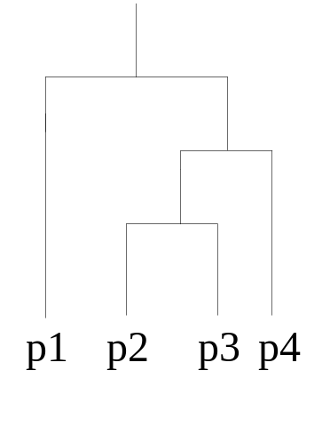
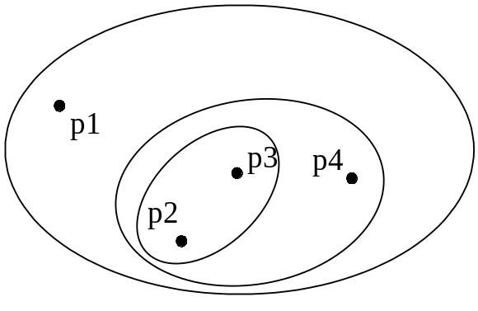
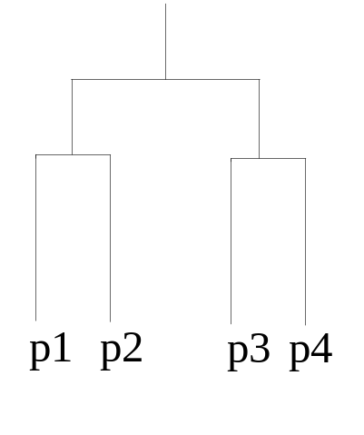
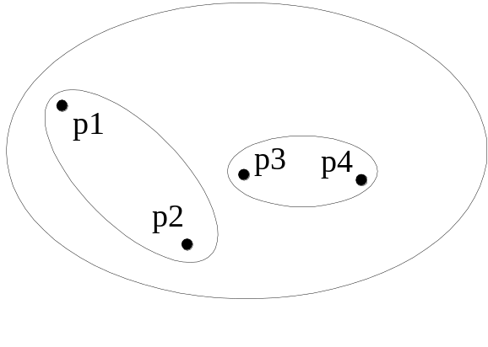
Hierarchical Clustering
Traditional Hierarchical Clustering
Traditional Dendrogram
Non-traditional Hierarchical Clustering
Non-traditional Dendrogram

Slide 7
Other Distinctions Between Sets of Clusters
Exclusive versus non-exclusive
  In non-exclusive clustering, points may belong to multiple clusters.
  Can represent multiple classes or ‘border’ points
Fuzzy versus non-fuzzy
  In fuzzy clustering, a point belongs to every cluster with some weight between 0 and 1 (FCM)
  Weights must sum to 1
  Probabilistic clustering has similar characteristics (GMC or EM)
Partial versus complete
  In some cases, we only want to cluster some of the data
Heterogeneous versus homogeneous
  Cluster of widely different sizes, shapes, and densities

Slide 8
Types of Clusters: Well-Separated
Well-Separated Clusters:
  A cluster is a set of points such that any point in a cluster is closer (or more similar) to every other point in the cluster than to any point not in the cluster.
3 well-separated clusters

Slide 9
Types of Clusters: Center-Based
Center-based
  A cluster is a set of objects such that an object in a cluster is closer (more similar) to the “center” of a cluster, than to the center of any other cluster
  The center of a cluster is often a centroid, the average of all the points in the cluster, or a medoid, the most “representative” point of a cluster
4 center-based clusters

Slide 10
Types of Clusters: Contiguity-Based
Contiguous Cluster (Nearest neighbor or Transitive)
  A cluster is a set of points such that a point in a cluster is closer (or more similar) to one or more other points in the cluster than to any point not in the cluster.
8 contiguous clusters

Slide 11
Types of Clusters: Density-Based
Density-based
  A cluster is a dense region of points, which is separated by low-density regions, from other regions of high density.
  Used when the clusters are irregular or intertwined, and when noise and outliers are present.
6 density-based clusters

Slide 12
Types of Clusters: Conceptual Clusters
Shared Property or Conceptual Clusters
  Finds clusters that share some common property or represent a particular concept.
  .
2 Overlapping Circles

Slide 13
Types of Clusters: Objective Function
Clusters Defined by an Objective Function
  Finds clusters that minimize or maximize an objective function.
  Enumerate all possible ways of dividing the points into clusters and evaluate the `goodness' of each potential set of clusters by using the given objective function. (NP Hard)
  Can have global or local objectives.
    Hierarchical clustering algorithms typically have local objectives
    Partitional algorithms typically have global objectives
  A variation of the global objective function approach is to fit the data to a parameterized model.
    Parameters for the model are determined from the data.
    Mixture models assume that the data is a ‘mixture' of a number of statistical distributions.

Slide 14

K-means Clustering
Partitional clustering approach
Each cluster is associated with a centroid (center point)
Each point is assigned to the cluster with the closest centroid
Number of clusters, K, must be specified
The basic algorithm is very simple

Slide 15
K-means Clustering – Details
Initial centroids are often chosen randomly.
  Clusters produced vary from one run to another.
The centroid is (typically) the mean of the points in the cluster.
‘Closeness’ is measured by Euclidean distance, cosine similarity, correlation, etc.
K-means will converge for common similarity measures mentioned above.
Most of the convergence happens in the first few iterations.
  Often the stopping condition is changed to ‘Until relatively few points change clusters’
Complexity is O( n * K * I * d )
  n = number of points, K = number of clusters,
  I = number of iterations, d = number of attributes

Slide 16



Two different K-means Clusterings
Original Points
Optimal Clustering
Sub-optimal Clustering

Slide 17






Importance of Choosing Initial Centroids

Slide 18
Importance of Choosing Initial Centroids

Slide 19
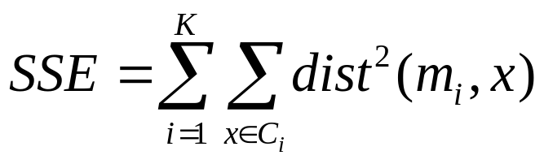
Evaluating K-means Clusters
Most common measure is Sum of Squared Error (SSE)
  For each point, the error is the distance to the nearest cluster
  To get SSE, we square these errors and sum them.
  x is a data point in cluster C_{i} and m_{i} is the representative point for cluster C_{i}
    can show that m_{i} corresponds to the center (mean) of the cluster
  Given two clusters, we can choose the one with the smallest error
  One easy way to reduce SSE is to increase K, the number of clusters
    A good clustering with smaller K can have a lower SSE than a poor clustering with higher K

Slide 20
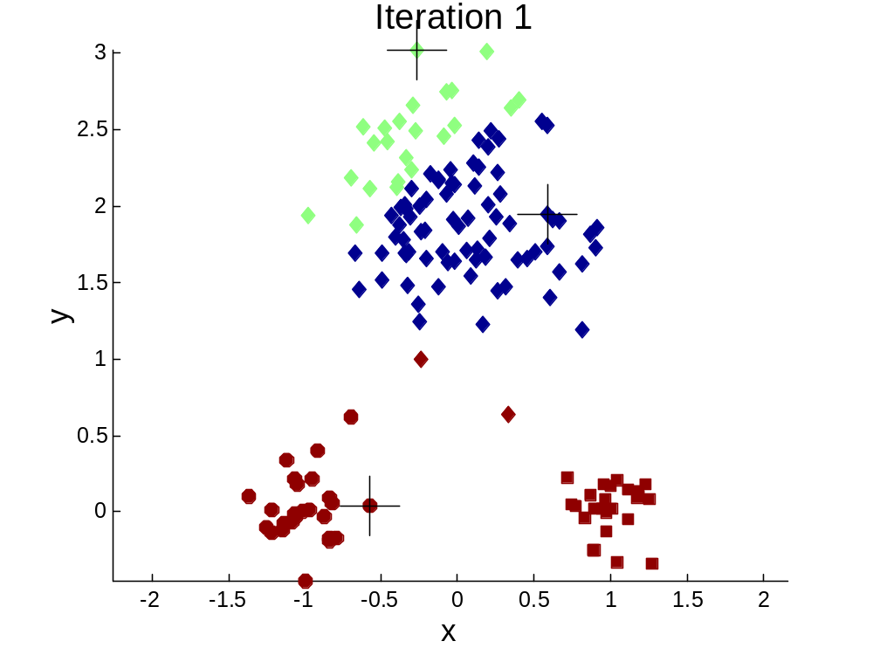


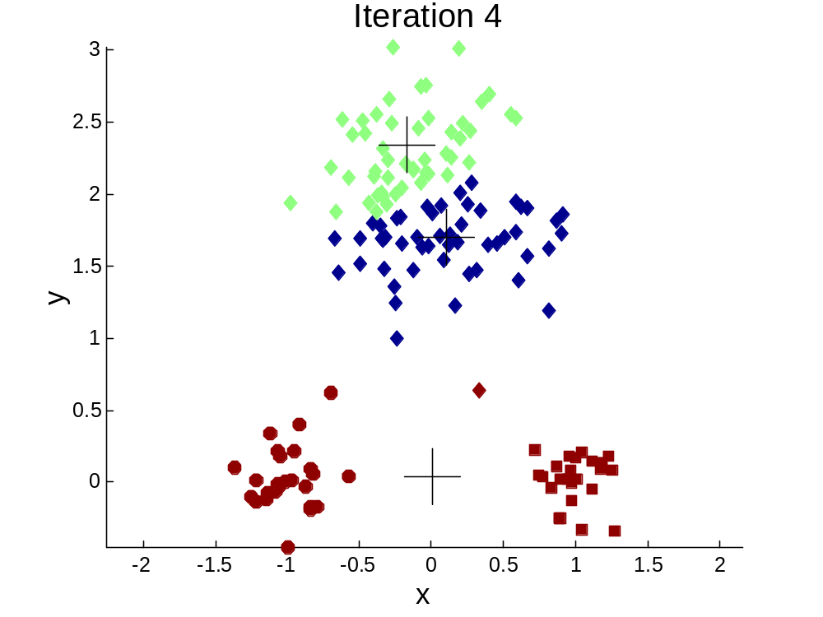
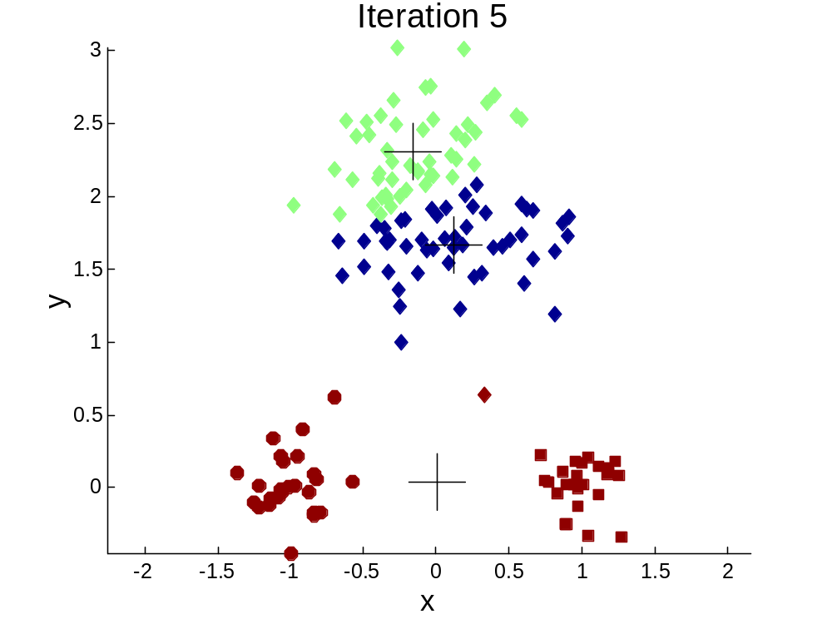
Importance of Choosing Initial Centroids …

Slide 21
Importance of Choosing Initial Centroids …

Slide 22
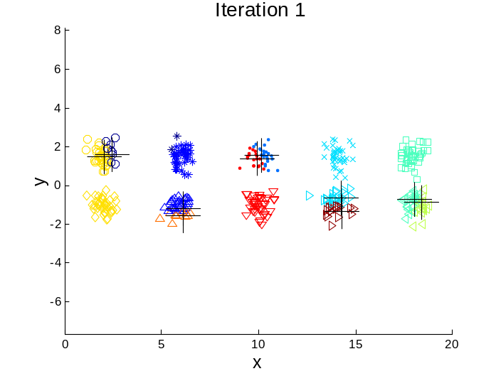
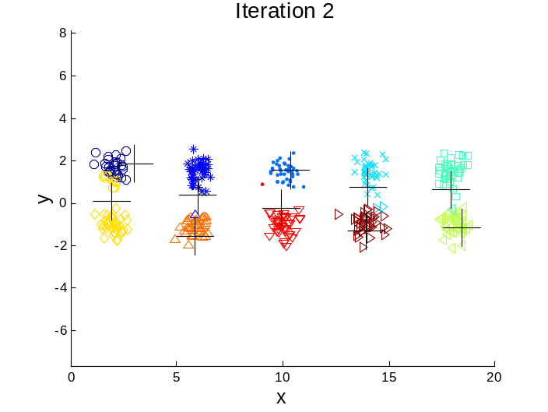
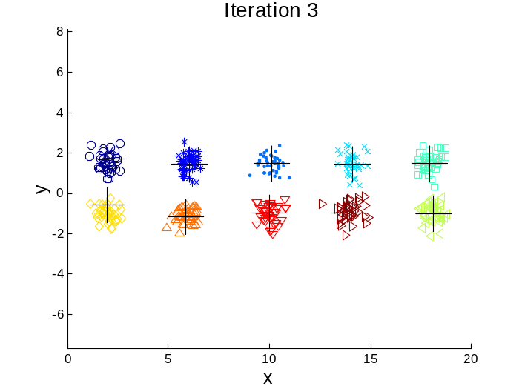

10 Clusters Example
Starting with two initial centroids in one cluster of each pair of clusters

Slide 23
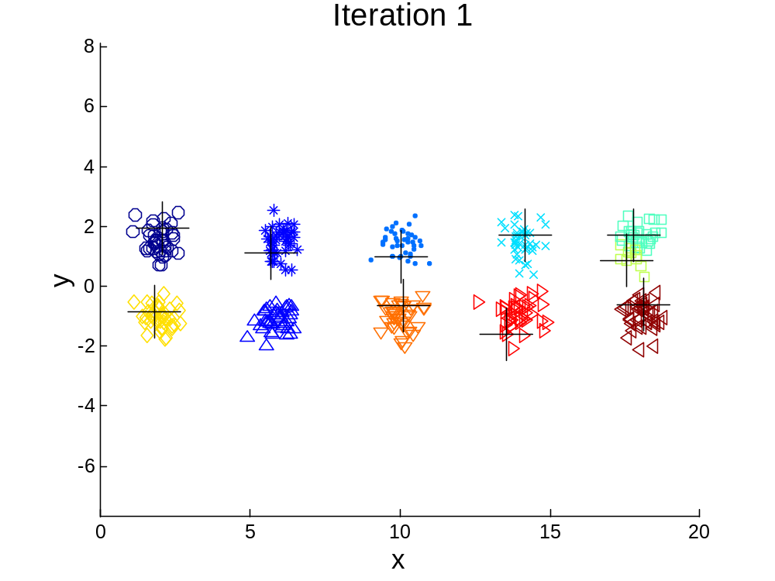



10 Clusters Example
Starting with some pairs of clusters having three initial centroids, while other have only one.

Slide 24
10 Clusters Example
Starting with some pairs of clusters having three initial centroids, while other have only one.

Slide 25
Pre-processing and Post-processing
Pre-processing
  Normalize the data
  Eliminate outliers
Post-processing
  Eliminate small clusters that may represent outliers
  Split ‘loose’ clusters, i.e., clusters with relatively high SSE
  Merge clusters that are ‘close’ and that have relatively low SSE

Slide 26

Bisecting K-means
Bisecting K-means algorithm
  Variant of K-means that can produce a partitional or a hierarchical clustering

Slide 27
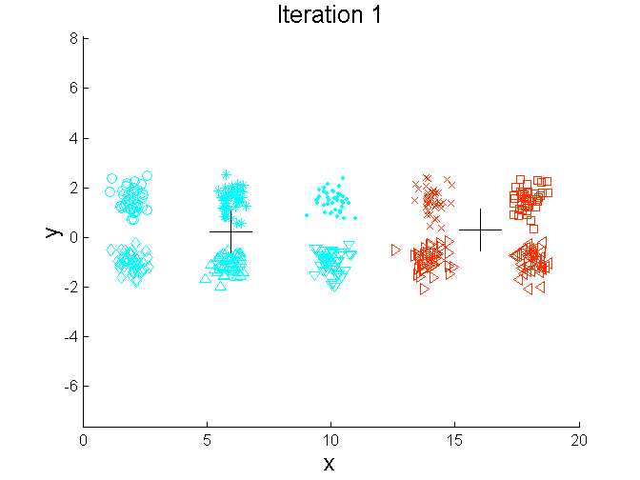
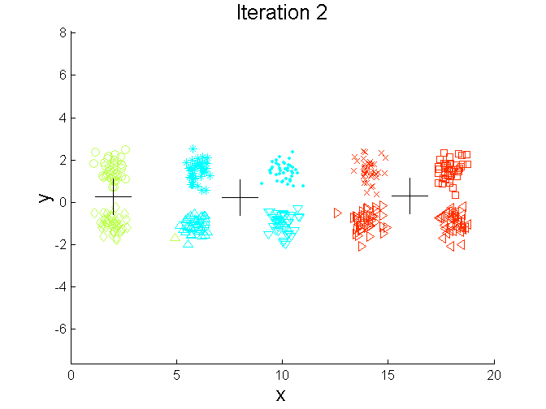
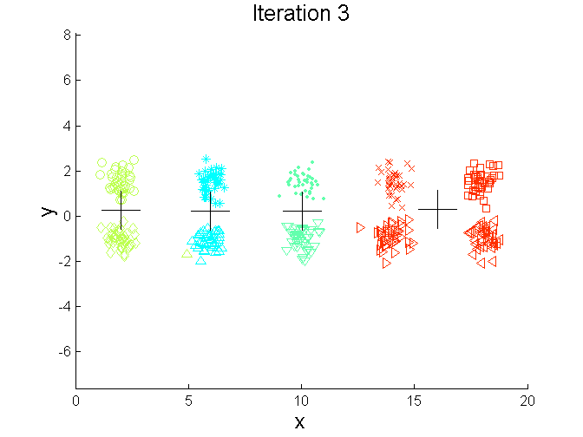
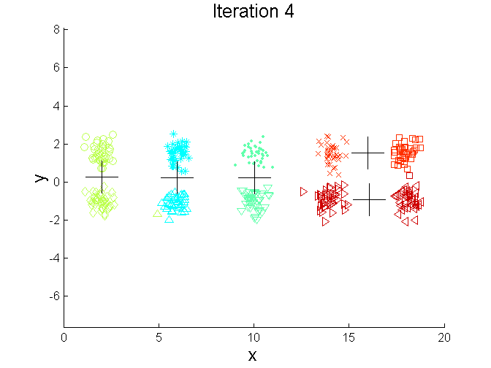
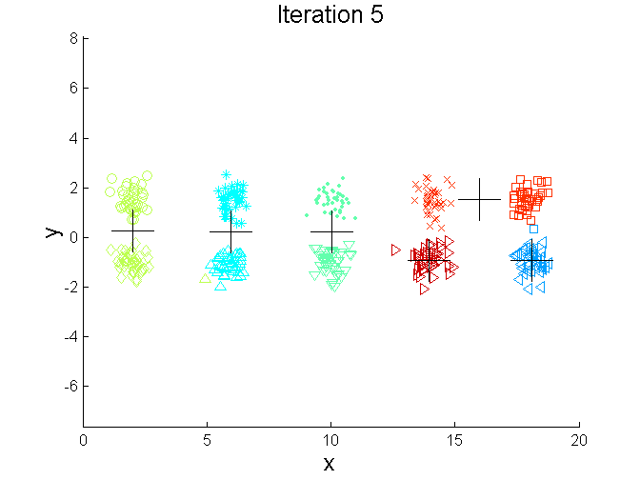
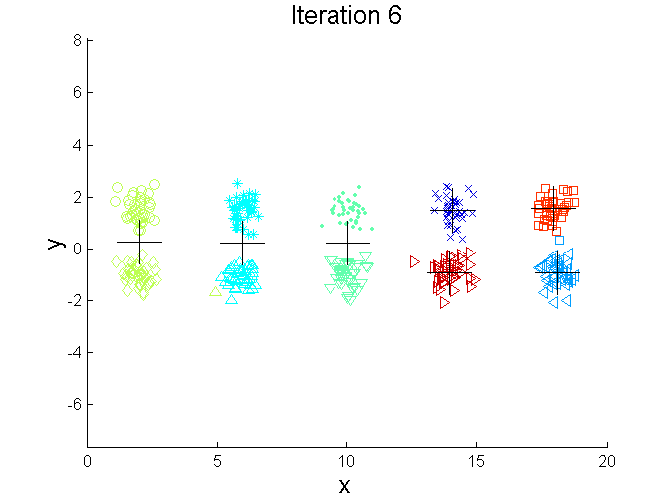
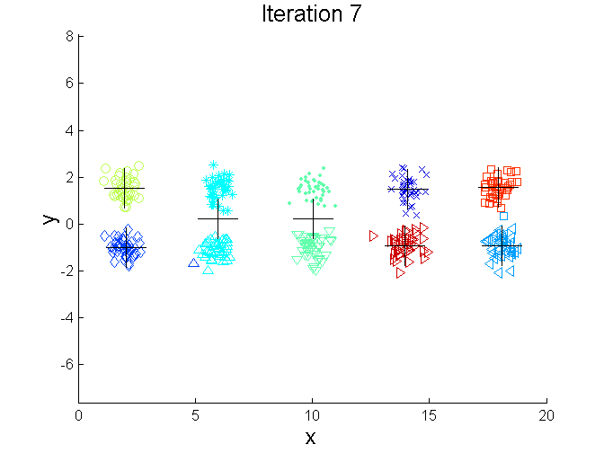
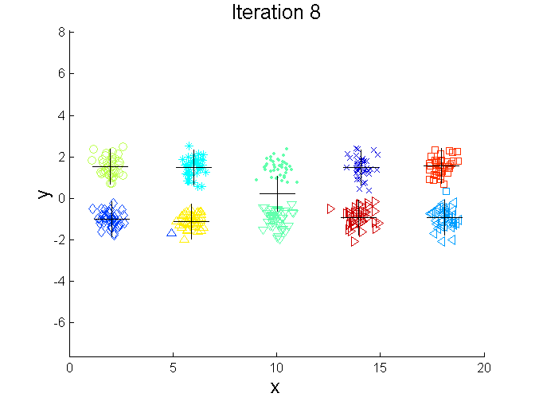
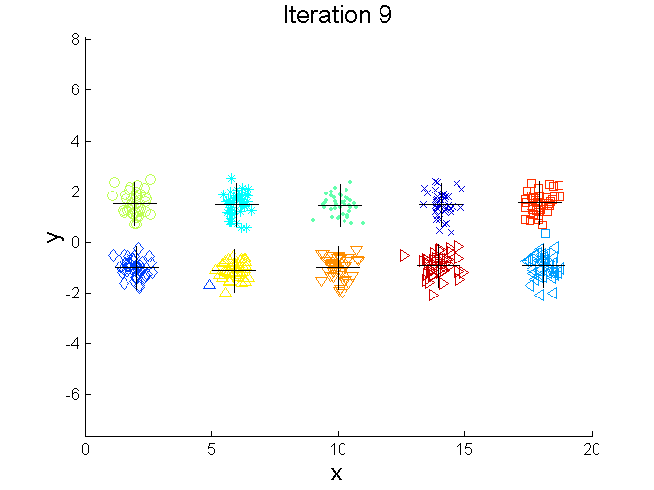
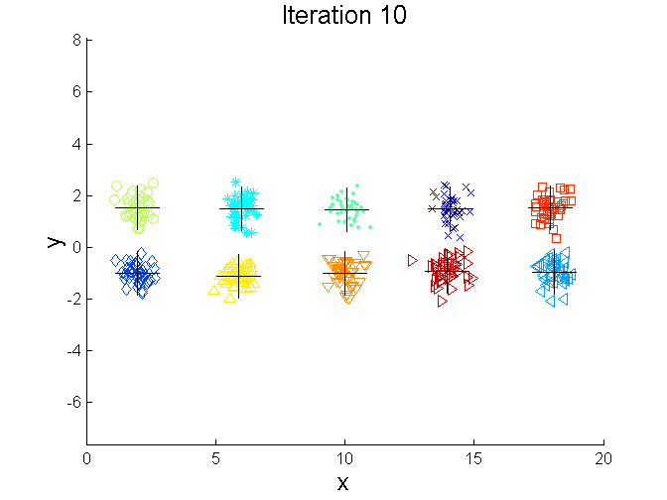
Bisecting K-means Example

Slide 28
Limitations of K-means
K-means has problems when clusters are of differing
  Sizes
  Densities
  Non-globular shapes
K-means has problems when the data contains outliers.

Slide 29


Limitations of K-means: Differing Sizes
Original Points
K-means (3 Clusters)

Slide 30


Limitations of K-means: Differing Density
Original Points
K-means (3 Clusters)

Slide 31


Limitations of K-means: Non-globular Shapes
Original Points
K-means (2 Clusters)

Slide 32

Overcoming K-means Limitations
Original Points K-means Clusters
One solution is to use many clusters.
  Find parts of clusters, but need to put together.

Slide 33
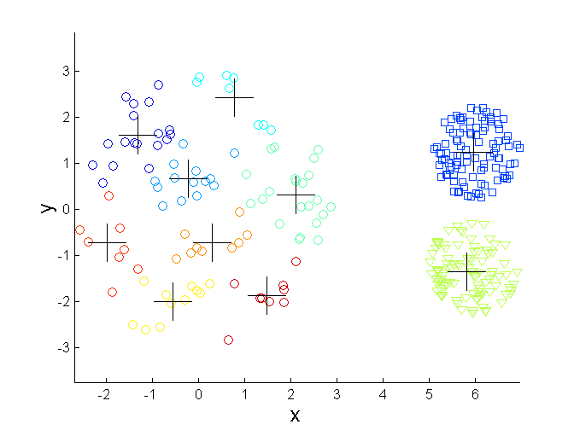
Overcoming K-means Limitations
Original Points K-means Clusters

Slide 34
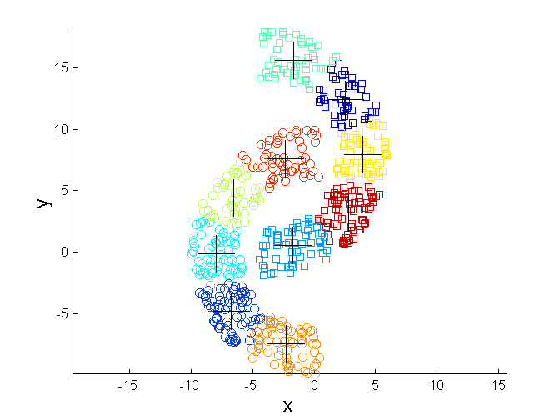
Overcoming K-means Limitations
Original Points K-means Clusters

Slide 35
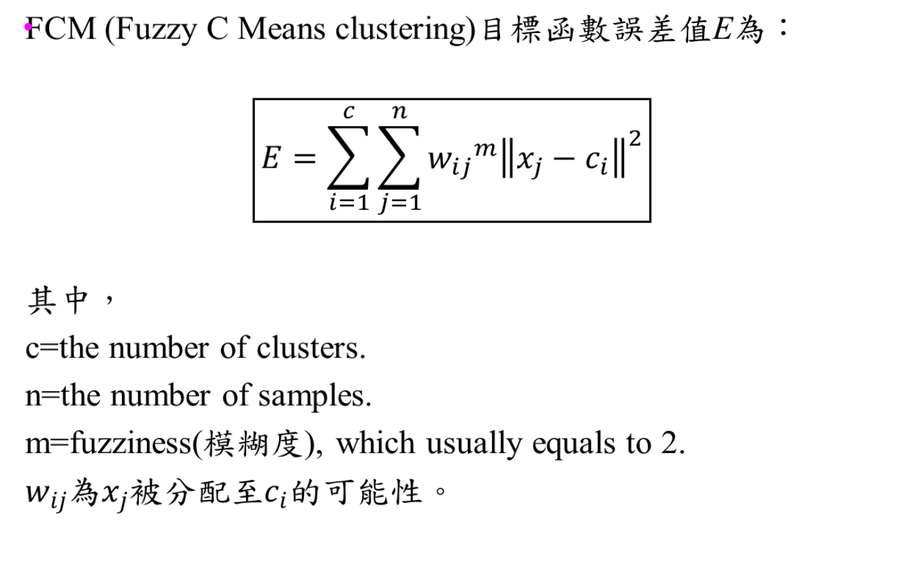
Fuzzy c means (C-means)

Slide 36
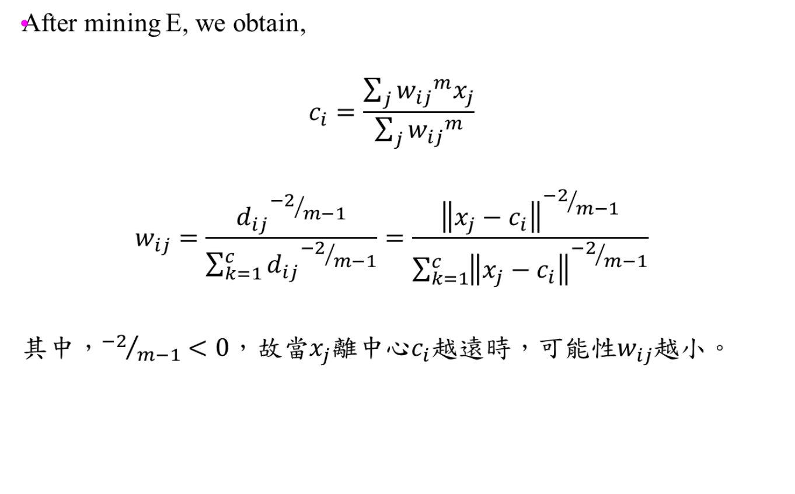
Fuzzy c means (補充)

Slide 37
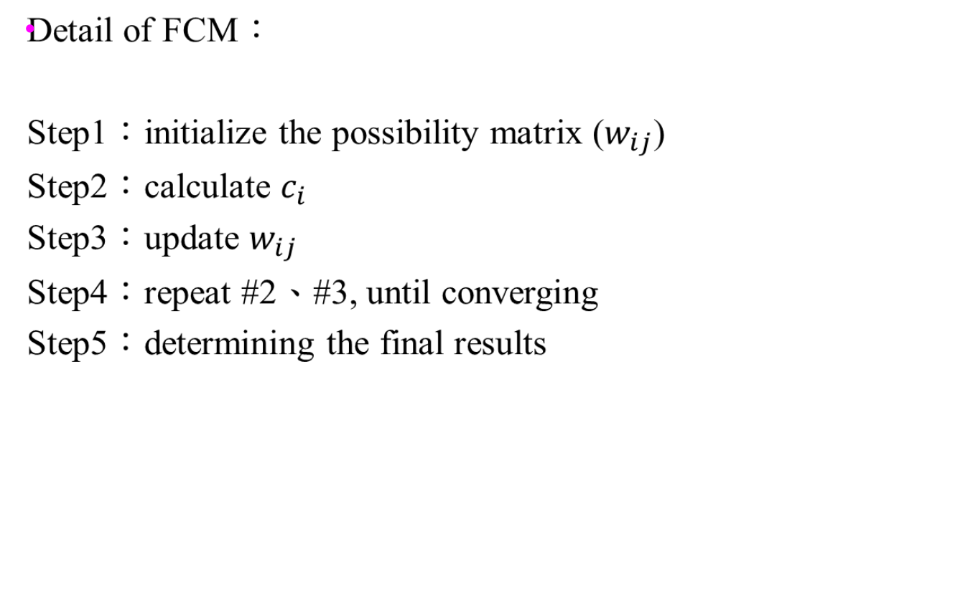
Fuzzy c means

Slide 38
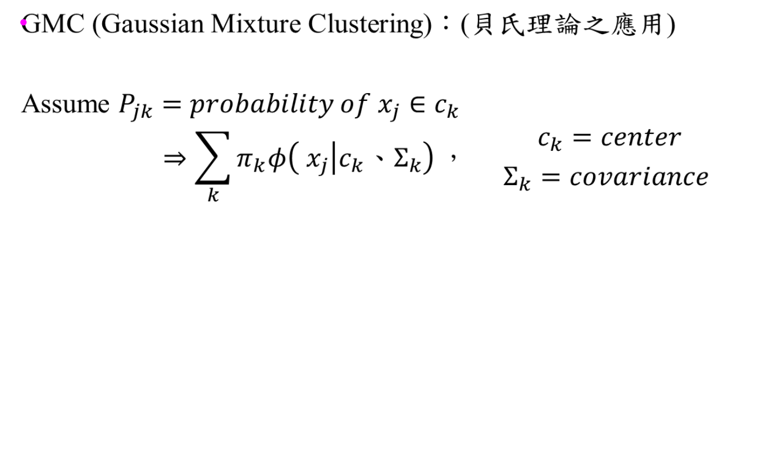
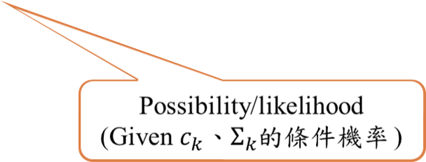
GMC (又稱EM clustering)
posterior
prior
EM: expectation-maximization

Slide 39
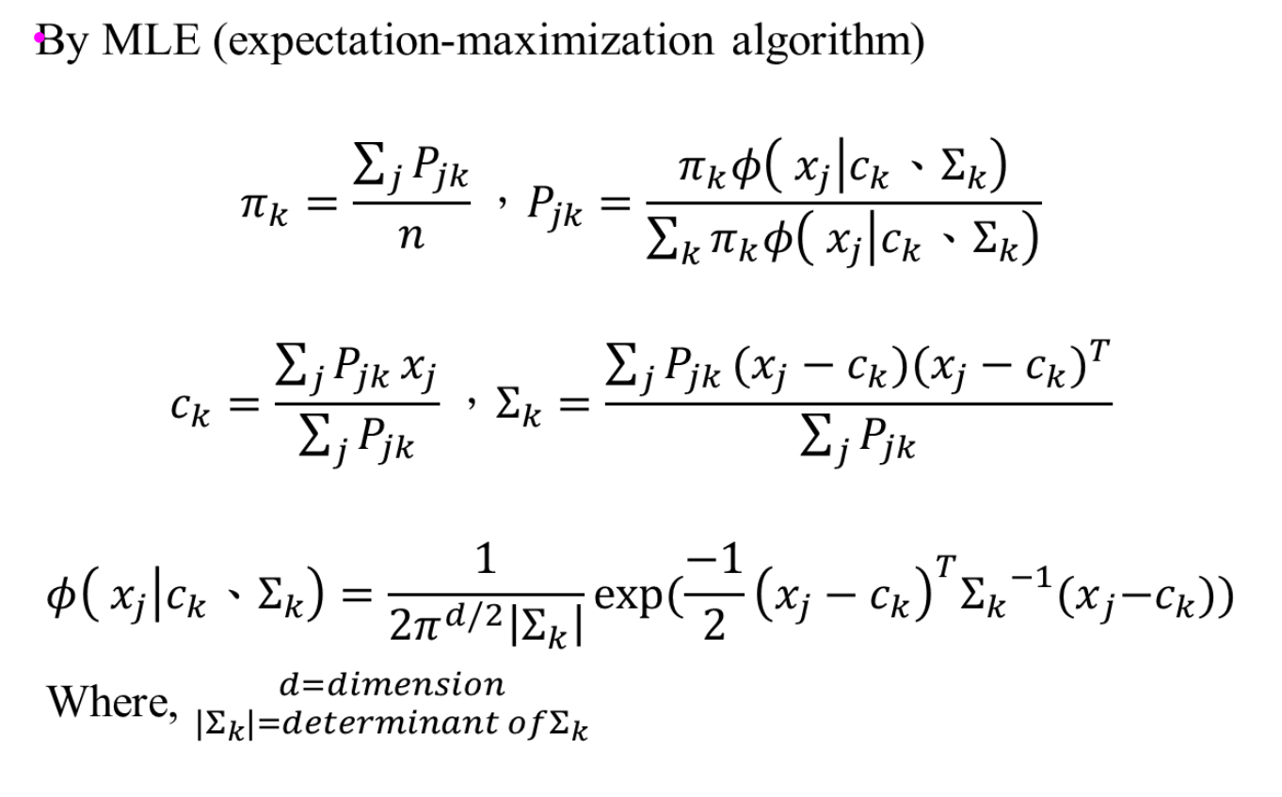
GMC (Gaussian mixture clustering)
Mahalanbis distance

Slide 40
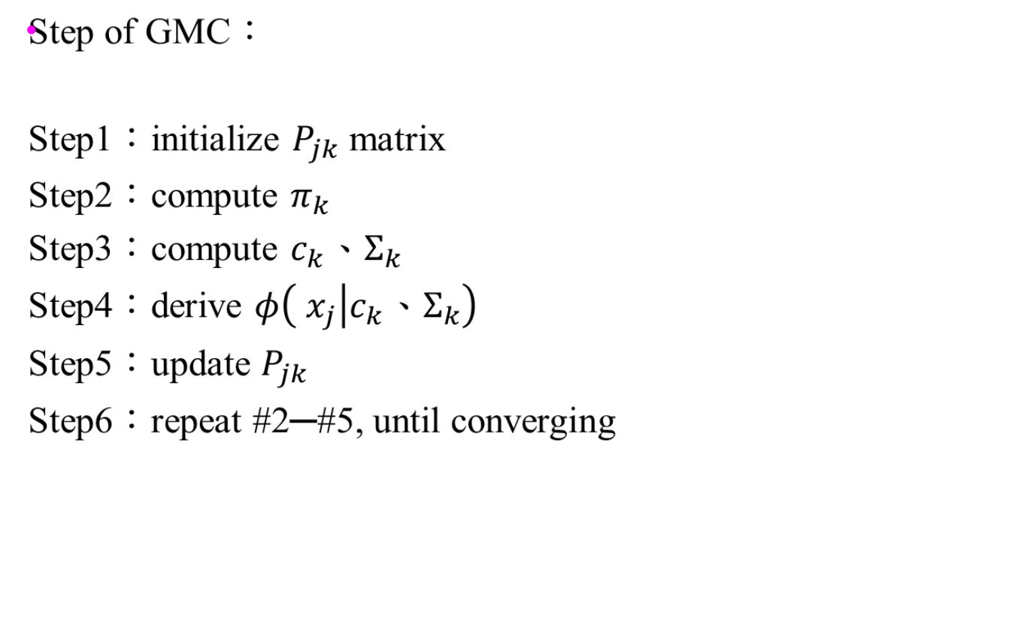
GMC (又稱EM clustering)

Slide 41
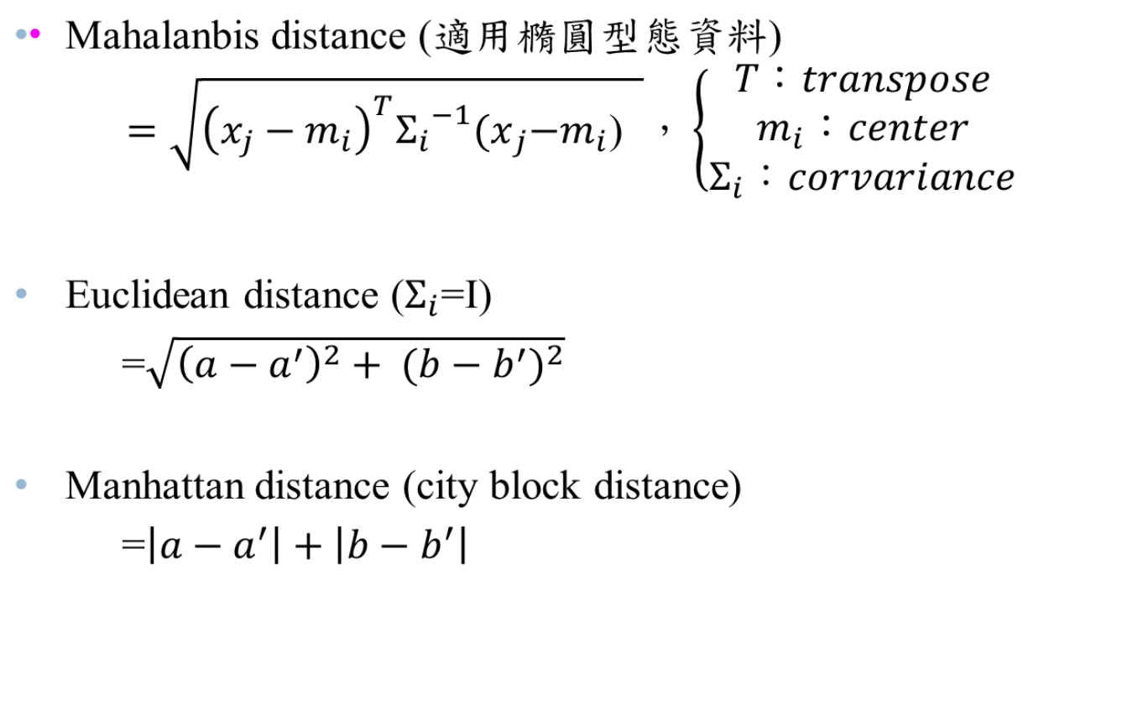
Review distance metrics

Slide 42
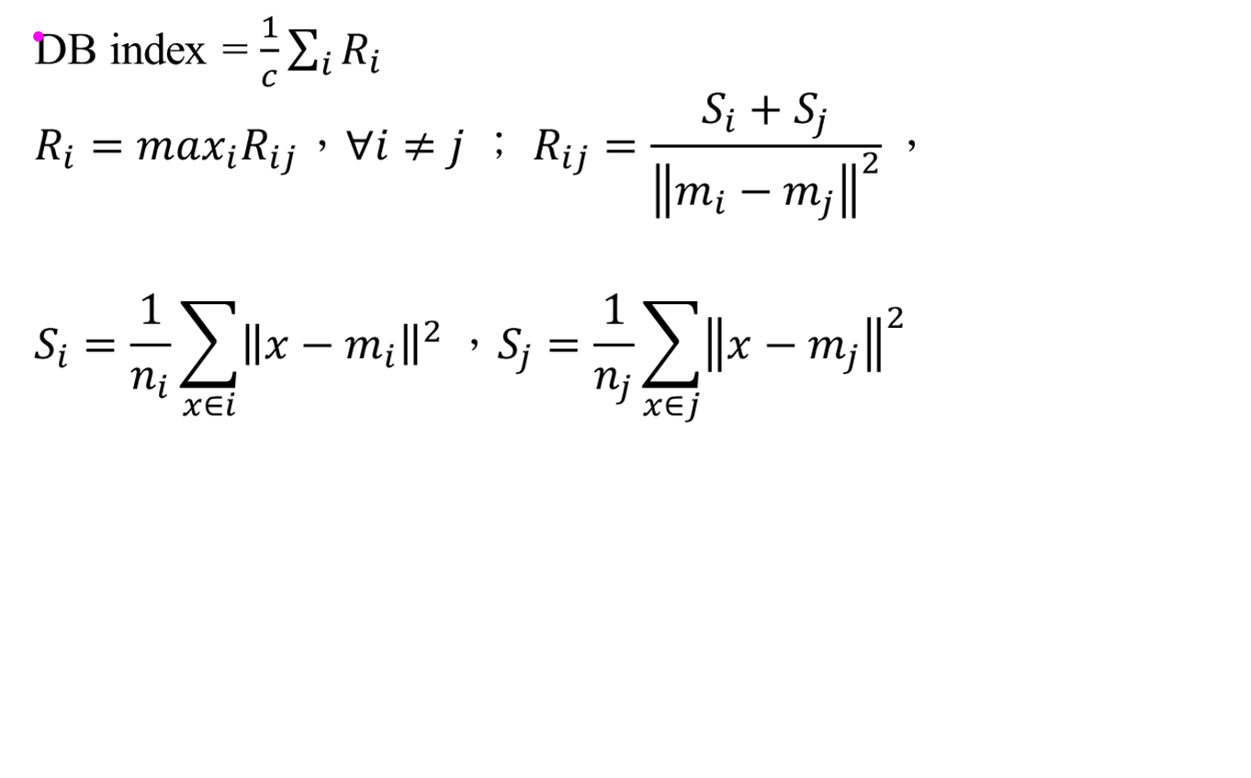
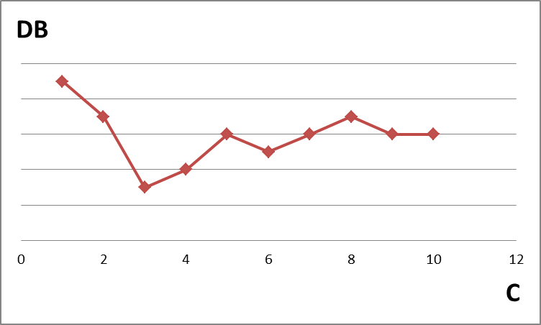
How to know the optimal number of clusters?
i, j 之間的separation
i 群之平均compactness
C=3

Slide 43
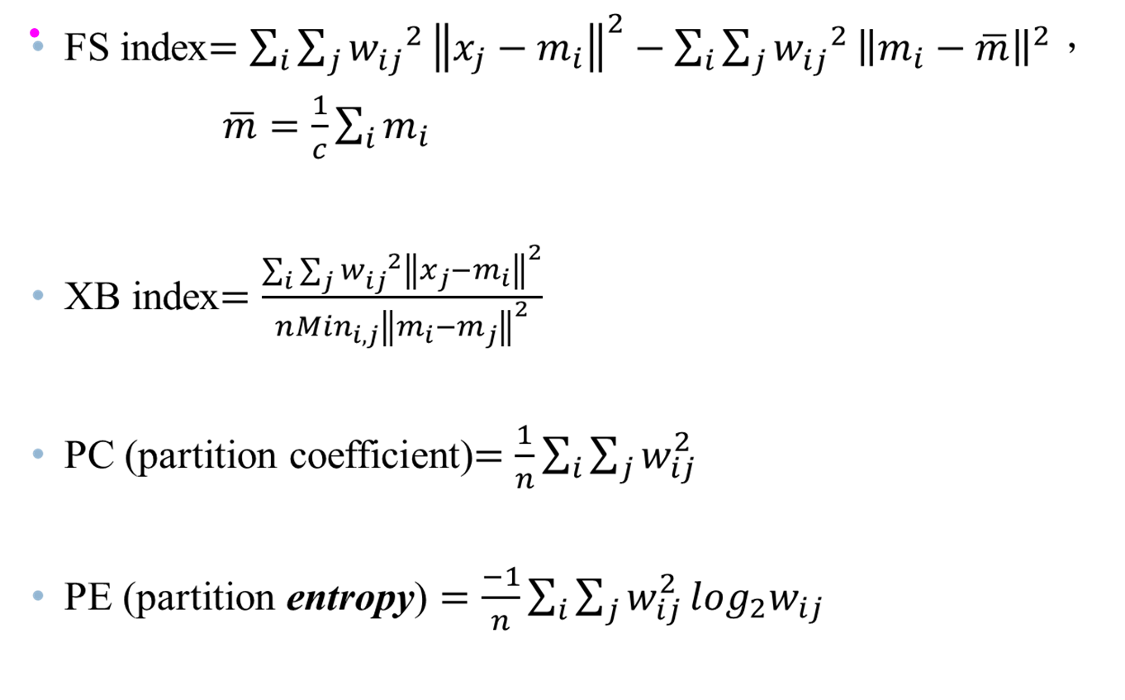
Cluster validity for fuzzy clustering

Slide 44


Hierarchical Clustering
Produces a set of nested clusters organized as a hierarchical tree
Can be visualized as a dendrogram
  A tree like diagram that records the sequences of merges or splits

Slide 45
Strengths of Hierarchical Clustering
Do not have to assume any particular number of clusters
  Any desired number of clusters can be obtained by ‘cutting’ the dendogram at the proper level
They may correspond to meaningful taxonomies
  Example in biological sciences (e.g., animal kingdom, phylogeny reconstruction, …)
Traditional hierarchical algorithms use a similarity or distance matrix
  Merge (agglomerative) or split (divisive) one cluster at a time

Slide 46
Agglomerative Clustering Algorithm
More popular hierarchical clustering technique
Basic algorithm is straightforward
  Compute the proximity matrix
  Let each data point be a cluster
  Repeat
  Merge the two closest clusters
  Update the proximity matrix
  Until only a single cluster remains
Key operation is the computation of the proximity of two clusters
  Different approaches to defining the distance between clusters distinguish the different algorithms

Slide 47
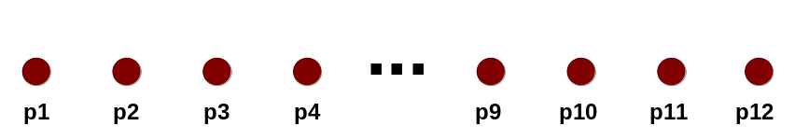
Starting Situation
Start with clusters of individual points and a proximity matrix
p1
p2
p3
p4
p5
. . .
p1
p2
p3
p4
p5
.
.
.
Proximity Matrix

Slide 48
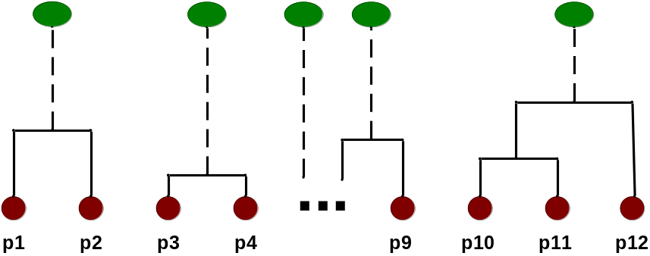
Intermediate Situation
After some merging steps, we have some clusters
C1
C2
C3
C4
C5
C1
C2
C3
C3
C4
C4
C5
Proximity Matrix
C1
C2
C5

Slide 49

Intermediate Situation
We want to merge the two closest clusters (C2 and C5) and update the proximity matrix.
C1
C2
C3
C4
C5
C1
C2
C3
C3
C4
C4
C5
Proximity Matrix
C1
C2
C5

Slide 50

After Merging
The question is “How do we update the proximity matrix?”
C2 U C5
C1
C3
C4
C1
?
C2 U C5
? ? ? ?
C3
C3
?
C4
C4
?
Proximity Matrix
C1
C2 U C5

Slide 51
How to Define Inter-Cluster Similarity
p1
p2
p3
p4
p5
. . .
p1
Similarity?
p2
p3
p4
p5
MIN (nearest neighbor)
MAX (farthest neighbor)
Group Average
Distance Between Centroids
Ward’s Method uses squared error
.
.
.
Proximity Matrix

Slide 52
How to Define Inter-Cluster Similarity
p1
p2
p3
p4
p5
. . .
p1
p2
p3
p4
p5
MIN
MAX
Group Average
Distance Between Centroids
Other methods driven by an objective function
  Ward’s Method uses squared error
.
.
.
Proximity Matrix

Slide 53
How to Define Inter-Cluster Similarity
p1
p2
p3
p4
p5
. . .
p1
p2
p3
p4
p5
MIN
MAX
Group Average
Distance Between Centroids
Other methods driven by an objective function
  Ward’s Method uses squared error
.
.
.
Proximity Matrix

Slide 54
How to Define Inter-Cluster Similarity
p1
p2
p3
p4
p5
. . .
p1
p2
p3
p4
p5
MIN
MAX
Group Average
Distance Between Centroids
Other methods driven by an objective function
  Ward’s Method uses squared error
.
.
.
Proximity Matrix

Slide 55
How to Define Inter-Cluster Similarity
p1
p2
p3
p4
p5
. . .
p1
×
×
p2
p3
p4
p5
MIN
MAX
Group Average
Distance Between Centroids
Other methods driven by an objective function
  Ward’s Method uses squared error
.
.
.
Proximity Matrix

Slide 56
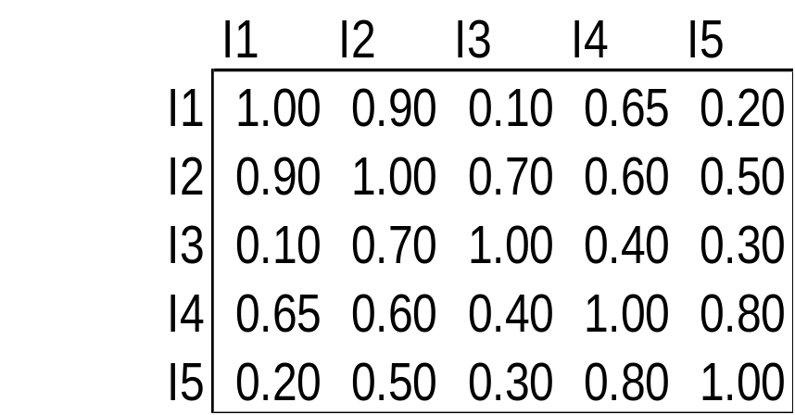
Cluster Similarity: MIN or Single Link
Similarity of two clusters is based on the two most similar (closest) points in the different clusters
  Determined by one pair of points, i.e., by one link in the proximity graph.
1
2
3
4
5

Slide 57

Hierarchical Clustering: MIN
5
1
3
5
2
1
2
3
6
4
4
Nested Clusters
Dendrogram

Slide 58
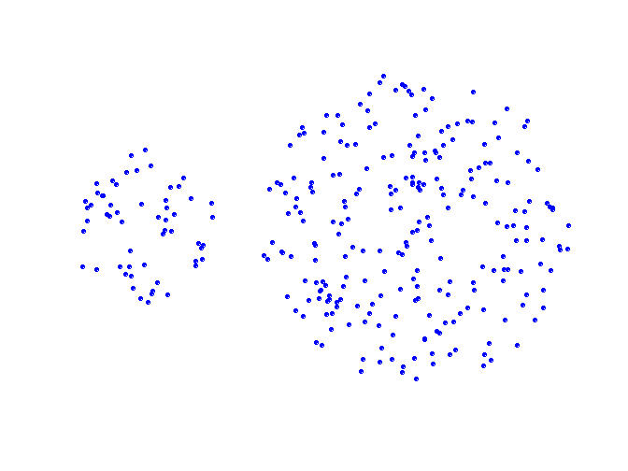
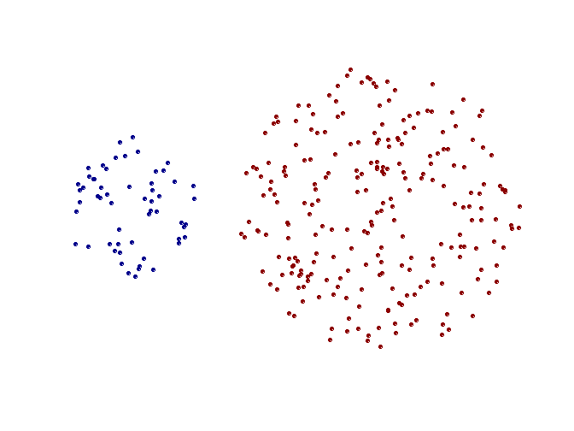
Strength of MIN
Original Points
Two Clusters
Can handle non-elliptical shapes

Slide 59
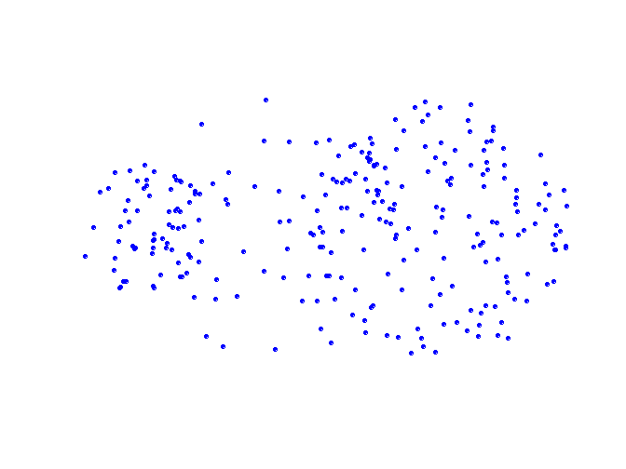
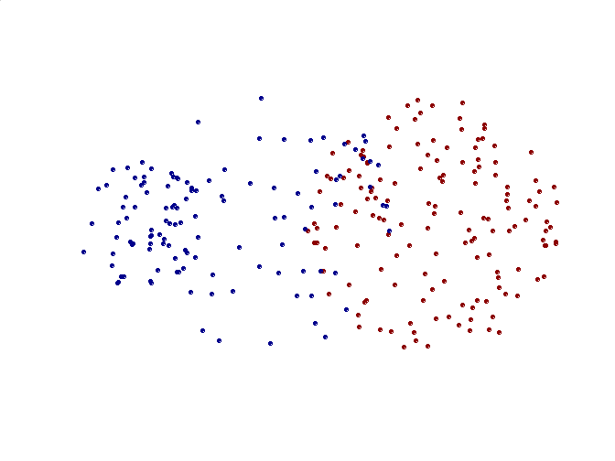
Limitations of MIN
Original Points
Two Clusters
Sensitive to noise and outliers

Slide 60

Cluster Similarity: MAX or Complete Linkage
Similarity of two clusters is based on the two least similar (most distant) points in the different clusters
  Determined by all pairs of points in the two clusters
1
2
3
4
5

Slide 61
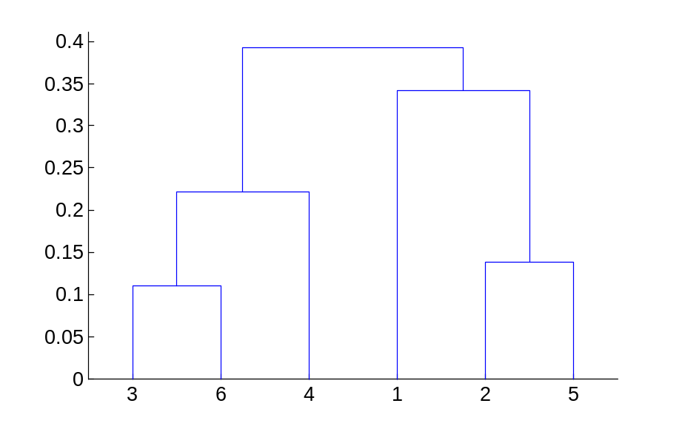
Hierarchical Clustering: MAX
4
1
2
5
5
2
3
6
3
1
4
Nested Clusters
Dendrogram

Slide 62
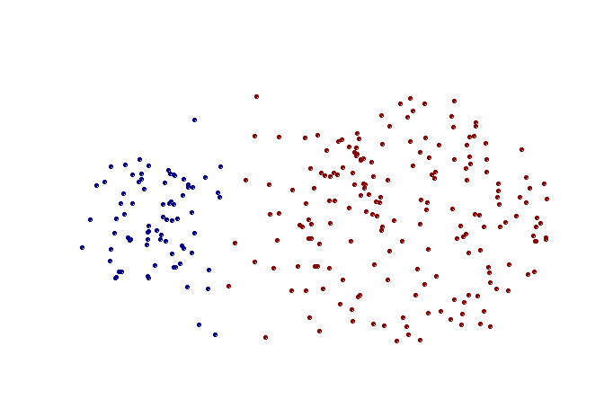
Strength of MAX
Original Points
Two Clusters
Less susceptible to noise and outliers

Slide 63
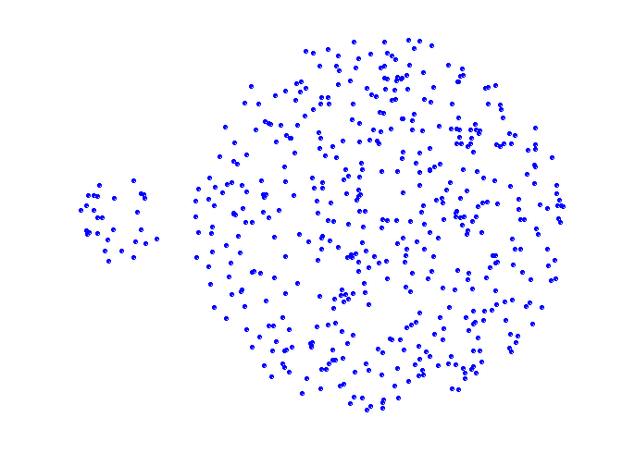
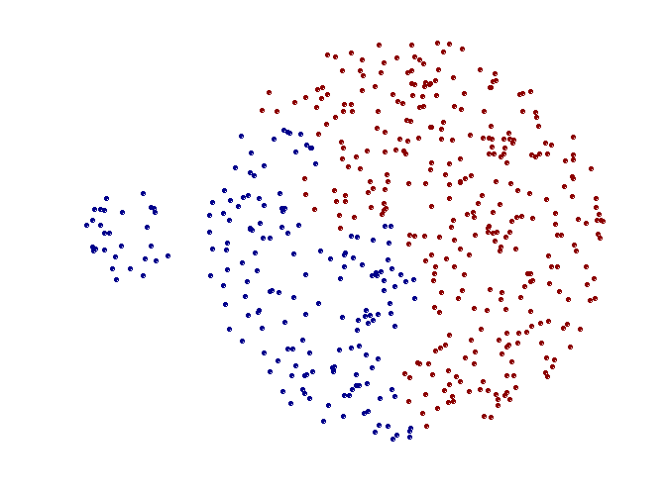
Limitations of MAX
Original Points
Two Clusters
Tends to break large clusters
Biased towards globular clusters

Slide 64
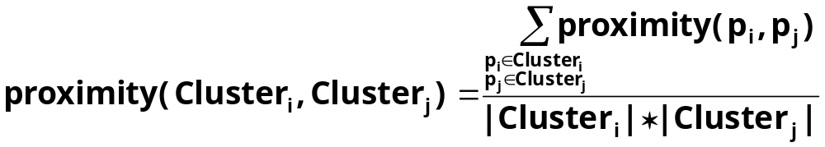

Cluster Similarity: Group Average
Proximity of two clusters is the average of pairwise proximity between points in the two clusters.
Need to use average connectivity for scalability since total proximity favors large clusters
1
2
3
4
5

Slide 65

Hierarchical Clustering: Group Average
5
4
1
2
5
2
3
6
1
4
3
Nested Clusters
Dendrogram

Slide 66
Hierarchical Clustering: Group Average
Compromise between Single and Complete Link
Strengths
  Less susceptible to noise and outliers
Limitations
  Biased towards globular clusters

Slide 67
Cluster Similarity: Ward’s Method
Similarity of two clusters is based on the increase in squared error when two clusters are merged
  Similar to group average if distance between points is distance squared
Less susceptible to noise and outliers
Biased towards globular clusters
Hierarchical analogue of K-means
  Can be used to initialize K-means

Slide 68
Hierarchical Clustering: Comparison
5
1
4
1
3
2
5
5
5
2
1
MIN
2
MAX
2
3
6
3
3
6
1
4
4
4
5
5
1
4
1
2
2
5
2
Ward’s Method
5
2
3
6
Group Average
3
3
6
4
1
1
4
4
3

