Slide 1
Supervised Classification Techniques
Data Mining & Business Intelligence
Lecture 3
By
Prof. Chih-Hsuan Wang (王志軒)
Data Mining, the IEM Department of NCTU

Slide 2
Logistic的概念
Logistic迴歸類似線性迴歸模式。迴歸分析是描述一個依變數與一個或多個預測變數之間的關係，通常Logistic迴歸所探討結果的依變數是離散型，特別是其分類只有二類(例如“是與否”、“同意與不同意”、“成功與失敗”)或少數幾類時。
利用Logistic迴歸的目的是在於建立一個最精簡和最能配適(fit)的分析結果，而且在實用上合理的模式，建立模式後可用來預測依變數與一組預測變數之間的關係。

Slide 3
Logistic概念的圖示
成功
(1)
. . . . . . . … . . …. …………….……
成功與否（Ｙ）
Logistic迴歸曲線
0.5
實際觀察值
失敗
(0)
….…..…..…….……… … . . . . . . . .
a
c
b
溫度（壓力）（Ｘ）

Slide 4
Logistic Regression的假設
Logistic迴歸的基本假設與其他多變量分析之假設不同，因為它不需要假設分配類型，在Logistic分配中，自變數(X)對於依變數(Y)之影響方式是以指數的方式來變動，即y=e^{f(x)}。此意味著Logistic迴歸無需具有符合常態分配的假設，但是如果預測變數為常態分配的話，結果會比較可靠。在Logistic迴歸分析中，依變數必須為類別變數（category variable），而自變數可以是類別變數(需使用dummy variable技巧)，也可以是連續變數。

Slide 5
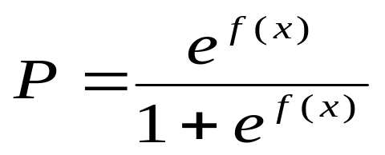
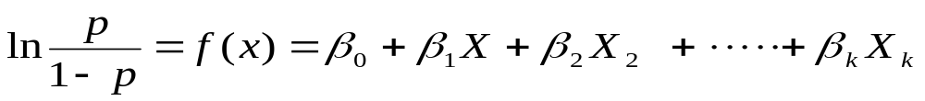
Logistic迴歸模式
令p表示某種事件成功的機率，它受因素x的
影響，即p與x之關係如下：
P/(1-P): odds ratio (成功比上失敗謂之勝算比)

Slide 6
Logistic迴歸分析的評估
下表是收集125位年齡從21歲到69歲成年人的資料，研究年齡Ｘ與是否患
心臟病(Y=0表未患心臟病，Y=1表患心臟病)的關係。並依下表繪出Ｙ
對Ｘ的散佈情形，如下圖 所示。
年齡 (X) 與罹患心臟病 (Y) 之關係表
X Y | X Y | X Y | X Y | X Y | X Y | X Y | X Y | X Y | X Y
21 0 21 0 22 0 22 0 22 0 23 0 24 0 24 1 25 0 25 0 26 0 26 0 | 26 0 27 0 27 1 28 0 28 0 29 1 30 0 30 0 30 0 31 0 31 0 31 1 | 32 0 33 0 33 0 33 0 34 0 34 1 34 1 34 0 35 0 35 0 35 0 36 0 | 36 1 36 0 36 0 37 1 37 0 38 1 39 0 39 1 39 0 40 0 40 1 40 0 | 41 1 42 0 42 0 42 1 43 0 43 1 43 0 43 1 44 0 44 0 44 1 45 0 | 45 0 45 0 46 0 47 0 47 1 47 0 47 0 48 1 48 1 48 0 48 1 49 1 | 54 0 54 1 54 0 55 1 56 0 56 0 56 1 57 0 57 1 57 1 57 0 57 1 | 57 1 58 0 58 0 58 1 58 1 59 1 59 0 60 0 60 0 60 1 60 1 61 1 | 61 1 62 0 62 0 62 1 63 1 64 1 64 1 65 1 65 1 65 0 66 1 66 1 | 67 1 67 1 68 1 68 1 69 1

Slide 7
Logistic迴歸分析的評估
罹患者
(
編碼為
1)
的
心臟疾病受年齡影響之散佈圖
密集度集中在年齡
1.2
層高的地方。
1.0
.8
.6
患心臟病
.4
( )
Y
.2
未罹患者
(
編碼為
0)
集
0.0
中在年齡層低的地方。
-.2
20
30
40
50
60
70
年齡
(X)
年齡 (X) 與罹患心臟病 (Y) 之關係圖
Ｙ與Ｘ的相關係數為0.4641。 (使用直線廻歸模式)
Ｙ對Ｘ的簡單迴歸式為：Y ＝ -0.268 + 0.01524 X
Ｒ²＝0.168
由於上述屬於0、1之資料類別，所以由R-square僅達0.168可看出，本範例不適合使用直線廻歸模式

Slide 8
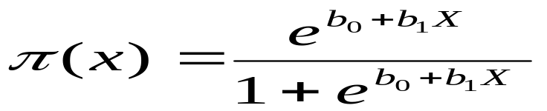
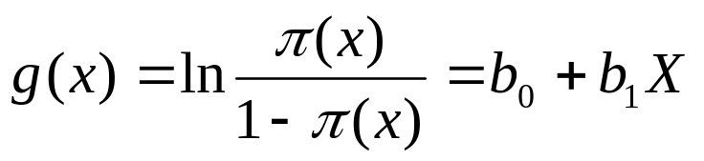
Logistic迴歸分析的評估
當以Logistic迴歸作為考量，則設年齡X與患心臟病機率的關係式為：
經過Logistic轉換：
則此時與X呈線性關係，即可進行Logistic迴歸分析。

Slide 9
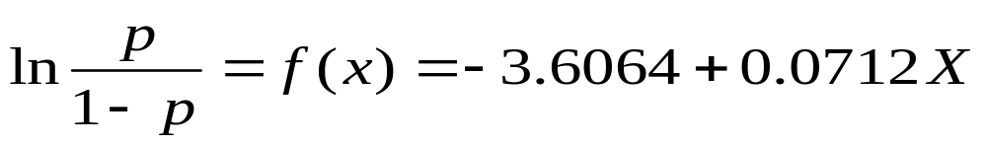
Logistic迴歸分析的評估
年齡 (X) 與罹患心臟病 (Y) 之Logistic模型檢定表
 | Chi-Square | df | Significance
Model | 22.418 | 1 | 0.000
Block | 22.418 | 1 | 0.000
Step | 22.418 | 1 | 0.000
年齡 (X) 與罹患心臟病 (Y) 之Logistic迴歸係數表
Variable | B | S.E. | Wald | df | Sig | R | Exp (B)
年齡 | 0.0712 | 0.0165 | 18.5247 | 1 | 0.0000 | 0.3114 | 1.0737
Constant | -3.6064 | 0.8071 | 19.9648 | 1 | 0.0000
根據上表，我們可以求得Logistic迴歸的方程式:

Slide 10
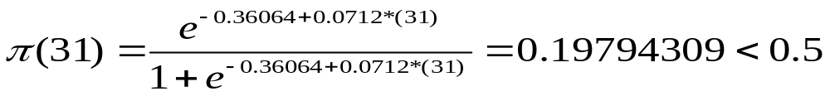
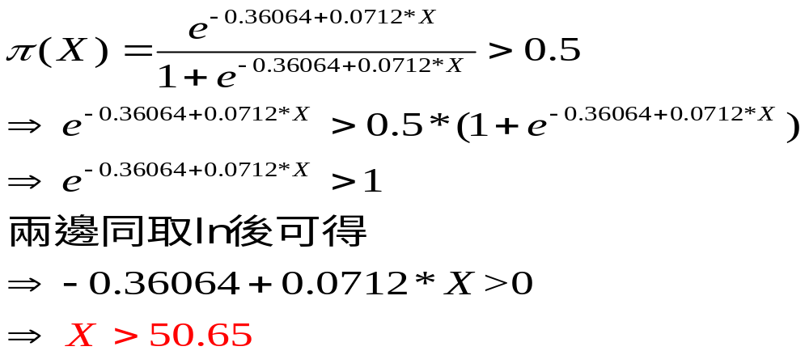
Logistic迴歸的評估
在Logistic迴歸式，假設病患的年齡為31歲，以X=31代入Logistic迴歸式中，可得知其患有心臟病的機率為:
故判斷在年齡X=31歲的病患有心臟病的機率為19.79%
如果想要知道年齡要超過多少歲，心臟病的機率會大於50%。則可使用下列式子獲得:

Slide 11
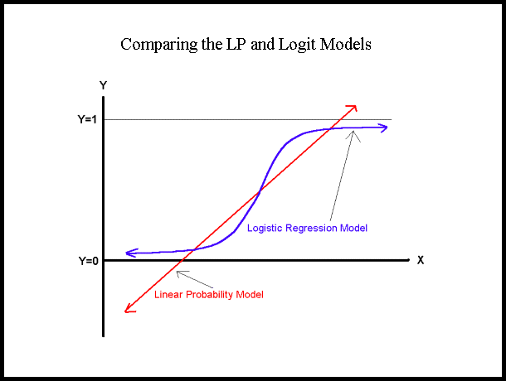
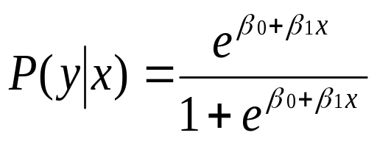

Slide 12
The Logistic Regression Model
The "logit" model solves these problems:
ln[p/(1-p)] = β₀ + β₁X
p is the probability that the event Y occurs, p(Y=1)
  [range=0 to 1]
p/(1-p) is the "odds ratio"
  [range=0 to ∞]
ln[p/(1-p)]: log odds ratio, or "logit“
  [range=-∞ to +∞]

Slide 13
Interpretation of LR
The logistic distribution constrains the estimated probabilities to lie between 0 and 1.
The estimated probability is:
p = e^{(β0 + β1X )}/[1 + e^{(β0 + β1X )}]
If you let β₀ + β₁X =0, then p = .50
as β₀ + β₁X gets really big, p approaches 1
as β₀ + β₁X gets really small, p approaches 0

Slide 14

Illustrating Classification Task

Slide 15

Underfitting and Overfitting
Overfitting
Underfitting: when model is too simple, both training and test errors are large

Slide 16

Overfitting due to Noise
Decision boundary is distorted by noise point

Slide 17

Underfitting due to Insufficient Examples
Lack of data points in the lower half of the diagram makes it difficult to predict correctly the class labels of that region
- Insufficient number of training records in the region causes the decision tree to predict the test examples using other training records that are irrelevant to the classification task

Slide 18
Common methods of Estimation
Holdout
  Reserve 2/3 for training and 1/3 for testing
Random subsampling
  Repeated holdout
Cross validation
  Partition data into k disjoint subsets
  k-fold: train on k-1 partitions, test on the remaining one
  Leave-one-out: k=n
Stratified sampling
  oversampling vs undersampling
Bootstrap
  Sampling with replacement

Slide 19
Instance Based Classifiers (KNN)
Examples:
  Rote-learner
    Memorizes entire training data and performs classification only if attributes of record match one of the training examples exactly
  K-Nearest neighbor (近朱者赤、近墨者黑)
    Uses k “closest” points (nearest neighbors) for performing classification

Slide 20






Nearest Neighbor Classifiers
Basic idea:
  If it walks like a duck, quacks like a duck, then it’s probably a duck
Compute Distance
Test Record
Training Records
Choose k of the “nearest” records

Slide 21
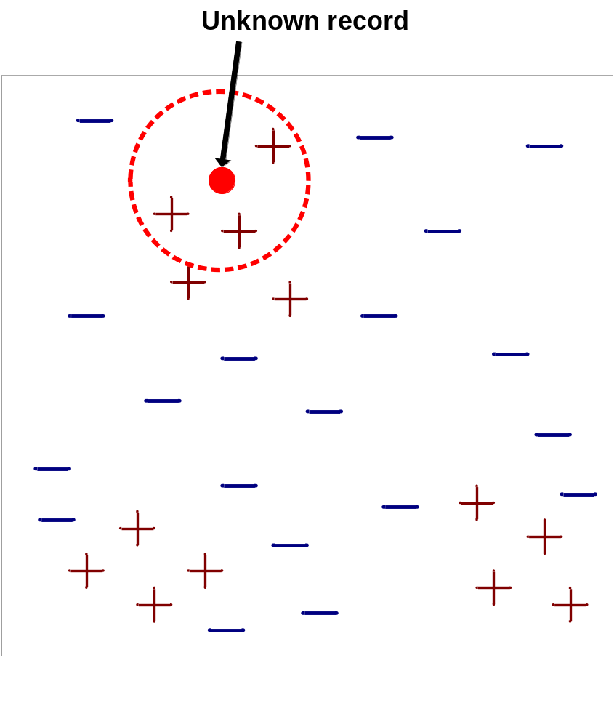
Nearest-Neighbor Classifiers
Requires three things
  The set of stored records
  Distance Metric to compute distance between records
  The value of k, the number of nearest neighbors to retrieve
To classify an unknown record:
  Compute distance to other training records
  Identify k nearest neighbors
  Use class labels of nearest neighbors to determine the class label of unknown record (e.g., by taking majority vote)

Slide 22

Definition of Nearest Neighbor
K-nearest neighbors of a record x are data points that have the k smallest distance to x

Slide 23
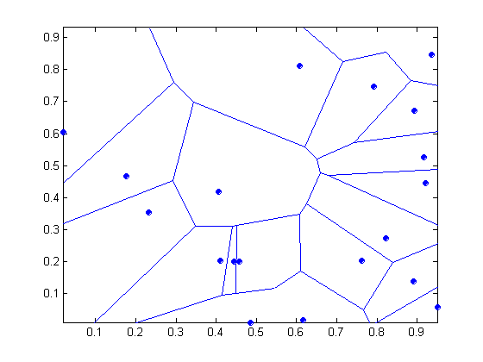
1 nearest-neighbor (K=1)
Voronoi Diagram

Slide 24
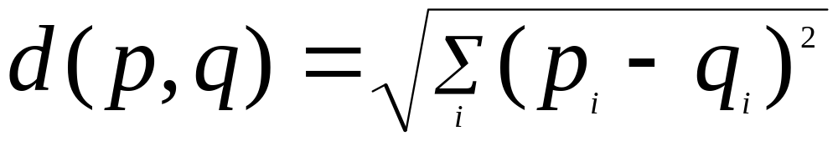
Nearest Neighbor Classification
Compute distance between two points:
  Euclidean distance
Determine the class from nearest neighbor list
  take the majority vote of class labels among the k-nearest neighbors
  Weigh the vote according to distance
    weight factor, w = 1/d²

Slide 25
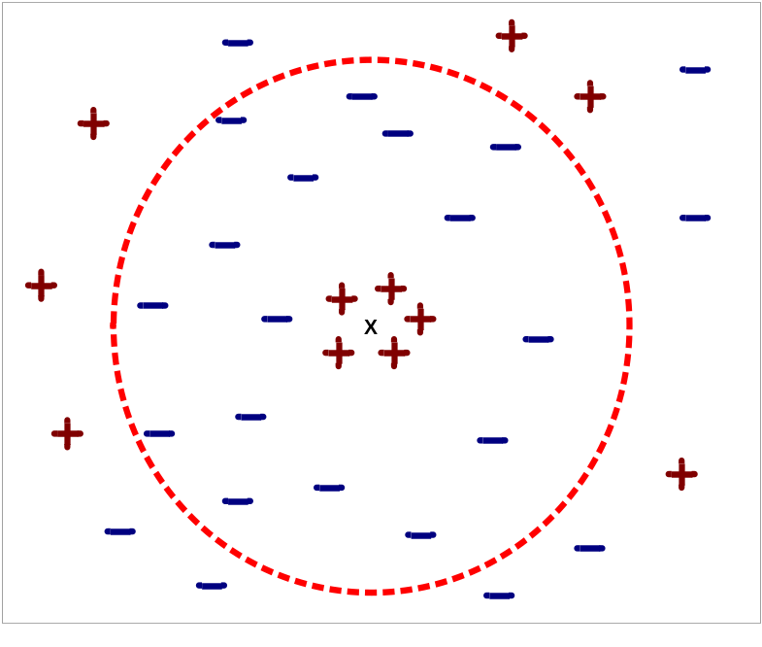
Nearest Neighbor Classification…
Choosing the value of k:
  If k is too small, sensitive to noise points
  If k is too large, neighborhood may include points from other classes

Slide 26
Nearest Neighbor Classification…
Scaling issues
  Attributes may have to be scaled to prevent distance measures from being dominated by one of the attributes
  Example:
    height of a person may vary from 1.5m to 1.8m
    weight of a person may vary from 90lb to 300lb
    income of a person may vary from $10K to $1M

Slide 27
Nearest neighbor Classification
k-NN classifiers are lazy learners
  It does not build models explicitly
  Unlike eager learners such as decision tree induction and rule-based systems
  Classifying unknown records are relatively expensive

Slide 28
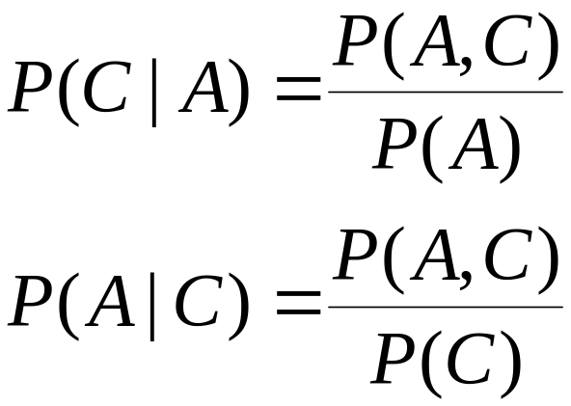
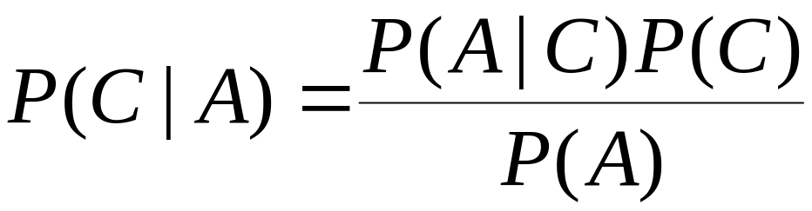
Naïve Bayes Classifier (NBC: 天真貝氏法)
A probabilistic framework for solving classification problems
Conditional Probability:
Bayes theorem:

Slide 29
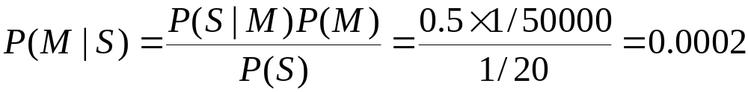
Example of Bayes Theorem
Given:
  A doctor knows that meningitis causes stiff neck 50% of the time
  Prior probability of any patient having meningitis is 1/50,000
  Prior probability of any patient having stiff neck is 1/20
If a patient has stiff neck-頸部痠痛, what’s the probability he/she has meningitis-腦膜炎 (from 0.00002 to 0.0002)?

Slide 30
Bayesian Classifiers
Consider each attribute and class label as random variables
Given a record with attributes (A₁, A₂,…,A_{n})
  Goal is to predict class C
  Specifically, we want to find the value of C that maximizes P(C| A₁, A₂,…,A_{n} ) (posterior)
Can we estimate P(C| A₁, A₂,…,A_{n} ) directly from data?

Slide 31
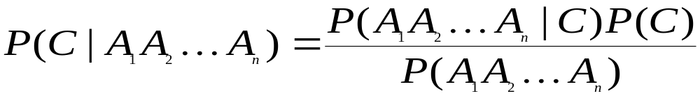
Bayesian Classifiers
Approach:
  compute the posterior probability P(C | A₁, A₂, …, A_{n}) for all values of C using the Bayes theorem
  Choose value of C that maximizes
  P(C | A₁, A₂, …, A_{n})
  Equivalent to choosing value of C that maximizes
  P(A₁, A₂, …, A_{n}|C) P(C)
How to estimate P(A₁, A₂, …, A_{n} | C )?

Slide 32
Naïve Bayes Classifier
Assume independence among attributes A_{i} when class is given:
  P(A₁, A₂, …, A_{n} |C) = P(A₁| C_{j}) P(A₂| C_{j})… P(A_{n}| C_{j})
  Can estimate P(A_{i}| C_{j}) for all A_{i} and C_{j}.
  New point is classified to C_{j} if P(C_{j}) Π P(A_{i}| C_{j}) is maximal.

Slide 33
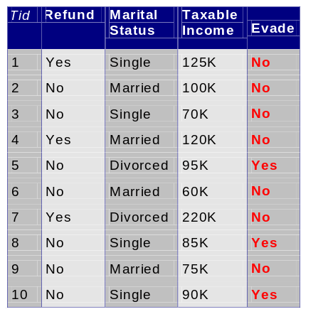
How to Estimate Probabilities from Data?
Class: P(C) = N_{c}/N
  e.g., P(No) = 7/10,
  P(Yes) = 3/10
For discrete attributes:
P(A_{i} | C_{k}) = |A_{ik}|/ N_{ck}
where |A_{ik}| is number of instances having attribute A_{i} and belongs to class C_{k}
  Examples:
  P(Status=Married|No) = 4/7
  P(Refund=Yes|Yes)=0/3

Slide 34
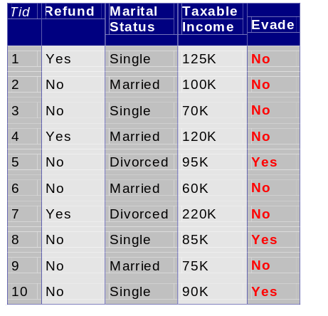
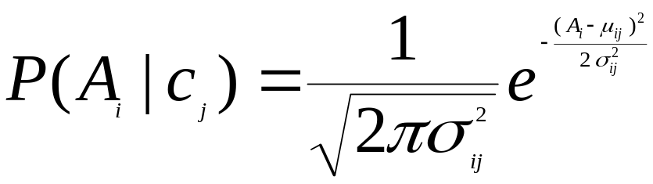
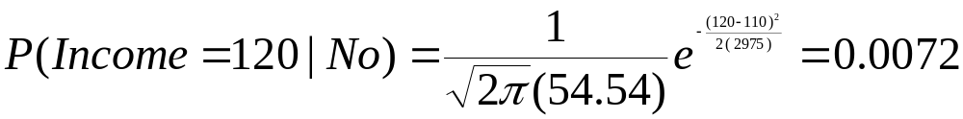
How to Estimate Probabilities from Data?
Normal distribution:
  One for each (A_{i},c_{i}) pair
For (Income, Class=No):
  If Class=No
    sample mean = 110
    sample variance = 2975

Slide 35
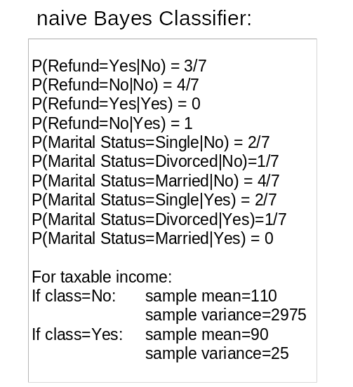
Example of Naïve Bayes Classifier
Given a Test Record:
P(X|Class=No) = P(Refund=No|Class=No)
× P(Married| Class=No)
× P(Income=120K| Class=No)
= 4/7 × 4/7 × 0.0072 = 0.0024
P(X|Class=Yes) = P(Refund=No| Class=Yes)
× P(Married| Class=Yes)
× P(Income=120K| Class=Yes)
= 1 × 0 × 1.2 × 10⁻⁹ = 0
Since P(X|No)P(No) > P(X|Yes)P(Yes)
Therefore P(No|X) > P(Yes|X)
=> Class = No

Slide 36
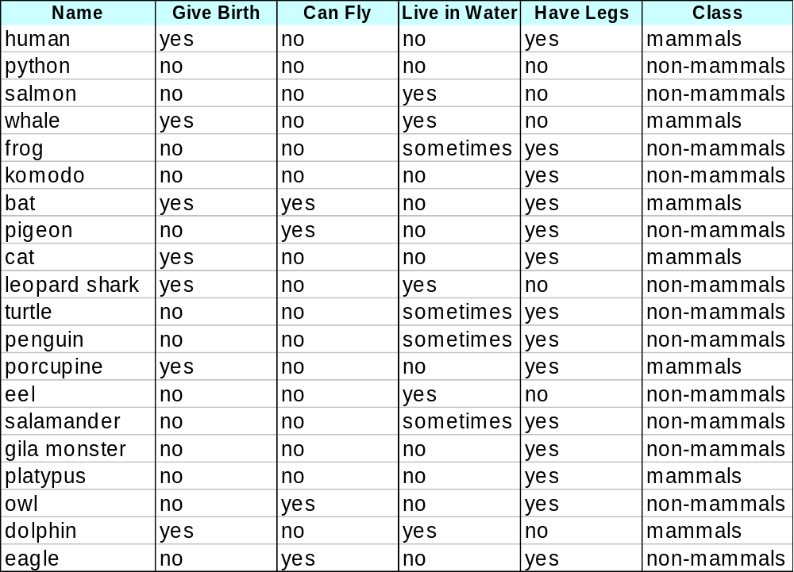
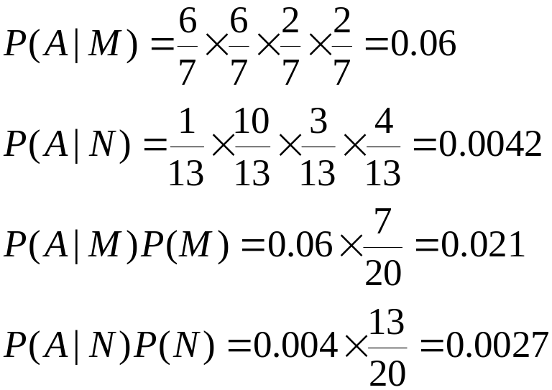
Example of Naïve Bayes Classifier
A: attributes
M: mammals
N: non-mammals
P(A|M)P(M) > P(A|N)P(N)
=> Mammals

Slide 37
Naïve Bayes Classifier (Summary)
Robust to isolated noise points
Handle missing values by ignoring the instance during probability estimate calculations
Robust to irrelevant attributes
Independence assumption may not hold for some attributes
  Use other techniques such as Bayesian Belief Networks (BBN)

Slide 38

Example of a Decision Tree
categorical
categorical
continuous
class
Splitting Attributes
Refund
Yes
No
NO
MarSt
Single, Divorced
Married
TaxInc
NO
< 80K
> 80K
NO
YES
Training Data
Model: Decision Tree

Slide 39

Decision Tree Classification Task
Decision Tree

Slide 40

Apply Model to Test Data
Test Data
Start from the root of tree.
Refund
Yes
No
NO
MarSt
Single, Divorced
Married
TaxInc
NO
< 80K
> 80K
NO
YES

Slide 41
Apply Model to Test Data
Test Data
Refund
Yes
No
NO
MarSt
Single, Divorced
Married
TaxInc
NO
< 80K
> 80K
NO
YES

Slide 42

Apply Model to Test Data
Test Data
Refund
Yes
No
NO
MarSt
Single, Divorced
Married
TaxInc
NO
< 80K
> 80K
NO
YES

Slide 43
Apply Model to Test Data
Test Data
Refund
Yes
No
NO
MarSt
Single, Divorced
Married
TaxInc
NO
< 80K
> 80K
NO
YES

Slide 44

Apply Model to Test Data
Test Data
Refund
Yes
No
NO
MarSt
Single, Divorced
Married
TaxInc
NO
< 80K
> 80K
NO
YES

Slide 45
Apply Model to Test Data
Test Data
Refund
Yes
No
NO
MarSt
Single, Divorced
Married
Assign Cheat to “No”
TaxInc
NO
< 80K
> 80K
NO
YES

Slide 46

How to utilize training samples to learn a model
Decision Tree

Slide 47
Tree Induction
Greedy strategy.
  Split the records based on an attribute test that optimizes certain criterion.
Issues
  Determine how to split the records
    How to specify the attribute test condition?
    How to determine the best split?
  Determine when to stop splitting

Slide 48


How to determine the Best Split
Greedy approach:
  Nodes with homogeneous class distribution are preferred
Need a measure of node impurity:
Non-homogeneous,
High degree of impurity
Homogeneous,
Low degree of impurity

Slide 49
Measures of Node Impurity
Gini Index
Entropy
Misclassification error

Slide 50





How to Find the Best Split
Before Splitting:
M0
A?
B?
Yes
No
Yes
No
Node N1
Node N2
Node N3
Node N4
M1
M2
M3
M4
M12
M34
Gain = M0 – M12 v.s. M0 – M34

Slide 51




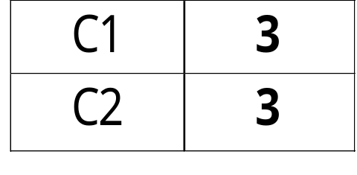
GINI
P(C1) = 0/6 = 0 P(C2) = 6/6 = 1
Gini = 1 – P(C1)² – P(C2)² = 1 – 0 – 1 = 0
P(C1) = 1/6 P(C2) = 5/6
Gini = 1 – (1/6)² – (5/6)² = 0.278
P(C1) = 2/6 P(C2) = 4/6
Gini = 1 – (2/6)² – (4/6)² = 0.444
P(C1) = 3/6 P(C2) = 3/6
Gini = 1 – (3/6)² – (3/6)² = 0.5

Slide 52

Splitting Based on GINI
Used in CART, SLIQ, SPRINT.
When a node p is split into k partitions (children), the quality of split is computed as,
where, n_{i} = number of records at child i,
n = number of records at node p.

Slide 53

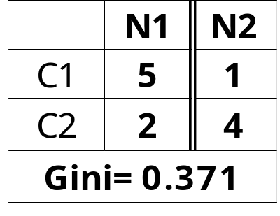
Binary Attributes: Computing GINI Index
Splits into two partitions
Effect of Weighing partitions:
  Larger and Purer Partitions are sought for.
B?
Yes
No
Node N1
Node N2
Gini(N1)
= 1 – (5/7)² – (2/7)²
= 0.408
Gini(N2)
= 1 – (1/5)² – (4/5)²
= 0.32
Gini(Children)
= (7/12) * 0.408 +
(5/12) * 0.32
= 0.371

Slide 54



Categorical Attributes: Computing Gini Index
For each distinct value, gather counts for each class in the dataset
Use the count matrix to make decisions
Multi-way split
Two-way split
(find best partition of values)

Slide 55

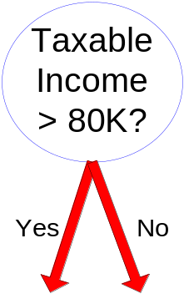
Continuous Attributes: Computing Gini Index
Use Binary Decisions based on one value
Several Choices for the splitting value
  Number of possible splitting values
  = Number of distinct values
Each splitting value has a count matrix associated with it
  Class counts in each of the partitions, A < v and A ≥ v
Simple method to choose best v (threshold)
  For each v, scan the database to gather count matrix and compute its Gini index
  Computationally Inefficient! Repetition of work.

Slide 56

Continuous Attributes: Computing Gini Index...
For efficient computation: for each attribute,
  Sort the attribute on values
  Linearly scan these values, each time updating the count matrix and computing gini index
  Choose the split position that has the least Gini index
Sorted Values
Split Positions

Slide 57

Information Entropy
P(C1) = 0/6 = 0 P(C2) = 6/6 = 1
Entropy = – 0 log 0 – 1 log 1 = – 0 – 0 = 0
P(C1) = 1/6 P(C2) = 5/6
Entropy = – (1/6) log₂ (1/6) – (5/6) log₂ (5/6) = 0.65
P(C1) = 2/6 P(C2) = 4/6
Entropy = – (2/6) log₂ (2/6) – (4/6) log₂ (4/6) = 0.92
P(C1) = 3/6 P(C2) = 3/6
Entropy = – (3/6) log₂ (3/6) – (3/6) log₂ (3/6) = 1

Slide 58

Splitting Based on INFO...
Information Gain:
    Parent Node, p is split into k partitions;
    n_{i} is number of records in partition i
  Measures Reduction in Entropy achieved because of the split. Choose the split that achieves most reduction (maximizes GAIN)
  Used in ID3 and C4.5
  Disadvantage: Tends to prefer splits that result in large number of partitions, each being small but pure.

Slide 59


Splitting Based on INFO...
Gain Ratio:
    Parent Node, p is split into k partitions
    n_{i} is the number of records in partition i
  Adjusts Information Gain by the entropy of the partitioning (SplitINFO). Higher entropy partitioning (large number of small partitions) is penalized!
  Used in C4.5
  Designed to overcome the disadvantage of Information Gain

Slide 60

Impurity based on misclassification error
P(C1) = 0/6 = 0 P(C2) = 6/6 = 1
Error = 1 – max (0, 1) = 1 – 1 = 0
P(C1) = 1/6 P(C2) = 5/6
Error = 1 – max (1/6, 5/6) = 1 – 5/6 = 1/6
P(C1) = 2/6 P(C2) = 4/6
Error = 1 – max (2/6, 4/6) = 1 – 4/6 = 1/3

Slide 61

Comparison among Splitting Criteria
For a 2-class problem:

Slide 62

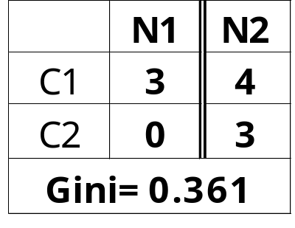
Information Gain based on Gini
A?
Yes
No
Node N1
Node N2
Gini(N1)
= 1 – (3/3)² – (0/3)²
= 0
Gini(N2)
= 1 – (4/7)² – (3/7)²
= 0.489
Gini(Children)
= 3/10 * 0
+ 7/10 * 0.489
= 0.342
Gini improves by 0.078 (0.42-0.342)

Slide 63
Tree Induction
Greedy strategy.
  Split the records based on an attribute test that optimizes certain criterion (most capable to decrease Gini or entropy in this node).
Issues
  Determine how to split the records
    How to specify the attribute test condition?
    How to determine the best split?
  Determine when to stop splitting

Slide 64
Stopping Criteria for Tree Induction
Stop expanding a node when all the records belong to the same class
Stop expanding a node when all the records have similar attribute values
Early termination (i.e. a class dominates more than 80%)

Slide 65
Example: C4.5
Simple depth-first construction.
Uses Information Gain or Gain Ratio
Sorts continuous attributes at each node.
Easy to explain for small datasets.
Unsuitable for large datasets.
You can download the software from:
http://www.cse.unsw.edu.au/~quinlan/c4.5r8.tar.gz

Slide 66
Rule-Based Classifier
Classify records by using a collection of “if…then…” rules
Rule: (Condition) → y
  where
    Condition is a conjunctions of attributes
    y is the class label
  LHS: rule antecedent or condition
  RHS: rule consequent
  Examples of classification rules:
    (Blood Type=Warm) ∧ (Lay Eggs=Yes) → Birds
    (Taxable Income < 50K) ∧ (Refund=Yes) → Evade=No

Slide 67
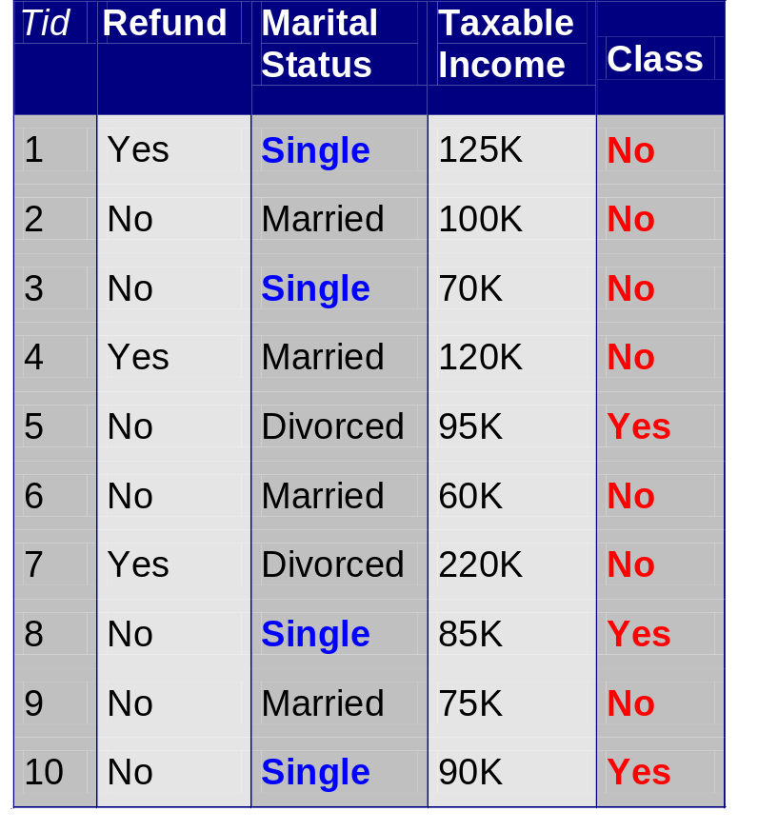
Rule Coverage and Accuracy
Coverage of a rule:
  Fraction of records that satisfy the antecedent of a rule
Strength of a rule:
  Fraction of records that satisfy both the antecedent and consequent of a rule
(Status=Single) → No
Coverage = 40%, Accuracy = 50%

Slide 68
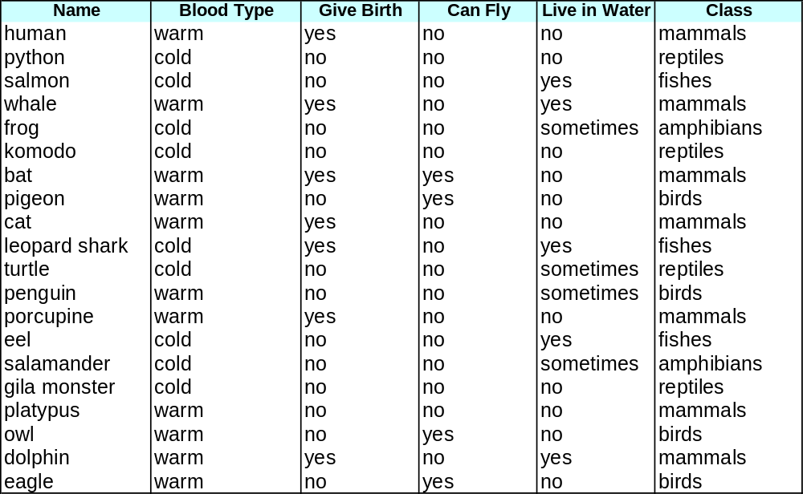
Rule-based Classifier (Example)
R1: (Give Birth = no) ∧ (Can Fly = yes) → Birds
R2: (Give Birth = no) ∧ (Live in Water = yes) → Fishes
R3: (Give Birth = yes) ∧ (Blood Type = warm) → Mammals
R4: (Give Birth = no) ∧ (Can Fly = no) → Reptiles
R5: (Live in Water = sometimes) → Amphibians

Slide 69
Application of Rule-Based Classifier
A rule r covers an instance x if the attributes of the instance satisfy the condition of the rule
R1: (Give Birth = no) ∧ (Can Fly = yes) → Birds
R2: (Give Birth = no) ∧ (Live in Water = yes) → Fishes
R3: (Give Birth = yes) ∧ (Blood Type = warm) → Mammals
R4: (Give Birth = no) ∧ (Can Fly = no) → Reptiles
R5: (Live in Water = sometimes) → Amphibians
The rule R1 covers a hawk => Bird
The rule R3 covers the grizzly bear => Mammal

Slide 70
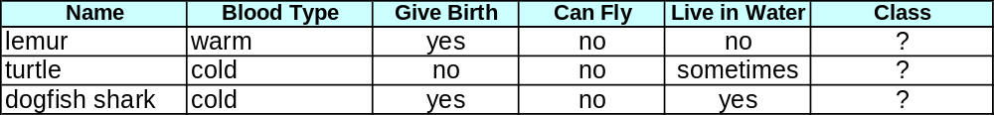
How does Rule-based Classifier Work?
R1: (Give Birth = no) ∧ (Can Fly = yes) → Birds
R2: (Give Birth = no) ∧ (Live in Water = yes) → Fishes
R3: (Give Birth = yes) ∧ (Blood Type = warm) → Mammals
R4: (Give Birth = no) ∧ (Can Fly = no) → Reptiles
R5: (Live in Water = sometimes) → Amphibians
A lemur triggers rule R3, so it is classified as a mammal
A turtle triggers both R4 and R5
A dogfish shark triggers none of the rules

Slide 71
Characteristics of Rule-Based Classifier
Mutually exclusive rules
  Classifier contains mutually exclusive rules if the rules are independent of each other
  Every record is covered by at most one rule
Exhaustive rules
  Classifier has exhaustive coverage if it accounts for every possible combination of attribute values
  Each record is covered by at least one rule

Slide 72
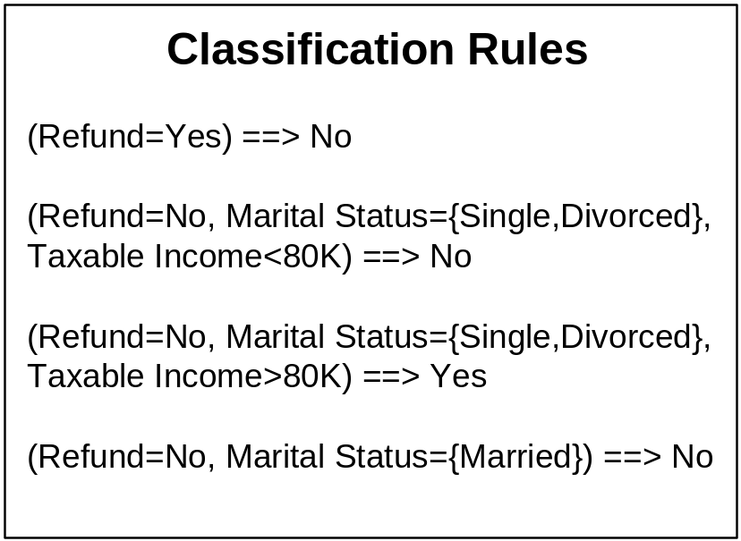
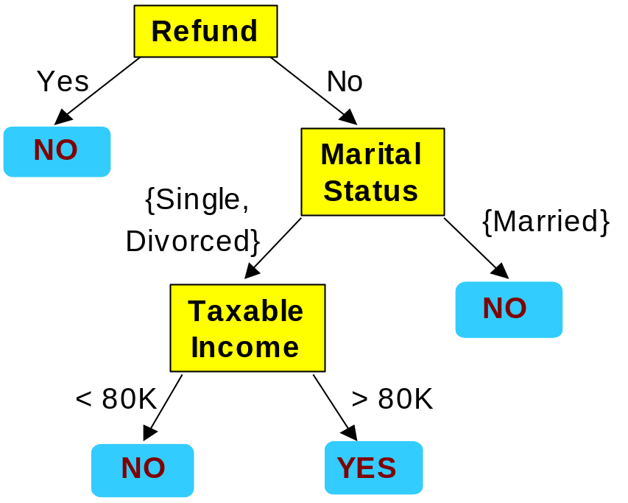
From Decision Trees To Rules
Rules are mutually exclusive and exhaustive
Rule set contains as much information as the tree

Slide 73
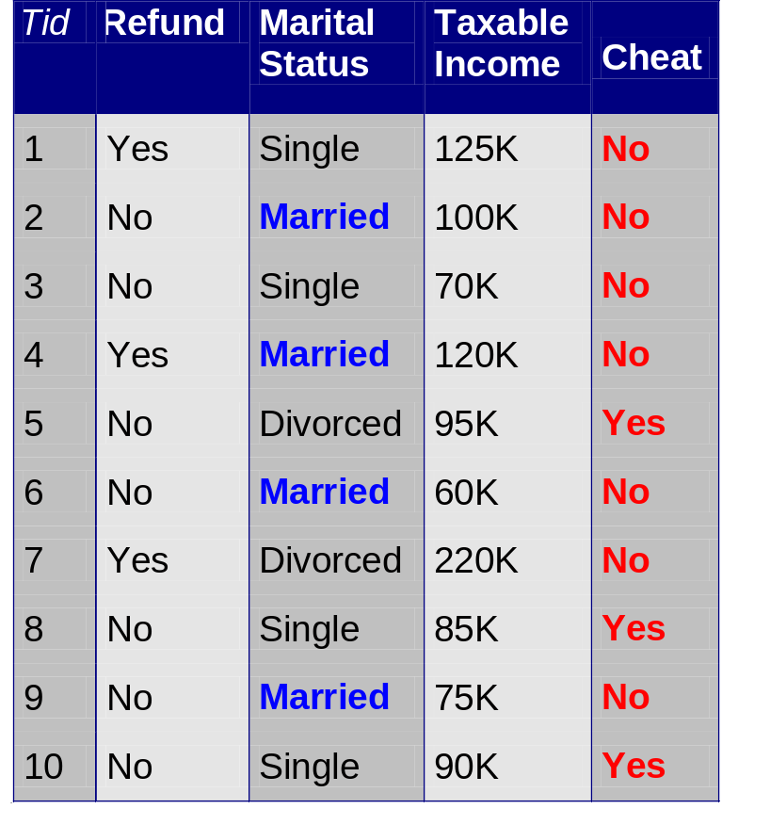
Rules Can Be Simplified
Initial Rule: (Refund=No) ∧ (Status=Married) → No
Simplified Rule: (Status=Married) → No

Slide 74
Advantages of Rule-Based Classifiers
As highly expressive as decision trees
Easy to interpret
Easy to generate
Can classify new instances rapidly
Performance comparable to decision trees

