Slide 1
Association Rule & Sequential Rule
Data Mining & Business Intelligence
Lecture 4
by
Prof. Chih-Hsuan Wang (王志軒)

Slide 2

關聯規則 Association Rule
Given a set of transactions, find rules that will predict the occurrence of an item based on the occurrences of other items in the transaction
Market-Basket transactions
Example of Association Rules
{Diaper} → {Beer},
{Milk, Bread} → {Eggs,Coke},
{Beer, Bread} → {Milk},
Implication means co-occurrence, not causality!

Slide 3

Definition: Frequent Itemset
Itemset
  A collection of one or more items
    Example: {Milk, Bread, Diaper}
  k-itemset
    An itemset that contains k items
Support count (σ)
  Frequency of occurrence of an itemset
  E.g. σ({Milk, Bread, Diaper}) = 2
Support
  Fraction of transactions that contain an itemset
  E.g. s({Milk, Bread, Diaper}) = 2/5
Frequent Itemset
  An itemset whose support is greater than or equal to a minsup threshold

Slide 4



Definition: Association Rule
Association Rule
  An implication expression of the form X → Y, where X and Y are itemsets
  Example:
  {Milk, Diaper} → {Beer}
Rule Evaluation Metrics
  Support (s)
    Fraction of transactions that contain both X and Y
  Confidence (c)
    Measures how often items in Y
    appear in transactions that
    contain X
Example:

Slide 5
Association Rule Mining Task
Given a set of transactions T, the goal of association rule mining is to find all rules having
  support ≥ minsup threshold
  confidence ≥ minconf threshold
Brute-force approach:
  List all possible association rules
  Compute the support and confidence for each rule
  Prune rules that fail the minsup and minconf thresholds
  ⇒ Computationally prohibitive!

Slide 6
Mining Association Rules
Example of Rules:
{Milk,Diaper} → {Beer} (s=0.4, c=0.67)
{Milk,Beer} → {Diaper} (s=0.4, c=1.0)
{Diaper,Beer} → {Milk} (s=0.4, c=0.67)
{Beer} → {Milk,Diaper} (s=0.4, c=0.67)
{Diaper} → {Milk,Beer} (s=0.4, c=0.5)
{Milk} → {Diaper,Beer} (s=0.4, c=0.5)
Observations:
All the above rules are binary partitions of the same itemset:
{Milk, Diaper, Beer}
Rules originating from the same itemset have identical support but
can have different confidence
Thus, we may decouple the support and confidence requirements

Slide 7
Mining Association Rules
Two-step approach:
  Frequent Itemset Generation
    Generate all itemsets whose support ≥ minsup
  Rule Generation
    Generate high confidence rules from each frequent itemset, where each rule is a binary partitioning of a frequent itemset
Frequent itemset generation is still computationally expensive

Slide 8

Frequent Itemset Generation
Given d items, there are 2^{d} possible candidate itemsets

Slide 9
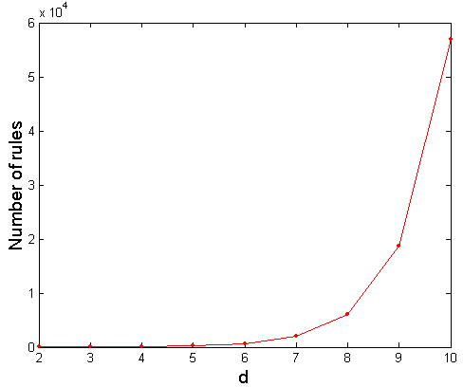
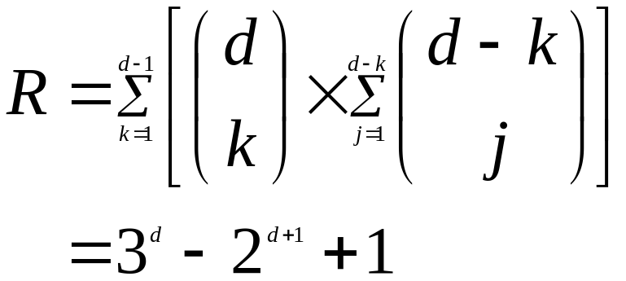
Computational Complexity
Given d unique items:
  Total number of itemsets = 2^{d}
  Total number of possible association rules:
If d=6 items, R = 602 rules

Slide 10
Frequent Itemset Generation Strategies
Reduce the number of candidates (M)
  Complete search: M=2^{d}
  Use pruning techniques to reduce M
Reduce the number of transactions (N)
  Reduce size of N as the size of itemset increases
  Used by DHP and vertical-based mining algorithms
Reduce the number of comparisons (NM)
  Use efficient data structures to store the candidates or transactions
  No need to match every candidate against every transaction

Slide 11
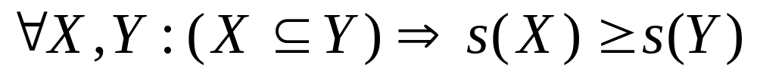
Reducing Number of Candidates
Apriori principle:
  If an itemset is frequent, then all of its subsets must also be frequent
Apriori principle holds due to the following property of the support measure:
  Support of an itemset never exceeds the support of its subsets
  This is known as the anti-monotone property of support

Slide 12


Illustrating Apriori Principle
Found to be Infrequent
Pruned supersets

Slide 13

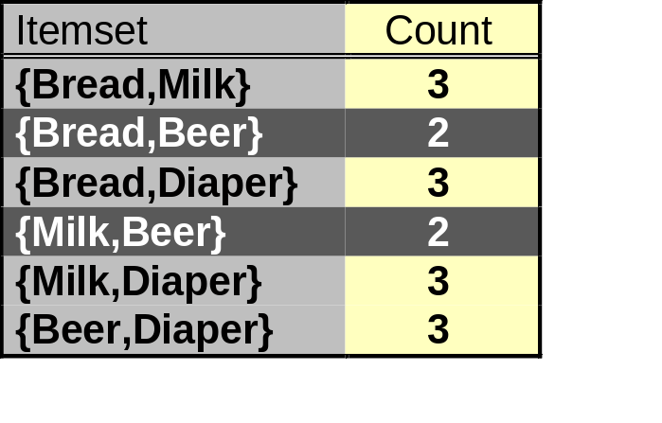
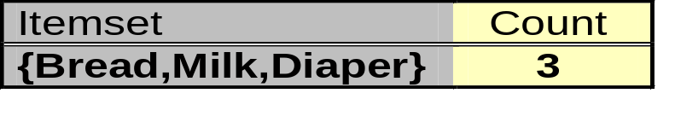
Illustrating Apriori Principle
Items (1-itemsets)
Pairs (2-itemsets)
(No need to generate
candidates involving Coke
or Eggs)
Minimum Support = 3
Triplets (3-itemsets)
If every subset is considered,
⁶C₁ + ⁶C₂ + ⁶C₃ = 41
With support-based pruning,
⁶C₁ + ⁴C₂ + ³C₃ = 13

Slide 14
Apriori Algorithm
Method:
  Let k=1
  Generate frequent itemsets of length (size) 1
  Repeat until no new frequent itemsets are identified
    Generate length (k+1) candidate itemsets from length k frequent itemsets
    Prune candidate itemsets (k+1) containing subsets of length k that are infrequent
    Count the support of each candidate by scanning the DB
    Eliminate candidates that are infrequent, leaving only those that are frequent

Slide 15
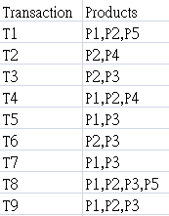
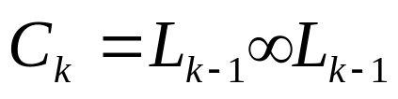
Illustration of Apriori
Apriori algorithm：join + prune

Slide 16
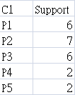
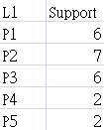
Apriori step 1
(1)
Threshold=2

Slide 17
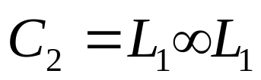
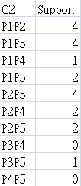
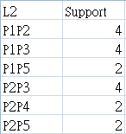
Apriori step 2
(2)

Slide 18
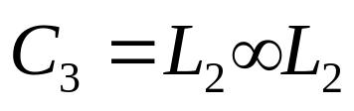


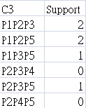

Apriori step 3
(3)
…
…
No L4

Slide 19
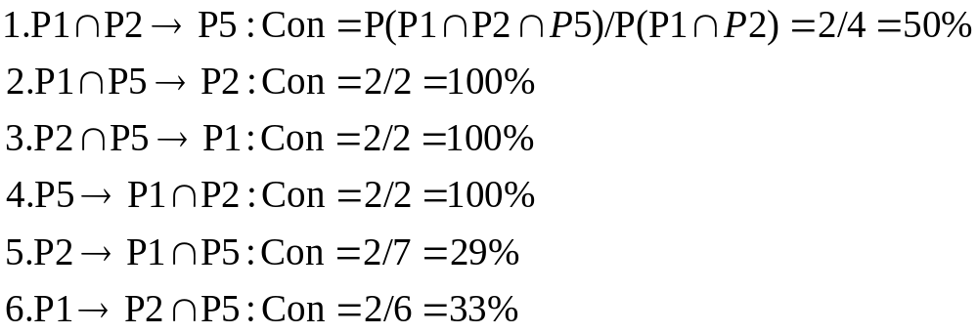
Apriori step 4
(4)Conclusion：How to seek significant association rules
ex：subset of P={P1},{P2}, {P5},{P1,P2},
{P1,P5},{P2,P5}
X
V
V
V
X
Threshold=70%
X

Slide 20
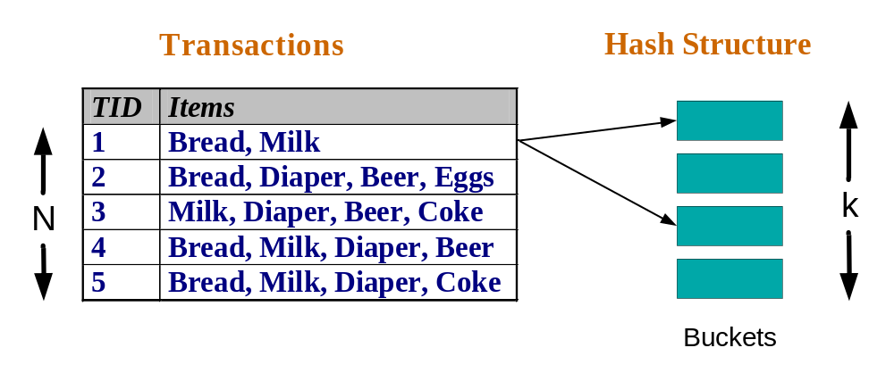
Reducing Number of Comparisons
Candidate counting:
  Scan the database of transactions to determine the support of each candidate itemset
  To reduce the number of comparisons, store the candidates in a hash structure
    Instead of matching each transaction against every candidate, match it against candidates contained in the hashed buckets

Slide 21
Pattern Evaluation
Association rule algorithms tend to produce too many rules
  many of them are uninteresting or redundant
  Redundant if {A,B,C} → {D} and {A,B} → {D}
  have same support & confidence
Interestingness measures can be used to prune/rank the derived patterns
In the original formulation of association rules, support & confidence are the only measures used

Slide 22
Computing Interestingness Measure
Given a rule X → Y, information needed to compute rule interestingness can be obtained from a contingency table
Contingency table for X → Y
 | Y | Y
X | f₁₁ | f₁₀ | f₁₊
X | f₀₁ | f₀₀ | f_{o+}
 | f₊₁ | f₊₀ | |T|
f₁₁: support of X and Y
f₁₀: support of X and Y
f₀₁: support of X and Y
f₀₀: support of X and Y
Used to define various measures
support, confidence, lift, Gini,
J-measure, etc.

Slide 23
Drawback of Confidence
 | Coffee | Coffee
Tea | 15 | 5 | 20
Tea | 75 | 5 | 80
 | 90 | 10 | 100
Association Rule: Tea → Coffee
Confidence= P(Coffee|Tea) = 0.75
but P(Coffee) = 0.9
Although confidence is high, rule is misleading
P(Coffee|Tea) = 0.9375

Slide 24
Statistical Independence
Population of 1000 students
  600 students know how to swim (S)
  700 students know how to bike (B)
  420 students know how to swim and bike (S,B)
  P(S∧B) = 420/1000 = 0.42
  P(S) × P(B) = 0.6 × 0.7 = 0.42
  P(S∧B) = P(S) × P(B) => Statistically independent
  P(S∧B) > P(S) × P(B) => Positively correlated
  P(S∧B) < P(S) × P(B) => Negatively correlated

Slide 25
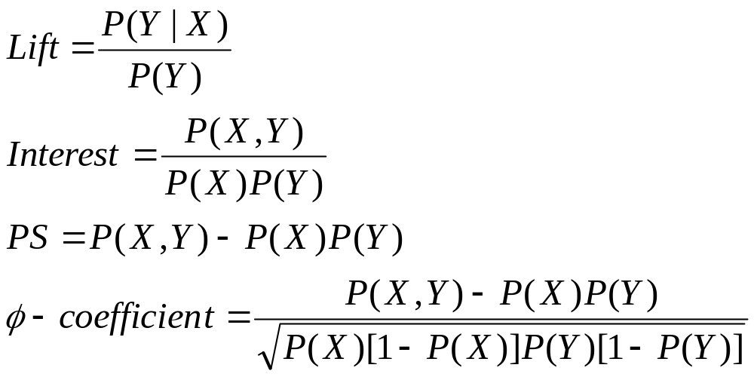
Statistical-based Measures
Measures that take into account statistical dependence

Slide 26
Example: Lift/Interest
 | Coffee | Coffee
Tea | 15 | 5 | 20
Tea | 75 | 5 | 80
 | 90 | 10 | 100
Association Rule: Tea → Coffee
Confidence= P(Coffee|Tea) = 0.75
but P(Coffee) = 0.9
Lift = 0.75/0.9= 0.8333 (< 1, therefore is negatively associated)

Slide 27
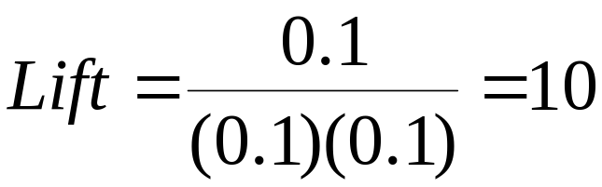
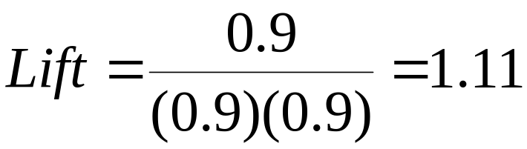
Drawback of Lift & Interest
 | Y | Y
X | 10 | 0 | 10
X | 0 | 90 | 90
 | 10 | 90 | 100
 | Y | Y
X | 90 | 0 | 90
X | 0 | 10 | 10
 | 90 | 10 | 100
Statistical independence: If P(X,Y)=P(X)P(Y) => Lift = 1
PS= P(X,Y)-P(X)P(Y) = 0.09 (左右皆成立)

Slide 28
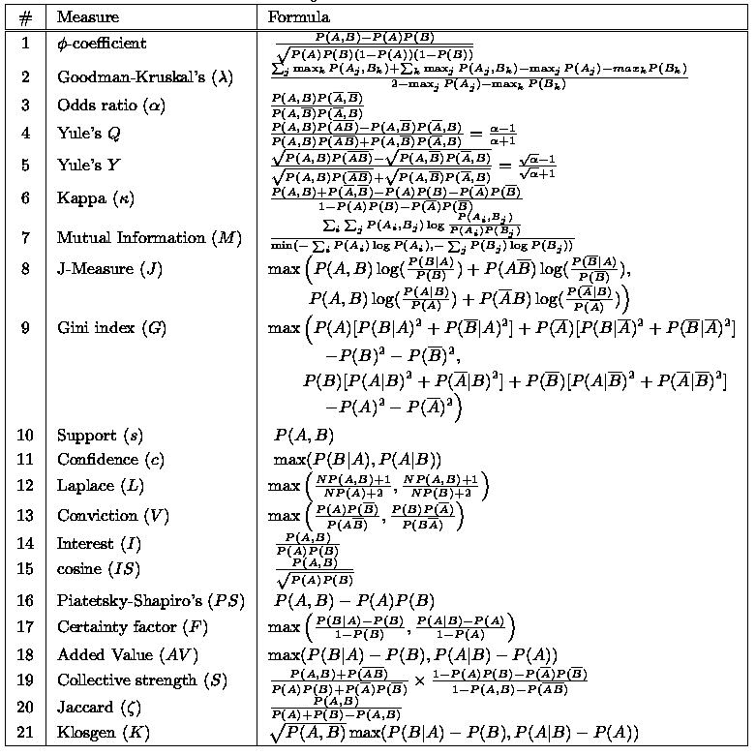

Slide 29
FP-growth Algorithm
A compressed representation of the database by using an FP-tree (more efficient than Apriori algorithm)
Once an FP-tree has been constructed, it uses a recursive divide-and-conquer approach to mine the frequent itemsets

Slide 30
Rule Generation
Given a large itemset L, find all non-empty subsets f ⊂ L such that f → (L – f) satisfies the minimum confidence requirement
  If {A,B,C,D} is a frequent itemset, candidate rules:
    ABC →D, ABD →C, ACD →B, BCD →A,
    A →BCD, B →ACD, C →ABD, D →ABC
    AB →CD, AC → BD, AD → BC, BC →AD,
    BD →AC, CD →AB,
If |L| = k, then there are 2^{k} – 2 candidate association rules (ignoring L → ∅ and ∅ → L)

Slide 31
Rule Generation
How to efficiently generate rules from frequent itemsets?
  In general, confidence does not have an anti-monotone property
    c(ABC →D) can be larger or smaller than c(AB →D)
  But confidence of rules generated from the same itemset has an anti-monotone property
  e.g., L = {A,B,C,D}:
  c(ABC → D) ≥ c(AB → CD) ≥ c(A → BCD)
    Confidence is anti-monotone w.r.t. number of items on the RHS of the rule

Slide 32
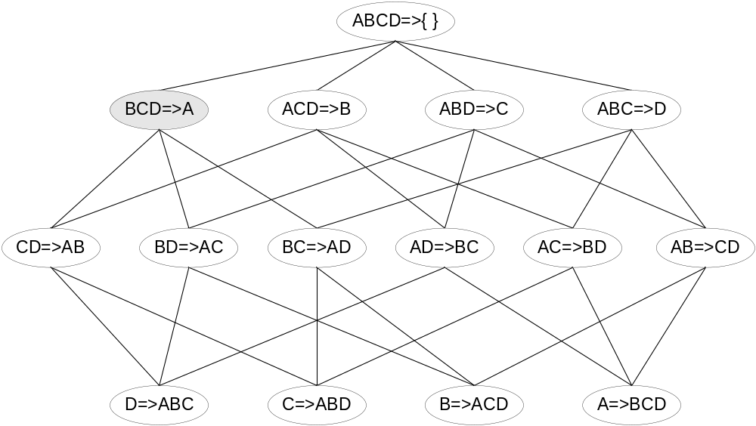

Rule Generation for Apriori Algorithm
Lattice of rules
Low Confidence Rule
Pruned Rules

Slide 33
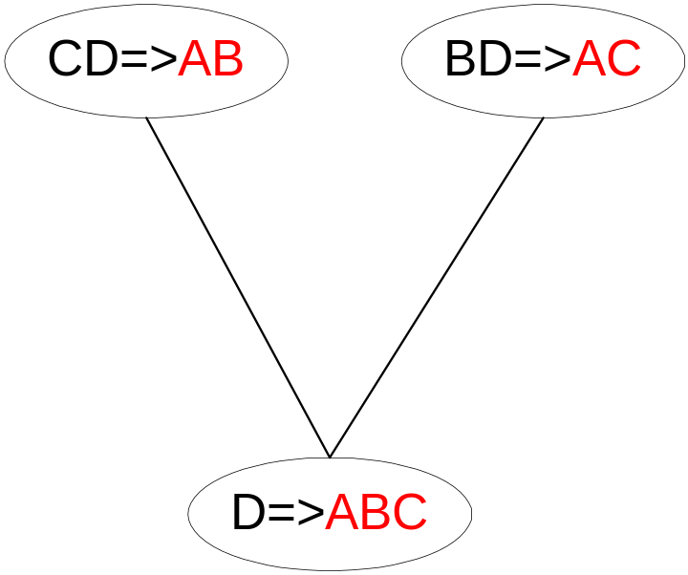
Rule Generation for Apriori Algorithm
Candidate rule is generated by merging two rules that share the same prefix
in the rule consequent
Join(CD=>AB, BD=>AC)
would produce the candidate
rule D => ABC
Prune rule D=>ABC if its
subset CD=>AB or BD=>AC does not have
high confidence

Slide 34
Effect of Support Distribution
How to set the appropriate minsup threshold?
  If minsup is set too high, we could miss itemsets involving interesting rare items (e.g., expensive products)
  If minsup is set too low, it is computationally expensive and the number of itemsets is very large
Using a single minimum support threshold may not be effective

Slide 35
Multiple Minimum Support
How to apply multiple minimum supports?
  MS(i): minimum support for item i
  e.g.: MS(Milk)=5%, MS(Coke) = 3%,
  MS(Broccoli)=0.1%, MS(Salmon)=0.5%
  MS({Milk, Broccoli}) = min (MS(Milk), MS(Broccoli))
  = 0.1%
  Challenge: Support is no longer anti-monotone
    Suppose: Support(Milk, Coke) = 1.5% and
    Support(Milk, Coke, Broccoli) = 0.5%
    {Milk,Coke} is infrequent but {Milk,Coke,Broccoli} is frequent

Slide 36
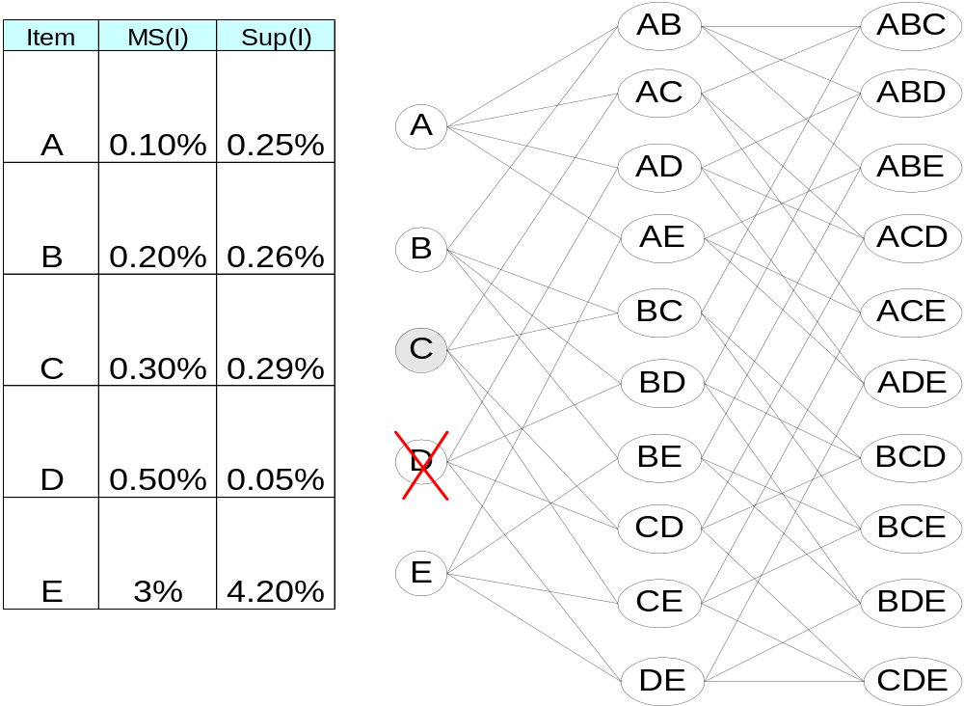
Multiple Minimum Support

Slide 37
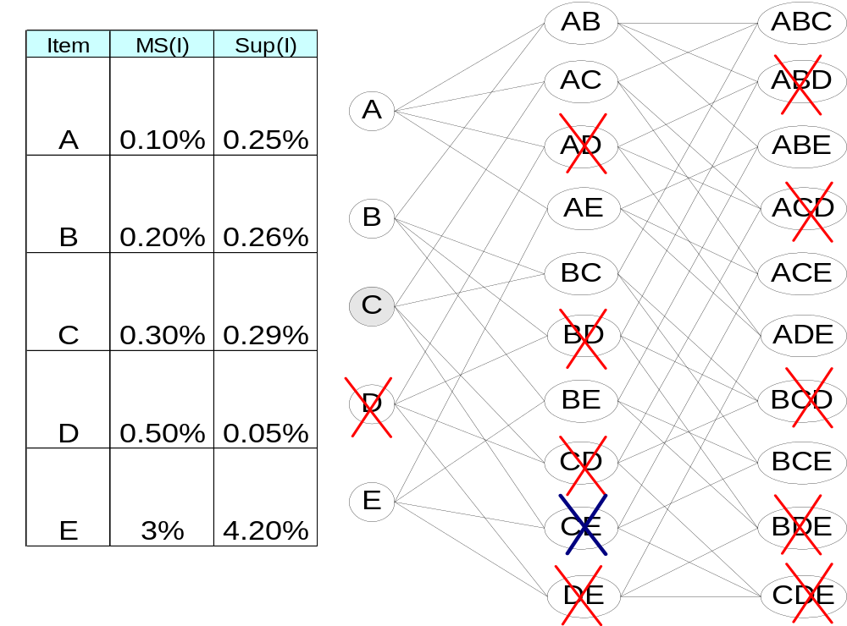
Multiple Minimum Support

Slide 38
Multiple Minimum Support (Liu 1999)
Order the items according to their minimum support (in ascending order)
  e.g.: MS(Milk)=5%, MS(Coke) = 3%,
  MS(Broccoli)=0.1%, MS(Salmon)=0.5%
  Ordering: Broccoli, Salmon, Coke, Milk
Need to modify Apriori such that:
  L₁ : set of frequent items
  F₁ : set of items whose support is ≥ MS(1)
  where MS(1) is min_{i}( MS(i) )
  C₂ : candidate itemsets of size 2 is generated from F₁
  instead of L₁

Slide 39
Multiple Minimum Support (Liu 1999)
Modifications to Apriori:
  In traditional Apriori,
    A candidate (k+1)-itemset is generated by merging two
    frequent itemsets of size k
    The candidate is pruned if it contains any infrequent subsets
    of size k
  Pruning step has to be modified:
    Prune only if subset contains the first item
    e.g.: Candidate={Broccoli, Coke, Milk} (ordered according to
    minimum support)
    {Broccoli, Coke} and {Broccoli, Milk} are frequent but
    {Coke, Milk} is infrequent
      Candidate is not pruned because {Coke, Milk} does not contain
      the first item, i.e., Broccoli.

Slide 40
Multi-level Association Rule
PC
Level I：product
Desktop
Laptop
Level II：type
Home
Business
Notebook
Tabelet
Level III：function
HP
Acer
Dell
HP
Toshiba
Acer
Asus
Ipad
Level IV：brand
*Min support for different levels
I=4, II=3, III=2, IV=2

Slide 41
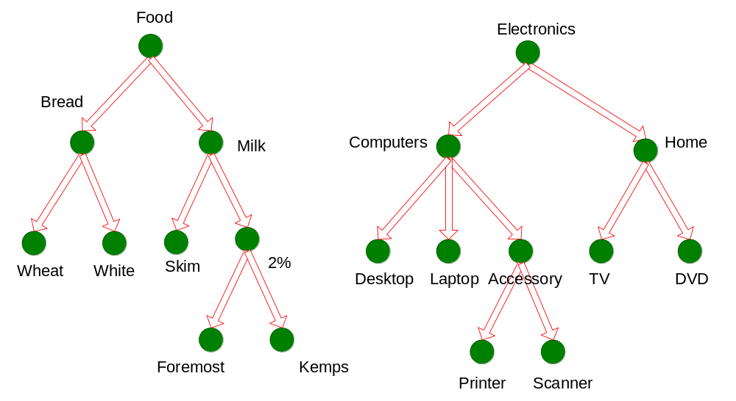
Multi-level Association Rules

Slide 42
Multi-level Association Rules
Why should we incorporate concept hierarchy?
  Rules at lower levels may not have enough support to appear in any frequent itemsets
  Rules at lower levels of the hierarchy are overly specific
    e.g., skim milk → white bread, 2% milk → wheat bread,
    skim milk → wheat bread, etc.
    are indicative of association between milk and bread

Slide 43
Multi-level Association Rules
How do support and confidence vary as we traverse the concept hierarchy?
  If X is the parent item for both X1 and X2, then
  σ(X) ≤ σ(X1) + σ(X2)
  If σ(X1 ∪ Y1) ≥ minsup,
  and X is parent of X1, Y is parent of Y1
  then σ(X ∪ Y1) ≥ minsup, σ(X1 ∪ Y) ≥ minsup
  σ(X ∪ Y) ≥ minsup
  If conf(X1 ⇒ Y1) ≥ minconf,
  then conf(X1 ⇒ Y) ≥ minconf

Slide 44
Multi-level Association Rules
[Chapter 7 .3]
Approach 1:
  Extend current association rule formulation by augmenting each transaction with higher level items
  Original Transaction: {skim milk, wheat bread}
  Augmented Transaction:
  {skim milk, wheat bread, milk, bread, food}
Issues:
  Items that reside at higher levels have much higher support counts
    if support threshold is low, too many frequent patterns involving items from the higher levels
  Increased dimensionality of the data

Slide 45
Multi-level Association Rules
Approach 2:
  Generate frequent patterns at highest level first
  Then, generate frequent patterns at the next highest level, and so on
Issues:
  I/O requirements will increase dramatically because we need to perform more passes over the data
  May miss some potentially interesting cross-level association patterns

Slide 46
次序規則 sequential rule

Slide 47

次序分析基本概念
由一群有次序性的資料中，找出具有經常次序性的交易項目組合，進而瞭解顧客的長期購買行為。不同於關聯規則分析以單筆交易為分析單位，來瞭解交易內交易項目的相關性，次序相關分析法則是著重於同一顧客、不同交易間交易項目的相關性。

Slide 48
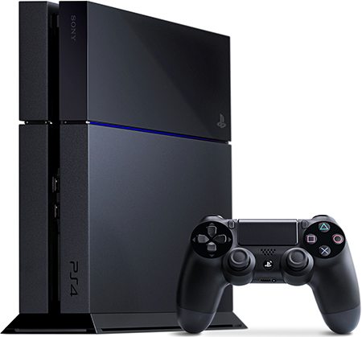

次序分析基本概念
所謂的次序型資料，重點在於資料中必須存在先後順序的關係（例如時間），而所有的項目則依該條件來呈現次序性的排列狀況，次序型的資料分析則是希望能夠在此循序排列的資料中找到有趣的規則。
以顧客的購買順序為例，若我們發現有許多人在買完「XBOB遊戲機」後，間隔一段時間會再來買「VR眼鏡」，便可稱為次序類型 (Sequential Pattern)。
因此，「次序資料分析 (Sequence) 」 與「類型資料分析 (Pattern) 」最大的差異在於次序分析中的各項目 (Item) 具有先後的關係，存在著「時間」的元素，而類型分析則不具先後關係

Slide 49
次序分析基本概念
目前次序分析有兩種方式：
一、只考量時間的先後順序，僅著重時間的順序作資料關聯的分析。
二、考量時間的區段，也就是週期性發生的類型，重點在於時間區段內的 變化。
在次序分析中有三個重要的參數需要注意，分別為：
事件期間 (Duration)
事件滑動視窗 (Event folding window)
事件間隔時間 (Event Interval)

Slide 50

次序分析基本概念
「事件期間」：為分析資料的起迄期間。
  如某市場為了要因應新年的促銷專案，所以訂定年度內一月至二月的交易銷售資料為分析事件期間。
  訂定分析時間的長短需取決於單位軟硬體的配合。
時間過長
分析資源的浪費、系統的額外負荷以及加長分析的時間
時間過短
挖掘不出有價資訊

Slide 51
次序分析基本概念
「事件滑動視窗」：是指在同一周期內發生的所有事件。
  若我們現在需要做客戶在一年期間對產品購買的次序分析，視窗長度設定為1個月，事件期間設定為1年，引此在週期內會有12個事件(12個月份)滑動視窗作為分析的標的。
  但是若將視窗長度設定為1年，那麼事件的發生相對於時間就失去其意義，和一般的關聯式法則分析無異。

Slide 52
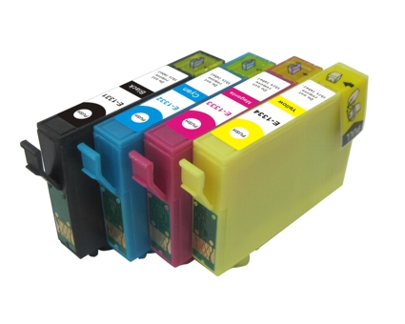


次序分析基本概念
「事件的間隔時間」：是指在一個項目發生之後，時間間隔多久 才會發生下一個項目。
  例如學生在開學後「一週」會購買「個人電腦」，間隔「四週」後有70% 的比例會購買印表機，並在「六週」後有75%的比例會購買「墨水匣」。
4週(70%)
1週
6週(75%)

Slide 53
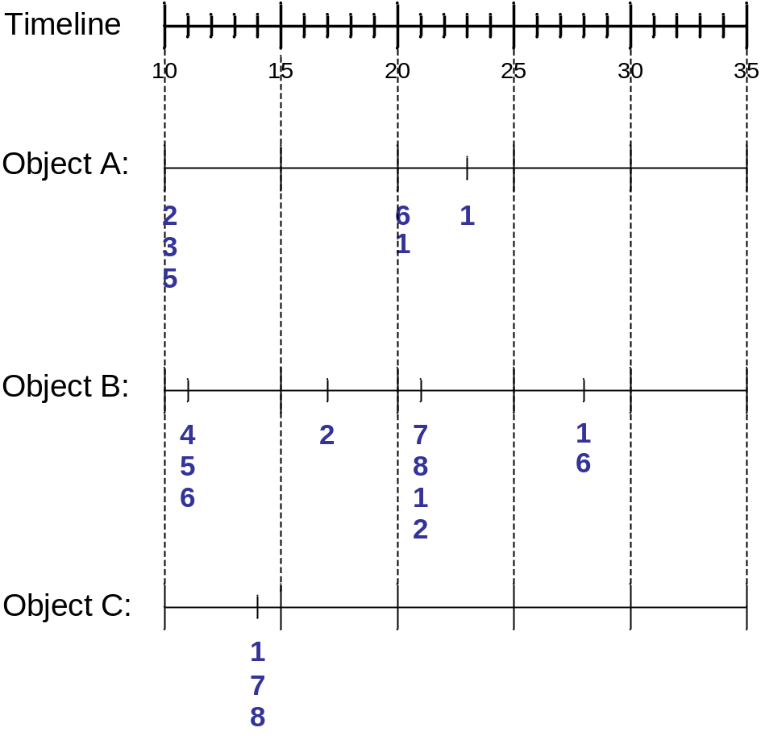
Sequence Data
Sequence Database:
Object
Timestamp
Events
A
10
2, 3, 5
A
20
6, 1
A
23
1
B
11
4, 5, 6
B
17
2
B
21
7, 8, 1, 2
B
28
1, 6
C
14
1, 8, 7

Slide 54
Examples of Sequence Data
Sequence Database | Sequence | Element (Transaction) | Event (Item)
Customer | Purchase history of a given customer | A set of items bought by a customer at time t | Books, diary products, CDs, etc
Web Data | Browsing activity of a particular Web visitor | A collection of files viewed by a Web visitor after a single mouse click | Home page, index page, contact info, etc
Event data | History of events generated by a given sensor | Events triggered by a sensor at time t | Types of alarms generated by sensors
Genome sequences | DNA sequence of a particular species | An element of the DNA sequence | Bases A,T,G,C
Element (Transaction)
Event
(Item)
E1
E2
E1
E3
E2
E2
E3
E4
Sequence

Slide 55
Formal Definition of a Sequence
A sequence is an ordered list of elements (transactions)
  s = < e₁ e₂ e₃ … >
  Each element contains a collection of events (items)
  e_{i} = {i₁, i₂, …, i_{k}}
  Each element is attributed to a specific time or location
Length of a sequence, |s|, is given by the number of elements of the sequence
A k-sequence is a sequence that contains k events (items)

Slide 56
Examples of Sequence
Web sequence:
  < {Homepage} {Electronics} {Digital Cameras} {Canon Digital Camera} {Shopping Cart} {Order Confirmation} {Return to Shopping} >
Sequence of initiating events causing the nuclear accident at 3-mile Island:
(http://stellar-one.com/nuclear/staff_reports/summary_SOE_the_initiating_event.htm)
  < {clogged resin} {outlet valve closure} {loss of feedwater}
  {condenser polisher outlet valve shut} {booster pumps trip}
  {main waterpump trips} {main turbine trips} {reactor pressure increases}>
Sequence of books checked out at a library:
  <{Fellowship of the Ring} {The Two Towers} {Return of the King}>

Slide 57
Formal Definition of a Subsequence
A sequence <a₁ a₂ … a_{n}> is contained in another sequence <b₁ b₂ … b_{m}> (m ≥ n) if there exist integers
i₁ < i₂ < … < i_{n} such that a₁ ⊆ b_{i1} , a₂ ⊆ b_{i1}, …, a_{n} ⊆ b_{in}
The support of a subsequence w is defined as the fraction of data sequences that contain w
A sequential pattern is a frequent subsequence (i.e., a subsequence whose support is ≥ minsup)
Data sequence | Subsequence | Contain?
< {2,4} {3,5,6} {8} > | < {2} {3,5} > | Yes
< {1,2} {3,4} > | < {1} {2} > | No
< {2,4} {2,4} {2,5} > | < {2} {4} > | Yes

Slide 58
Sequential Pattern Mining: Definition
Given:
  a database of sequences
  a user-specified minimum support threshold, minsup
Task:
  Find all subsequences with support ≥ minsup

Slide 59
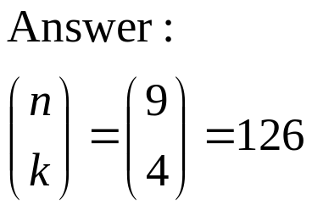
Sequential Pattern Mining: Challenge
Given a sequence: <{a b} {c d e} {f} {g h i}>
  Examples of subsequences:
    <{a} {c d} {f} {g} >, < {c d e} >, < {b} {g} >, etc.
How many k-subsequences can be extracted from a given n-sequence?
<{a b} {c d e} {f} {g h i}> n = 9
k=4: Y _ _ Y Y _ _ _ Y
<{a} {d e} {i}>

Slide 60
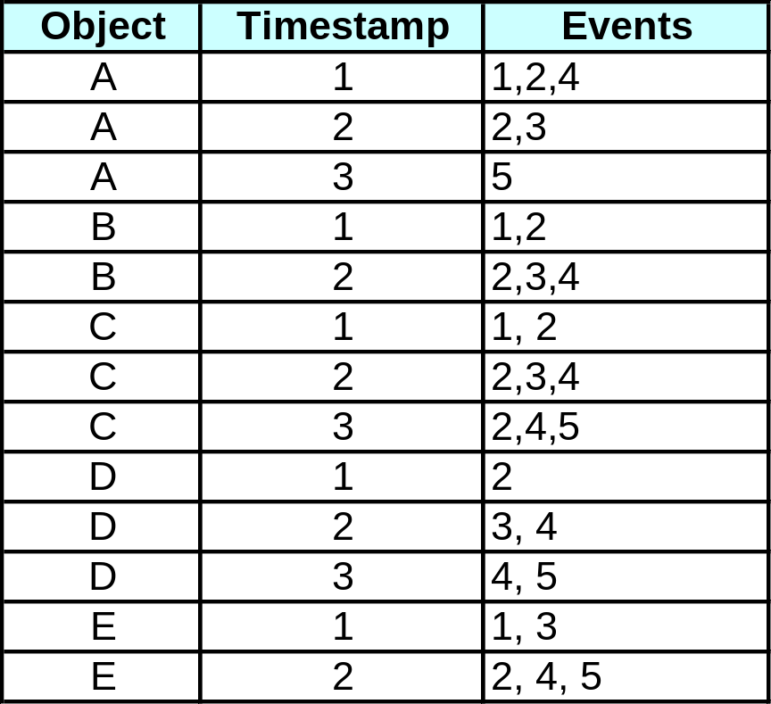
Sequential Pattern Mining: Example
Minsup = 50%
Examples of Frequent Subsequences:
< {1,2} > s=60%
< {2,3} > s=60%
< {2,4}> s=80%
< {3} {5}> s=80%
< {1} {2} > s=80%
< {2} {2} > s=60%
< {1} {2,3} > s=60%
< {2} {2,3} > s=60%
< {1,2} {2,3} > s=60%

Slide 61
Extracting Sequential Patterns
Given n events: i₁, i₂, i₃, …, i_{n}
Candidate 1-subsequences:
    <{i₁}>, <{i₂}>, <{i₃}>, …, <{i_{n}}>
Candidate 2-subsequences:
    <{i₁, i₂}>, <{i₁, i₃}>, …, <{i₁} {i₁}>, <{i₁} {i₂}>, …, <{i_{n-1}} {i_{n}}>
Candidate 3-subsequences:
    <{i₁, i₂ , i₃}>, <{i₁, i₂ , i₄}>, …, <{i₁, i₂} {i₁}>, <{i₁, i₂} {i₂}>, …,
    <{i₁} {i₁ , i₂}>, <{i₁} {i₁ , i₃}>, …, <{i₁} {i₁} {i₁}>, <{i₁} {i₁} {i₂}>, …

Slide 62
演算法簡介
次序分析之目的是希望藉由一群有順序性的資料，找出經常循序出現的項目組合，近而瞭解顧客的長期（購買）行為。因此，次序分析有以下步驟：
排序：以顧客代號為主要欄位，交易時間為次要欄位，將原始交易資料進行排序，如下表。
顧客交易次序轉換表
顧客編號 | 交易時間 | 交易項目集合
S1 S1 | 3月12日 8月8日 | C Y
S2 S2 S2 | 2月15日 4月12日 7月7日 | A,B C D,F,G
S3 | 3月22日 | C,E,G
S4 S4 S4 | 3月18日 5月11日 8月7日 | C D,G Y
S5 | 7月8日 | Y

Slide 63
演算法簡介
產生頻繁項目組 (L-itemset)：找出所有頻繁項目組 (L-itemset) 的集合 L1（所有大於或等於最小支持度的頻繁次序 (large 1-sequence) 的集合，也就是 l-itemset），並將每個頻繁項目組對應到一個代號。將頻繁項目組對應到一個代號，目的是為了將每一個項目視為單一個體來處理，如下表所示。
頻繁項目組與對應代號
頻繁項目組 | 項目組代號
〈C〉 | 1
〈D〉 | 2
〈G〉 | 3
〈D,G〉 | 4
〈Y〉 | 5

Slide 64
演算法簡介
轉換：將每筆紀錄由該紀錄所包含的頻繁項目組取代。若一筆紀錄沒有包含任何頻繁項目組，則該筆紀錄將不會被保留在交易次序 (transaction sequence) 中。若某顧客的購買次序 (customer sequence) 不包含任何頻繁項目組，則該顧客的購買次序將會被捨棄，如下表所示。
轉換後的資料集
顧客編號 | 原始交易紀錄 | 轉換後交易紀錄
S1 | 〈C〉〈G〉 | 《(C)》《(G)》
S2 | 〈A,B〉〈C〉〈D,F,G〉 | 《(C)》《(D) , (G), (D,G)》
S3 | 〈C,E,G〉 | 《(C),(G)》
S4 | 〈C〉〈D,G〉〈Y〉 | 《(C)》《(D) , (G), (D,G)》《(Y)》
S5 | 〈Y〉 | 《(Y)》
頻繁項目組與對應代號
頻繁項目組 | 項目組代號
〈C〉 | 1
〈D〉 | 2
〈G〉 | 3
〈D,G〉 | 4
〈Y〉 | 5

Slide 65
R軟體實作
Package : arulesSequences
可調整之參數
參數 | 說明
maxlen | 最大交易次數
maxsize | 單次交易最大項目次數
mingap | 每次交易事件最短發生間隔時間
maxgap | 每次交易事件最長發生間隔時間
maxwin | 每兩次交易事件最長發生間隔時間

Slide 66
演算法簡介 - 參數介紹
參數 | 說明
Most frequent items | 所以事件出現該項目的次數
Most frequent elements | 所以事件中出現該項目單獨出現的次數
Element size distribution | 交易次數
Element length distribution | 所有交易的項目長度
輸出參數
控制參數
參數 | 說明
verbose | 顯示建模的相關參數
memsize | 限制記憶體使用量(預設32MB，range>=16)
summary | 建模後的資訊顯示(可建模後再使用)

