Slide 1
Structure
Jupyter note
0. place the recorded file
1.DatatoPickle.ipynb
2.Learning.ipynb
- Recording and saving
- File name format
Choose the specific Ros bag file in the folder
Make pickle
3. Data pre-processing
4. Training the data
5. Show and save the results
0. place the recorded file
(1). Prepare the rosbag file
Take experiments for each shape of object several times (e.g. 4 object 5 times ➔ 20 folders )
Rosbag
Cir_1
Cir_2
Cir_3
Cur_4
Cir_1.db3
Metadata.yaml

Slide 2
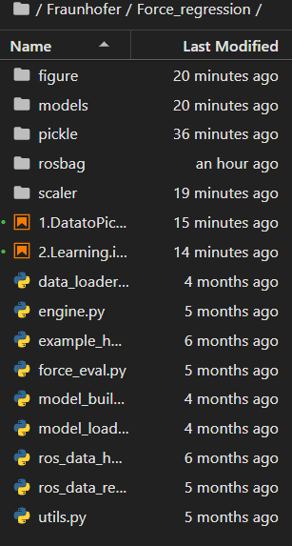
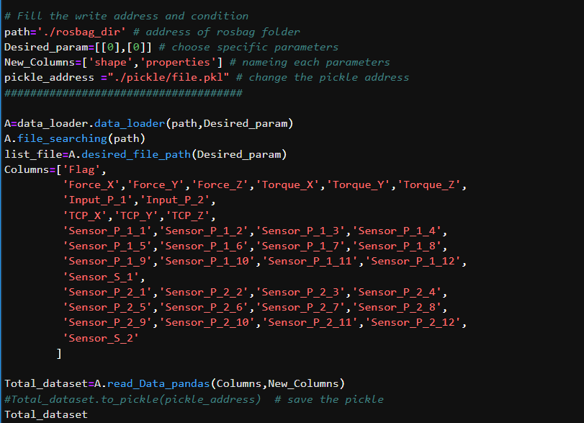
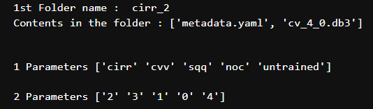
1.DatatoPickle.ipynb
➔ Convert the rosbag file into pickle
(1) Need to run the code first, then It will show the lists of the parameters by separating the folder name with ‘_’
(2) Choose the parameter
e.g. all cases of circular shape
→ [[0],[0,1,2,3,4]]
(3) Name the pickle
e.g. all cases of circular shape
→ ‘./pickle/cir.pkl’
(4) Save the pickle
(5) Iterate this process until saving all the parameters of the shape.
e.g. 4 different shape
→ 4 times and we have 4 different pickle files in the folder’pickle’

Slide 3
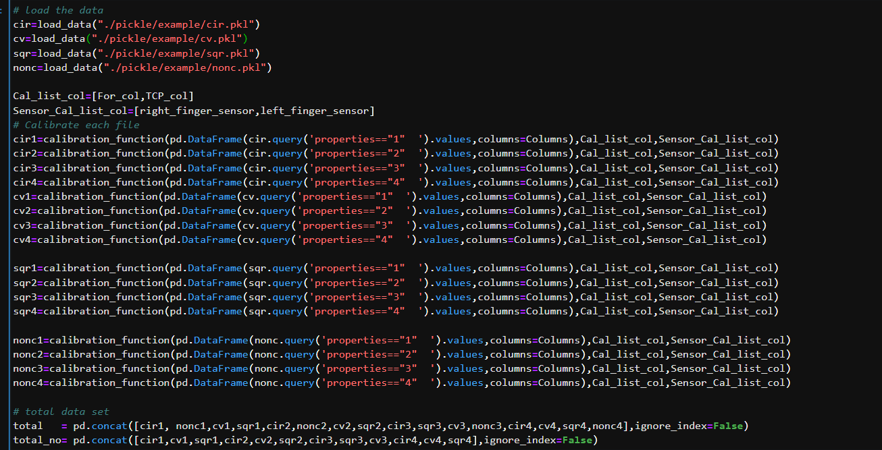
2.Learning.ipynb
(1) It consists of four different chapter
[a]. Load function
[b]. Model defining
[c]. Loading the data
Just run the code/cell if you don’t need nothing specific
Change the address
Calibration
process
➔ If you take the different experiment set up and have other names, then it needs to be modified

Slide 4
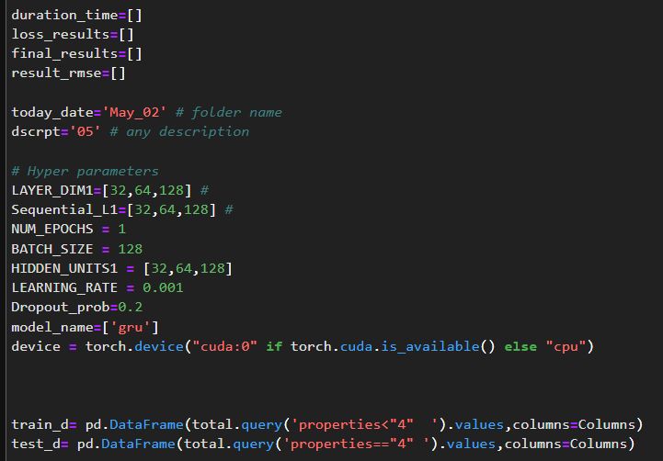
2.Learning.ipynb
(2) Learning set up
Naming the folder
Change the hyperparameter range where you want to know
Data division

Slide 5
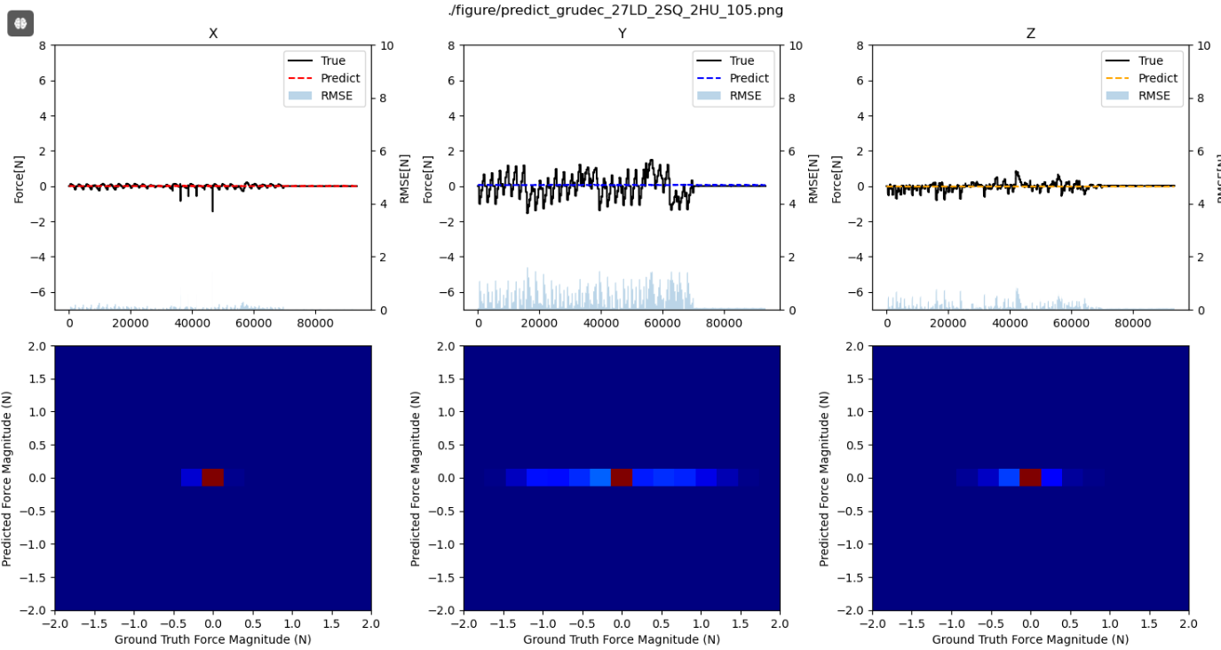
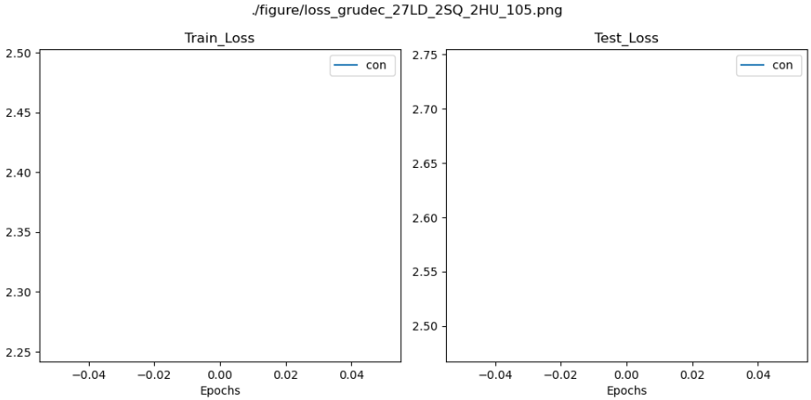
2.Learning.ipynb
(3) Show and save the model
(a). Compare the results
(b). Get the model and scaler and move them to on-line system

Slide 6
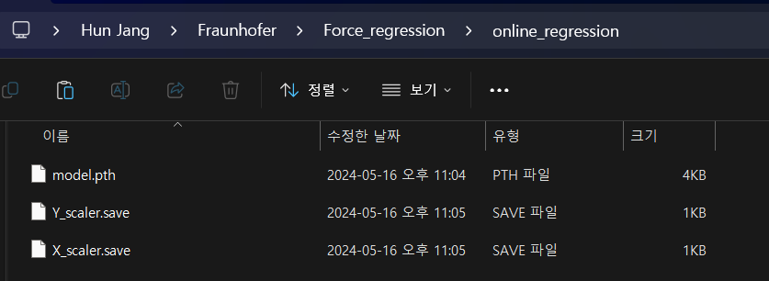
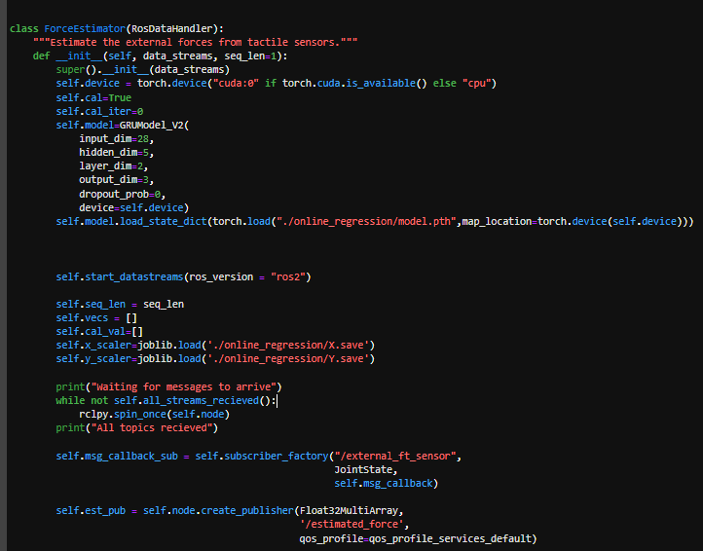
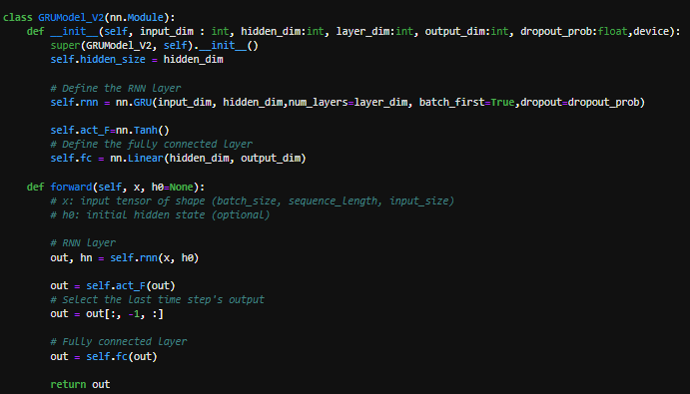
3. Online regression
(1)Place the best case and scalers in the folder named ‘online_regression’
Match to the file name
(2) If something change, modify the code
i. Model structure (Default model : GRU_v2 → Should be same structure as training model)
ii. Trained results(3 files ; model dict, X&Y scaler)
If python code doesn’t run, it should be placed at the right directory
If error occurs due to device location, cpu position should be changed to ‘cuda’

