Slide 1
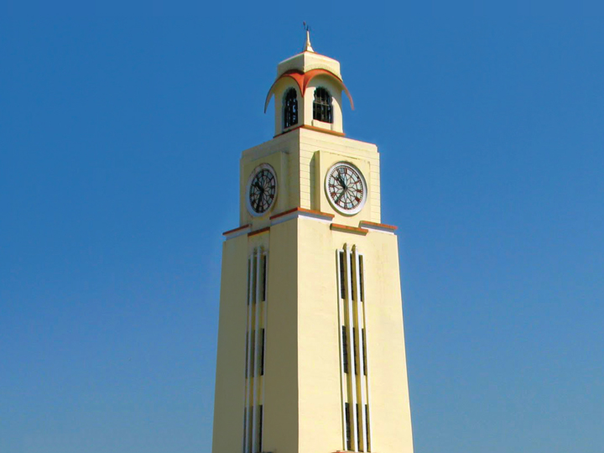

Exercise #3: Simulation of distance-vector algorithm
BITS Pilani
EA ZC451 Internetworking Technologies
(1st Sem 2016-17): Assignment
Pilani | Dubai | Goa | Hyderabad
EA ZC451

Slide 2

Agenda
Team
Routing
  Routing Algorithm
    Distance Vector Routing Algorithm
    Demo
    Q&A
EA ZC451
BITS Pilani, Deemed to be University under Section 3 of UGC Act, 1956

