Slide 1
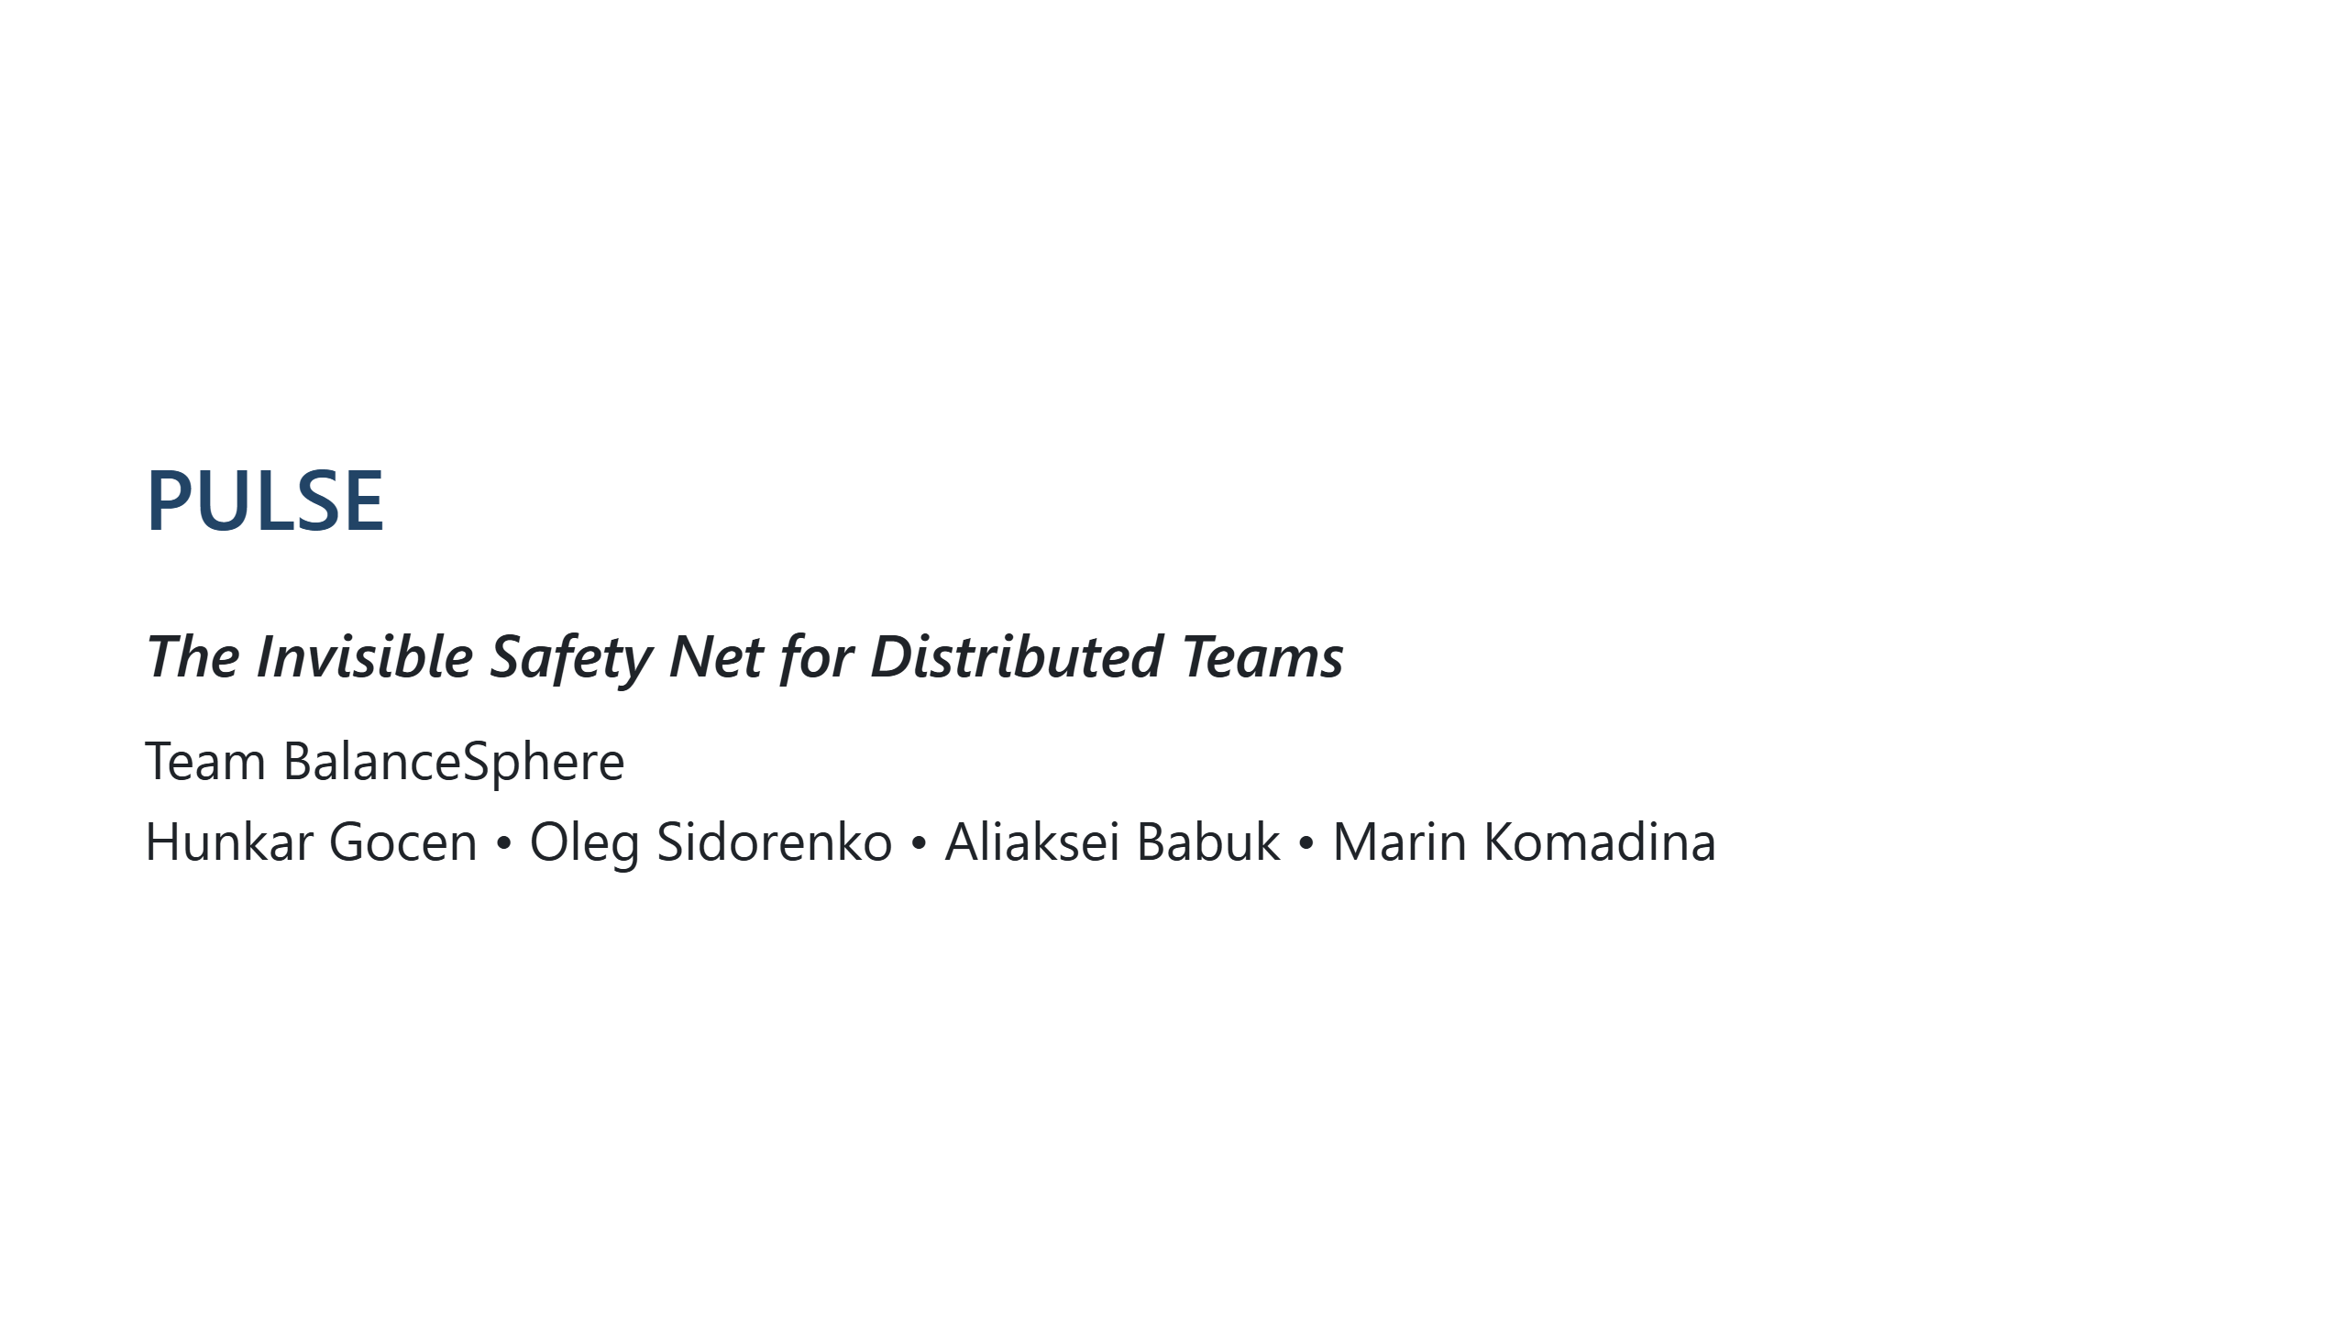
Notes:
Opening slide. Set the tone: confident, human, impactful.

Slide 2
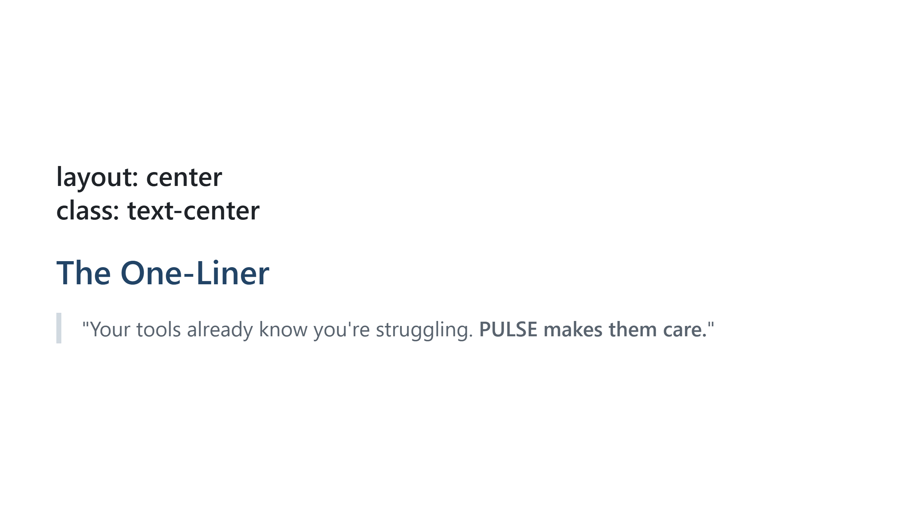
Notes:
Pause here. Let this land. This is the core message.

Slide 3
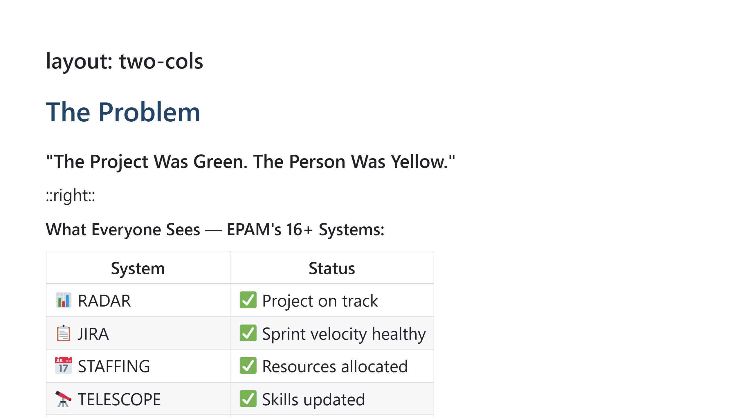
Notes:
Build tension: Everything looks green. All systems healthy.

Slide 4
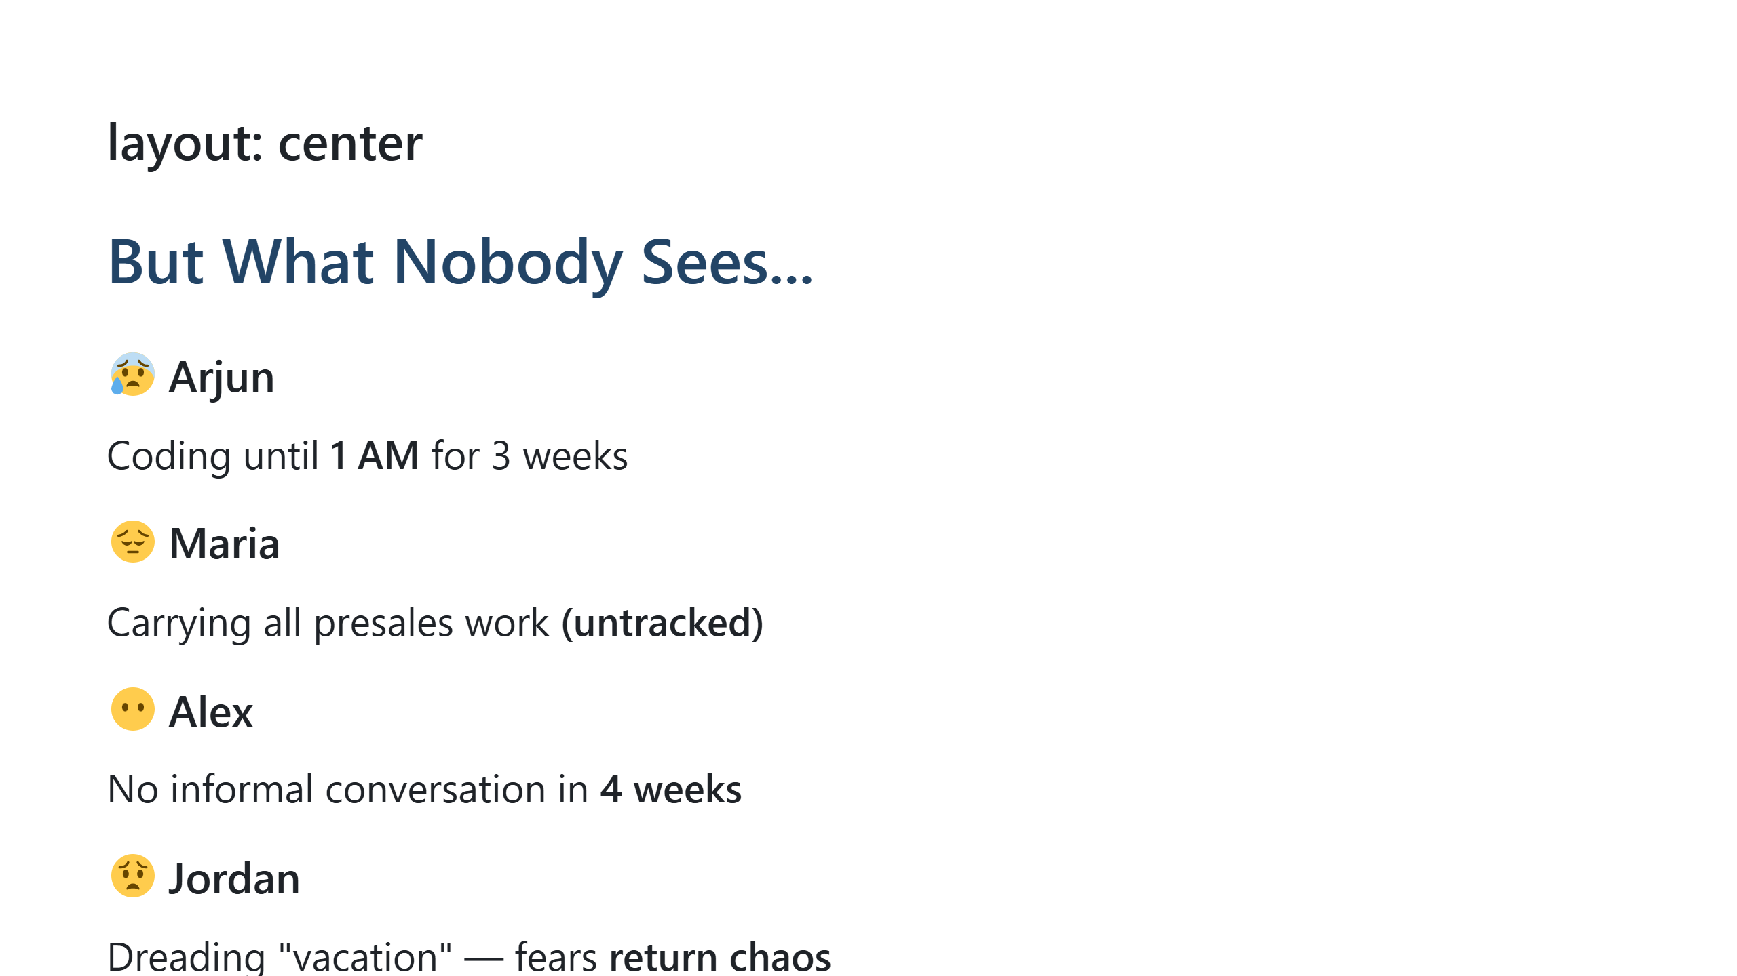
Notes:
This is the emotional core. These are real patterns we see.

Slide 5
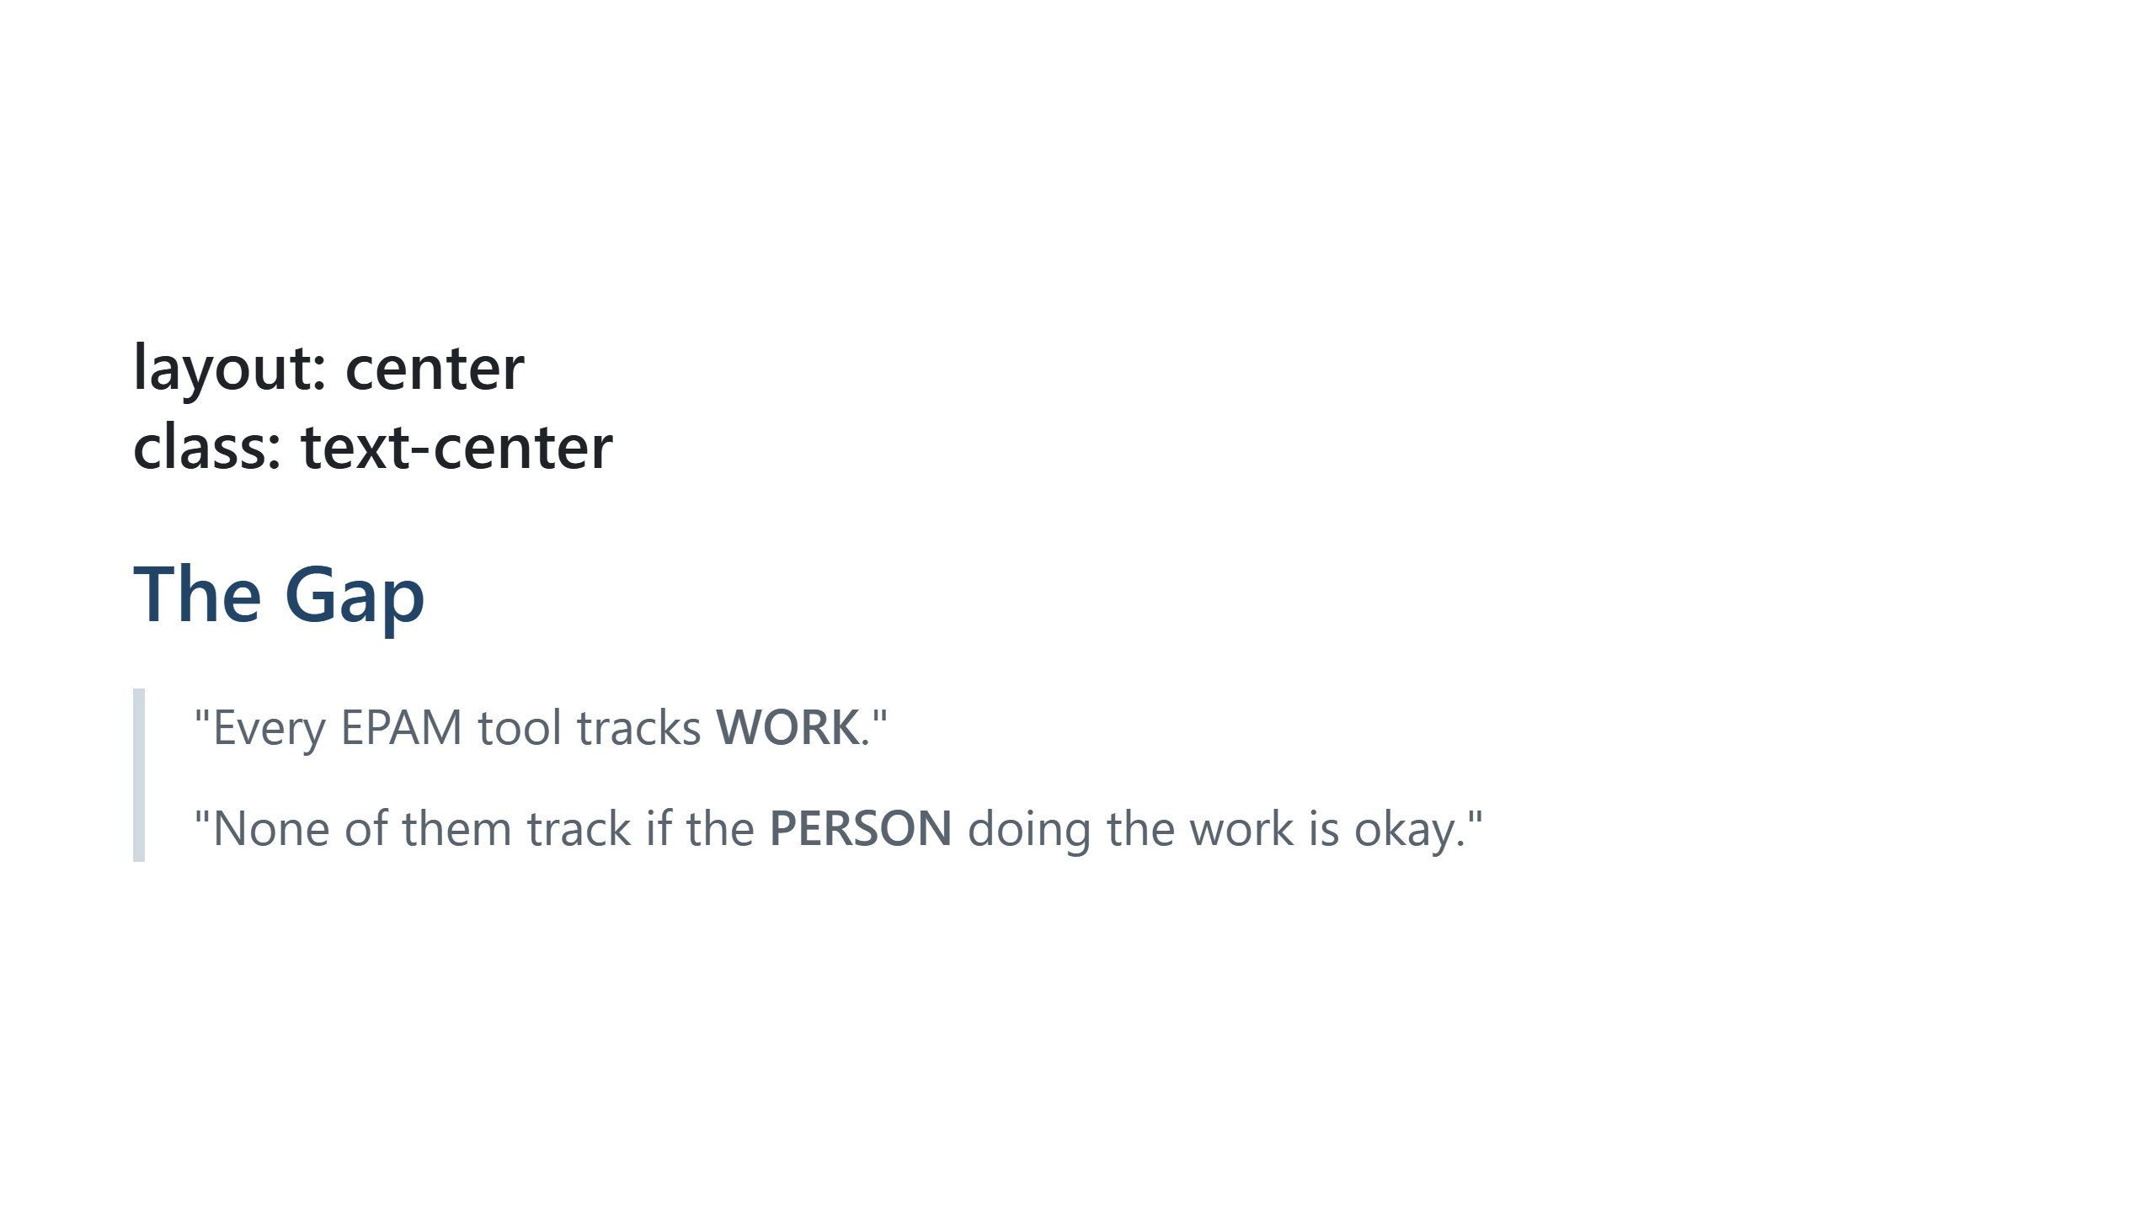
Notes:
The insight. This is what we're solving.

Slide 6
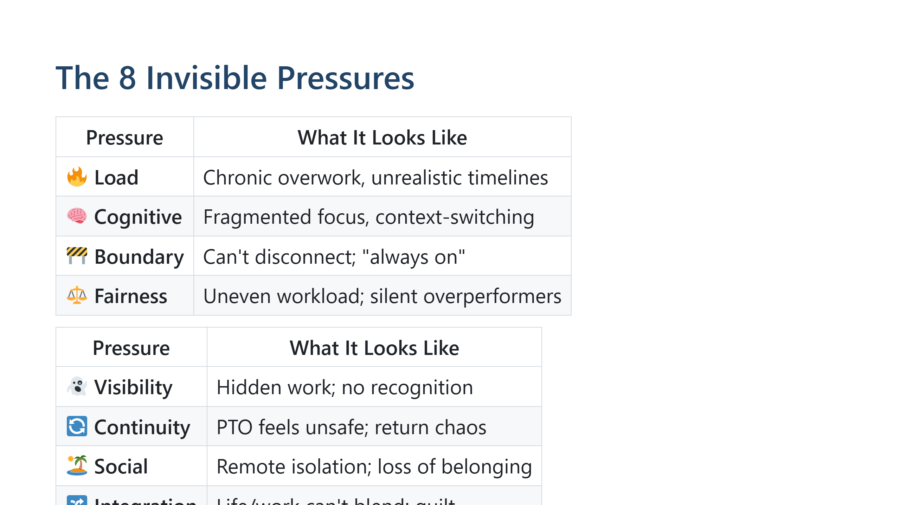
Notes:
The research behind PULSE. These are the 8 pressures our team identified.

Slide 7
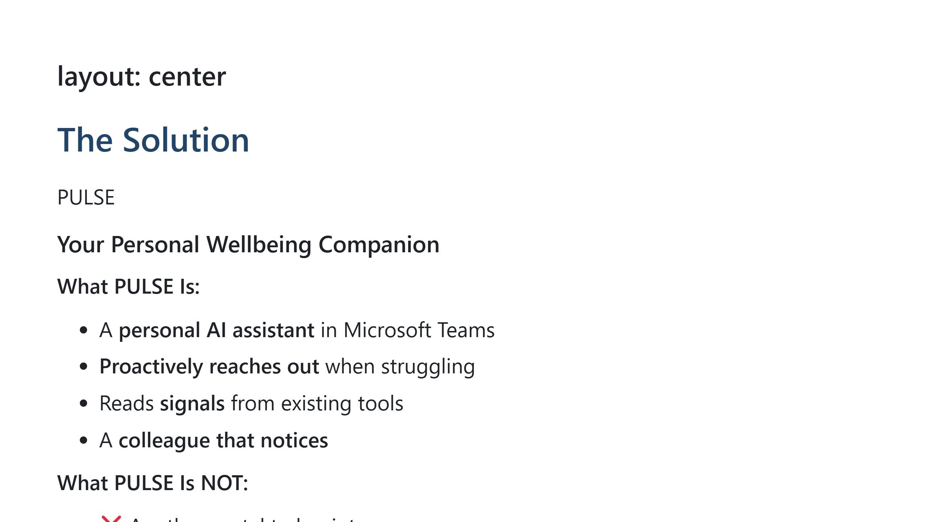
Notes:
Clear positioning. We're not adding surveillance. We're adding care.

Slide 8
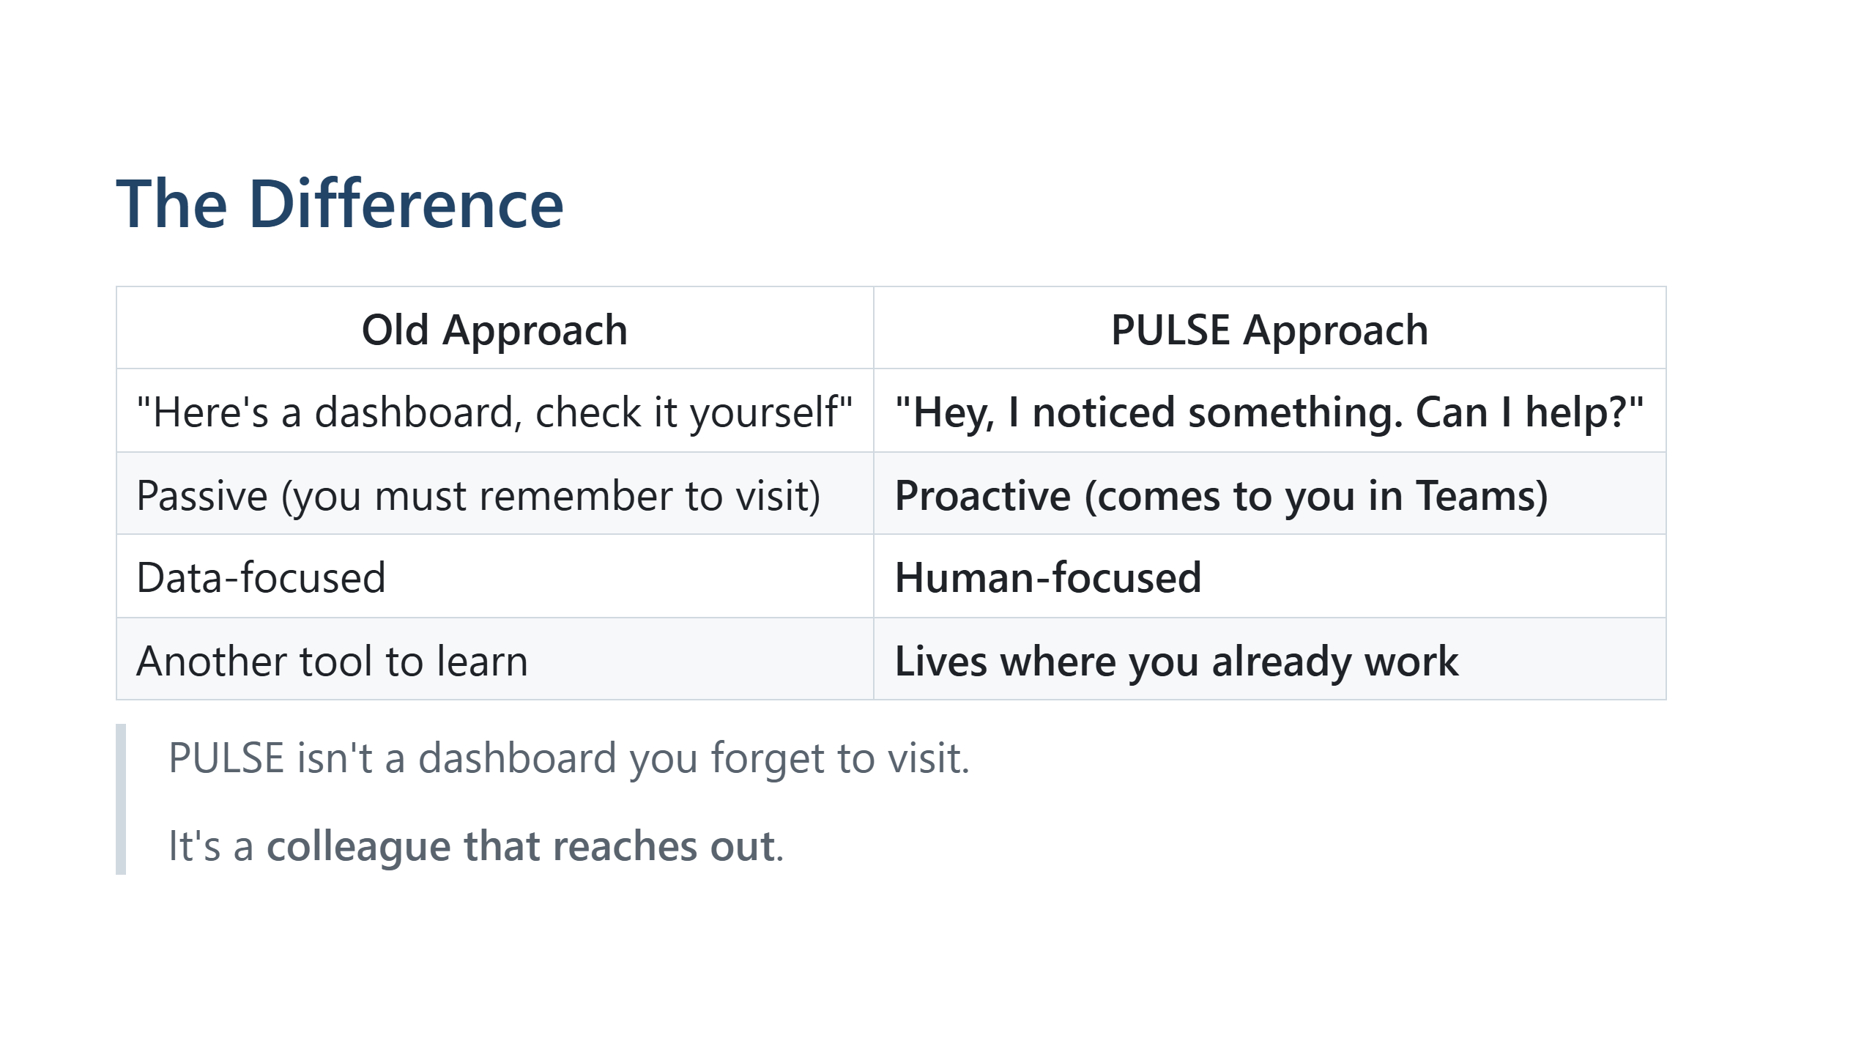
Notes:
This is key differentiation. Bot-first, not dashboard-first.

Slide 9
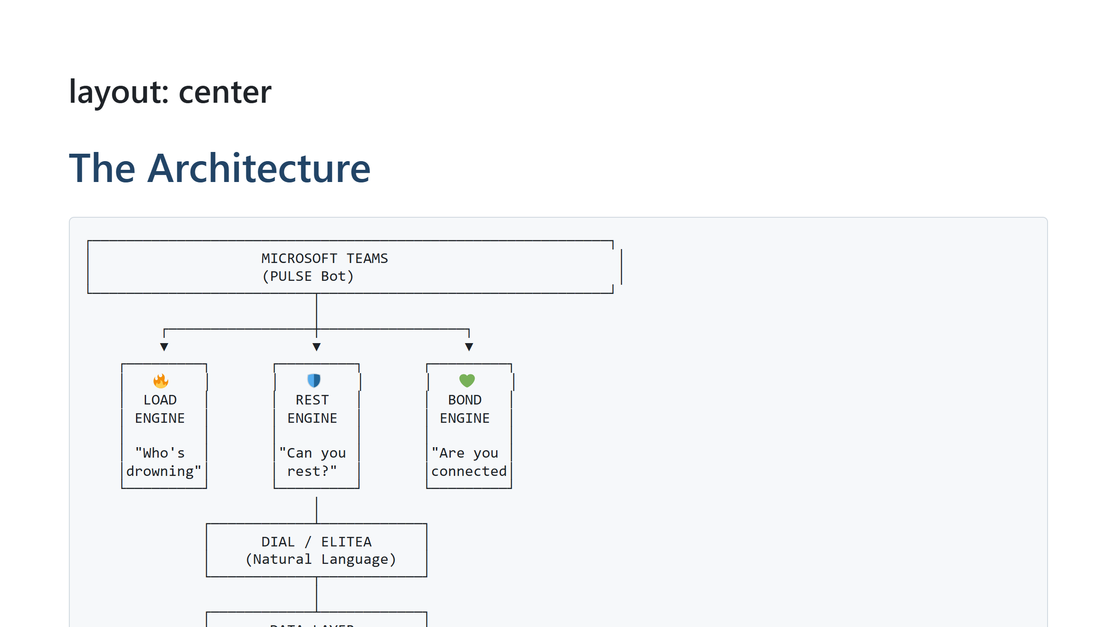
Notes:
Show how it all connects. EPAM's AI (DIAL/ELITEA) powers the natural language.

Slide 10
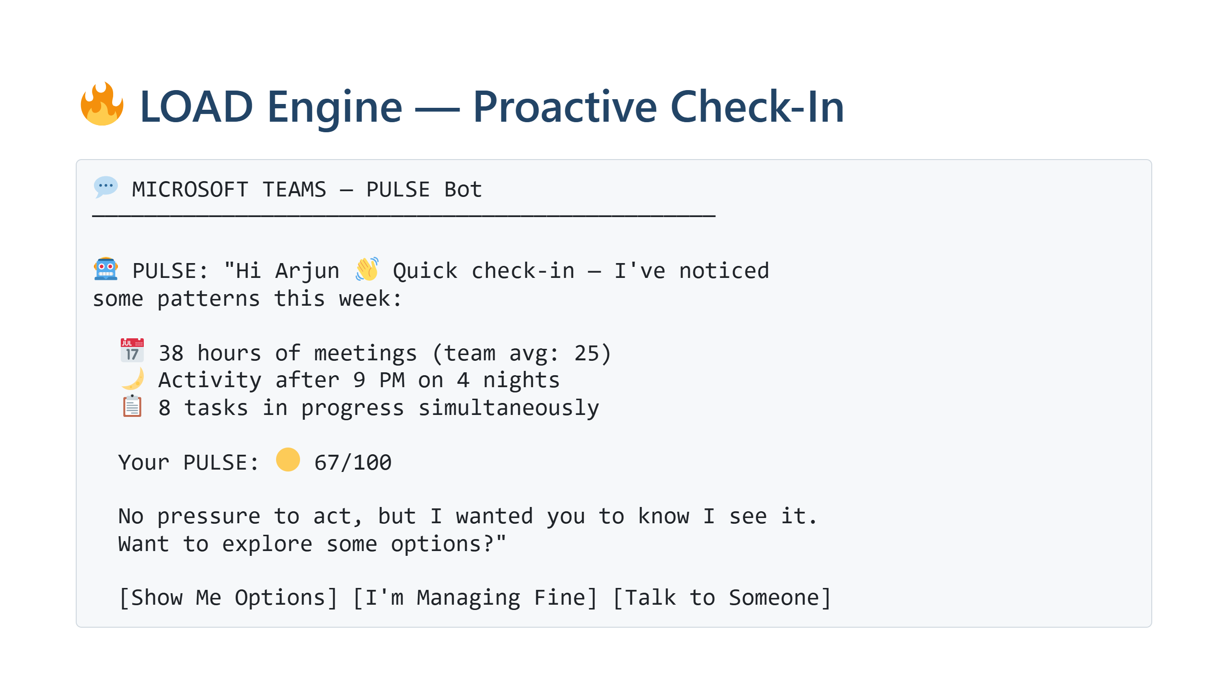
Notes:
Show the actual bot experience. This is what makes it real.

Slide 11
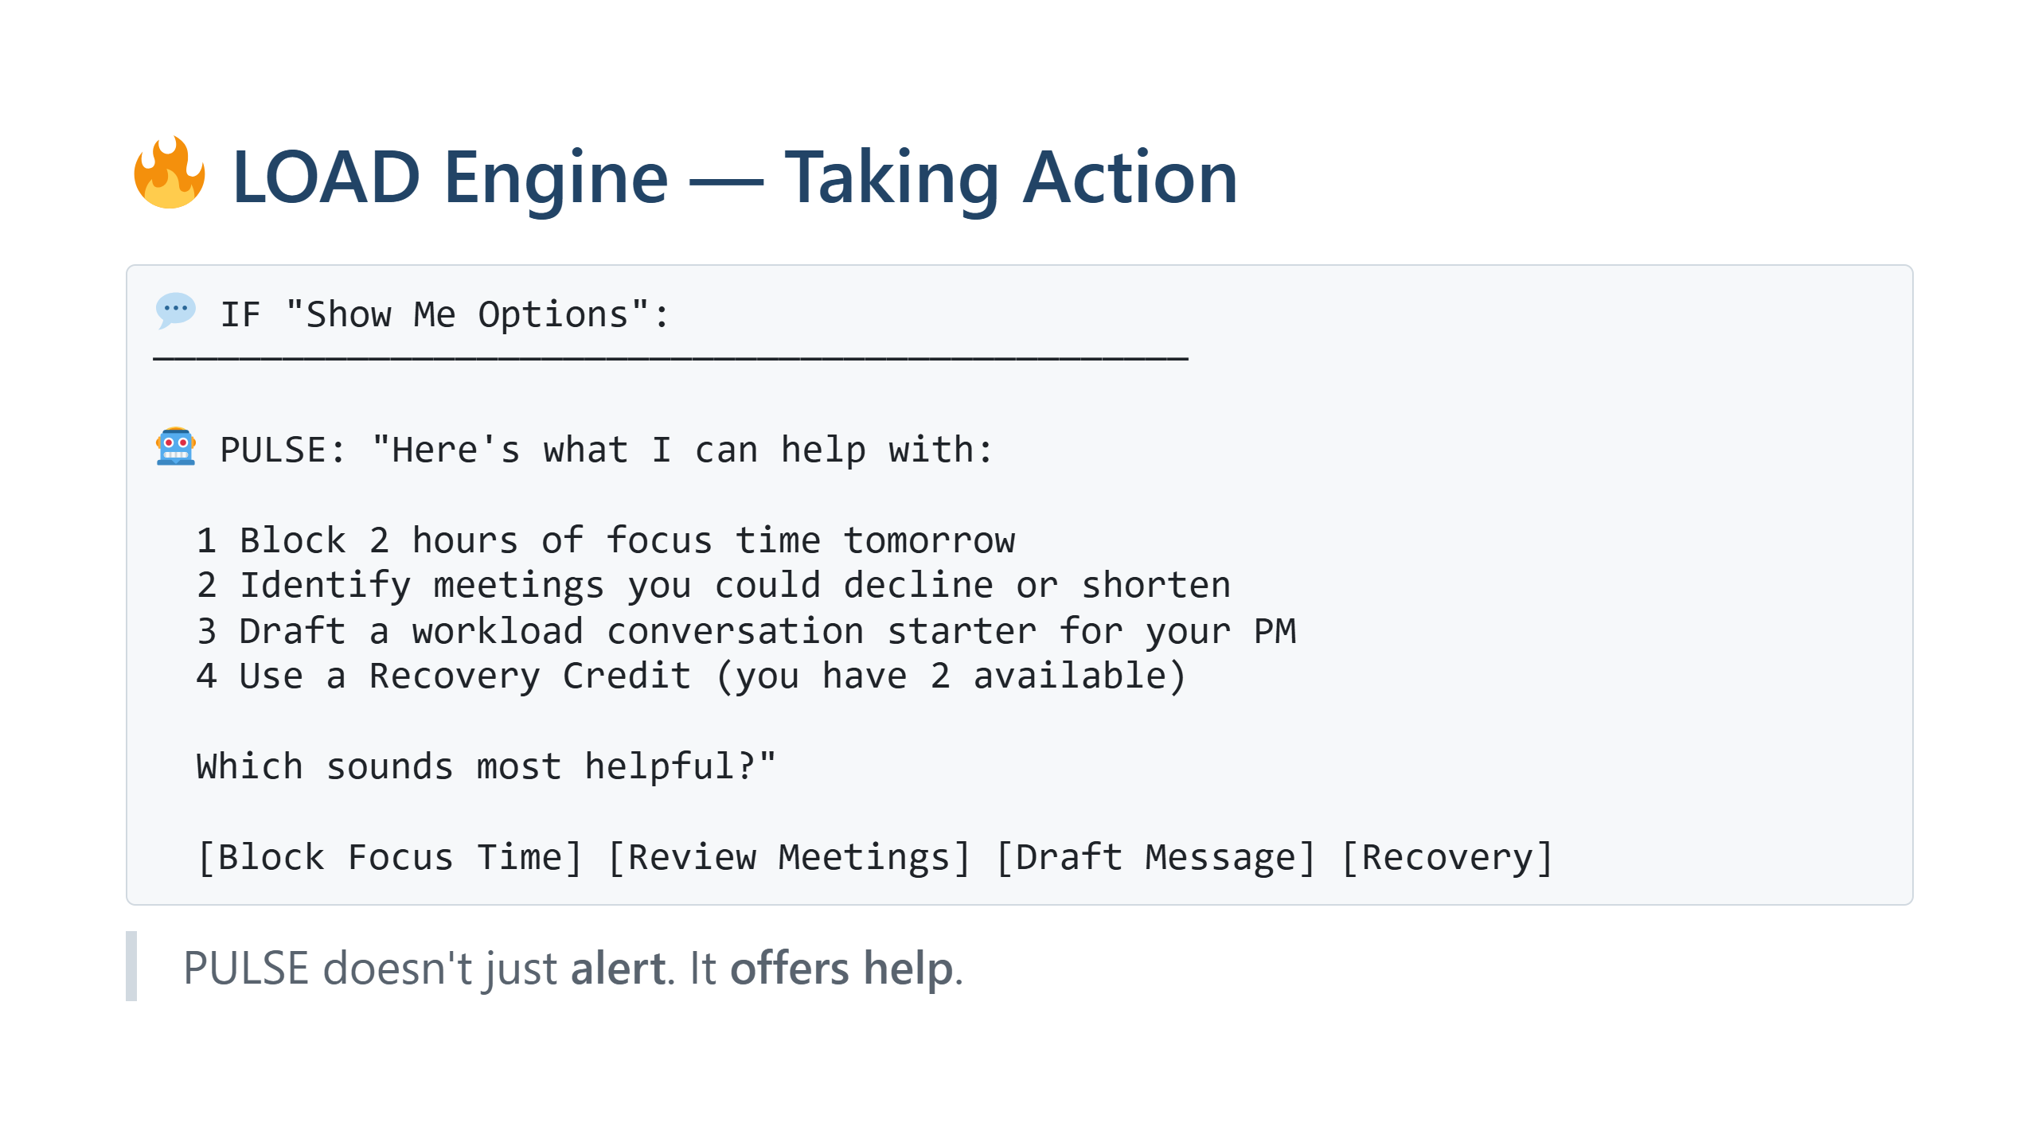
Notes:
The key: we don't just notify, we provide actionable options.

Slide 12
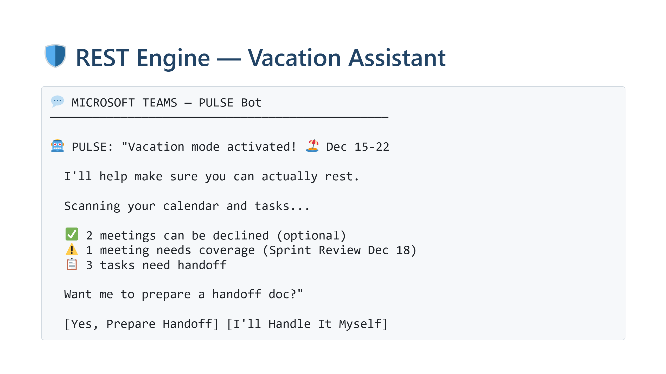
Notes:
This solves the "vacation anxiety" problem. PULSE does the prep work.

Slide 13
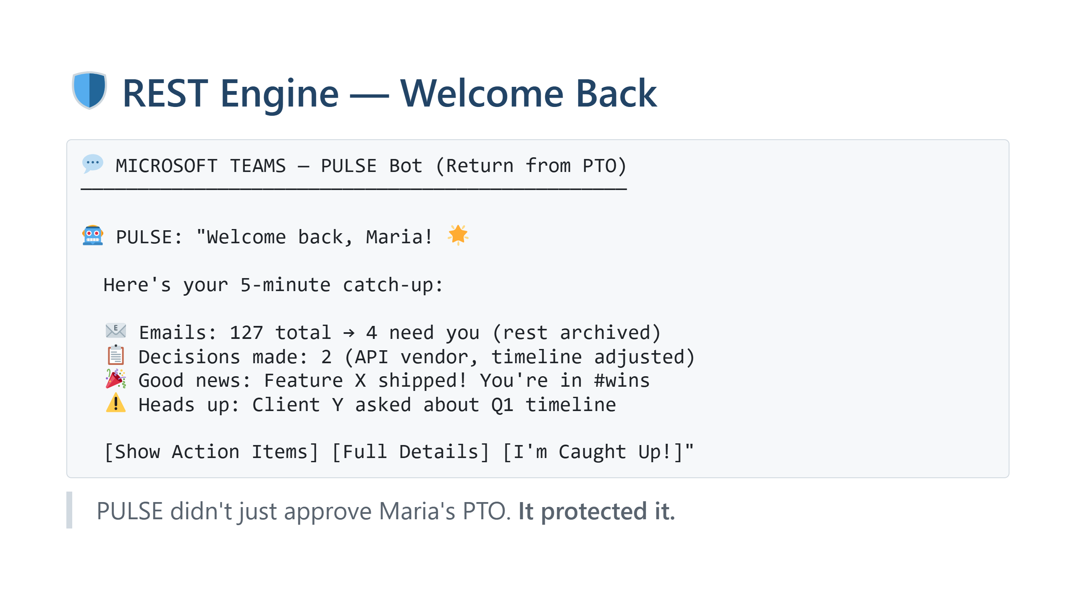
Notes:
The return experience is just as important as leaving.

Slide 14
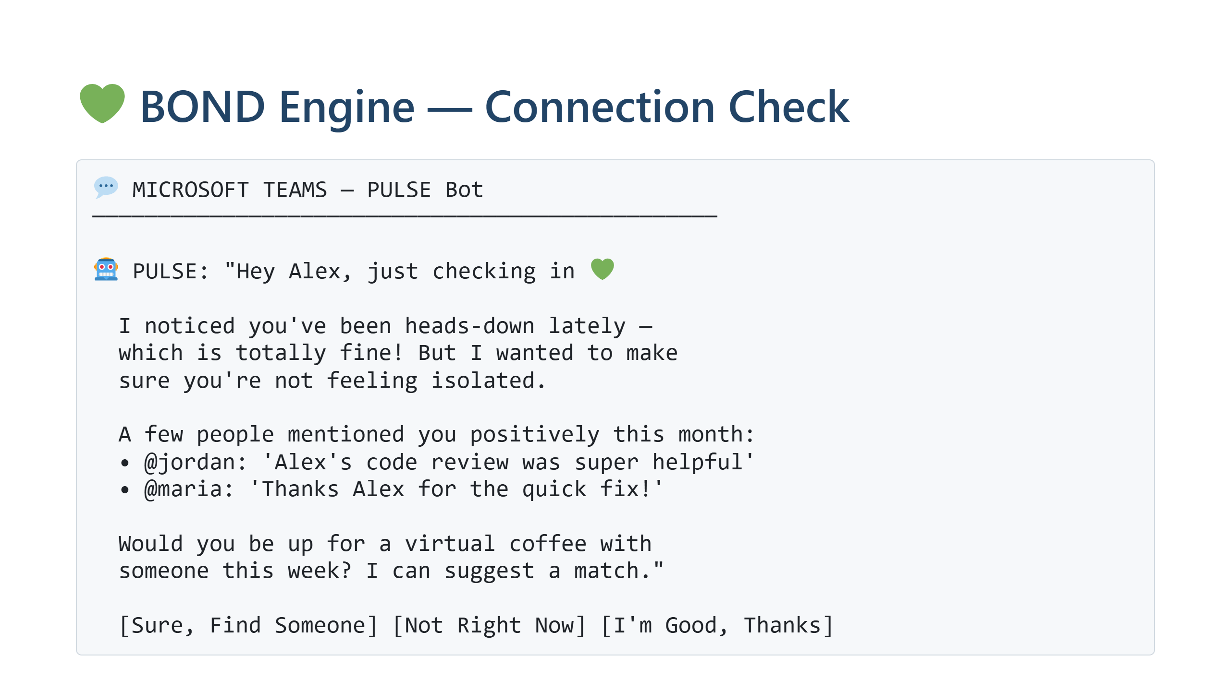
Notes:
Social isolation is invisible. PULSE catches it before it becomes loneliness.

Slide 15
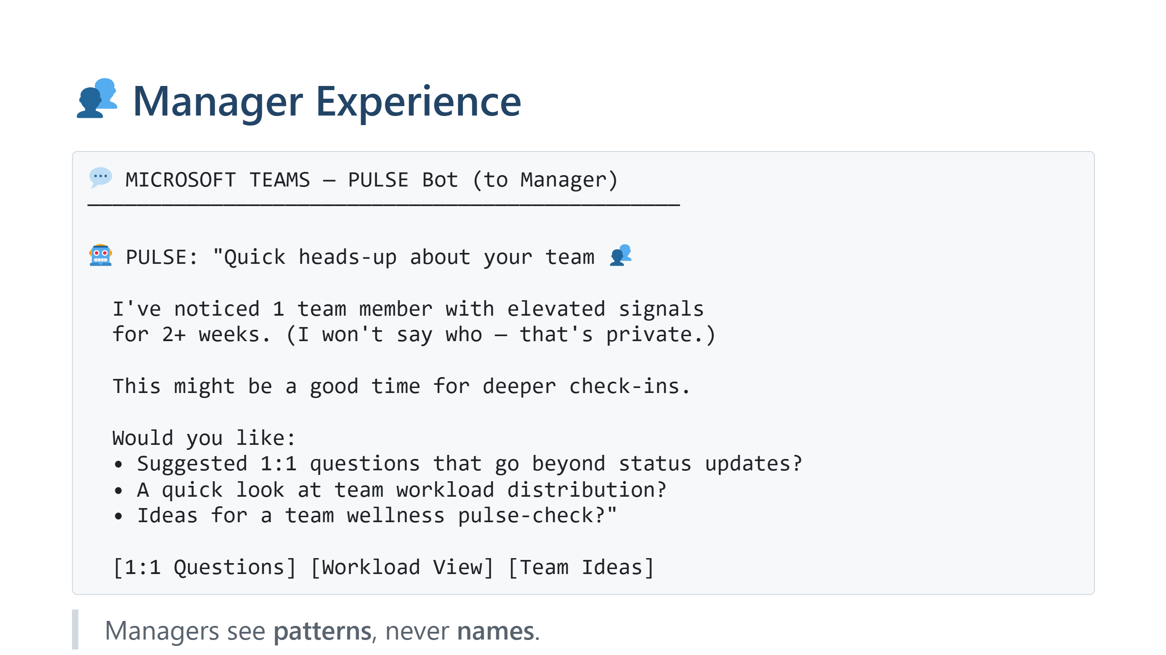
Notes:
Privacy is key. Manager gets a nudge, not a report.

Slide 16
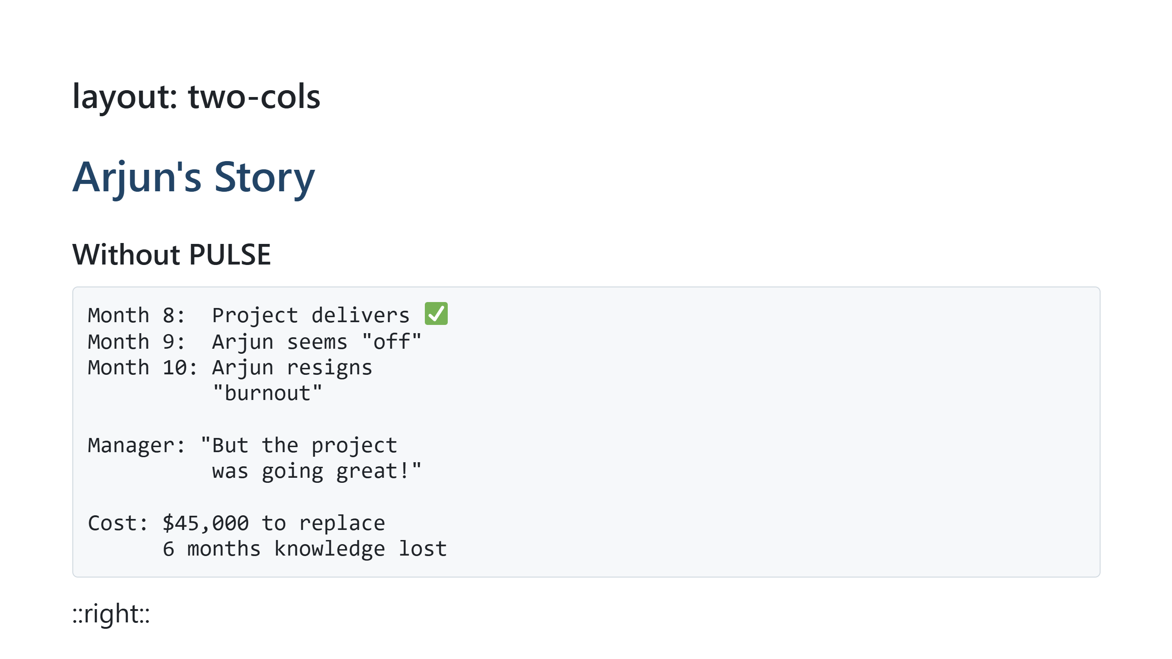
Notes:
The before/after that makes the case. Real impact.

Slide 17
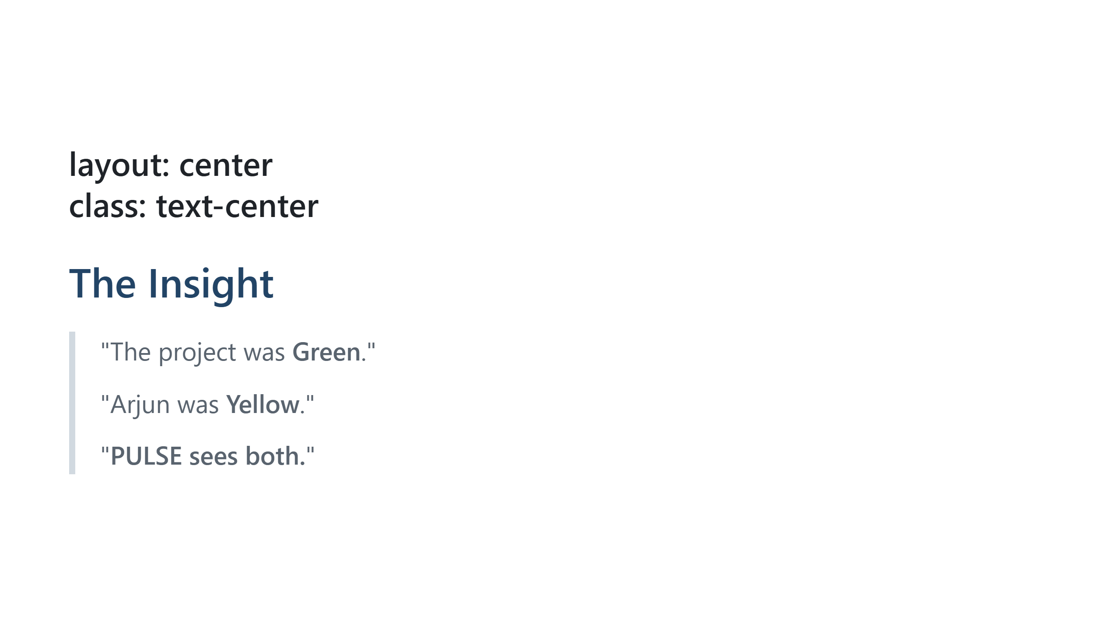
Notes:
This is the memorable line. Repeat it.

Slide 18
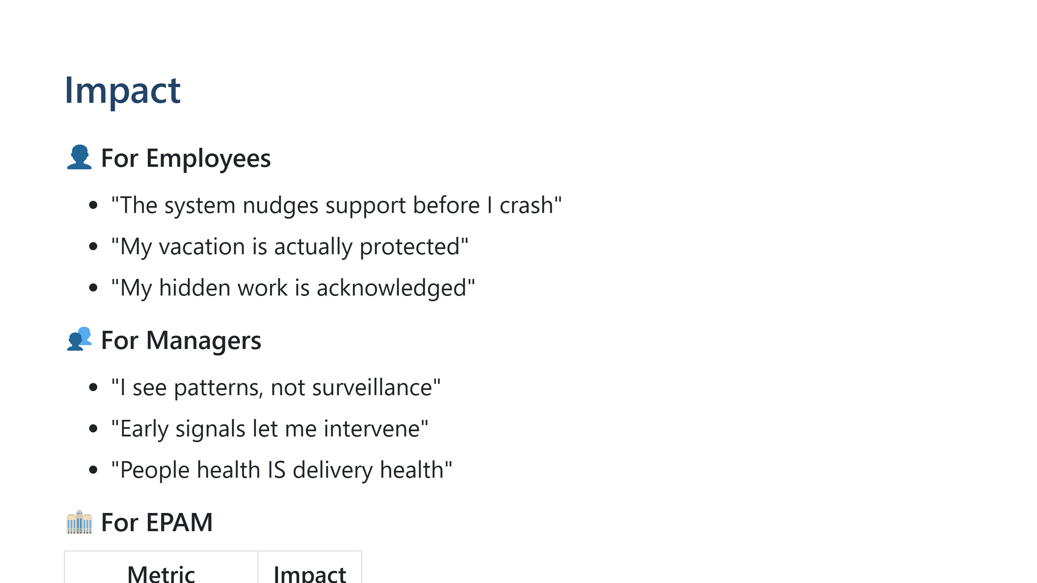
Notes:
Triple win: employee, manager, company.

Slide 19
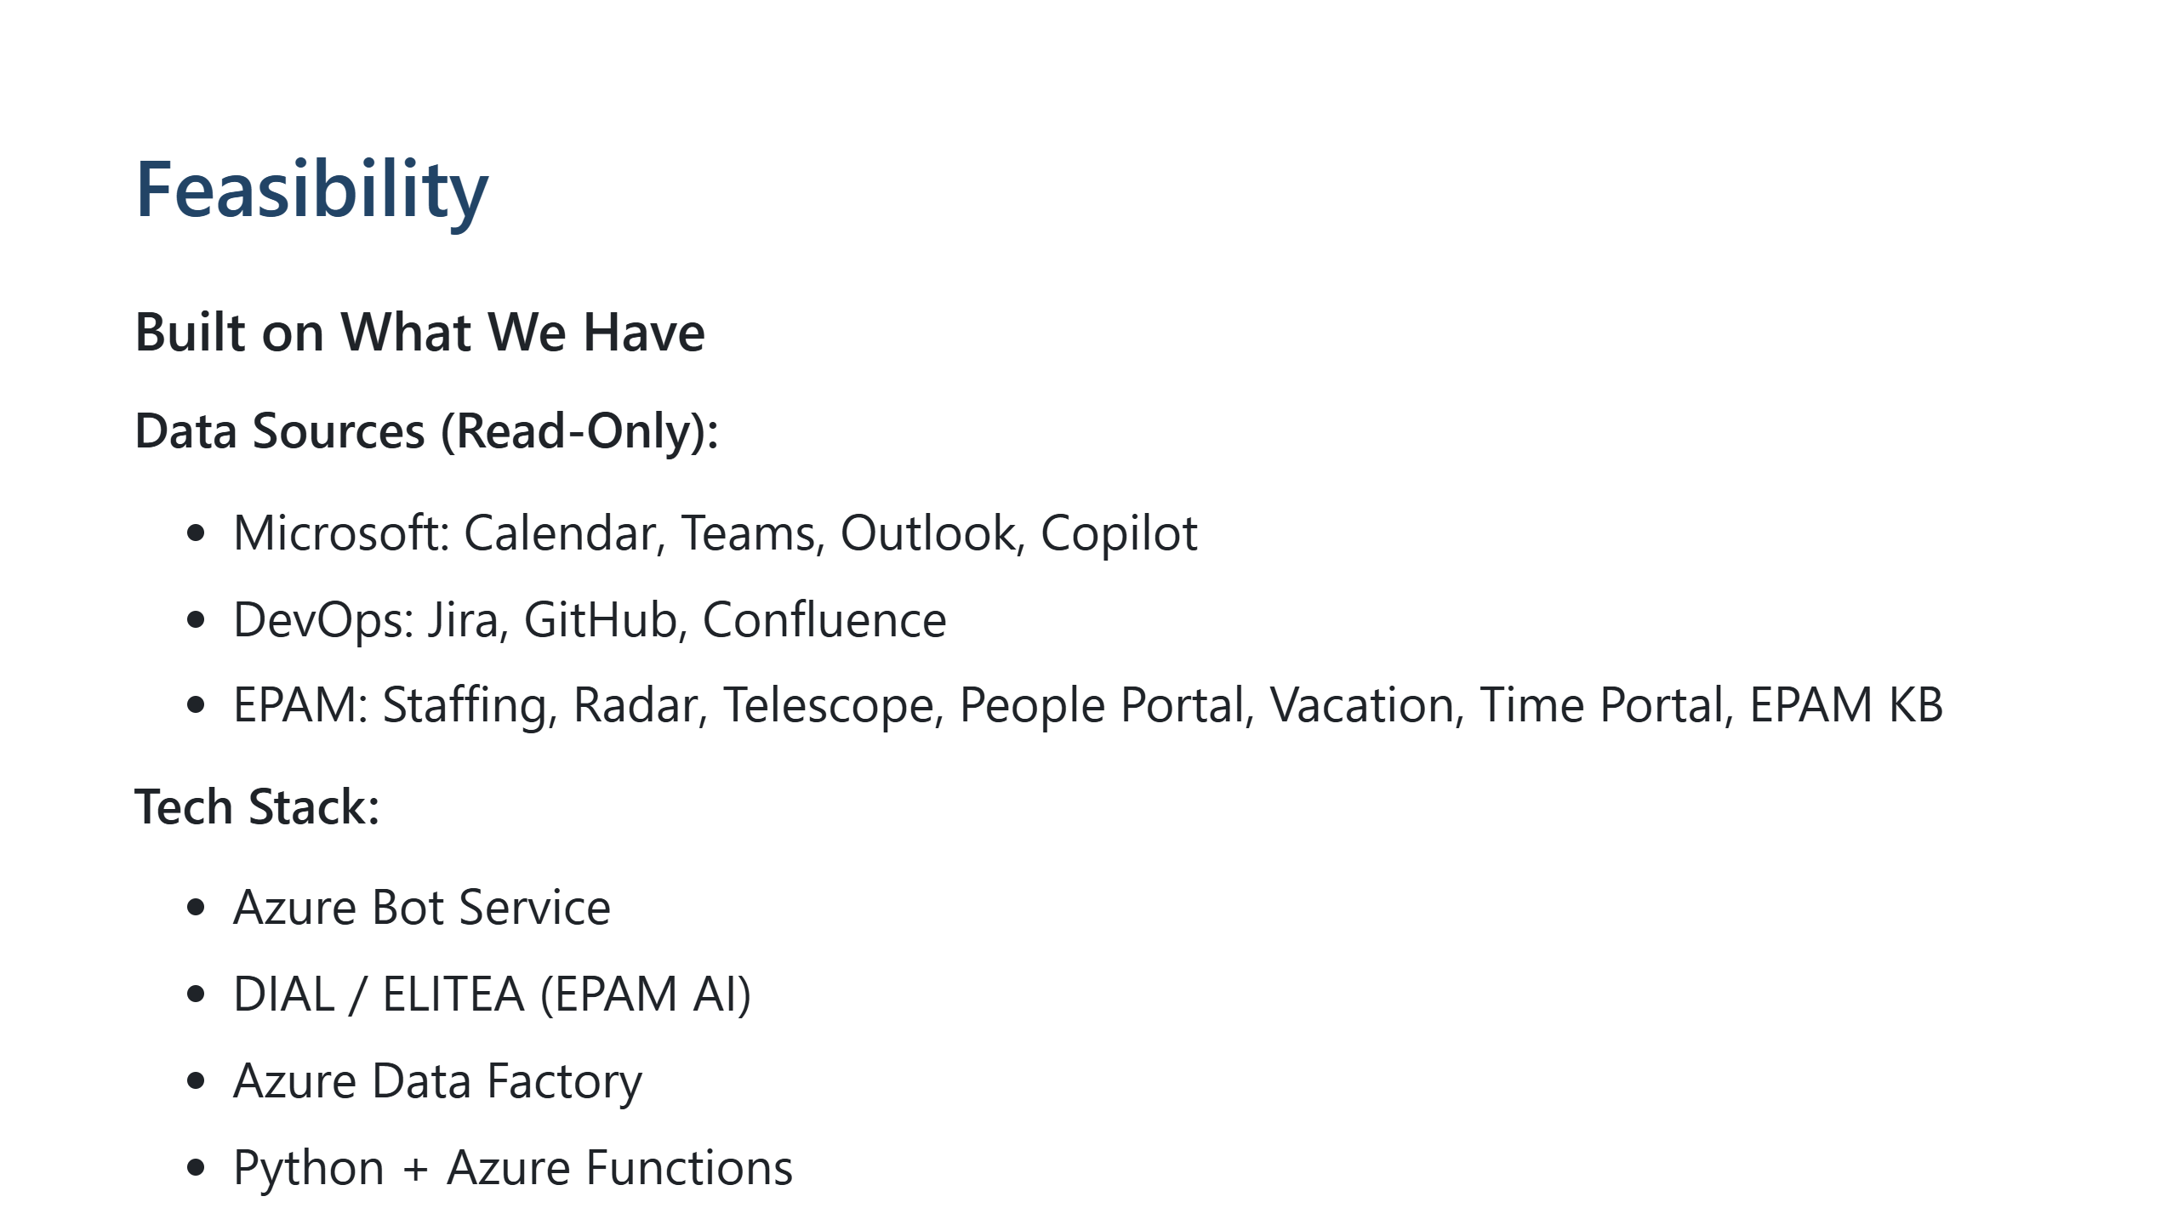
Notes:
Show it's realistic. Phase 1 is 6 weeks with 2-3 engineers.

Slide 20
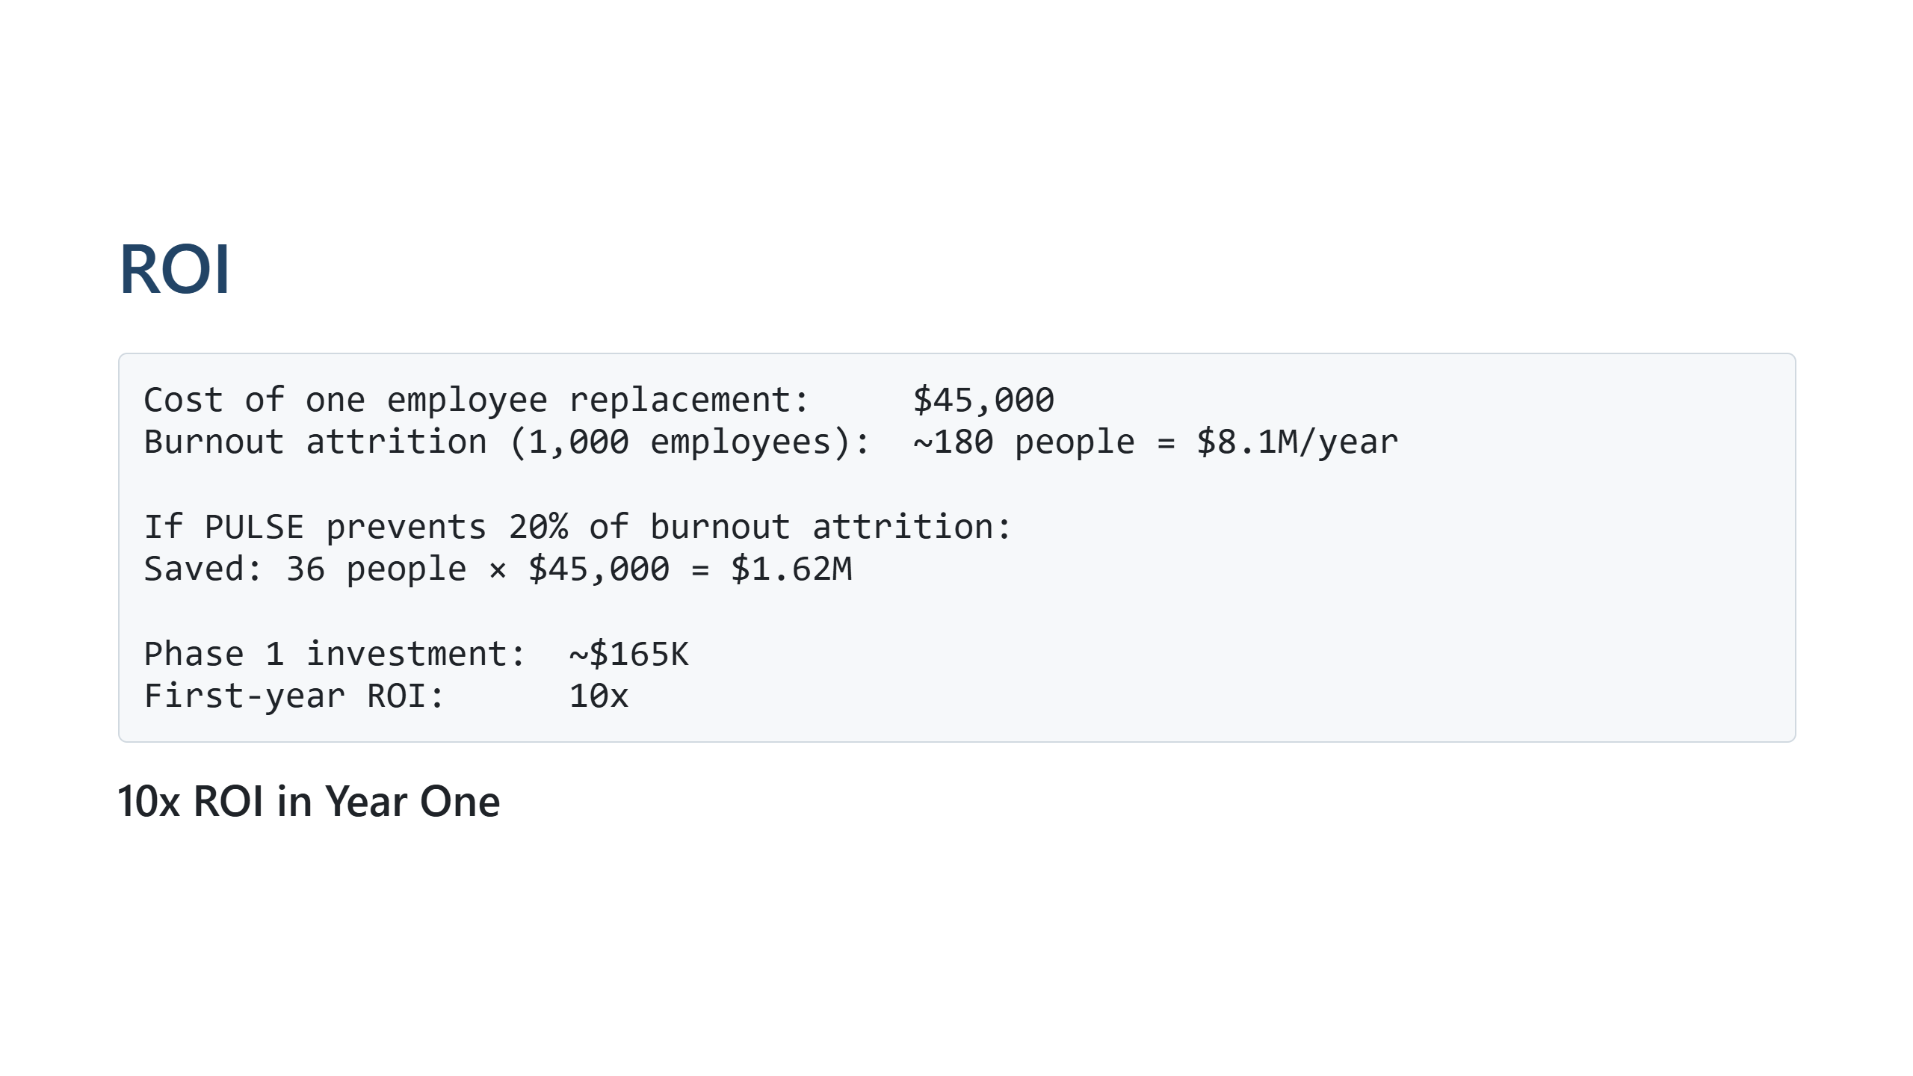
Notes:
The business case is clear.

Slide 21
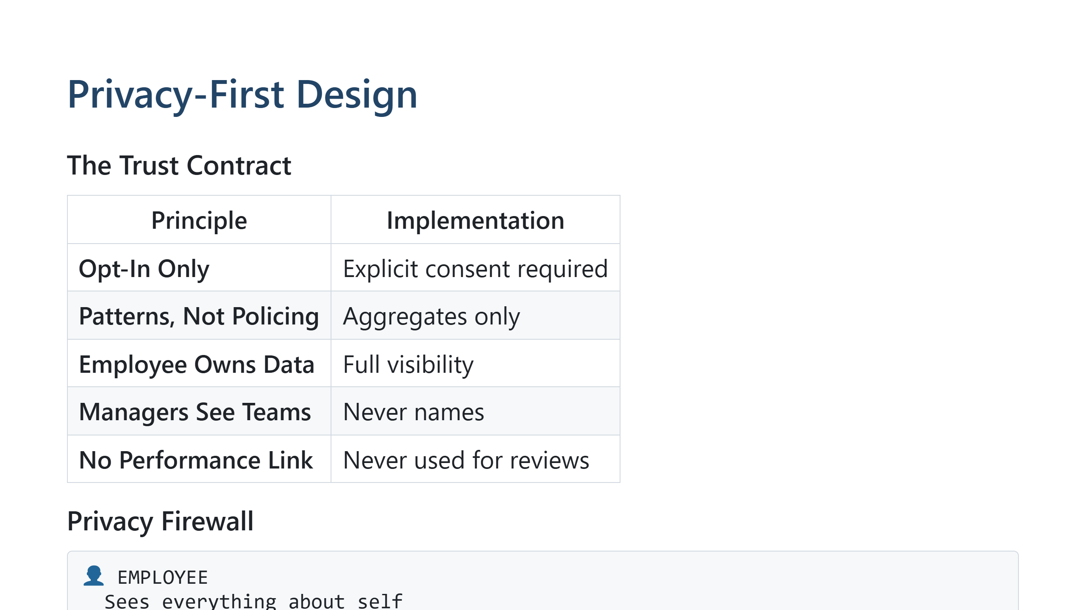
Notes:
Address the surveillance concern head-on. We're not Big Brother.

Slide 22
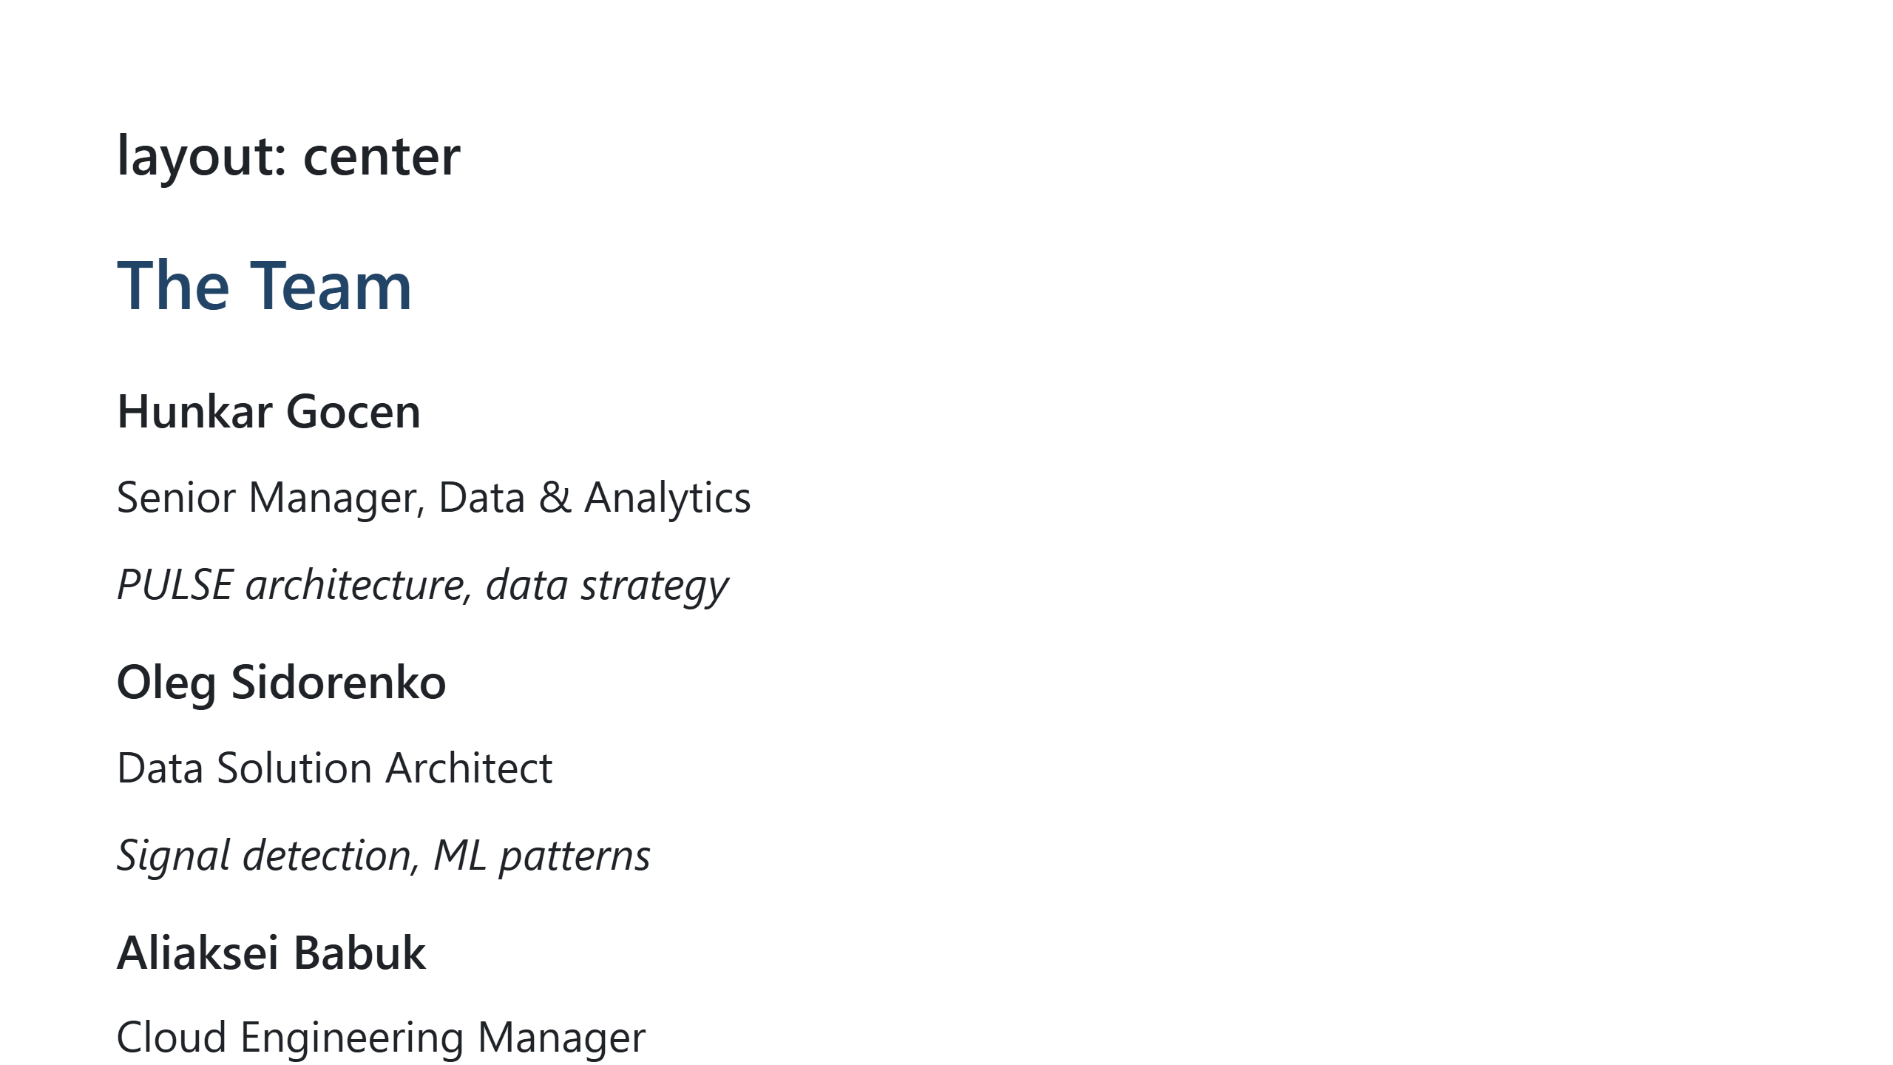
Notes:
We built this because we need it ourselves.

Slide 23
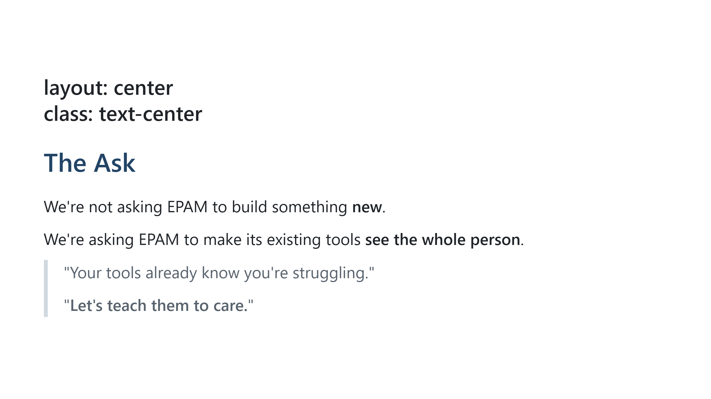
Notes:
End strong. This is the call to action.

Slide 24
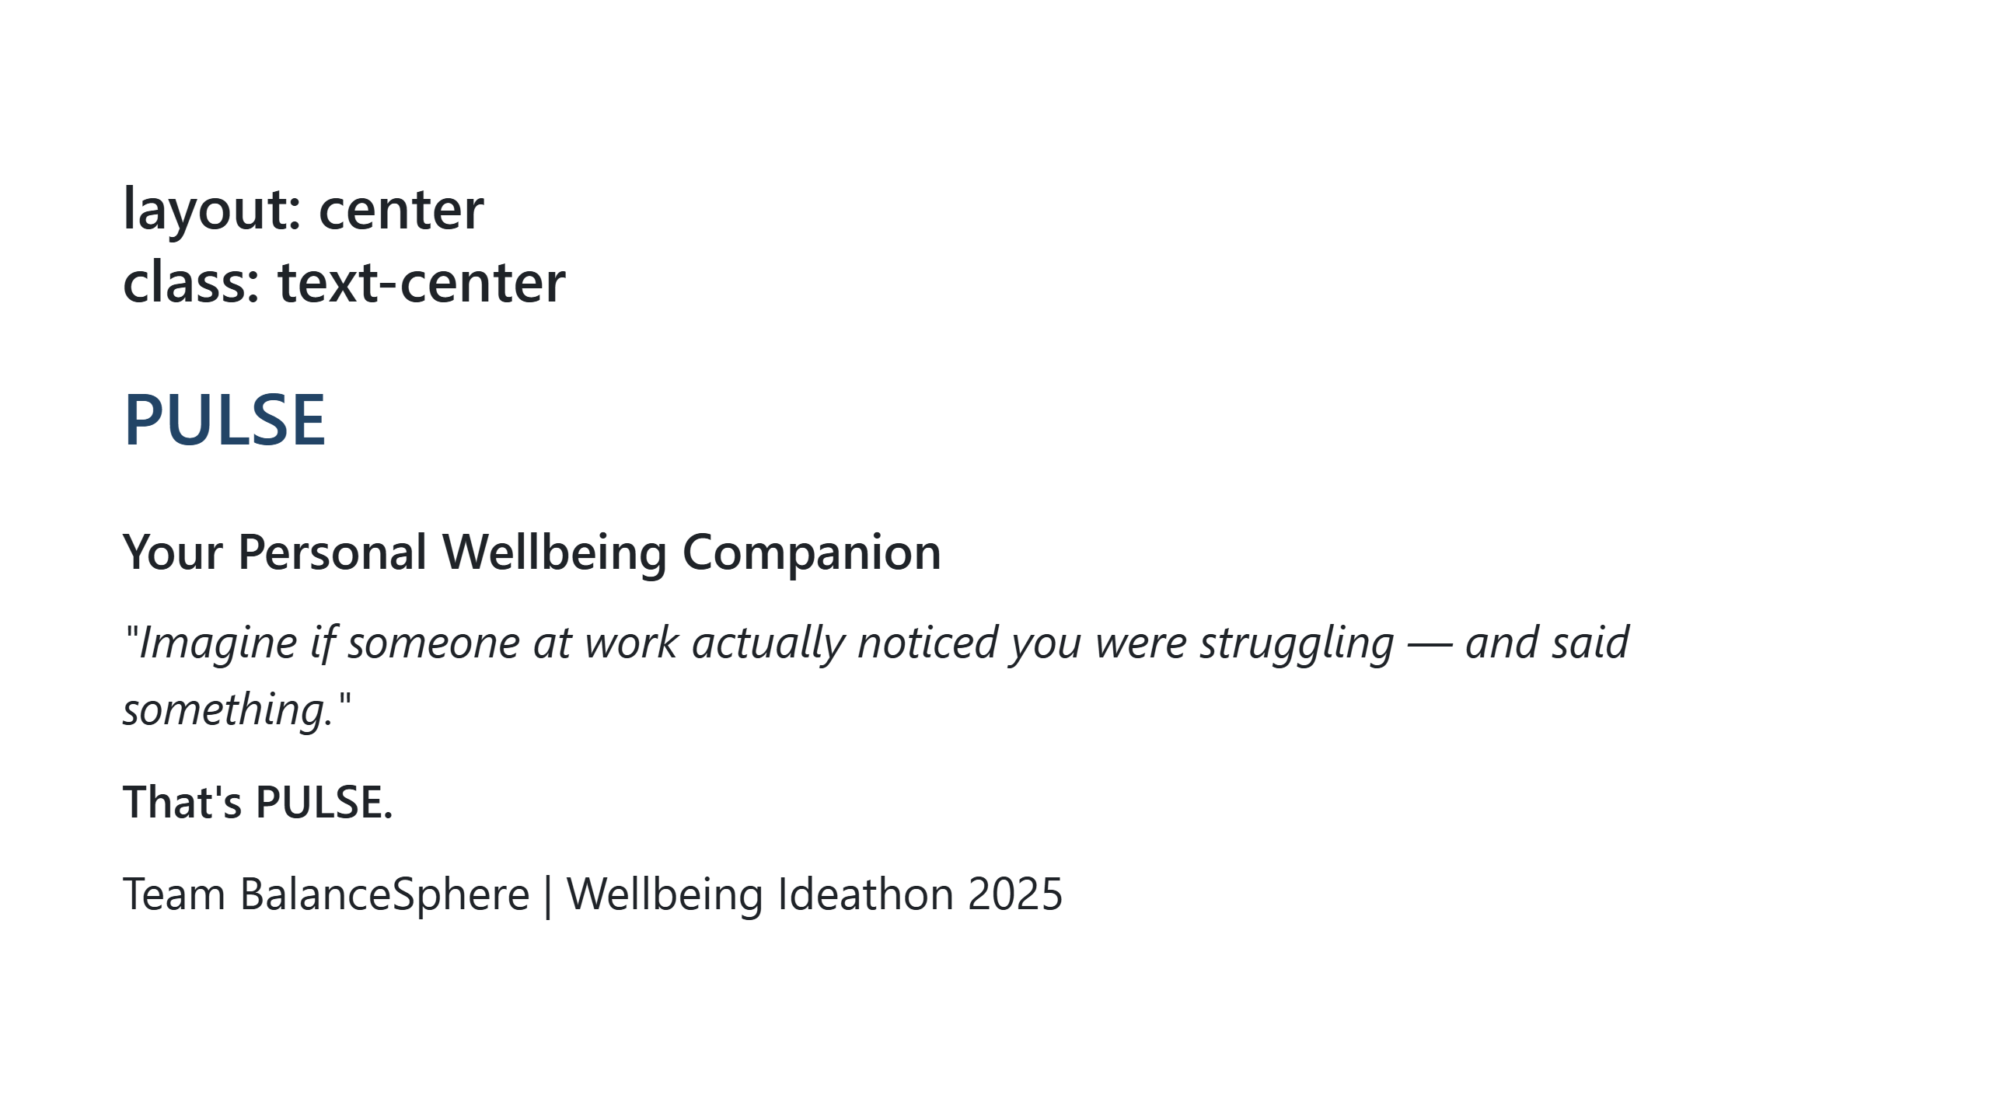
Notes:
Final slide. Let it sit. Thank the audience.

