Slide 1
TCSS558 – Applied Distributed Computing 3-Tier Distributed System
Nicolas Solovyev
Himanshu Thakur

Slide 2
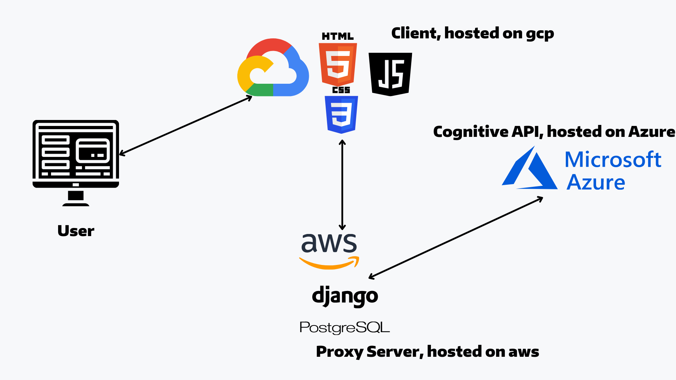
High Level Architecture

