Slide 1
TCSS558 – Applied Distributed Computing 3-Tier Distributed System
Nick Solovyev (2176780)
Himanshu Thakur (2075434)

Slide 2
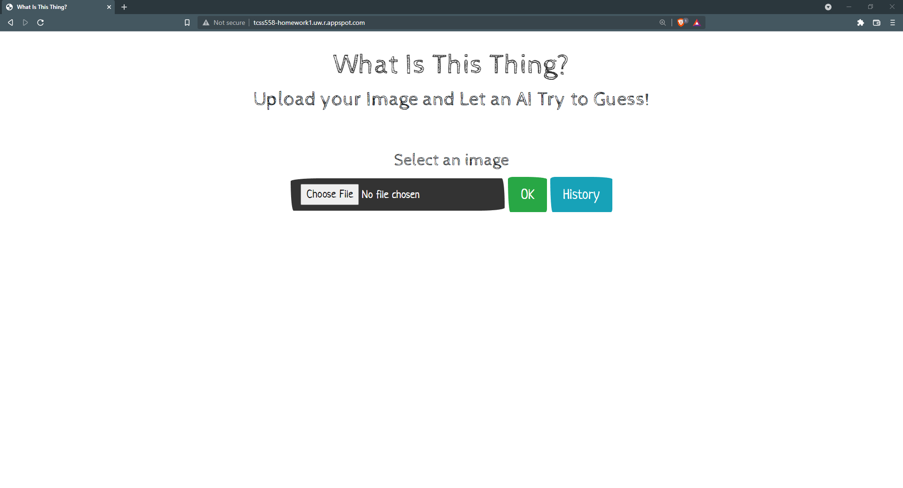

Slide 3
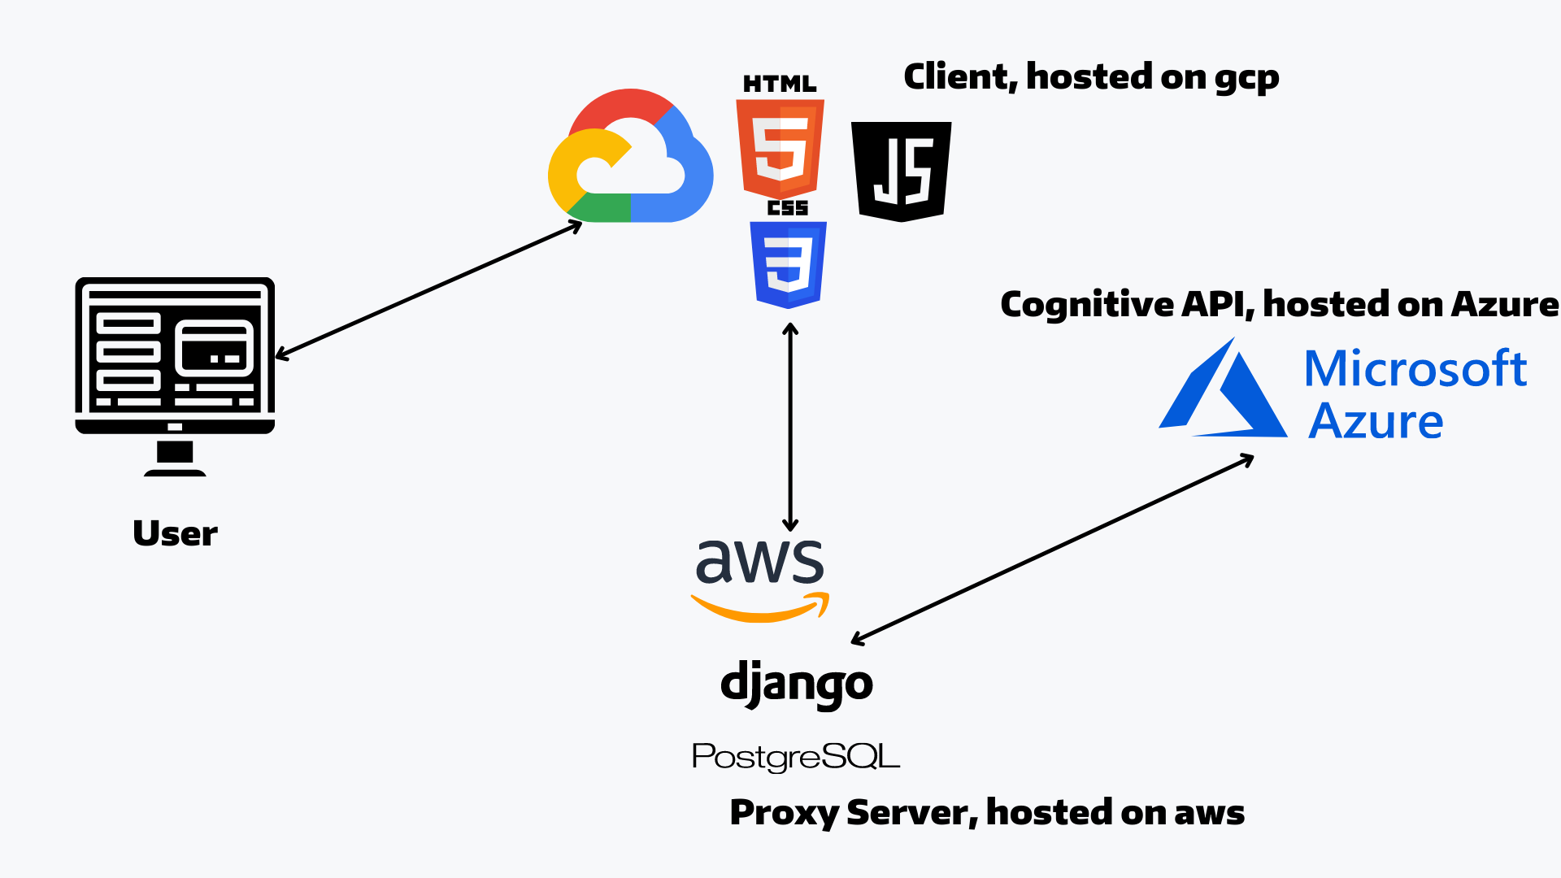
High Level Architecture

