Slide 1
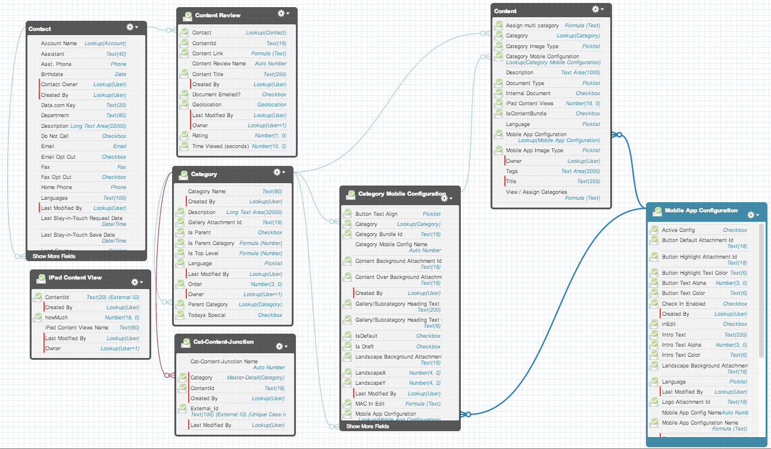
DSA Entity Relationship Diagram

