Slide 1
OPTICAL FLOW
LABORATORY

Slide 2
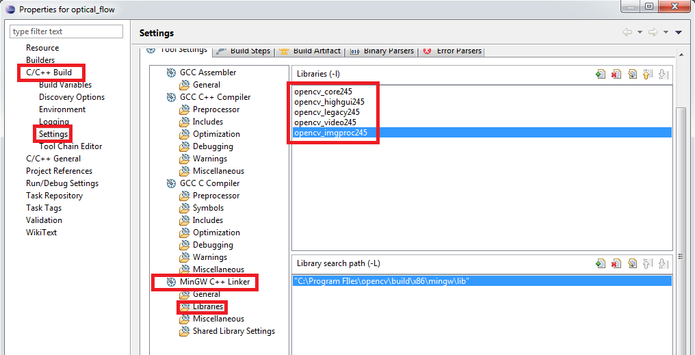
INCLUDING LIBRARIES
To run every example, we have to insert library links:
Windows:

Slide 3
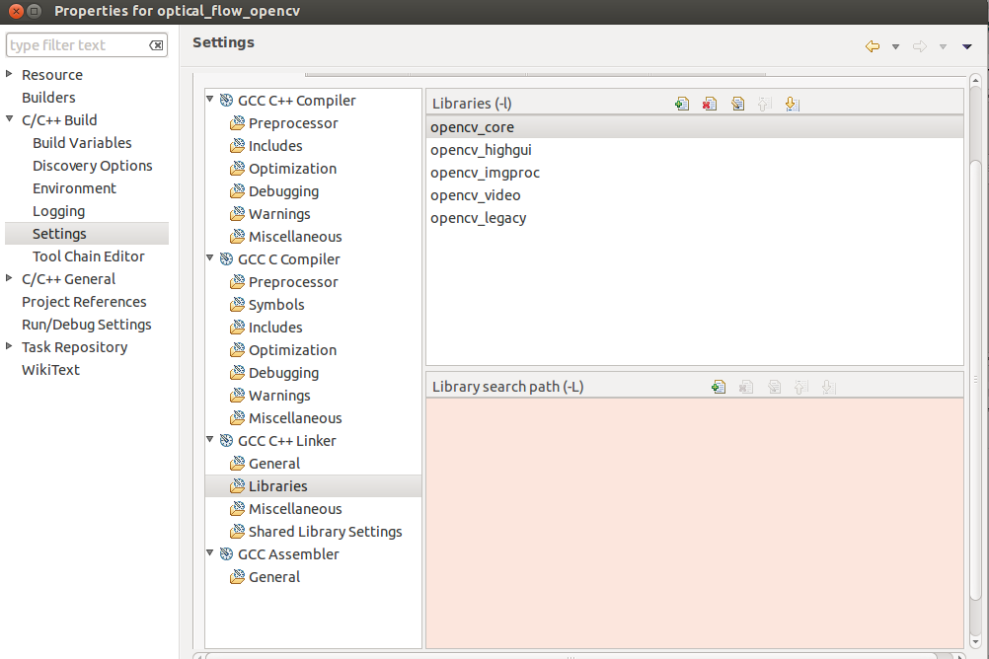
INCLUDING LIBRARIES
To run every example, we have to insert library links:
Ubuntu:

Slide 4
VARIABLES AND STRUCTURES
IplImage: Header for general image; inherited from Intel Processing Library
CvCapture: Video capturing structure
CvSize: 2 int tupla;
often used for window size (width, height)
CvPoint2D32F: 2D point with float coordinates (x, y)
CvScalar: tupla representing 4 int (color+channel)
CvTermCriteria: Termination criteria for iterative algorithms; params used: CV_TERMCRIT_ITER, CV_TERMCRIT_EPS

Slide 5
EXAMPLE VIDEO LINKS
Video used for the laboratory can be downloaded from this public link:
https://dl.dropboxusercontent.com/u/17194074/Optical_Flow_Video.rar

Slide 6
LOADING VIDEO
Using AVI file:
CvCapture *capture = cvCaptureFromAVI( argv[1] );
Run configurations->Arguments
Insert “name_video.avi” (ex. Optical_Flow_Bowling.avi)
Using WebCam:
CvCapture *capture = cvCaptureFromCAM( 0 );

Slide 7
HORN-SCHUNCK METHOD In OpenCV
cvCalcOpticalFlowHS( const CvArr* prev,
const CvArr* curr,
int use_previous,
CvArr* velx,
CvArr* vely,
double lambda,
CvTermCriteria criteria )
prev, curr – Previous and current 8-bit images, single-channel
use_previous – Boolean flag.
1=use the input velocity as initial approximations.
velx, vely – Horizontal and vertical component of the optical flow of the same size as input images, 32-bit floating-point, single-channel
lambda – Smoothness weight. The larger it is, the smoother optical flow map you get.
criteria – Criteria of termination of velocity computing

Slide 8
EXAMPLE Summary
INCLUDES AND METHODS
CAPTURING VIDEO
INITIALIZE VARIABLES
ITERATION + HS/PyrLK METHOD
RELEASE VARIABLES

Slide 9
EXAMPLE Includes and methods
#include <sstream>
#include <iostream>
#include <string>
#include <opencv2/opencv.hpp>
#include <opencv2/highgui/highgui.hpp>
#include <opencv/cv.h>
#include <opencv/highgui.h>
#include <opencv2/legacy/legacy.hpp>
#include <opencv2/video/tracking.hpp>
#define PI 3.14159
/*************** methods to calculate optical flow ***************/
void calcOpticalFlowHS(IplImage* prev, IplImage* curr, IplImage* flow,
int type=1, double lambda=0.01, int max_iter=100);
void calcOpticalFlowPyrLK(IplImage* prev, IplImage* curr, IplImage* flow,
int window_size=10,int pyramid_levels=4,
float min_corner_distance=5.0, float cornerQualityLevel=0.01);
/*************** methods to represent optical flow ***************/
void draw_arrows(IplImage** flow, int x, int y, float px, float py,
float min_threshold, float max_threshold,
int thickness, CvScalar colorLine, CvScalar colorHead);
void colorMapping(float dx, float dy, int j, int h, int frame_width,
int frame_height, IplImage* output);

Slide 10
EXAMPLE Capturing video
using namespace std;
using namespace cv;
int main(int argc, char *argv[])
{
IplImage *imgA;
IplImage *imgB;
CvCapture *capture;
if(argc<2){
capture = cvCaptureFromCAM( 0 );
}
else{
capture = cvCaptureFromAVI( argv[1] );
}
if( !capture ) return 1; /* always check */
[...]

Slide 11
EXAMPLE Initialize variables
[...]
IplImage* dst1, dst2;
IplImage* imgA_grey, imgB_grey;
imgA = cvQueryFrame( capture ); /* Load frame */
CvSize img_sz = cvGetSize(imgA); /* instantiate image size */
/* Initialize output images */
dst1 = cvCreateImage(img_sz, imgA->depth, imgA->nChannels);
cvCopy(imgA, dst1);
dst2 = cvCreateImage(img_sz, imgA->depth, imgA->nChannels);
cvCopy(imgA, dst2);
/* instantiate windows */
cvNamedWindow("OpticalFlow1", CV_WINDOW_NORMAL);
cvMoveWindow("OpticalFlow1",0,0);
cvResizeWindow("OpticalFlow1",640,480);
cvNamedWindow("OpticalFlow2", CV_WINDOW_NORMAL);
cvMoveWindow("OpticalFlow2",660,0);
cvResizeWindow("OpticalFlow2",640,480);
[...]

Slide 12
EXAMPLE Iteration + Horn-Schunck method
[...]
while((char)cvWaitKey(5)!='q'){
imgA_grey = cvCreateImage(img_sz, IPL_DEPTH_8U, 1);
cvConvertImage(imgA, imgA_grey);
imgB = cvQueryFrame( capture );
cvWaitKey(5);
if( !imgA || !imgB){
exit(1);
}
imgB_grey = cvCreateImage(img_sz, IPL_DEPTH_8U, 1);
cvConvertImage(imgB, imgB_grey);
cvConvertImage(imgB, dst1);
cvConvertImage(imgB, dst2);
/* Change your code here */
calcOpticalFlowHS(imgA_grey, imgB_grey, dst2);
/* ********************* */
cvShowImage("OpticalFlow1", dst1);
cvShowImage("OpticalFlow1", dst2);
}
[...]

Slide 13
EXAMPLE Release variables
[...]
cvReleaseImage(&dst1);
cvReleaseImage(&dst2);
cvReleaseImage(&imgA_grey);
cvReleaseImage(&imgB_grey);
cvReleaseImage(&imgA);
cvReleaseImage(&imgB);
cvDestroyAllWindows();
/* free memory */
cvReleaseCapture( &capture );
return 0;
} /* end main */

Slide 14

HORN-SCHUNCK METHOD changing variables
In this method we can change these parameters:
int type: reprentation of optical flow
1 (default): arrows
0: color by direction and intensity
double lambda: smoothness value in
Values from 0 to 1 (0.01 default)
int max_iter: iteration for termination criteria
Default 100

Slide 15
HORN-SCHUNCK METHOD changing type
See differences between two representations:
calcOpticalFlowHS(imgA_grey, imgB_grey, dst1,1);
calcOpticalFlowHS(imgA_grey, imgB_grey, dst2,0);
using (for example) video: “Optical_Flow_Bowling.avi”
Color meanings:
GREEN=arrows directions are in first quadrant
YELLOW=second quadrant
RED=third quadrant
BLUE=fourth quadrant
WHITE=magnitude too low

Slide 16
HORN-SCHUNCK METHOD changing lambda
See differences between two representations:
calcOpticalFlowHS(imgA_grey, imgB_grey, dst1, 1, 0.01);
calcOpticalFlowHS(imgA_grey, imgB_grey, dst2, 1, 0.2);
using (for example) video: “Optical_Flow_Water_2.avi”
When there is noise (for example, during changing scenes),
higher lambda means better approximation, but worse precision
in calculating optical flow

Slide 17
HORN-SCHUNCK METHOD changing max_iter
See differences between two representations:
calcOpticalFlowHS(imgA_grey, imgB_grey, dst1, 1, 0.01, 100);
calcOpticalFlowHS(imgA_grey, imgB_grey, dst2, 1, 0.01, 10);
using (for example) video: “Optical_Flow_People.avi”
Less iterations means less computational cost and higher
velocity, but also less precision with reliable features

Slide 18
HORN-SCHUNCK METHOD Issues
Horn-Schunck method is very heavy to compute a reliable optical
flow
Example:
Capturing from WebCam with default parameters of HS
calcOpticalFlowHS(imgA_grey, imgB_grey, dst2);
Due to high computational cost of this method, we are
interested in balancing realtime execution versus
optical flow reliability.

Slide 19
HORN-SCHUNCK METHOD WebCam realtime
Introducing a delay in computation may be interesting in case of low
performance hardware; in that case, we need to create a delay setting
a frequency variable to enumerate how many frames we have to wait
before calculating HS.
We can set also the number of iterations max_iter to obtain an
acceptable realtime execution
Example 1: (very slow and heavy)
int frequency = 50, max_iter = 100;
Example 2: (faster)
int frequency = 20, max_iter = 40;

Slide 20
HORN-SCHUNCK METHOD WebCam realtime
int frequency = 50, max_iter=100, i = 0;
while((char)cvWaitKey(5)!='q'){
imgA_grey = cvCreateImage(img_sz, IPL_DEPTH_8U, 1);
cvConvertImage(imgA, imgA_grey);
imgB = cvQueryFrame( capture );
cvWaitKey(5);
if( !imgA || !imgB){
exit(1);
}
imgB_grey = cvCreateImage(img_sz, IPL_DEPTH_8U, 1);
cvConvertImage(imgB, imgB_grey);
cvConvertImage(imgB, dst1);
cvConvertImage(imgB, dst2);
/* */
if(i%frequency==frequency-1){
calcOpticalFlowHS(imgA_grey, imgB_grey, dst2, 1, 0.01, max_iter);
}
/* */
cvShowImage("OpticalFlow1", dst1);
if(i%frequency==frequency-1){
cvShowImage("OpticalFlow2", dst2);
}
i++;
}

Slide 21
PYRAMID LUCAS-KANADE METHOD In OpenCV
cvCalcOpticalFlowPyrLK( const CvArr* prev,
const CvArr* curr,
CvArr* prev_pyr,
CvArr* curr_pyr,
const CvPoint2D32f* prev_features,
CvPoint2D32f* curr_features,
int count,
CvSize win_size,
int level,
char* status,
float* track_error,
CvTermCriteria criteria,
int flags)
prev, curr – First and second input 8-bit images or pyramid constructed by buildOpticalFlowPyramid()
prev_pyr, curr_pyr – Pyramids defined on prev and curr images with level levels.
prev_features, curr_features – Arrays of count features; prev_features is in input and containes the features of the first frame detected with cvGoodFeaturesToTrack;
curr_features is in output and contains the estimated position of the features in the current frame.
win_size – size of search window at each pyramid level
status – output status vector; 1 if the flow for the corresponding features has been found, 0 otherwise
track_error – output vector of errors
criteria – Criteria of termination of velocity computing
flags – flag to set if we use initial estimations stored in prev_pyr or use minimum eigen values as an error measure

Slide 22
EXAMPLE Iteration + Pyramid Lucas-Kanade method
[...]
while((char)cvWaitKey(5)!='q'){
imgA_grey = cvCreateImage(img_sz, IPL_DEPTH_8U, 1);
cvConvertImage(imgA, imgA_grey);
imgB = cvQueryFrame( capture );
cvWaitKey(5);
if( !imgA || !imgB){
exit(1);
}
imgB_grey = cvCreateImage(img_sz, IPL_DEPTH_8U, 1);
cvConvertImage(imgB, imgB_grey);
cvConvertImage(imgB, dst1);
cvConvertImage(imgB, dst2);
/* Change your code here */
calcOpticalFlowPyrLK(imgA_grey, imgB_grey, dst2);
/* ********************* */
cvShowImage("OpticalFlow1", dst1);
cvShowImage("OpticalFlow1", dst2);
}
[...]

Slide 23
PYRAMID LUCAS-KANADE METHOD changing variables
In this method we can change these parameters:
int window_size: dimension of the square window centered in
the spatial feature
Default: 10
int pyramid_levels: number of pyramid levels
Default: 4
Value 1 represents simple KLT algorithm
float min_corner_distance: threshold spatial distance between features
Default: 5.0
float cornerQualityLevel: normalized percentage in
Default: 0.01
Values from 0 to 1.0

Slide 24
PYRAMID LUCAS-KANADE METHOD changing window_size
See differences between two representations:
calcOpticalFlowPyrLK(imgA_grey, imgB_grey, dst1,10);
calcOpticalFlowPyrLK(imgA_grey, imgB_grey, dst2,100);
using (for example) video: “Optical_Flow_Bowling.avi”
With a small window size, the number of features detected is
higher and the optical flow is less accurate

Slide 25
PYRAMID LUCAS-KANADE METHOD changing pyramid_levels
See differences between two representations:
calcOpticalFlowPyrLK(imgA_grey, imgB_grey, dst1,10, 4);
calcOpticalFlowPyrLK(imgA_grey, imgB_grey, dst2,10, 1);
using (for example) video: “Optical_Flow_Race_cut.avi”
The calculate of optical flow for large movements is more
accurate with a bigger number of levels of the pyramid

Slide 26
PYRAMID LUCAS-KANADE METHOD changing min_corner_distance
See differences between two representations:
calcOpticalFlowPyrLK(imgA_grey, imgB_grey, dst1,20, 4, 5.0);
calcOpticalFlowPyrLK(imgA_grey, imgB_grey, dst2,20, 4, 10.0);
using (for example) video: “Optical_Flow_Horse.avi”
The bigger the corner distance, the more arrows are summerized
as a same feature.

Slide 27
PYRAMID LUCAS-KANADE METHOD changing cornerQualityLevel
See differences between two representations:
calcOpticalFlowPyrLK(imgA_grey, imgB_grey, dst1,20, 4, 5.0, 0.01);
calcOpticalFlowPyrLK(imgA_grey, imgB_grey, dst2,20, 4, 5.0, 0.2);
using (for example) video: “Optical_Flow_Water_3.avi”
This is a threshold for reliable features: the bigger it is, the less
features are considered

Slide 28
PYRAMID LUCAS-KANADE METHOD WebCam realtime
This method has a reduced functional cost, so there are no
particular issues when using it in case of realtime capturing, such
as capturing from a WebCam.
Example:
Capturing from WebCam with default parameters of PyrLK
calcOpticalFlowPyrLK(imgA_grey, imgB_grey, dst2);

