Slide 1
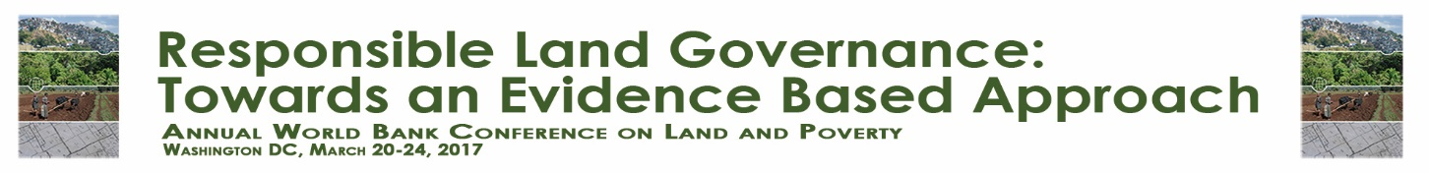
Exploring the Potential of the Land Readjustment Approach in Allocating Land for Affordable Housing from the Market Legitimacy Perspective
Reshma Shrestha, Jaap Zevenbergen, Fahria Masum and Mahesh Banskota
Department of Urban and Regional Planning, Faculty of Geo-Information Science and Earth Observation of the University of Twente, Enschede, The Netherlands
School of Arts, Kathmandu University, Hattiban, Lalitpur Nepal
Paper prepared for presentation at the
“2017 WORLD BANK CONFERENCE ON LAND AND POVERTY”
The World Bank - Washington DC, March 20-24, 2017

Slide 2
INTRODUCTION
Application of Land Readjustment (LR) method is wide ranging such as urban regeneration (Turk and Kortha ls Altes, 2010), urban development (Mittal, 2014; Uzun, 2009), post disaster (Mukherji, 2014) and regularizing informal settlement (Supriatna and van der Molen, 2014; Uzun et al., 2010) but not highlighted explicitly in allocation of low income plots.
The UN-Habitat has introduced PiLAR (Parcipatory and Inclusive Land Readjustment) which refers to accommodate low-income groups, informal settlers in LR process
Land Contribution and Land Reallocation are the critical stage of LR process

Slide 3
INTRODUCTION
The market norms like cost recovery and value capture are the core elements
The LR model applied in various countries reveals the prime success factor is the market legitimacy i.e. market value and market norms. For Instance
The increment in the land value after development
Market viability of the site
Less land contribution and more value gain

Slide 4
OBJECTIVE OF THIS STUDY
The good practices in LR approaches sufficiently shows that LR is applicable to capture value for infrastructure investment
There is less emphasis on the land value capture for social goods like land for affordable housing
This calls for in depth study to seek for the possible interventions to apply the LR approach to accommodate low-income people
Therefore, this study attempts to analyze LR process from the market perspective and its feasibility to address land for affordable housing.

Slide 5
METHODOLOGY
The two cases of LR Project of Kathmandu Nepal were studied
The first case was Kamerotar LR project which was applied to explore the factors that has restricted in allocating land for low-income housing
The second case was Icchangu LR project which was applied to explain how the land for low-income housing has been allocated

Slide 6
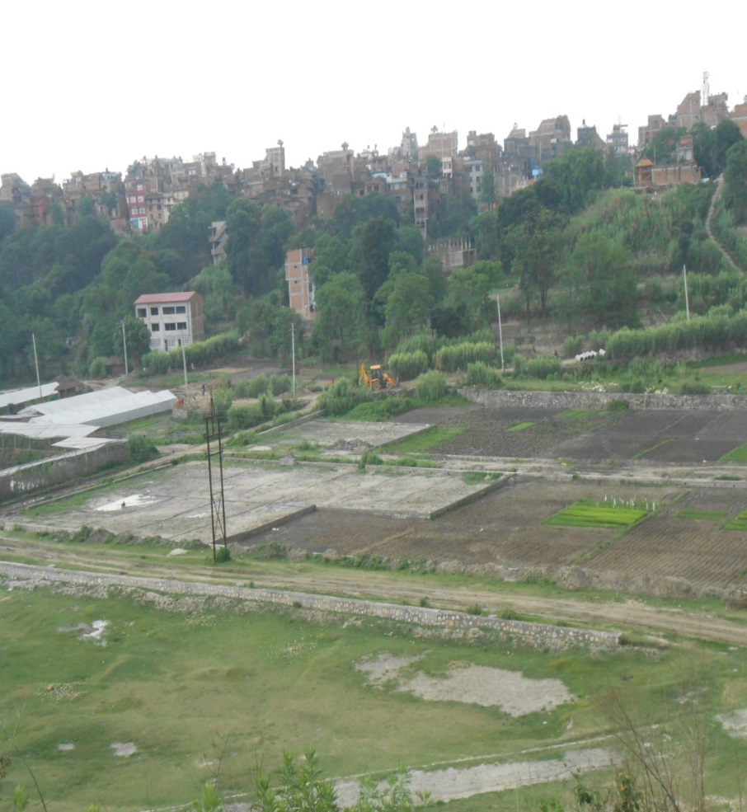
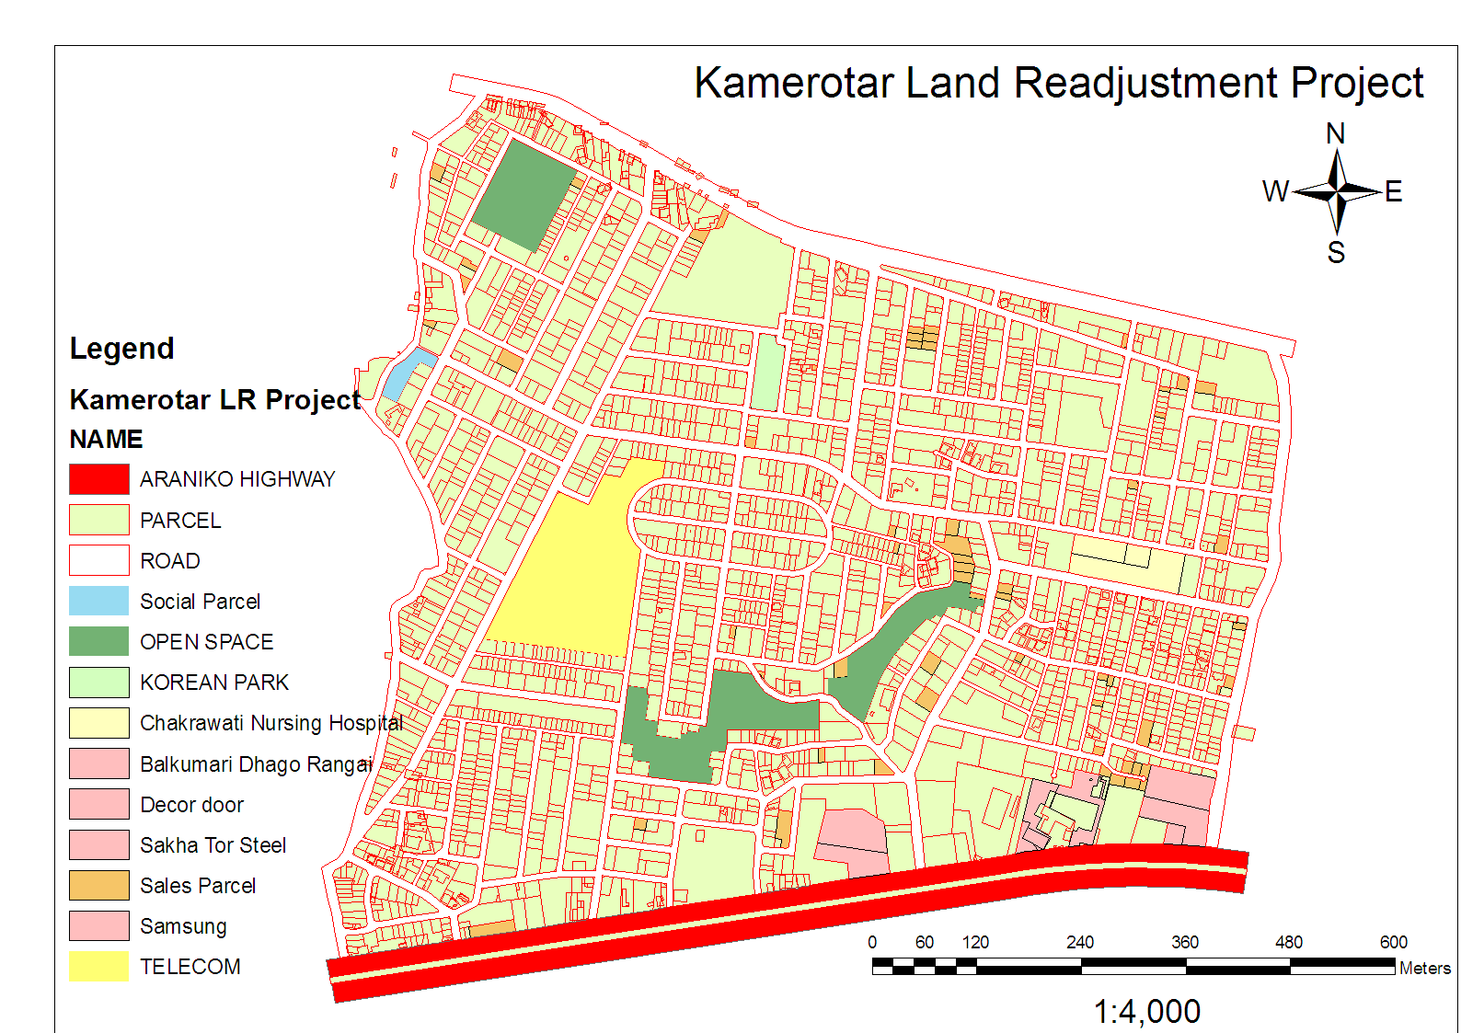
EXPLORATORY CASE STUDIES: ALLOCATION OF AFFORDABLE HOUSING IN KAMEROTAR
Source: Kamerotar Land Readjustment Project

Slide 7
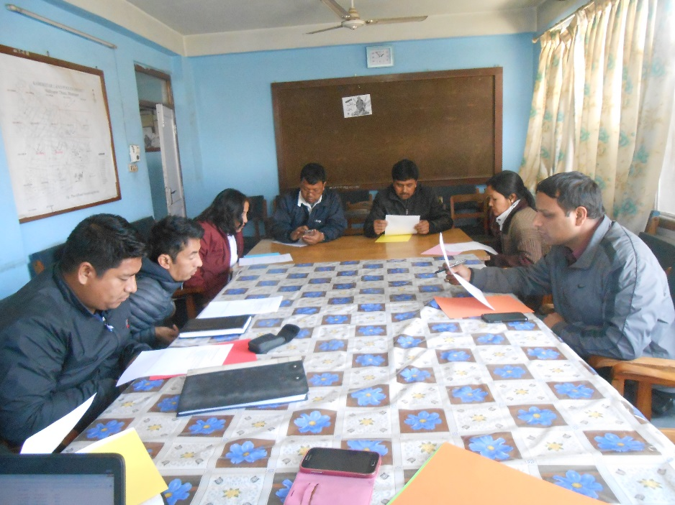
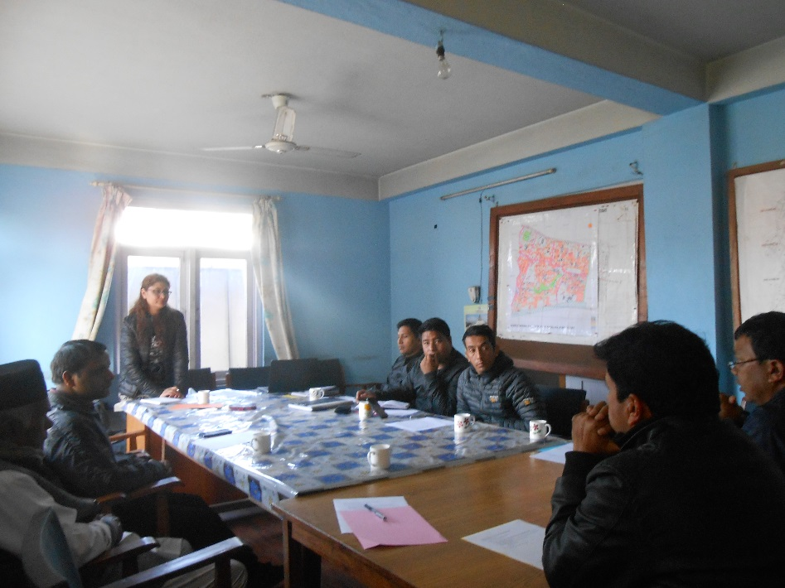
Kamerotar LR
Case Data was collected through: The workshop/ Focus Group Discussion with nine landowners/ employee of project, Interview with Users committee member (land owner representative), Project officer (government officer)
Workshop with land owners to explore the factors that restricted in allocating land for low-income groups

Slide 8
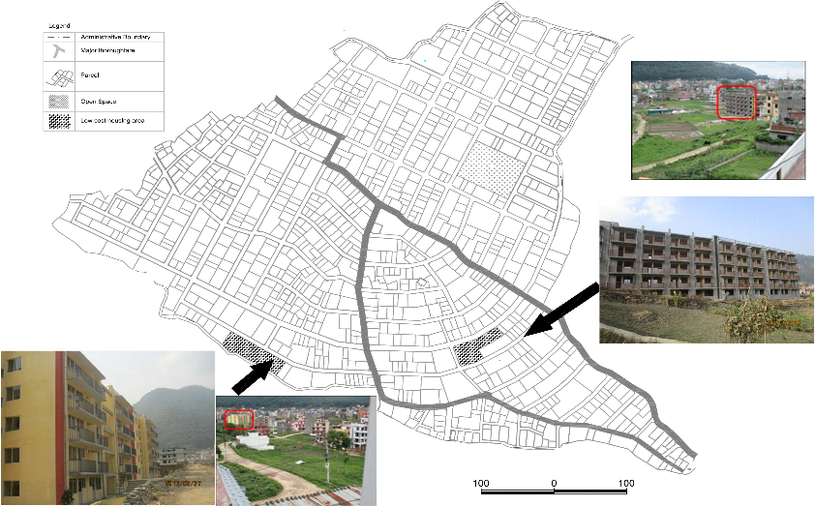
EXPLANATORY CASE STUDIES: ALLOCATION OF AFFORDABLE HOUSING IN ICCHANGU
Land Allocated for low-Income housing

Slide 9
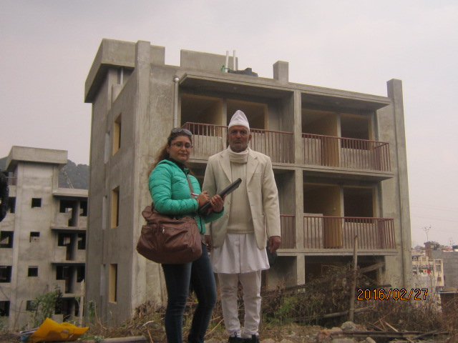
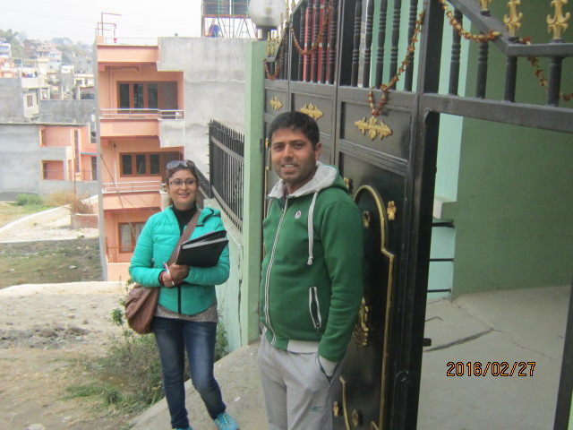
ICCHANGU LR
Case Data was collected through: Interview with members of Users Committee, Questionaire survey with 20 land owners residing near low-income housing, Indepth interview with project officer

Slide 10
CASE STUDY RESULTS
Kamerotar LR Project
Land Use Type | Area allocated (Square m)
Road | 159790
Open Space | 34,557.54
Play Ground | 8884.54
Nepal Korea Park | 2599.43
Green Space | 20,213.07
School, Offices, Public historical tap, well | 2860.50
Private Land | 5,06,655.74
Reserve plot for sale | 30,010.33
Land allocated to Nepal Telecom | 25,237.85
Icchangu LR Project
Land Use Type | Area Square feet
Road | 74034.08
Open space/ Community area | 71637.36
Private Land | 59705.27
Reserve plot for sales | 3151139.67
Land allocation for low income groups | 3229173
In Kamerotar land is allocated for Nepal Telecommunication whereas in Icchangu Land is allocated for low-income housing

Slide 11
CASE STUDY RESULTS
Factors that restrict for allocating land for low-income plots in Kamerotar Project
Lack of policy and legal norms that enforce compulsory allocation for low cost plot
Lack of external financial support
Consensus of landowners required to initiate the project
Technical norms provides financial burden
Factors for allocation of land for low-income groups in Icchangu Project
Government as a market actors
Effects in project due to decline in the market
Lack of participation of land owners

Slide 12
ANALYSIS AND DISCUSSION
Case of Kamerotar
There were no driving factor that compelled to allocate land for low-income housing
Lack of policy implementation of accommodating low-income groups
Increment in land deduction rate from land owners does not seems feasible intervention
Government agencies should introduce some intervention like financing infrastructure cost to divert self-financing LR model into cost sharing LR model
Social Stigma can restrict to allow low- income housing
Flexible technical norms regarding plot size and area required to reduce financial cost of project

Slide 13
ANALYSIS AND DISCUSSION
Case of Icchangu LR
Distortion in land market was driving factor to sell land for low-income housing
The government was market actors and able to negotiate to buy land
The land was bought in two phase with high cost then the minimum allocated price of the project
All land owners are not participated in decision making in allocation of land to government
The social stigma seems constrain in allowing low-income beneficiaries to move into the housing

Slide 14
CONCLUSION
The case shows how the market legitimacy is embedded in the allocation of plot for low-income groups
The policy to develop inclusive LR process should focus on the market value and market norms, which is acceptable to the landowners.
Flexible technical norms need to be adopted to allocate low cost land
Social aspect is also need to be considered in the inclusive LR process

