Slide 1
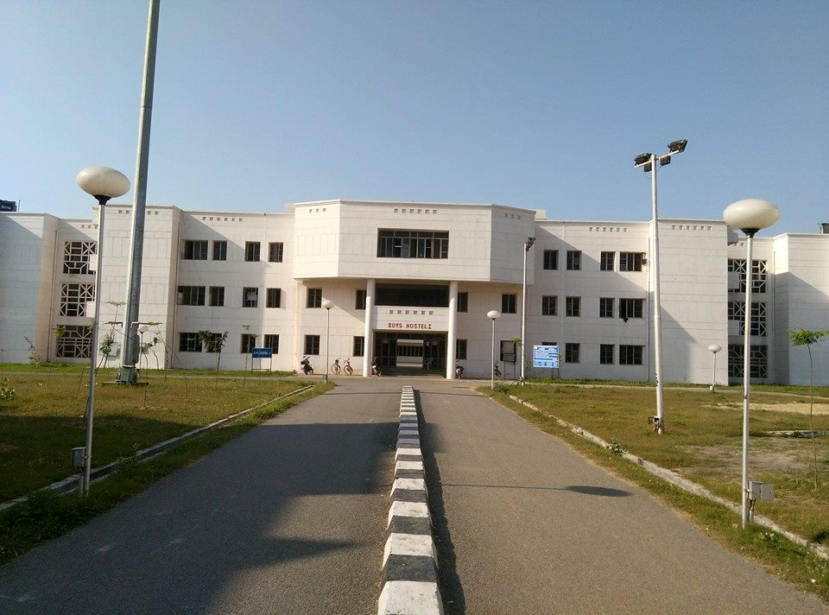
Hostel Entry-Exit Management: A Digital Solution
By
Atharav Yadav
Nirbhay Paliwal Aditya Bhardwaj Shivam Kumar Pratik Sarvaiya
Supervised by Dr. K.P. Singh

Slide 2
Problem Statement
Inefficient Manual System
Error Prone
Administrative Burden
Difficulty in tracking entry/exit time.
Manual record-keeping consumes significant administrative time and resources.
Time-consuming, error-prone, and lack of transparency.

Slide 3
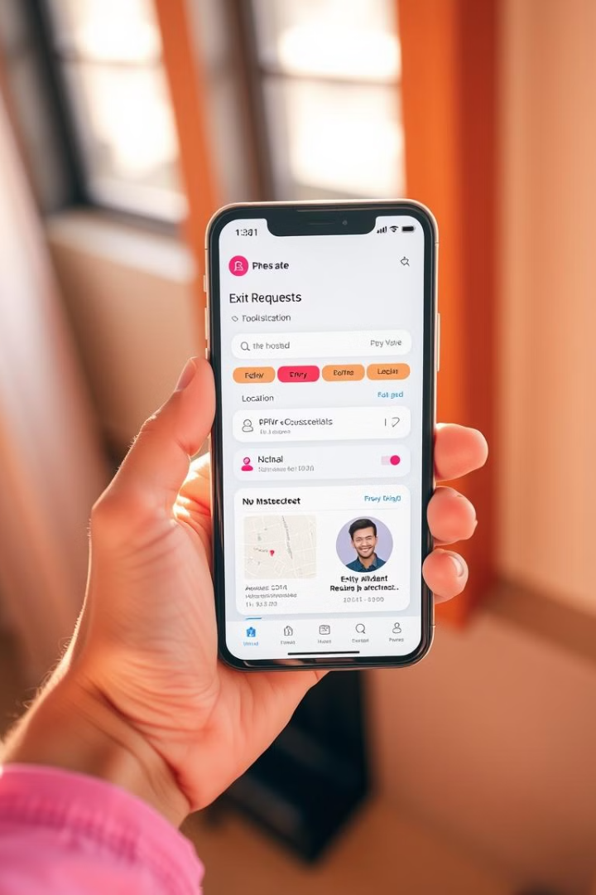
Solution: Digitalization
1
Geo-Location Validation
2
Real-Time Photo Capture
Ensures authenticity by verifying student location.
Provides visual confirmation of the student's identity.
3
Role-Based Functionality
Separate features for students and administrators.

Slide 4
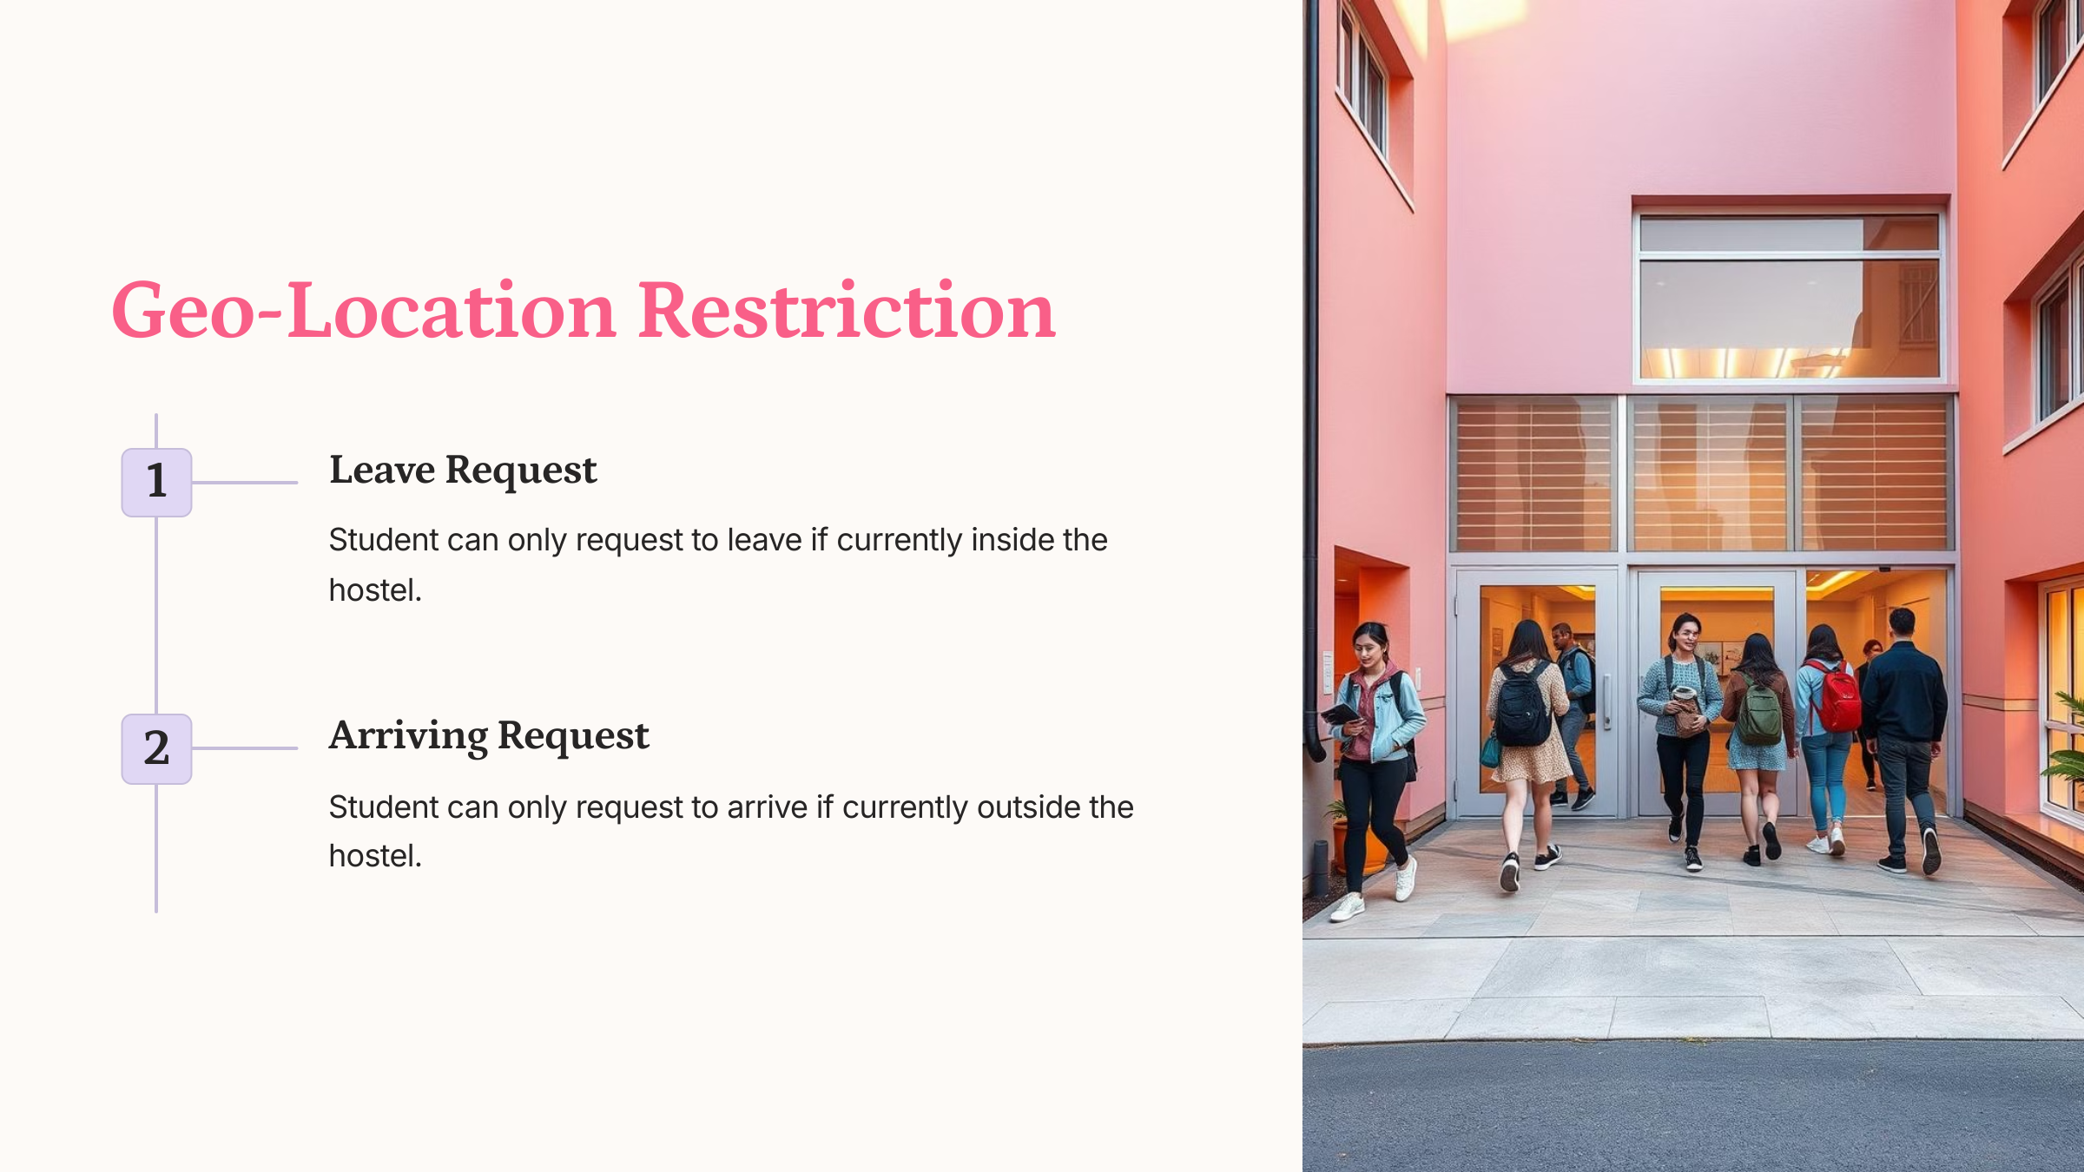
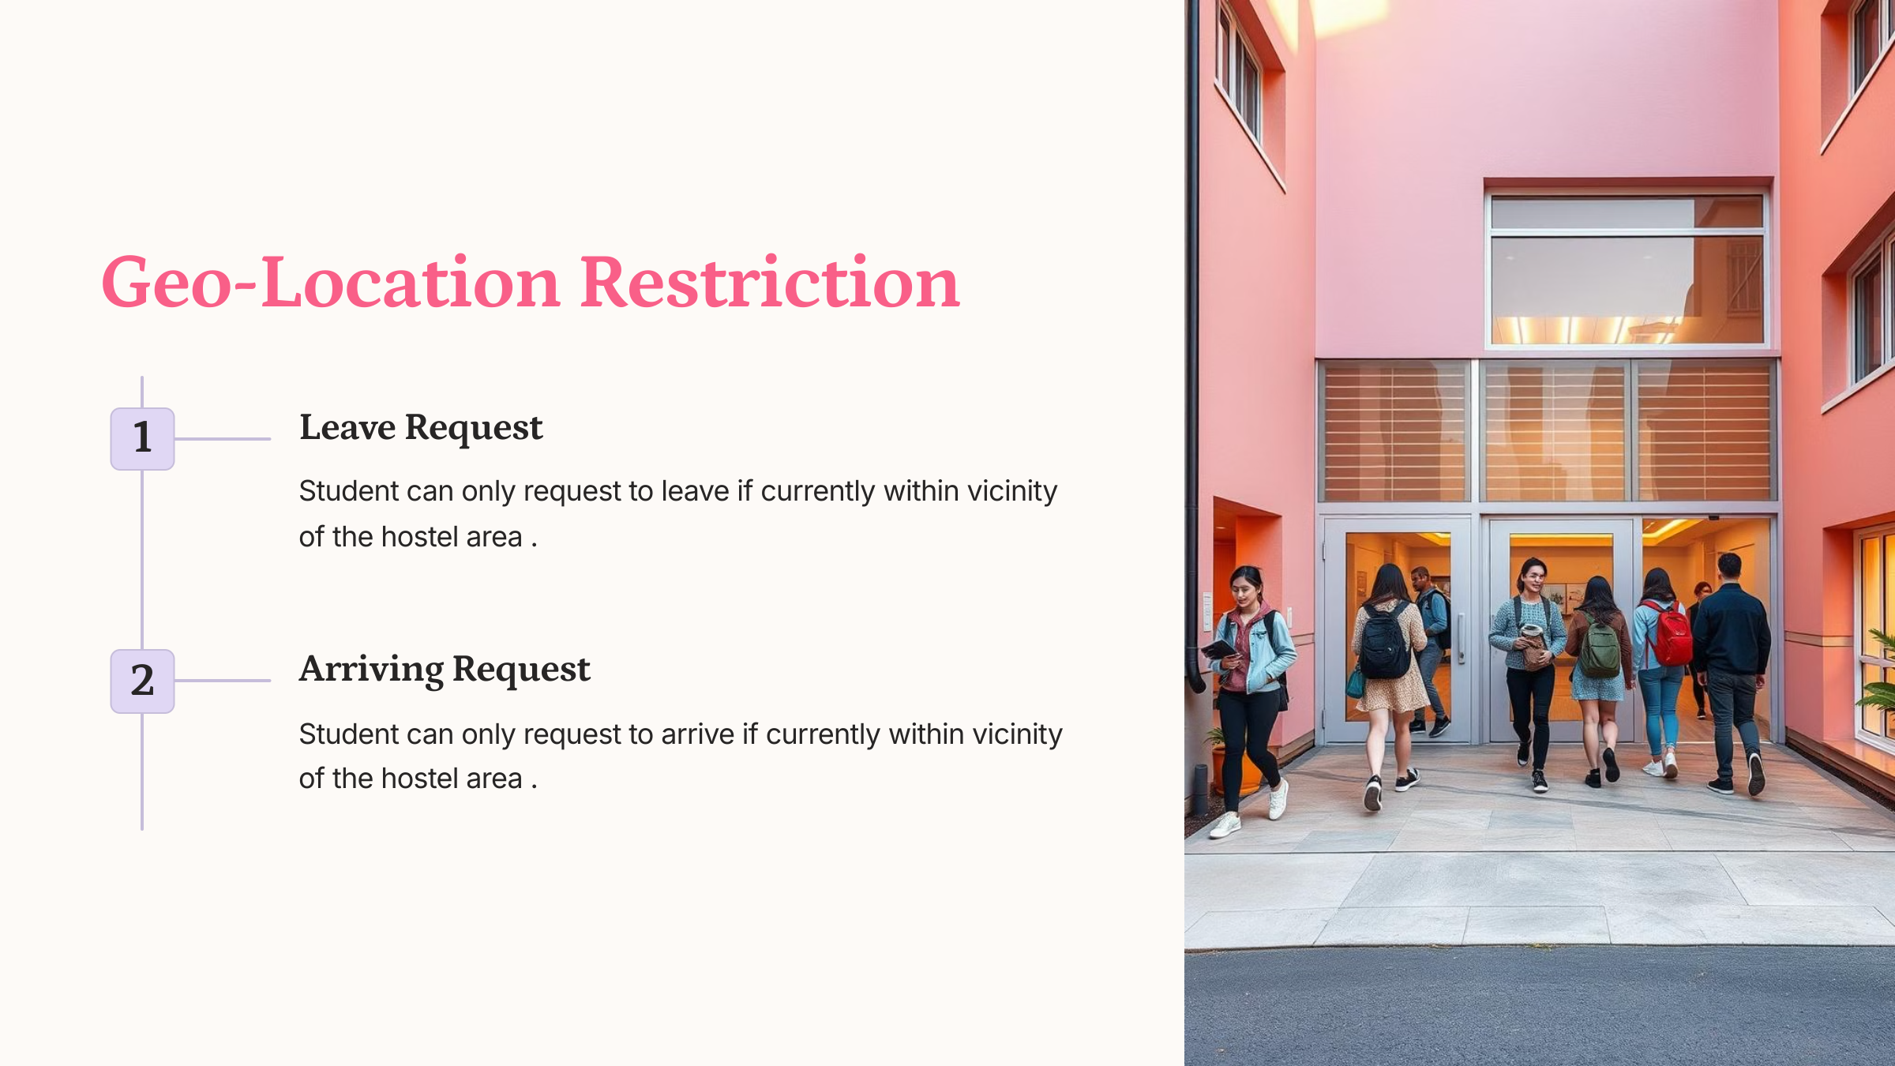
Geo-Location Restriction
Leave Request
Arriving Request
Student can only request to leave if currently inside the hostel.
Student can only request to arrive if currently outside the hostel.

Slide 5



Camera Integration for Verification
Photo Capture
1
Student takes a photo at the gate.
Verification
2
Student reviews photo and location.
Request Submission
3
App sends request to the server.

Slide 6
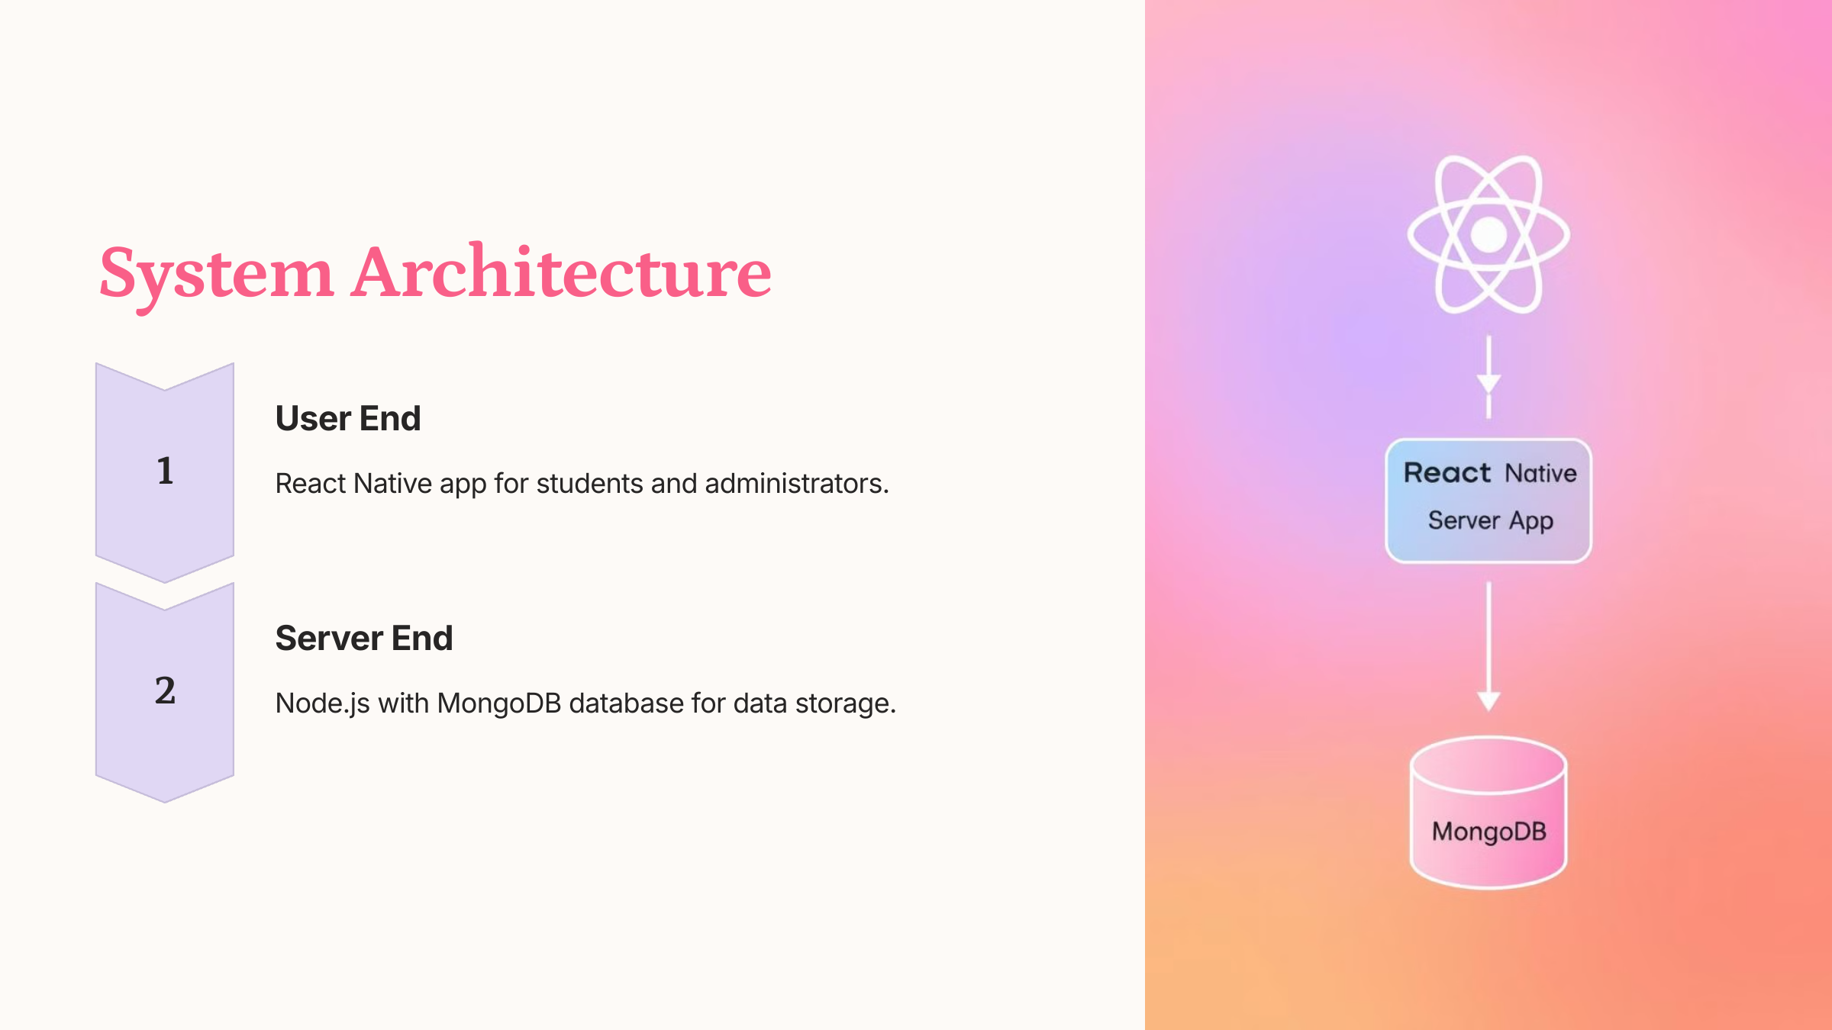
System Architecture
Client-Side
Server-Side
React Native app for students and administrators.
Node.js with MongoDB database for data storage.

Slide 7




Technologies Used
Expo Go
React Native
Cross-platform mobile development framework.
JavaScript framework for building native mobile apps.
MongoDB
Node.js
Document-oriented NoSQL database.
JavaScript runtime environment for server-side development.

Slide 8

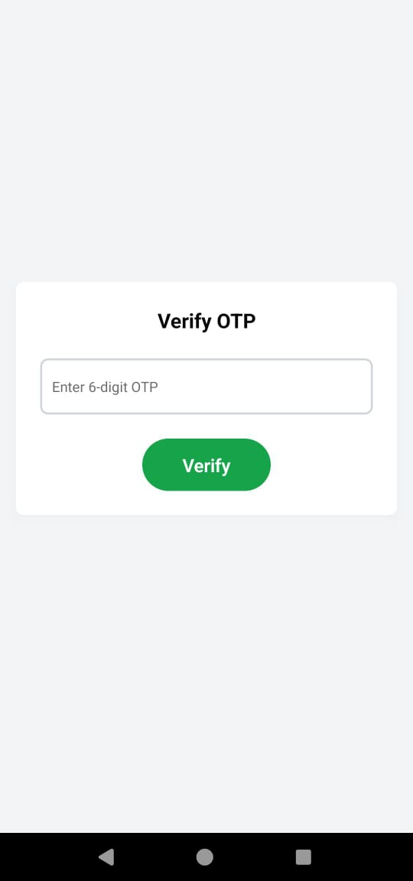
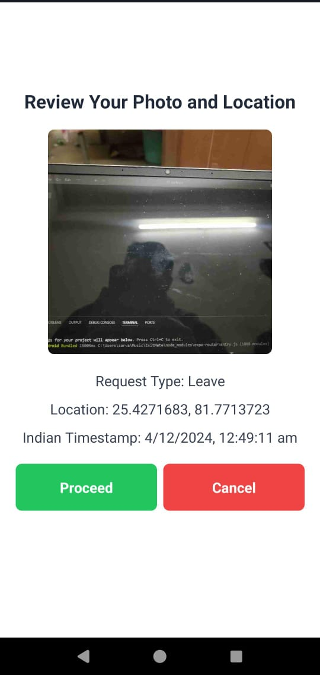
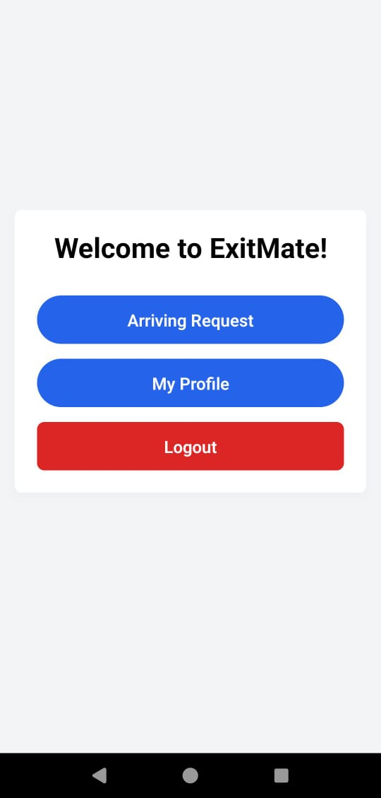
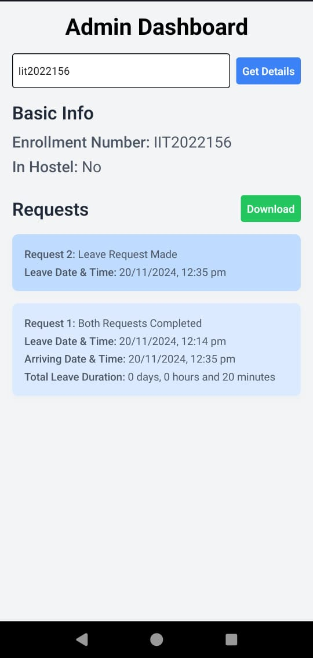
Key Features
Student Features
Admin Features
Login, request, view history.
View requests, manage records.
General Features
Geo-location validation, photo capture.

Slide 9
Future Enhancements
Mess Rebate Calculation
1
Automated rebate based on days away.
Event Reminders
2
Notifications about events and deadlines.
Emergency Alerts
3
Send alerts with location to admin.

Slide 10
Conclusion
This digital solution addresses the limitations of the manual system.
Provides a secure, efficient, and transparent way to manage hostel entry and exit records.
Future enhancements aim to further improve the app's functionality and expand its features.

Slide 11

