Slide 1
Data Viz
How can visualizing data be useful?

Slide 2
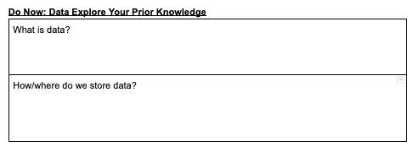
Do Now
Stop & Jot: 5 min

Slide 3
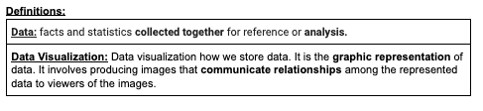
Definitions
Complete Guided Notes

Slide 4

Why would we want to use data?
Share Out
Notes:
To tell a story
To give information
To persuade
To analyze

Slide 5
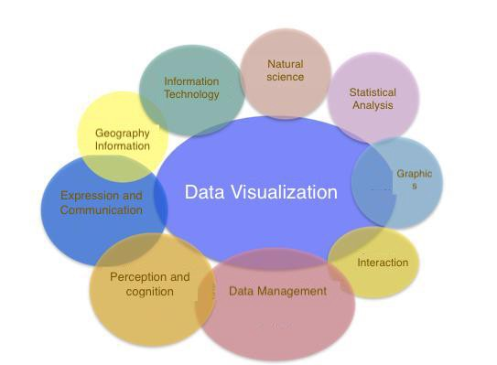

Slide 6

When would we want to use different types of data visualizations?
Pen a Prediction

Slide 7
How can we navigate a spreadsheet?

Slide 8
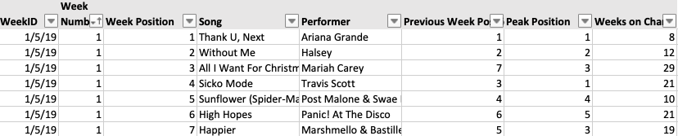
Getting to know your Spreadsheet
Notes:
Highlight the Performer Column Yellow
Highlight the Song Column Blue
Highlight the Weeks on Chart Column Green

Slide 9
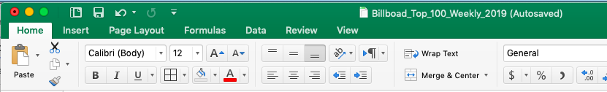

Follow Along
Notes:
Filter

Slide 10
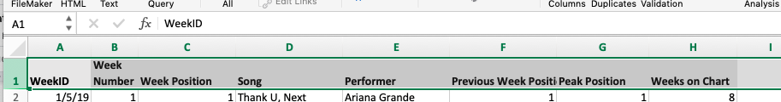
Follow Along
Notes:
Filter

Slide 11
Follow Along
Notes:
Filter

Slide 12
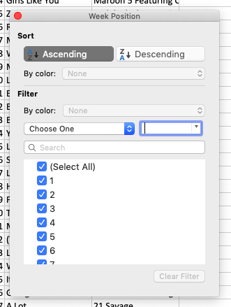
Uncheck select all.
Check 1.
Want to filter for #1 songs?
Follow Along

Slide 13
Choose ascending or descending.
Want to sort by #1 songs?
(or anything else)
Follow Along

Slide 14
Guided Exploration:
Find the Song that was #1
on the Week with the Date Closest to Your Birthday
Follow Along

Slide 15
Independent Exploration:
Use the data set to find the answers to the questions given.
As you do, pay attention to the actions you are taking to find the information.
Semi-Independent

Slide 16

What benefits can you see about using spreadsheets?
Discussion

Slide 17
What are the limitations are there with spreadsheets?
Discussion

Slide 18
Which prompts were most difficult to complete? What about them made them more difficult to complete?
Discussion

