Slide 1
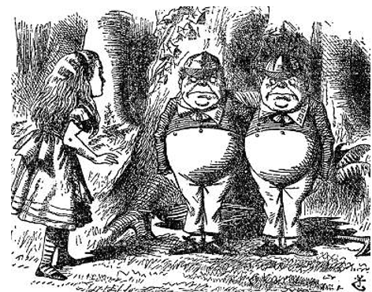
Do Now:
Read the scenario below from Alice’s Adventures in Wonderland by Lewis Carroll. Write down all of the conditional statements you see in the text.
"If you think we're wax-works," he said, "you ought to pay, you know.” "Contrariwise" added the one marked 'DEE', "if you think we're alive, you ought to speak." "I'm sure I'm very sorry," was all Alice could say. "I know what you're thinking about," said Tweedledum: "but it isn't so, nohow." "Contrariwise," continued Tweedledee, "if it was so, it might be; and if it were so, it would be: but as it isn't, it ain't. 'That's logic."
Tweedle Dee and Tweedle Dum

Slide 2
JavaScript Conditionals
Conditional statements are “if-then” statements.
If “this” is true, do “something.”
If “this” is false, do “something else”
In JavaScript, we use “if,” “else if,” and “else.”

Slide 3
Comparison and Logical Operators
< less than | <== less than or equal to
> greater than | >== greater than or equal to
=== equal to | !== not equal to
&& and | || or

Slide 4
Summary

