Slide 1
Do Now:
Think about your favorite book, movie, video game, etc.
Write down information about three characters.
Include the following:
first name
last name
age
description

Slide 2
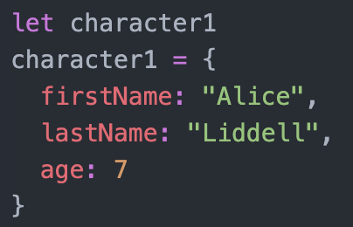
JavaScript Objects
Objects can be used to store multiple properties in one variable.
Use curly brackets to contain the information.
Use a colon instead of an equals sign.
Use a comma to separate the properties.

Slide 3
Object Activity
1) Write new objects with information for the other two characters from the Do Now. Display several statements using dot notation with information about the different characters.
2) Look up information about players from various sports teams. Write an object for at least two different player with relevant stats.
3) Time Permitting: Students can write an object for an address (It doesn’t have to be their address) and print out the address or another person.

Slide 4
Think-Pair-Share
Why is it helpful to use an object to store variables?

