Slide 1
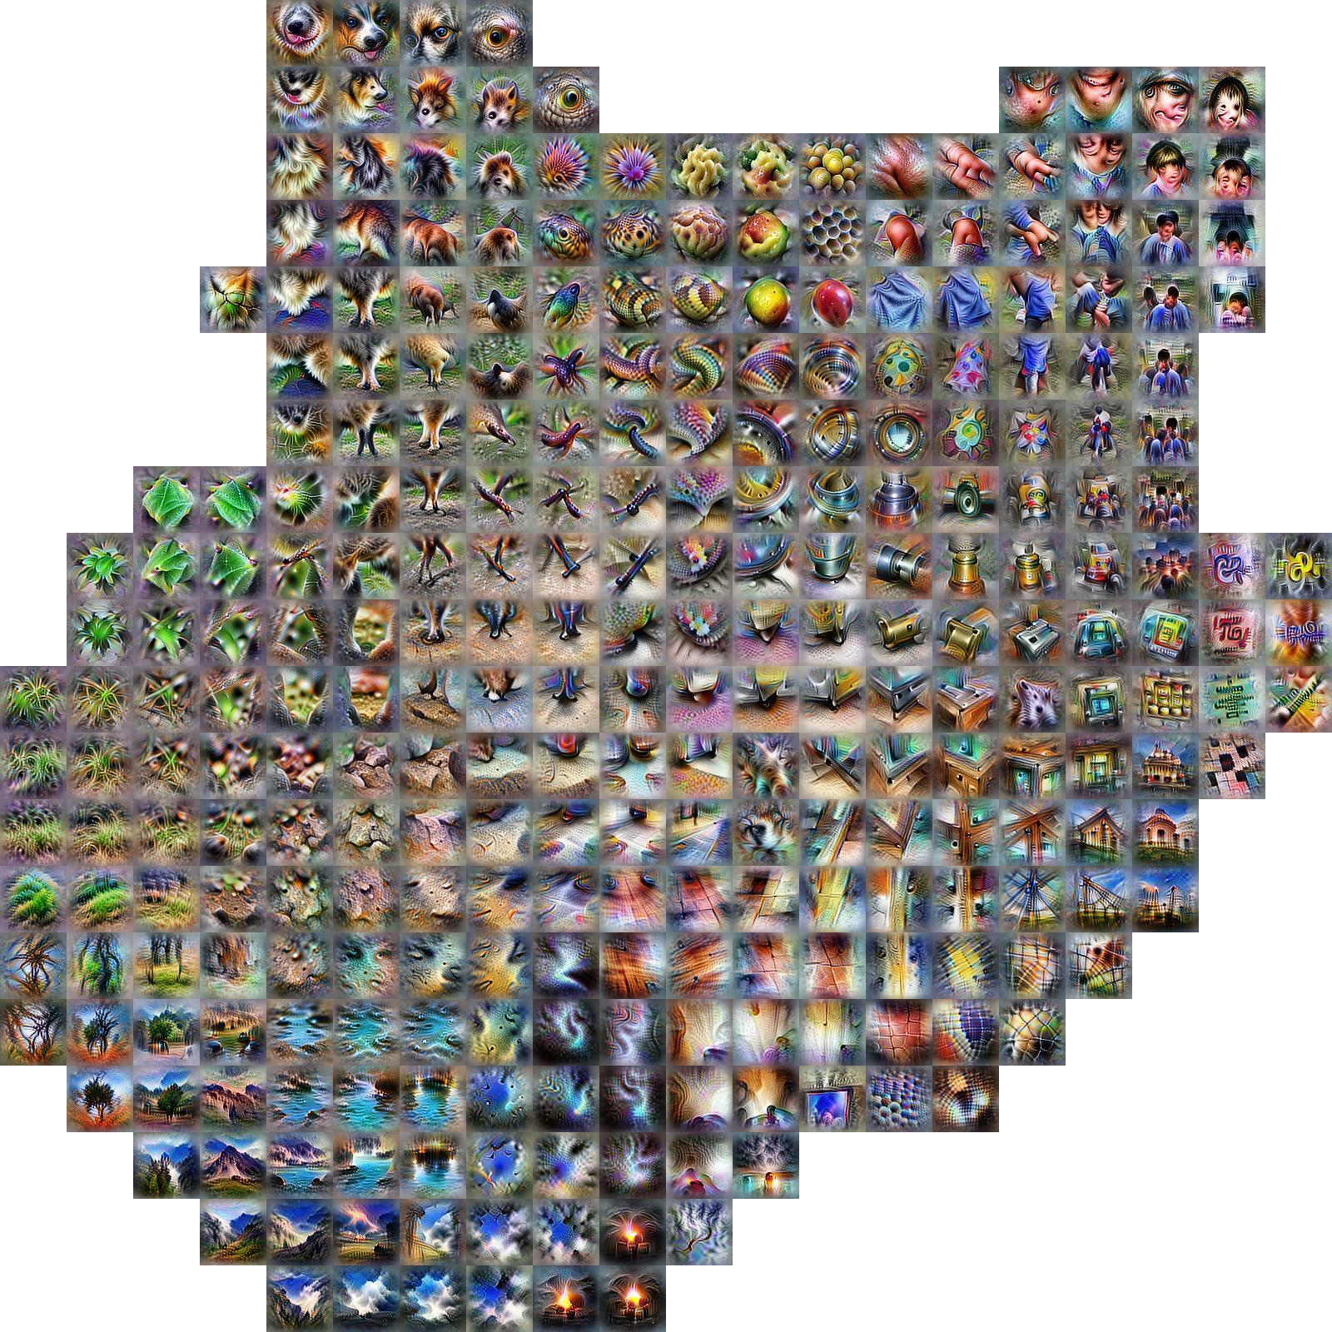
AI / MACHINE LEARNING
Activation Atlas
Shan Carter, Zan Armstrong, Ludwig Schubert, Ian Johnson & Chris Olah
Distill, 2019 · doi:10.23915/distill.00015 · CC-BY 4.0
What I think it's showing
I think this is a map of the activation (embedding) space of the InceptionV1 vision network: activation vectors from a million images are laid out in 2-D (via UMAP), the space is divided into grid cells, and each tile is a synthesized image of what that region of the space “looks for.” Nearby tiles represent similar visual concepts, so you can literally browse the geography of what the network has learned — from animal faces and body parts to textures, water and landscapes.
Figure: activation atlas of layer mixed4c, snapshot from the article's repository (github.com/distillpub/post--activation-atlas).
Notes:
Carter, Armstrong, Schubert, Johnson & Olah (2019). Activation Atlas. Distill. https://distill.pub/2019/activation-atlas/ — CC-BY 4.0. Figure image obtained from the article's own GitHub repository (distillpub/post--activation-atlas).

Slide 2
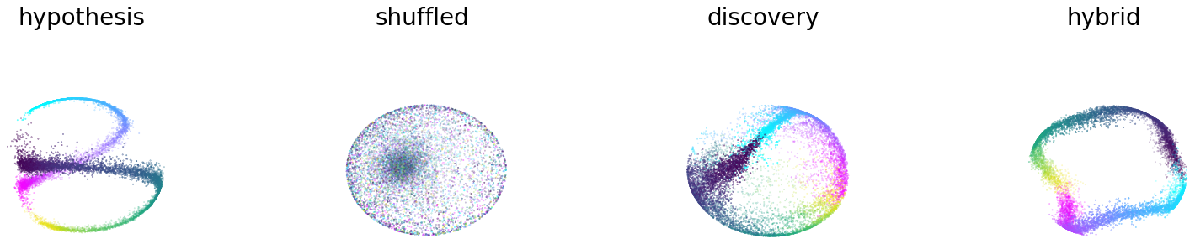
NEUROSCIENCE
Learnable latent embeddings for joint behavioural and neural analysis (CEBRA)
Steffen Schneider, Jin Hwa Lee & Mackenzie Weygandt Mathis
Nature 617, 360–368 (2023) · open access, CC-BY 4.0
What I think it's showing
I think each cloud is the same rat hippocampal population activity embedded into a 3-D latent space by CEBRA (from their Fig. 2). When the embedding is trained with the animal's position as a label (“hypothesis”) — or discovered without labels (“discovery”/“hybrid”) — the neural trajectories organize into a smooth ring-like manifold that tracks where the rat is on the track (color = position/direction). Shuffled controls collapse into an unstructured ball, so the geometry is real signal, not an artifact.
Figure: panels of Fig. 2, extracted from the authors' figure-reproduction repository (github.com/AdaptiveMotorControlLab/cebra-figures).
Notes:
Schneider, Lee & Mathis (2023). Learnable latent embeddings for joint behavioural and neural analysis. Nature 617, 360-368. https://doi.org/10.1038/s41586-023-06031-6 — open access CC-BY 4.0. Figure extracted from the authors' official cebra-figures GitHub repository.

Slide 3
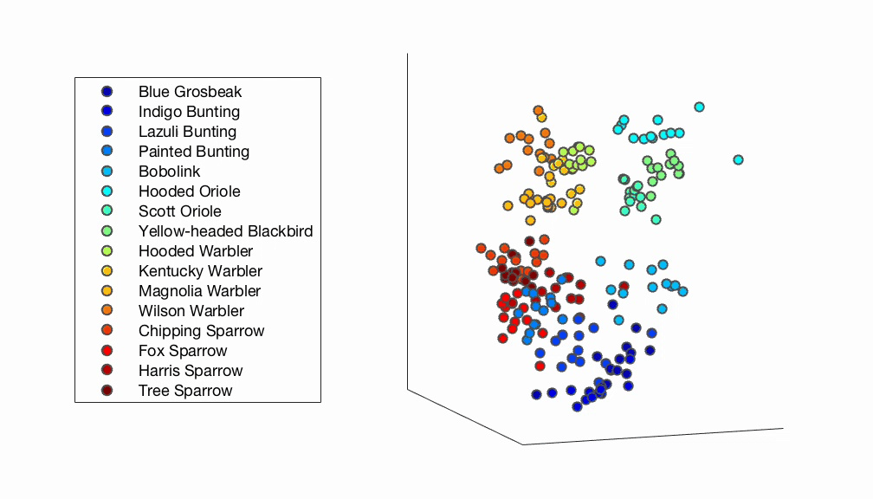
PSYCHOLOGY
Obtaining psychological embeddings through joint kernel and metric learning
Brett D. Roads & Michael C. Mozer
Behavior Research Methods 51, 2180–2193 (2019)
What I think it's showing
I think this is a 3-D “psychological embedding” of bird photographs inferred purely from human similarity judgments (which images people group together), using the authors' PsiZ method. Each dot is one bird image, colored by species; images that people perceive as similar land close together, and the species — and larger families like warblers vs. sparrows — form distinct clusters. It's a map of how these birds are organized in our mental representation, not in pixel space.
Figure: 3-D embedding of the birds-16 dataset, from the authors' PsiZ repository docs (github.com/psiz-org/psiz) — the journal PDF was not reachable from this sandbox, so this author-made visualization stands in for the paper's embedding figures.
Notes:
Roads & Mozer (2019). Obtaining psychological embeddings through joint kernel and metric learning. Behavior Research Methods 51, 2180-2193. https://doi.org/10.3758/s13428-019-01285-3. Visualization from the authors' psiz repository documentation (Apache-2.0).

