Slide 1
NYC collisions vs the Weather
Ibrahim Abdulrahmon
Chris Hart
Ugochi Akaluso
Hunter Cash

Slide 2
Motivation
40,000 people killed, millions of injuries every year
Vision Zero Pioneered
NYC made this data public in 2014
GOAL: Eliminate traffic related accident and deaths
Do the weather conditions affect the amount of collisions and collision related injuries?

Slide 3
Null Hypothesis
There is no statistical significance between the weather and the amount of collisions, and collision related injuries.
We refute the null hypothesis based on temperature
We accept the null hypothesis on all other weather conditions

Slide 4
Questions
Which type of weather has the highest occurrence of collisions?
Which weather factor(s) contribute towards collisions and injuries?

Slide 5
Data
NYC Open Data:
monthly breakdown of every collision in NYC by location and injury or death. Each record represents a collision in NYC by city, borough, precinct and cross street. This data is typically used by the NYPD and general public to see dangerous/safe intersections in NYC.
DarkSkyAPI:
This api request provides minutely, hourly, and daily current and historical data for weather conditions.

Slide 6
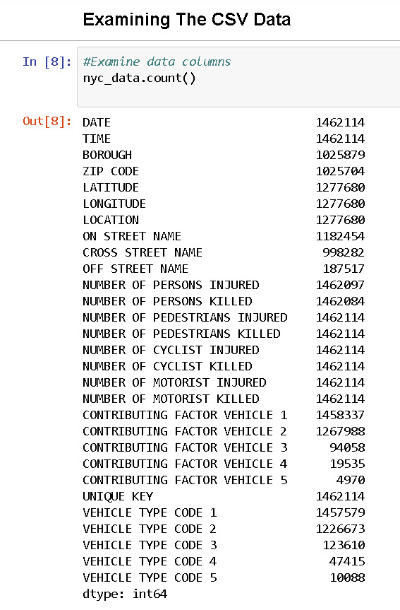
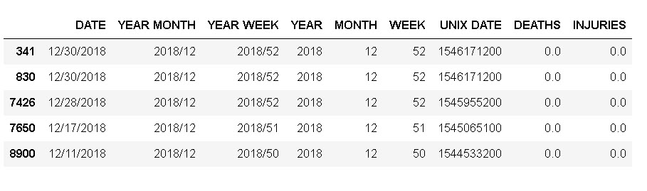
Data Cleanup & exploration
Download NYPD Motor Vehicle Collisions report from NYC Open Data
BEFORE: 1.46 rows x 29 columns
Concat date and time columns for easy analysis
Add UNIX Date to pass into Dark Sky API
Drop dates before 2014 and after 2018
Split dates by Year, Month and Week
Drop Unwanted Columns
AFTER: 1.1 Mil Rows x 9 columns

Slide 7
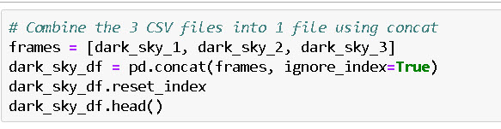
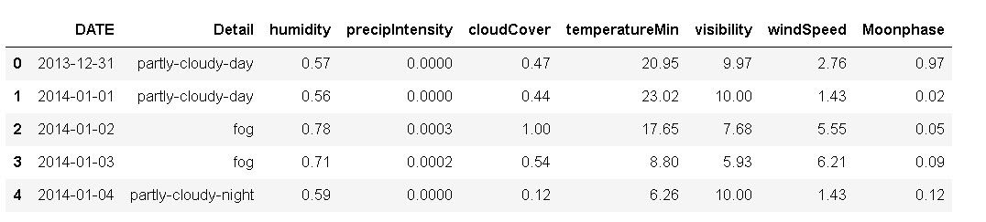
Dark Sky API
Locating the data was very difficult
LIST-DICT-LIST-DICT-DICT
3 Separate Calls, 1000 per day
Weather data via API calls from Darksky.net
BEFORE: 1910 rows x 22 columns
Merged Three separate API CSV’s
Reformatted UNIX to back to Date for Merging
Left Join into Collision DataFrame

Slide 8
Challenges/difficulties
API limits
Git LFS
Correcting weeks and years at year boundaries

Slide 9
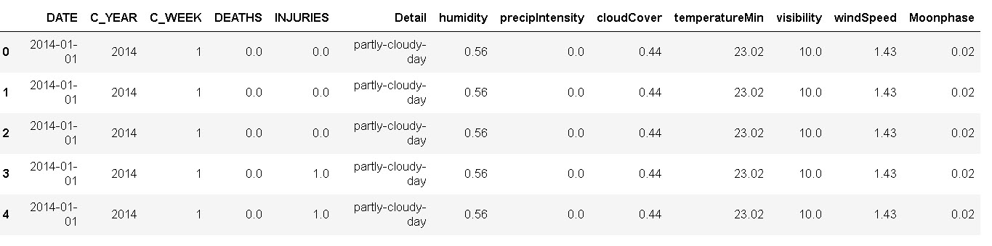
FINAL DATA FRAME
Merge NYC collisions data and Dark sky Weather data Left Join
Dropped most categorical information
Create “Year” and “Week” columns using an IF statement in a Loop
Create function to correct weeks and years at year boundaries

Slide 10
Data Analysis

Slide 11
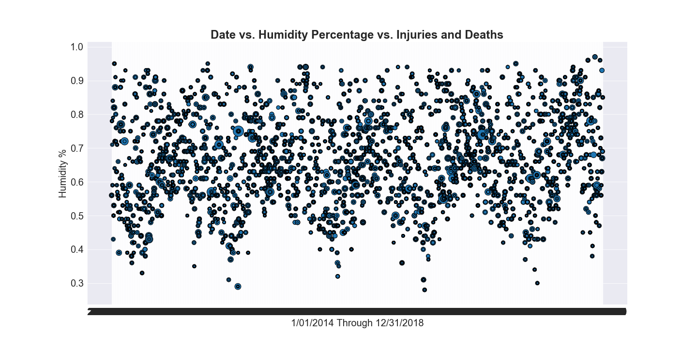
Example: Data by day

Slide 12
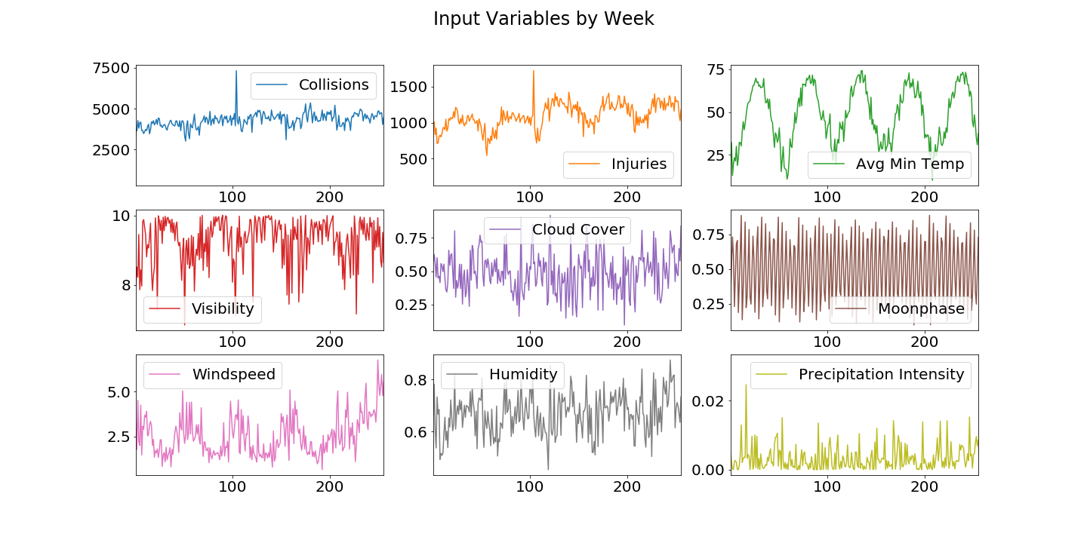

Slide 13
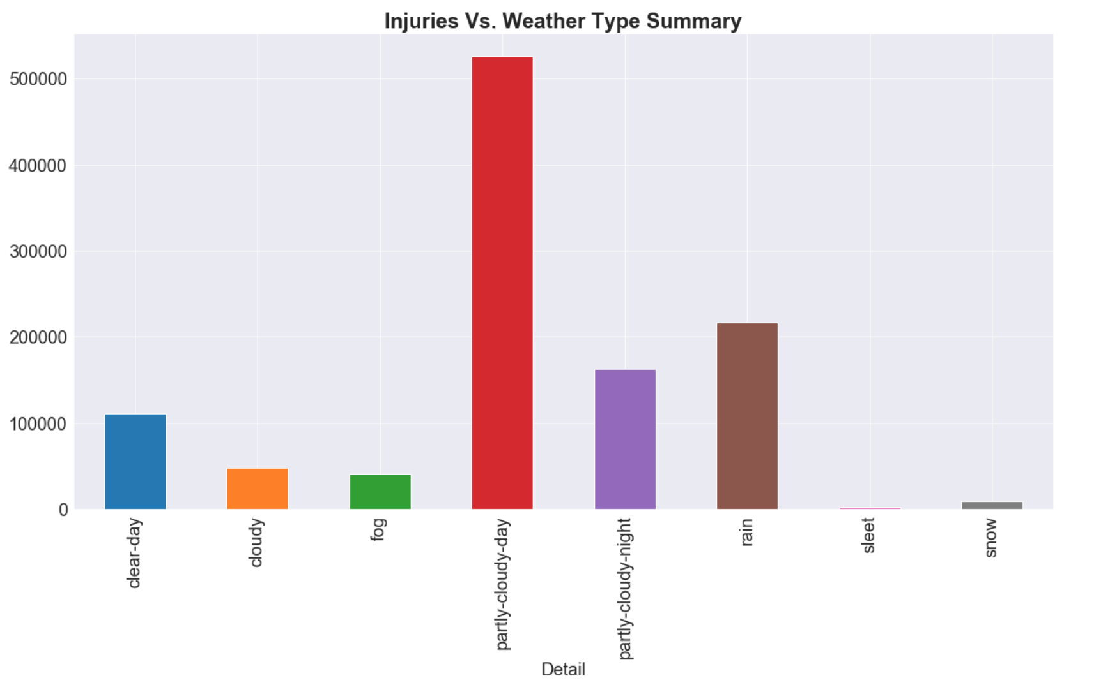
Highest injuries by weather type

Slide 14
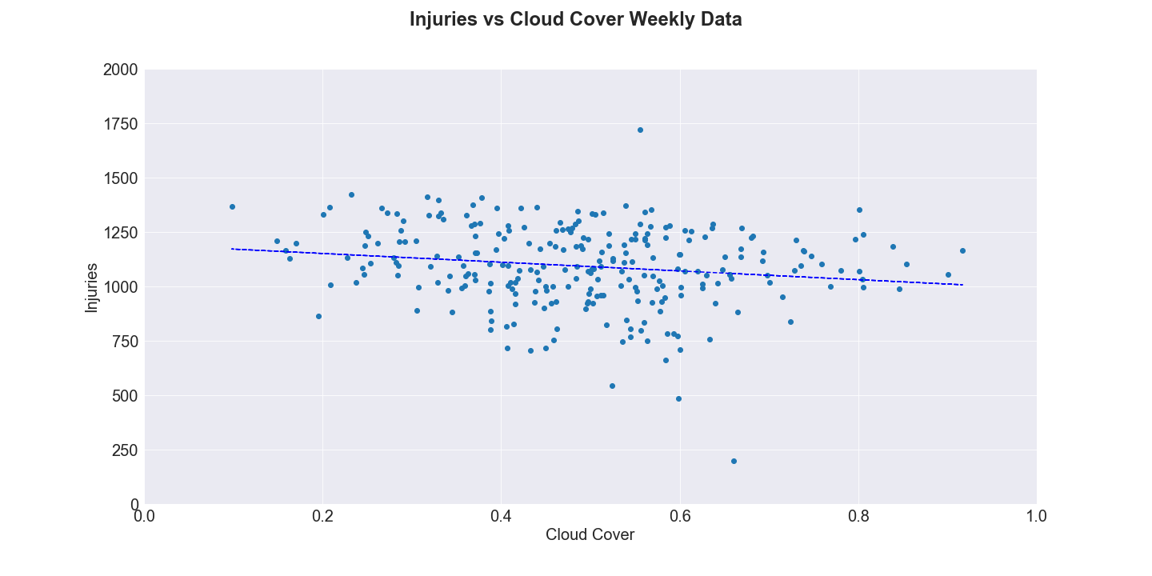
Does the cloudiness have a significant effect on the number of Collisions or Injuries?
WEATHER FACTOR | R-SQUARED | P-VALUE | STANDARD ERROR
Cloud Cover | 0.027 | 0.01 | 73.98

Slide 15
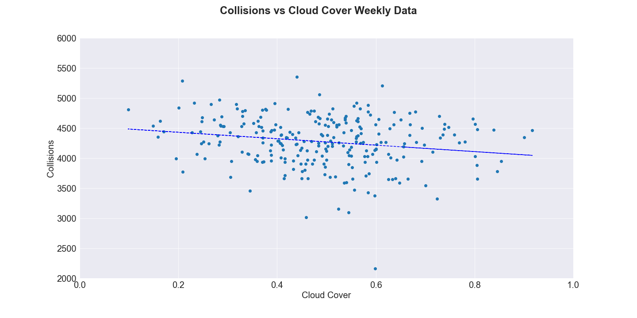
Does the cloudiness have a significant effect on the number of Collisions or Injuries?
WEATHER FACTOR | R-SQUARED | P-VALUE | STANDARD ERROR
Cloud Cover | 0.03 | 0.01 | 203.88

Slide 16
Table of injury & collision regression results
INJURY
COLLISONS
WEATHER FACTOR | R-SQUARED | P-VALUE | STANDARD ERROR
Avg. Min Temperature | 0.35 | 8.07e-26 | 0.56
Cloud Cover | 0.03 | 0.01 | 73.98
Visibility | 0.10 | 2.15e-07 | 16.41
Humidity | 0.03 | 0.00 | 143.41
Precipitation | 0.00 | 0.32 | 2822.31
Wind Speed | 0.01 | 0.12 | 9.84
Moon Phase | 0.00 | 0.57 | 51.31
WEATHER FACTOR | R-SQUARED | P-VALUE | STANDARD ERROR
Avg. Min Temperature | 0.10 | 2.09e-7 | 1.82
Cloud Cover | 0.03 | 0.01 | 203.88
Visibility | 0.05 | 0.00 | 46.42
Humidity | 0.00 | 0.59 | 41.02
Precipitation | 0.02 | 0.02 | 7709.26
Wind Speed | 3.01e-5 | 0.93 | 27.22
Moon Phase | 0.00 | 0.45 | 141.23

Slide 17
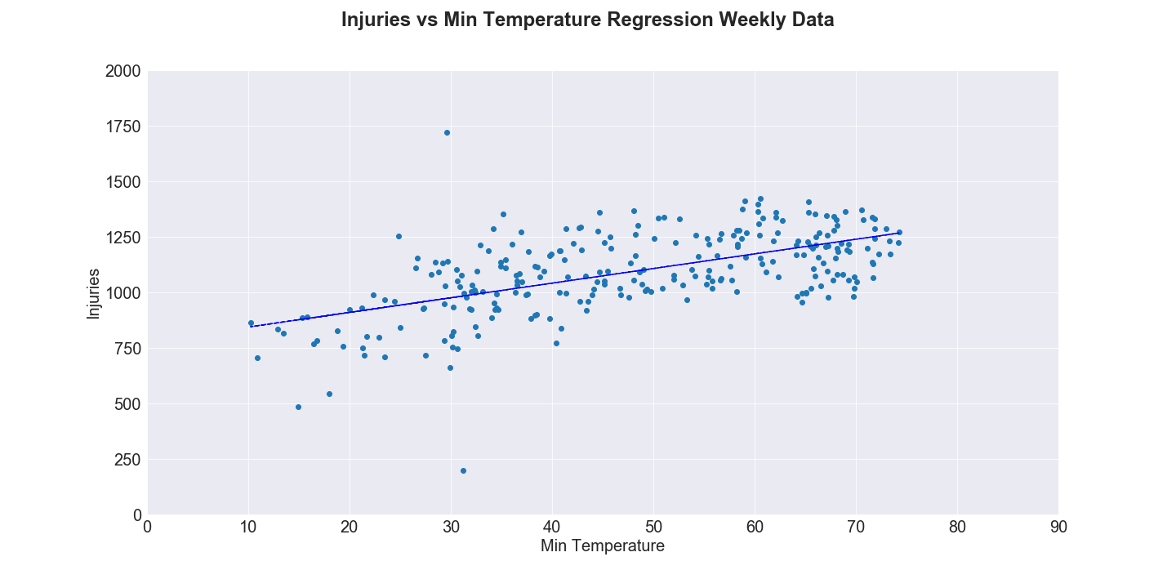
Does the minimum temperature have a significant effect on the number of Collisions or injuries?
WEATHER FACTOR | R-SQUARED | P-VALUE | STANDARD ERROR
Avg. Min Temperature | 0.35 | 8.07e-26 | 0.56

Slide 18
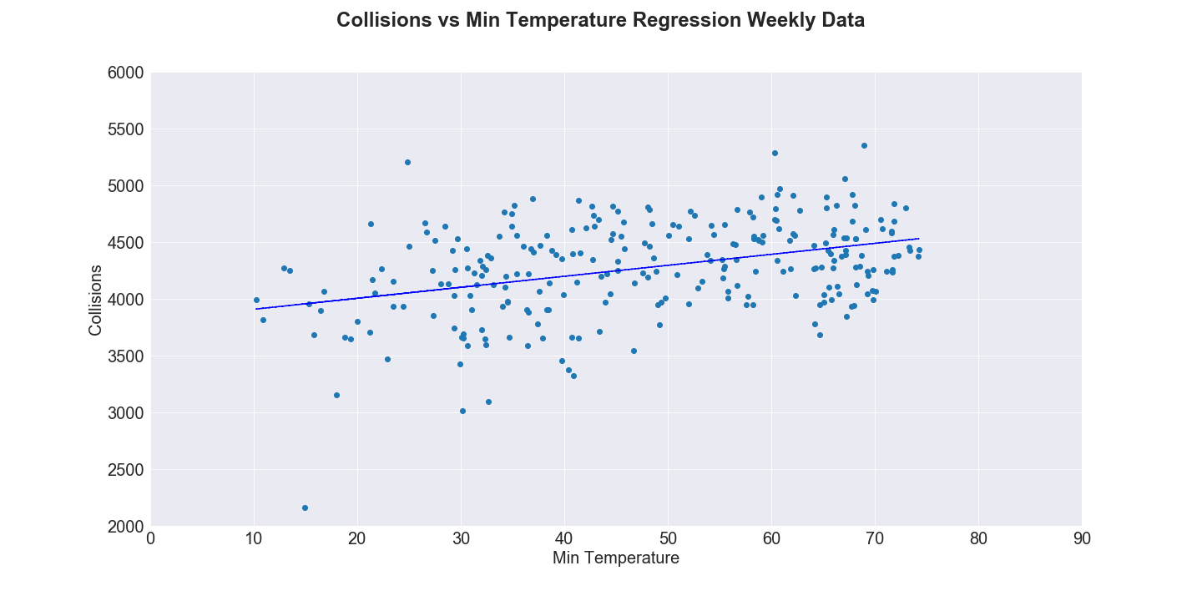
Does the minimum temperature have a significant effect on the number of collisions or injuries?
WEATHER FACTOR | R-SQUARED | P-VALUE | STANDARD ERROR
Avg. Min Temperature | 0.10 | 2.09e-7 | 1.82

Slide 19
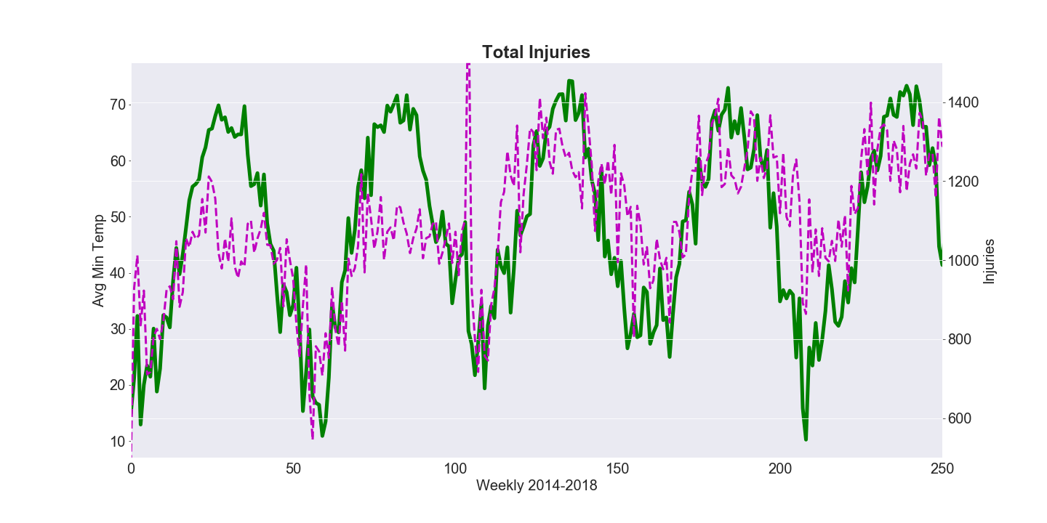
Total INJURIES vs. Avg Min Temperature

Slide 20
Conclusion
Our null hypothesis is there is no statistical significance between the weather and the amount of collisions, and collision related injuries.
We refute the null hypothesis based on temperature
We accept the null hypothesis on all other weather conditions

Slide 21
Conclusions
Expected Results
We expected higher traffic collisions in the winter because of adverse weather conditions, but the opposite was proven
Inferences
The higher amounts of traffic collisions in the summer may be due to other factors such as:
Increase in total miles driven per person
Increased tourism
Increase in night time activities

Slide 22
Further Research/ questions
Does the temperature affect the number of Pedestrians killed or injured?
Is the correlation and significance in temperature versus number of injuries and conditions due to the following:
Increase in total miles driven in the summer
Increase in tourism/ number of people
What is the highest contributing reason for traffic condition in NYC?
Does the percentage of collisions increase due to weather condition
Data shows number of collisions increase in the summer but so do the amount of people

