Slide 1
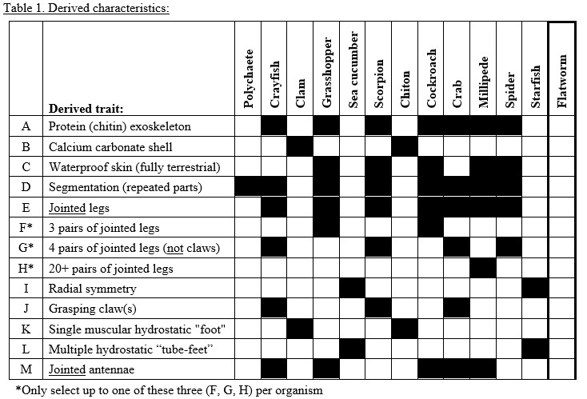
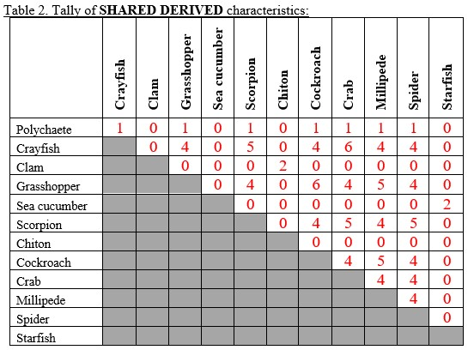
Cladogram Construction
Notes:
Keys for Table 1 and 2.
You can ignore the polychaete and sea cucumber.
We will make an example cladogram with five of these species: the crayfish, scorpion, crab, spider, and flatworm
Afterward, you will have several examples of cladograms to serve as the foundation of your larger cladogram with all eleven species.

Slide 2
Example Cladogram Construction
 | Trait List | Crayfish | Scorpion | Crab | Spider | Flatworm
Crayfish | A DE G J M |  | 5 | 6 | 4 | 0
Scorpion | A CDE G J |  |  | 5 | 5 | 0
Crab | A DE G J M |  |  |  | 4 | 0
Spider | A CDE G |  |  |  |  | 0
Flatworm
Notes:
Tallies of shared derived characters for each pair of species.
IT IS EXTREMELY HELPFUL to include the list of traits next to each organism’s name.

Slide 3
Example Cladogram Construction
Outgroup
 | Trait List | Crayfish | Scorpion | Crab | Spider | Flatworm
Crayfish | A DE G J M |  | 5 | 6 | 4 | 0
Scorpion | A CDE G J |  |  | 5 | 5 | 0
Crab | A DE G J M |  |  |  | 4 | 0
Spider | A CDE G |  |  |  |  | 0
Flatworm
Notes:
Flatworm is an outgroup: it does not share any traits with the other species.
A good reference point for determining relationships of the other species.
Methods for constructing cladograms by hand:
Working from outgroup in, from few shared traits to many
Working from many shared traits to few
Mixture of both
Best method is a matter of personal preference.

Slide 4
Flatworm ( )
Notes:
This example starts with the flatworm.
HIGHLY ENCOURAGED to list each species’ traits next to its name.

Slide 5
 | Trait List | Crayfish | Scorpion | Crab | Spider | Flatworm
Crayfish | A DE G J M |  | 5 | 6 | 4 | 0
Scorpion | A CDE G J M |  |  | 5 | 5 | 0
Crab | A DE G J M |  |  |  | 4 | 0
Spider | A CDE G |  |  |  |  | 0
Flatworm
+ADEG
Flatworm ( )
Notes:
All four remaining species share the traits A, D, E, and G.
One way to construct the cladogram would be to list them all here at the ancestor of these species.
Remember that each time a trait is added or subtracted, it counts as one transition.
We have FOUR transitions so far

Slide 6
Crayfish (A DE G J M)
Crab (A DE G J M)
+ADEG
Flatworm ( )
Notes:
Crayfish and crab share 6 characters (and their lists are the same)
We can place them in a clade, leaving room for other species on the tree.

Slide 7
+ADEG
Crayfish (A DE G J M)
Crab (A DE G J M)
Flatworm ( )
Notes:
It does not matter where we place them in the remaining space
This format is just as correct.

Slide 8
Crayfish (A DE G J M)
Crab (A DE G J M)
+ADEG
Flatworm ( )
Notes:
For simplicity and easier comparison with the other cladograms you’ll see, we’ll put this clade here.

Slide 9
Crayfish (A DE G J M)
+J M
Crab (A DE G J M)
+ADEG
Flatworm ( )
Notes:
Crayfish and crab both have traits J and M, added to their ancestor here.
Total number of transitions 6 so far.

Slide 10
Crayfish (A DE G J M)
+J M
Crab (A DE G J M)
+ADEG
+C
Flatworm ( )
Notes:
The remaining two species both have trait C, so added here at their common ancestor.
The total number of transitions is now 7.

Slide 11
Crayfish (A DE G J M)
+J M
Crab (A DE G J M)
+ADEG
+J
Scorpion (A CDE G J )
+C
Spider (A CDE G )
Flatworm ( )
Notes:
Placed scorpion and the spider together in a clade and added the final transition, J to the cladogram at the unique ancestor of scorpion.
This brings the final number of transitions to 8.

Slide 12
Crayfish (A DE G J M)
+J M
Crab (A DE G J M)
+ADEG
+J
Scorpion (A CDE G J )
+C
Spider (A CDE G )
Flatworm ( )
Number of Total Transitions: 8 Analogous Traits: J
Notes:
Identify analogous traits (homplasies)
Trait present in two species, but not inherited from common ancestor
J arises twice, so it is an analogous trait
This is a parsimonious hypothesis for the relationships of these species.
However, it is not necessarily the ONLY possible hypothesis.

Slide 13
Crayfish (A DE G J M)
+M -C
+J
Crab (A DE G J M)
+ACDEG
Scorpion (A CDE G J )
Spider (A CDE G )
Flatworm ( )
Number of Total Transitions: 8 Analogous Traits: None
Notes:
This cladogram is equally parsimonious to the last one: it has 8 transitions.
However, this one suggests slightly different relationships compared to the first.
Scorpion and spider are not in their own clade, suggesting a slightly more distant relationship.
Also note: Trait C was added in the ancestor of the crayfish, crab, scorpion, and spider, but was then lost in the ancestor of crayfish and crab.
This trait loss is still considered to be one transition.

Slide 14
Crayfish (A DE G J M)
+M
+J
Crab (A DE G J M)
+ADEG
+C
Scorpion (A CDE G J )
+C
Spider (A CDE G )
Flatworm ( )
Number of Total Transitions: 8 Analogous Traits: C
Notes:
This cladogram is also equally parsimonious, with 8 transitions.
Here the hypothesized relationships are the same as the last cladogram, but the ancestral positions of character transitions are different.
Instead of the ancestor of crayfish and crab losing trait C, the trait is instead gained twice, in the unique ancestor of scorpion and the unique ancestor of spider.
Again, this is an example of an analogous trait.

Slide 15
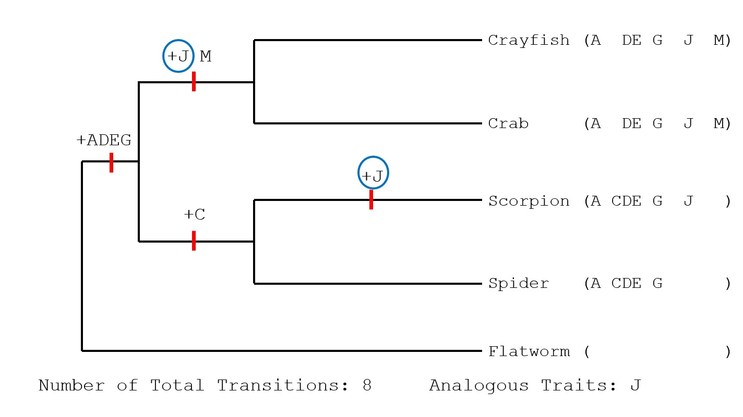
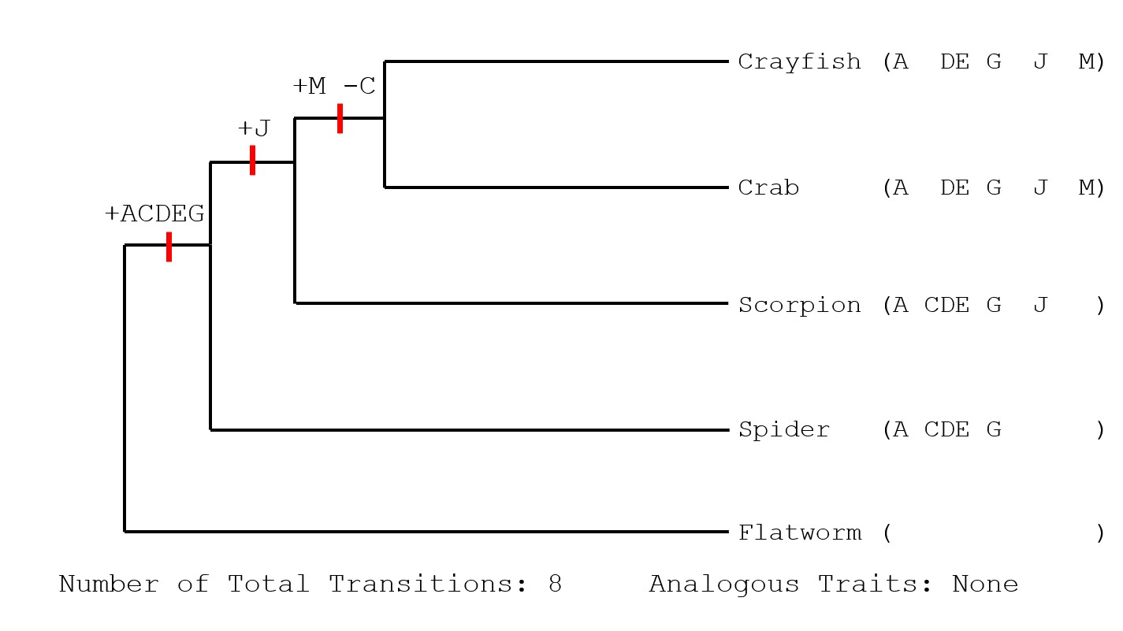
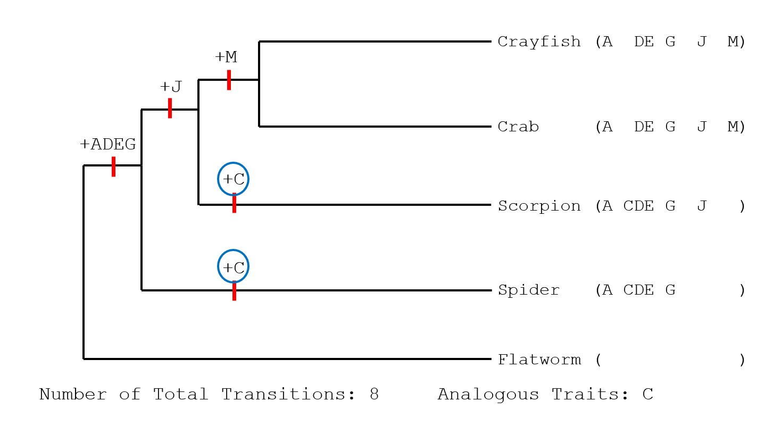
Cladogram Construction
All three are viable, equally parsimonious cladograms based on the information that we have.
Notes:
So, based on the information that we have, all three of these hypotheses are equally viable.
Our hypotheses are always changing as we gain more information.
There is great value in using both phenotypic AND genotypic data for generating hypothesized relationships.
If we used genomic data as well, the first cladogram (top right) would likely be most parsimonious.
However, for the purposes of this assignment and given the limited information you were provided with, any one of these three cladograms are just as parsimonious, and could serve as the basis of your full cladogram.
Now use Tables 1 and 2 of your lab manual to construct a cladogram with all eleven species
Work on in class/for homework - Due next week.
Please do not hesitate to ask for assistance or clarification! The process of creating cladograms can be easy for some, but incredibly difficult and frustrating for others.
However, it is an incredibly useful skill that can help you better understand the fundamental concepts of evolution.

