Slide 1

[!] ACCESS GRANTED
╔════════════════════════════════════════════════════════════════════════════════╗
PENETRATION TEST REPORT
Red Team Simulation
[ PREPARED BY ]
Mohanad Ahmed Usama Atea Ahmed
Yassen Wagih Fathy Abdel Salam
Nancy Sameh Sami Sallam
Ahmed Ayman Ahmed El-Leithy
Approach
Target Host
Assessment Type
Black-Box
192.168.196.138
Internal Network
╚════════════════════════════════════════════════════════════════════════════════╝
[CLASSIFIED]

Slide 2

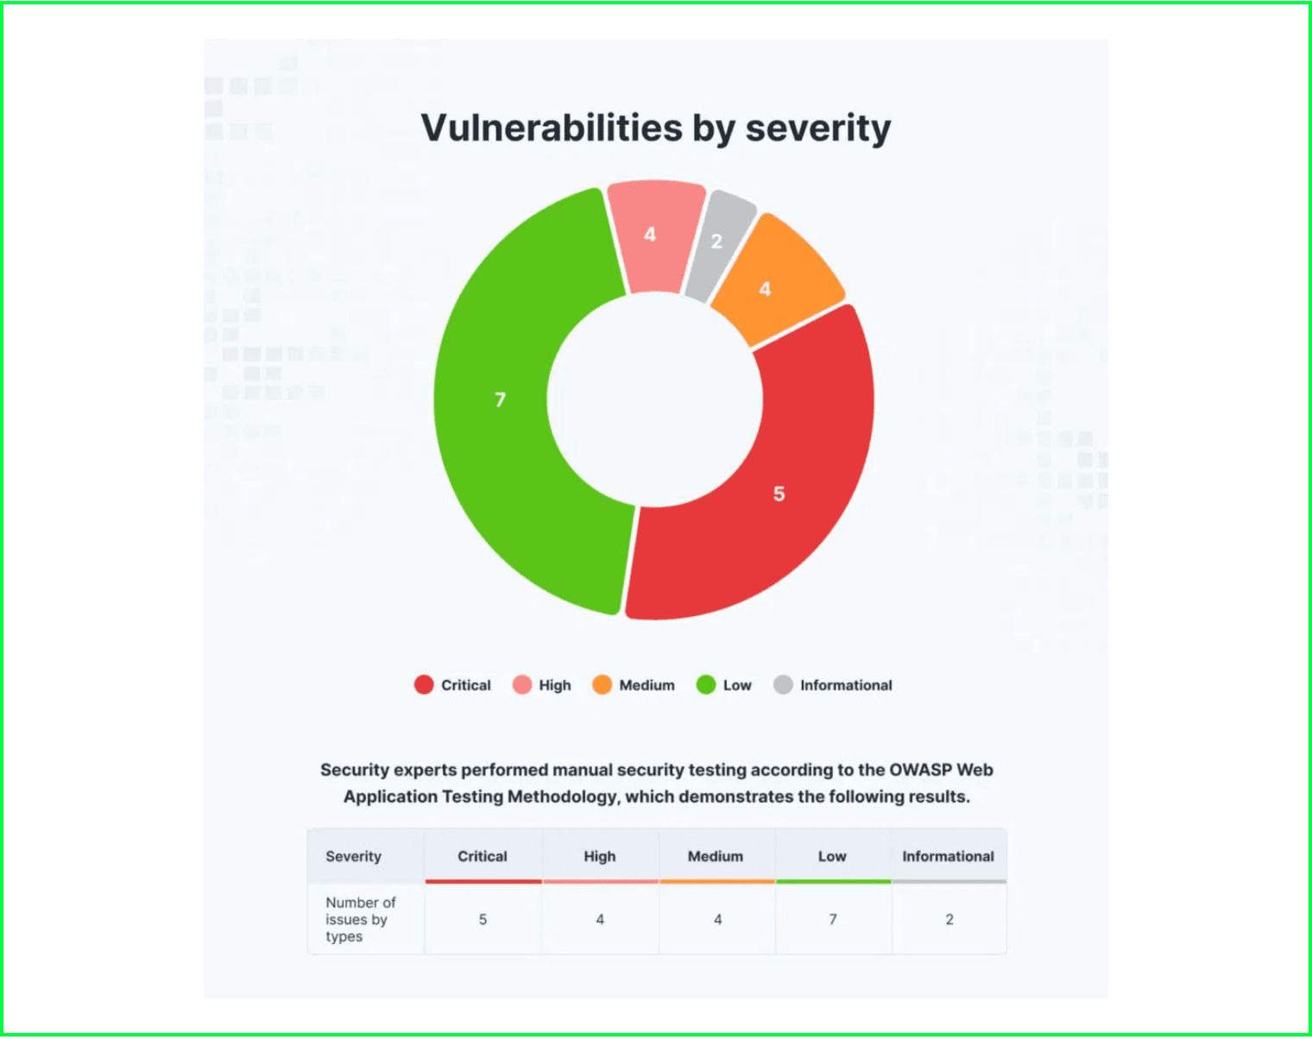
► CRITICAL VULNERABILITIES LED TO FULL SYSTEM COMPROMISE
[ OBJECTIVE ]
Simulate a realistic Red Team adversary to uncover exploitable weaknesses, validate detection and response capabilities, and recommend improvements to reduce organizational risk.
[ SCOPE ]
Internal network penetration test focused on target host 192.168.196.138 and related application functionality under an agreed black-box model with no prior credentials provided.
[ APPROACH ]
Black-box assessment simulating real-world adversary tactics. Network range scanned: 192.168.196.0/24. Tools: Nmap, sqlmap, hydra, knock, ssh, CrackStation, Kali Linux utilities.
⚠ OUTCOME: A chain of linked vulnerabilities was successfully exploited, demonstrating a practical attack path resulting in FULL SYSTEM COMPROMISE if not remediated.
SEVERITY DISTRIBUTION

Slide 3

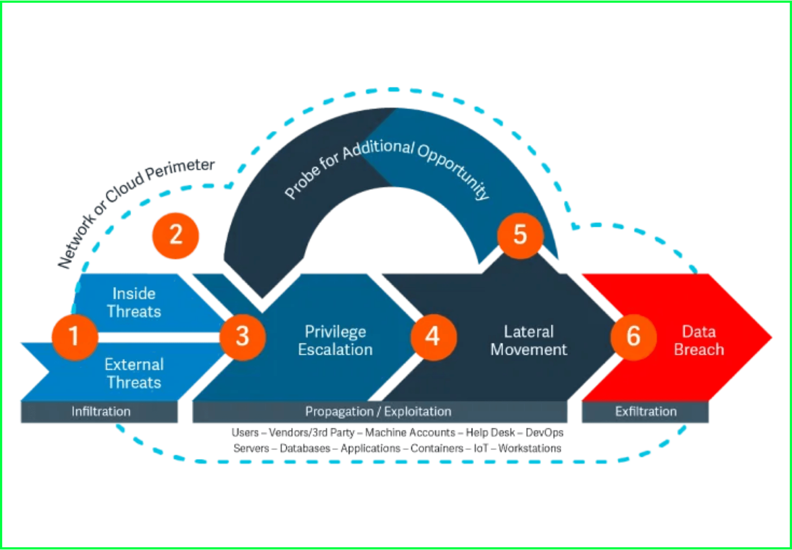
► THE EXPLOIT CHAIN: FROM WEB APP TO ROOT ACCESS
[1]
SQL Injection
Exploited search parameter to extract database contents
↓
[2]
Local File Inclusion
Read sensitive system files via path traversal
↓
[3]
Configuration Disclosure
LFI exposed /etc/knockd.conf with port sequence
↓
[4]
Firewall Bypass
Executed port knocking sequence to open SSH port 22
↓
[5]
Credential Harvesting
Used extracted hashes and dictionary attacks for SSH access
↓
[6]
Privilege Escalation
Exploited sudo NOPASSWD misconfiguration for root access

Slide 4
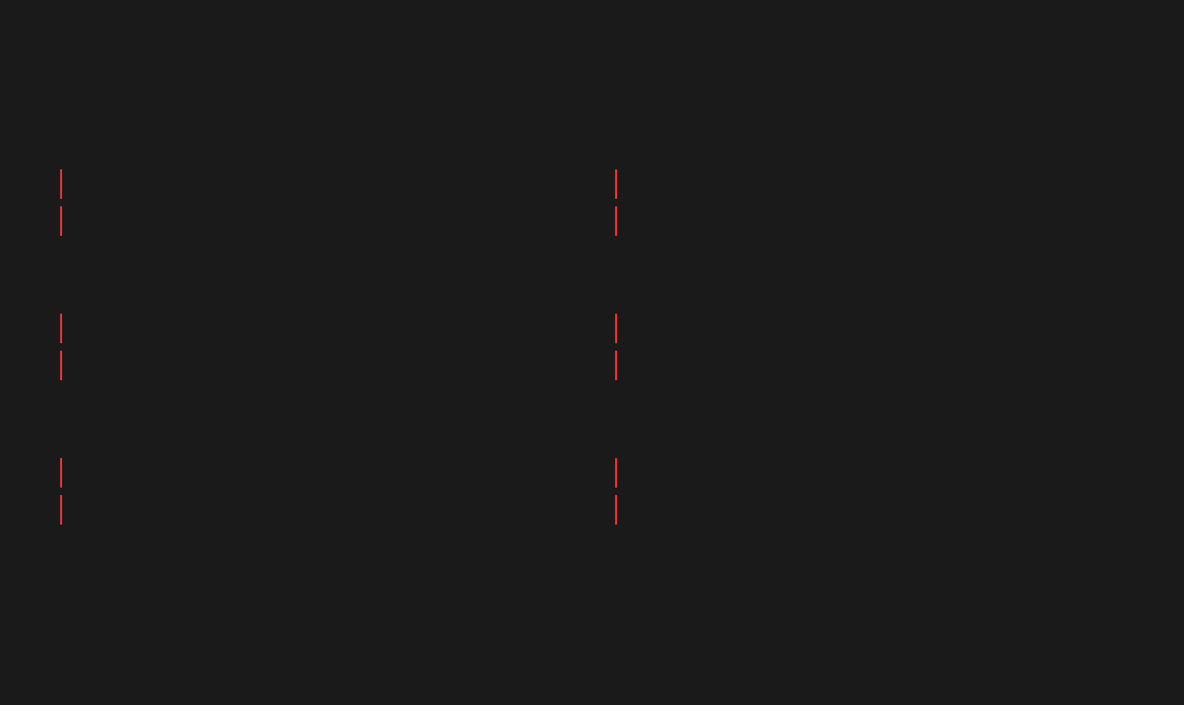
► BLACK-BOX METHODOLOGY: EMULATING A REAL-WORLD ADVERSARY
APPROACH: Black-Box (No Prior Credentials)
[ Reconnaissance ]
[ Service Enumeration ]
Purpose:
Purpose:
Discover live hosts and verify target availability
Identify open ports, services, and versions
Commands:
Commands:
ifconfig, nmap -sn 192.168.196.0/24
nmap -A -Pn -p- 192.168.196.138
[ Initial Compromise ]
[ Post-Exploitation ]
Techniques:
Techniques:
SQL Injection exploitation, Local File Inclusion, Path traversal
Port knocking, SSH authentication, credential attacks
Tools:
Tools:
sqlmap for SQLi detection and database extraction
knock, hydra, ssh for access and enumeration
[ Privilege Escalation ]
[ Exfiltration ]
Objective:
Purpose:
Identify and exploit local privilege escalation vectors
Demonstrate data extraction and proof of compromise
Checks:
Evidence:
sudo entries, file permissions, kernel vulnerabilities
Database dumps, credential harvesting, flag retrieval
[ Tools & Utilities ]
Nmap (port scanning & service detection) • sqlmap (SQL injection detection & exploitation) • hydra (credential brute-forcing) • knock (port knocking client) • ssh (remote access & post-exploitation) • CrackStation (password hash cracking PoC) • Kali Linux utilities • Standard Linux commands (ifconfig, cat, ls, sudo, etc.)

Slide 5

► FINDING 3.1: CRITICAL SQL INJECTION IN SEARCH PARAMETER
[ VULNERABILITY DESCRIPTION ]
[ DATABASE DISCLOSURE ]
Unvalidated user input in a POST search parameter allowed SQL Injection attacks using boolean, time-based, and UNION-based techniques. The application failed to implement prepared statements or input sanitization.
Full extraction of usernames, emails, and password hashes from multiple databases. Complete database schema enumeration possible.
[ AUTHENTICATION BYPASS ]
Potential to bypass login mechanisms by manipulating SQL queries to return valid credentials or create unauthorized access.
CRITICAL
[ EXPLOITATION METHOD ]
Tool: sqlmap was used to systematically identify and exploit the vulnerability. Multiple databases were enumerated, including Staff and users databases with sensitive tables.
[ REMOTE CODE EXECUTION ]
Possible RCE via chaining with additional vulnerabilities or database-specific functions (e.g., INTO OUTFILE, xp_cmdshell).
sqlmap -r check2.txt --dbs
sqlmap -r check2.txt -D Staff -T Users -C username,password --dump
[ BUSINESS IMPACT ]
Complete compromise of data confidentiality, integrity, and availability. Regulatory compliance violations and reputational damage.
[ VULNERABILITY TYPES ]
• Boolean-based SQL Injection
• Time-based SQL Injection
• UNION-based SQL Injection

Slide 6


► FINDING 3.2: HIGH-SEVERITY LOCAL FILE INCLUSION (LFI)
[ DESCRIPTION ]
A vulnerable file parameter in the web application allowed local file inclusion and path traversal attacks, enabling unauthorized reading of arbitrary system files from the target host.
[ VULNERABLE ENDPOINT ]
Parameter: file (GET/POST)
Endpoint: welcome.php
http://192.168.196.138/welcome.php?file=../../../../etc/passwd
http://192.168.196.138/welcome.php?file=///////etc/knockd.conf
SEVERITY
HIGH
[ EXPLOITATION TECHNIQUE ]
Path traversal using directory traversal sequences (../) and null byte injection to bypass basic filters. The application failed to validate or sanitize user input, allowing attackers to read files outside the intended webroot directory.
[ FILES ACCESSED ]
/etc/passwd - System user enumeration
▸
/etc/knockd.conf - Port knocking configuration (CRITICAL)
▸
Other sensitive configuration files
▸
⚠ IMPACT:
Disclosure of system users, credentials, and critical security configuration files. This vulnerability was instrumental in escalating the attack surface by revealing the port knocking sequence, which enabled firewall bypass and unauthorized SSH access.

Slide 7

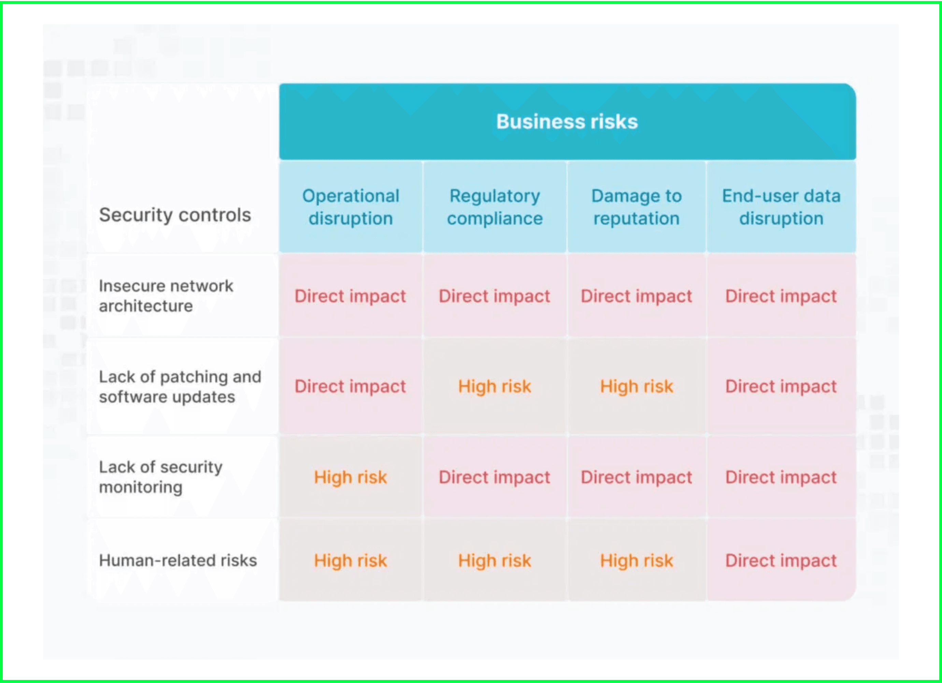
► FINDINGS 3.3 & 3.4: CONFIGURATION AND CREDENTIAL WEAKNESSES
[ FINDING 3.3 ]
Disclosure of Port Knocking Configuration
Description:
/etc/knockd.conf content was exposed via Local File Inclusion vulnerability, revealing the SSH open sequence used for network access control.
Potential Impact:
Bypass of network filtering and firewall rules, enabling remote SSH access when the knock sequence is executed by unauthorized actors.
⚠ HIGH SEVERITY
[ FINDING 3.4 ]
Weak Password Storage & Credential Reuse
Description:
Passwords stored in weak formats (plaintext or MD5 hash) and reused across multiple accounts found in database dumps via SQL injection.
Potential Impact:
Easy hash cracking via online tools (PoC with CrackStation demonstrated), credential reuse across services leading to unauthorized access.
BUSINESS IMPACT ANALYSIS
⚠ HIGH SEVERITY

Slide 8

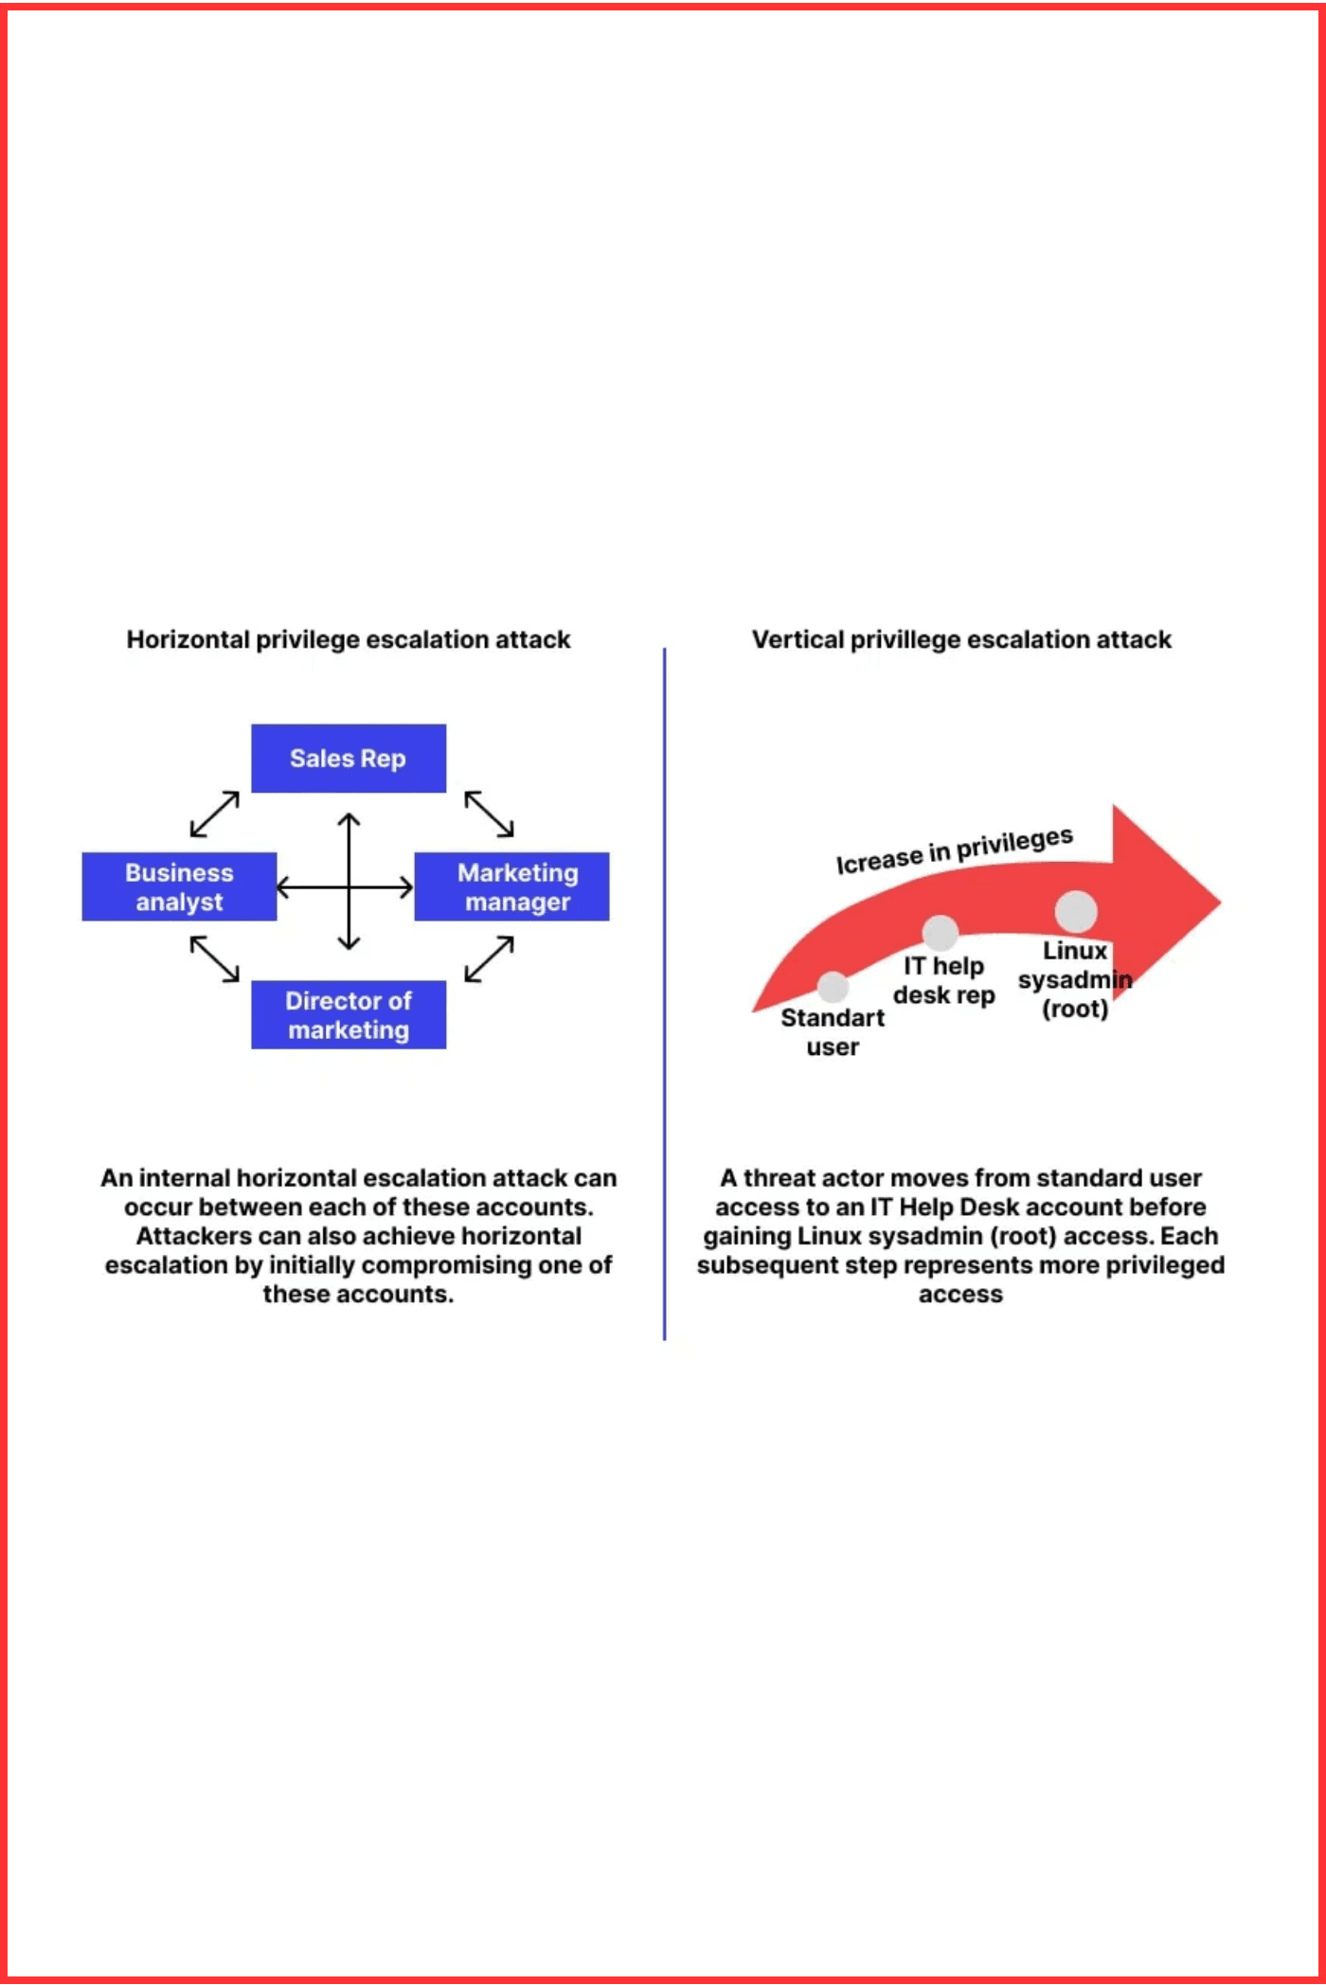
⚠ FINDING 3.6: CRITICAL SUDO MISCONFIGURATION FOR PRIVILEGE ESCALATION
[ VULNERABILITY DESCRIPTION ]
A sudoers entry permitted a non-privileged user to run a binary as root without requiring a password (NOPASSWD). This misconfiguration creates a direct privilege escalation vector allowing any authenticated user to execute arbitrary commands with root privileges.
[ TECHNICAL DETAILS ]
Sudoers configuration allowed execution as root without password authentication:
user ALL=(root) NOPASSWD: /path/to/binary
[ POTENTIAL IMPACT ]
Local privilege escalation to root access
Full system compromise and control
Unauthorized access to all system resources
Ability to modify system configurations
Data exfiltration and destruction capabilities
Severity Rating
VERTICAL ESCALATION ATTACK
CRITICAL

Slide 9
⚠ IMMEDIATE ACTION: PRIORITIZED REMEDIATION STEPS
[ CRITICAL ] Implement these recommendations immediately to mitigate highest-risk vulnerabilities
[ RECOMMENDATION 1 ]
[ RECOMMENDATION 2 ]
Fix SQL Injection Vulnerabilities
Patch Local File Inclusion (LFI)
Replace vulnerable queries with prepared statements and parameterized queries to prevent SQL injection attacks.
Remove direct file-include functionality and implement secure file handling with allowlists.
Implementation:
Implementation:
Replace dynamic includes with allowlist of permitted resources
→
Use prepared statements for all database queries
→
Use realpath() to prevent directory traversal
→
Implement strict input validation and sanitization
→
Restrict web server process file access permissions
→
Deploy WAF rules to block common SQLi payloads
→
Disable dangerous PHP functions (include, require)
→
Enable monitoring and alerting for SQLi attempts
→
Priority: CRITICAL | Timeline: Immediate (24-48 hours)
Priority: CRITICAL | Timeline: Immediate (24-48 hours)
[ RECOMMENDATION 3 ]
[ RECOMMENDATION 4 ]
Address Sudo NOPASSWD Misconfiguration
Secure Configuration Files
Remove unnecessary NOPASSWD entries from sudoers configuration immediately to eliminate privilege escalation vector.
Move sensitive configuration files outside webroot and restrict filesystem permissions to prevent unauthorized access.
Implementation:
Implementation:
Audit all sudoers entries for NOPASSWD configurations
→
Move knockd.conf outside webroot directory
→
Remove all unnecessary NOPASSWD entries
→
Restrict file permissions (chmod 600 or 640)
→
Restrict commands allowed via sudo to minimum required
→
Store secrets in secure vault or protected location
→
Enable sudo logging and monitoring
→
Remove web server read permissions on sensitive files
→
Priority: CRITICAL | Timeline: Immediate (within hours)
Priority: CRITICAL | Timeline: Immediate (24 hours)

Slide 10

► HIGH/MEDIUM TERM: LONG-TERM SECURITY IMPROVEMENTS
[ STRATEGIC INITIATIVES ] Implementation over weeks to months for sustained security posture improvement
[ RECOMMENDATION 5 ]
[ RECOMMENDATION 6 ]
[ RECOMMENDATION 7 ]
Improve Password Management & Authentication
Reconsider Port Knocking Usage
Update & Patch All Systems
Migrate from weak password storage formats to modern, cryptographically secure hashing algorithms with enforcement of strong authentication policies.
Evaluate the necessity of port knocking and migrate to stronger, industry-standard access control mechanisms that provide better security and auditability.
Establish a comprehensive patch management program to keep all operating systems, server software, databases, and libraries current with security updates.
Implementation Actions:
Implementation Actions:
Implementation Actions:
Migrate from MD5 to Argon2 or bcrypt
→
Audit current port knocking deployment
→
Audit current system versions and EOL status
→
Use unique salts for each password hash
→
Implement VPN for remote access
→
Establish patch management policy
→
Enforce strong password complexity rules
→
Deploy IP allowlisting for trusted networks
→
Update Debian and all OS packages
→
Implement account lockout after failed attempts
→
Use SSH jump hosts / bastion servers
→
Update Apache, DBMS, and dependencies
→
Enable Multi-Factor Authentication (MFA)
→
If retaining knockd, secure configuration
→
Implement automated patch deployment
→
Conduct user security awareness training
→
Never store sequences in plaintext
→
Schedule regular maintenance windows
→
Timeline:
Timeline:
Timeline:
4-8 weeks for implementation and user migration
6-12 weeks for planning and deployment
Ongoing | Initial deployment 2-4 weeks
Priority:
Priority:
Priority:
High | Foundational for access control
High | Improves access control architecture
Critical | Continuous operational requirement

Slide 11

► CONCLUSION: CRITICAL RISK MITIGATION REQUIRED
The Red Team simulation successfully identified a critical, multi-stage attack path that resulted in full system compromise. A chain of linked vulnerabilities—spanning SQL injection, local file inclusion, configuration disclosure, firewall bypass, credential harvesting, and privilege escalation—demonstrates the real-world risk to the organization if these issues remain unaddressed.
[ KEY FINDINGS SUMMARY ]
2 CRITICAL
4 HIGH
SQL Injection, Sudo Misconfiguration
LFI, Port Knocking Config, Weak Passwords, Credential Reuse
[ IMMEDIATE NEXT STEPS ]
Implement prepared statements and parameterized queries to eliminate SQL injection
▸
Remove or restrict dynamic file inclusion functionality to patch LFI
▸
▸
Audit and remove all NOPASSWD entries from sudoers configuration
Migrate password storage from MD5 to Argon2 or bcrypt with unique salts
▸
Deploy Web Application Firewall (WAF) rules to block common attack payloads
▸
⚠ CRITICAL ACTION REQUIRED
Begin immediate implementation of Critical-level recommendations. These vulnerabilities present an active and exploitable risk to organizational security. Delay in remediation increases exposure to data breach, system compromise, and regulatory violations.
[ CALL TO ACTION ]
Conduct a comprehensive security audit of all web application input vectors and server configurations. Engage security teams to validate remediation efforts. Schedule follow-up penetration testing after fixes are implemented to verify vulnerability closure.
END OF REPORT | Questions? Contact Security Team

