Slide 1
Piano-Playing Robot
Updated Task List

Slide 2
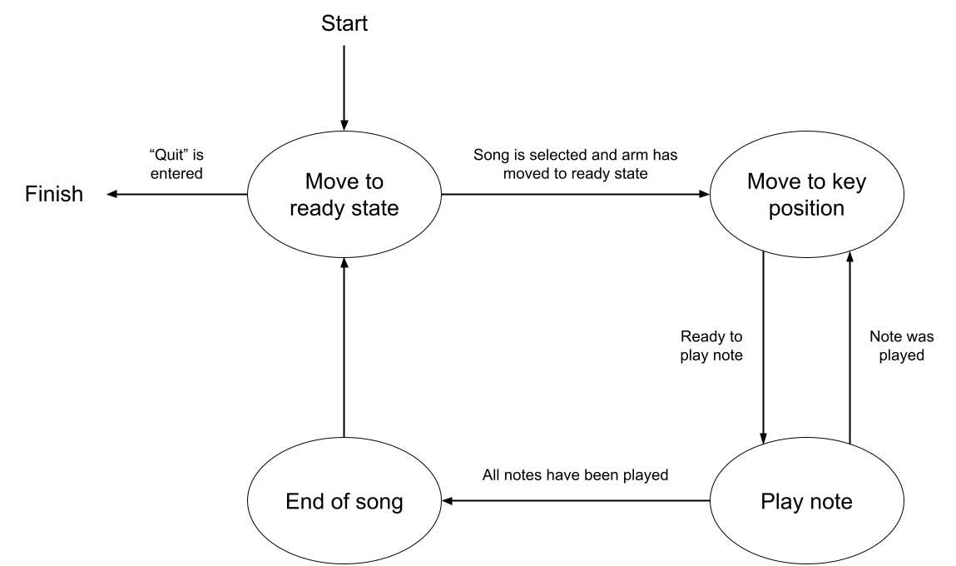

Slide 3
Tasks Overview
Read input
Move to starting position
Read the next note and move to that position
If two notes are read, open the claw to reach
Play the note(s)
Repeat 3-5 until all notes are played
Go back to starting position when the song is over

Slide 4
1. Read input
Completed:
Ask user for a choice of song to play
Read in note names from txt file
Convert to relative x positions
TODO:
Return an error on bad input (out-of-bounds X positions, invalid note letters, two simultaneous notes that are too far apart, etc.)
Add modularity to reading in text file

Slide 5
2. Move to starting position
Completed:
Lift up for clearance
Move to center of piano
TODO:
Use a camera to find the piano’s position

Slide 6
3. Read the next note and move to that position
Completed:
Get desired note
Move to the x position of the desired note
TODO:
If time permits, check positioning with camera and adjust if needed

Slide 7
4. If two notes are read, open the claw to reach
Completed:
Find the difference of the two notes’ positions to get the distance between them
Use the distance to determine how much to open the claw
If the two notes are the same, close the claw instead
Tasks 3 and 4 can be performed at the same time
TODO:

Slide 8
5. Play the note(s)
Completed:
Move down until the key is pressed
Wait for the duration of the note
Move up
TODO:

Slide 9
6. Repeat 3-5 until all notes are played
Completed:
Get the next note from the input and continue playing
Repeat until the end of the input is reached
TODO:

Slide 10
7. Go back to starting position
Completed:
Give prompt to user that the song is done
Move back to ready state or quit based upon user input
TODO:

Slide 11
Obstacles
MoveIt motion planning issues
Uneven table
IP addressing when creating publisher and subscriber for the claw
Rewiring of main disconnect in Gizmo
Potentially broken camera cable
Larry never got to wear a fedora :(

Slide 12
Future Work
Get camera setup
Play black notes
Try to optimize speed
Fault detection

