Slide 1
Biru’s Story

Slide 2
Research Question:

Slide 3
How does Caritas Australia continue Jesus’ mission of human dignity by applying the Catholic Social Teaching principles to support people in India who are struggling under conditions of poverty and discrimination?

Slide 4
By Zach and Hunter

Slide 5
Who is Biru, and how is he affected by the social issues of poverty and discrimination?

Slide 6
This is Biru

Slide 7
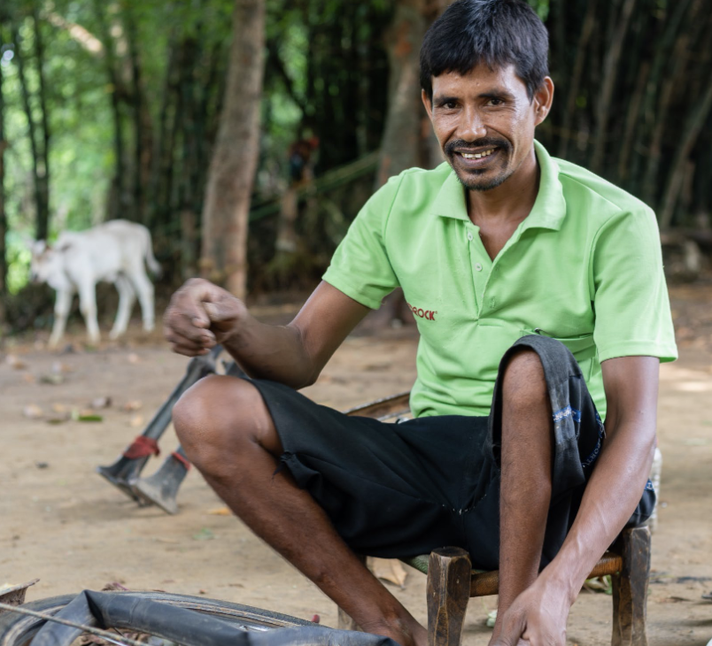

Slide 8
He lives in a rural village in Jharkhand state

Slide 9
In the east of India

Slide 10
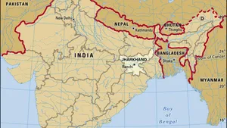

Slide 11
Biru contracted polio when he was young

Slide 12
And lost mobility in one of his legs

Slide 13
So, it became very difficult to walk

Slide 14
He was unable to attend school until 6th grade

Slide 15
Although he had and still has the support of his family and friends

Slide 16
Biru used to be a shepherd

Slide 17
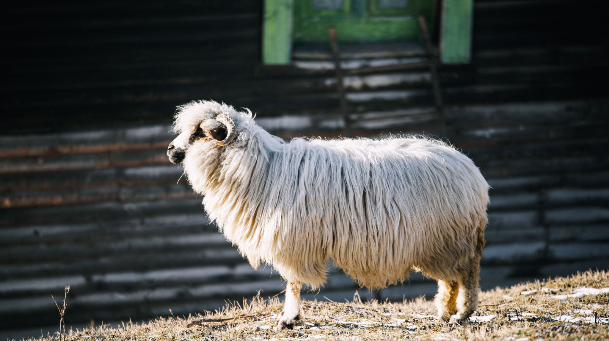

Slide 18
...but keeping up with the cattle would often be tedious for him

Slide 19
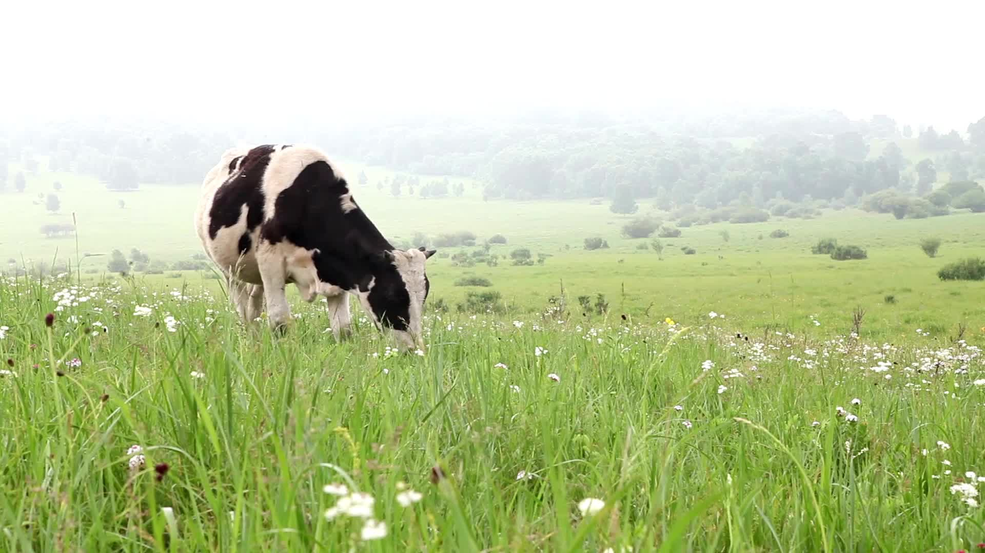

Slide 20
as it required him to run...

Slide 21


Slide 22
...sometimes injuring him

Slide 23
He lived in poverty, so he did not have access to the proper facilities or equipment required to help him. (over 26 million people with a disability live in poverty).

Slide 24
In his community, Biru was discriminated against due to his disability.

Slide 25
Early in life, Biru needed to depend on his parents for help but as he got older, he found different ways to earn money and overcome the challenges of his disability.

Slide 26
At a young age, Biru started to shepherding other people’s cattle.

Slide 27
Biru has continued to work after his marriage and has four children although it has started to become harder to perform his job

Slide 28
Biru then taught himself how to repair bicycles after looking after cattle became too challenging

Slide 29
How and why does Caritas address discrimination and poverty, and what have they done for Biru?

Slide 30
Caritas has provided support to Biru in the form of entrepreneurship and livelihood training programs

Slide 31
Biru now, with the support of Caritas’ programs owns and actively runs his own bicycle repair business.

Slide 32
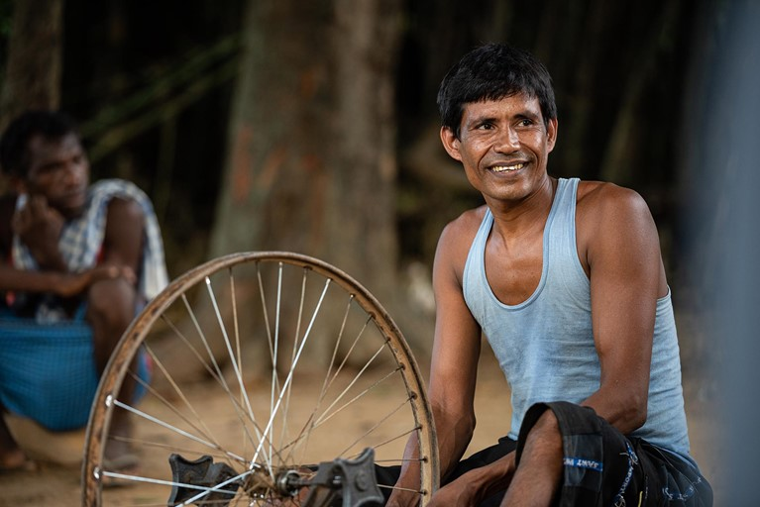

Slide 33
How does the work Caritas undertakes towards discrimination and poverty relate to Catholic Social Teaching?

Slide 34
Caritas works to end Poverty and promote Justice in countries throughout Africa, Asia, Australia, the Pacific and the middle east, including Biru’s village, Jharkland State.
In Jharkland State, Caritas works to develop sustainable incomes of workers, improve access to Education and health services and empower women’s voices.
Caritas carefully designs their development and humanitarian programs by improving basic necessities like water, sanitation, hygiene, healthcare and education.

Slide 35
References

Slide 36
Harvard style

Slide 37


Slide 38
Harvard style

Slide 39
Wikipedia. 2022. Caritas Internationalis - Wikipedia. [ONLINE] Available at: https://en.wikipedia.org/wiki/Caritas_Internationalis. [Accessed 05 April 2022].
Caritas. 2022. Biru's story. [ONLINE] Available at: https://www.caritas.org.au/project-compassion/biru-story/. [Accessed 05 April 2022].

