Slide 1
Can trigram trick us?
- Learning to detect fake articles
Group Members:
Leonid (Leo) Boytsov
Zhou Yu
Di Wang
Hector, Zhengzhong Liu

Slide 2
Outline
Introduction
Hypothesis
Approach and feature design
Experiments and discussion
Problems encountered (might be too much to say in 10 min)

Slide 3
Introduction
As we all know, our problem is…
Given some articles, can we distinguish fake ones generated by a trigram model from real ones?
We believe the answer lies in the statistics
And we use a machine learning approach to exploit it

Slide 4
Some Initial Hypothesis
Higher-order n-gram models on articles will expose the weakness of tri-gram model
Higher-order n-gram models perplexity
Mutual information between distant words
Sentences generated by Tri-gram model may not be well formed
POS tags might be screwed up
Coherence in between fake sentences are weak
Mutual information in between sentences

Slide 5
Designed Features
Original text n-gram model perplexity
2 to 7 gram (with backoff)
Good-Turing smoothing
POS tag n-gram model perplexity
2 to 7 gram (with backoff)
Good-Turing smoothing
Number of <UNK> and total number of words
Point-wise mutual information between distant words (word in between > 2)
Point-wise mutual information between words in different sentences

Slide 6
Additional data*
Sparsity is always an issue for language processing
Estimation of N-Gram requires large amount of data
We need more….
We tried NLTK, the generated data is different
We tried CMU Sphinx toolkit
We tend to generate long documents
2000 words longer than provided for training
* For more details, please refer to our report

Slide 7
Experiments

Slide 8
Approach
Soft-margin SVM
Good classifier, but no probability
Tried different kernels
Regularized logistic regression
Probably not as good as SVM here
But we have probability results
LASSO and Tiknonov regularization
Naïve Bayes
You know it didn’t work well
Parameters tuned by 10-fold cross-validation

Slide 9
Experimental results
Original Dev Set
Generated Dev Set
Hard Metric
Hard Metric
SVM | Original training set |  | Generated training set
 | short | all | short | all
 | 0.88 | 0.90 | 0.92 | 0.895
SVM | Original training set |  | Generated training set
 | short | all | short | all
 | 0.927 | 0.923 | 0.927 | 0.901
Soft Metric
Soft Metric
LR-L1 | Original training set |  | Generated training set
 | short | All | Short | all
Exp(ll) | 0.7 | 0.73 | 0.75 | 0.76
LR-L1 | Original training set |  | Generated training set
 | short | all | short | all
Exp(ll) | 0.8 | 0.78 | 0.8 | 0.73

Slide 10
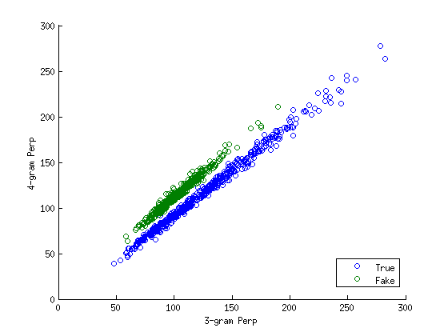
Trigram vs. 4-Gram
It is the interaction ( say ratio) between tri-gram and 4-gram on the data that make the difference
Notes:
It is the ratio between T

Slide 11
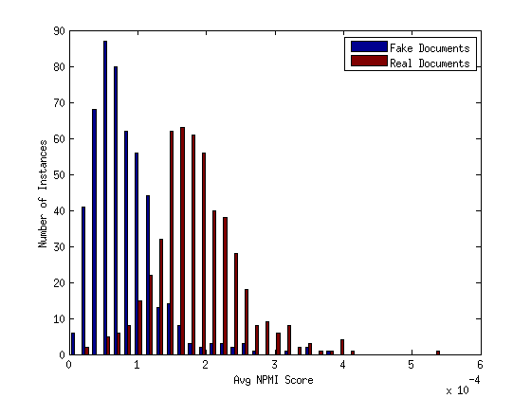
Point-wise Mutual Information

Slide 12
Accuracy vs. # Sentences
Accuracy
# sentences

Slide 13
Conclusion
About machine learning
Soft margin linear SVM
Logistic regression with LASSO
About features
N-Gram model dominates
Interaction between N-Gram is important
Classification work well with two features
Probability estimation work with all features
Additional data
On development set
Unsure on unseen data

Slide 14
Q&A

