Slide 1
LEARNING TO DETECT FAKE DOCUMENTS
Team #6
Team Members:
Leonid (Leo) Boytsov
Zhou Yu
Di Wang
Hector, Zhengzhong Liu

Slide 2
General Approach
Design linguistically motivated features
Train a discriminative classifier to produce document classes (fake or real)
Train a logistic regression model to produce posterior probabilities

Slide 3
Initial Hypotheses
We can detect fake articles by taking into account features computed for histories longer than three words:
Perplexity computed using a higher-order n-gram models (n>3)
Perplexity computed using a higher order n-gram model built over sequences of POS-tags
Mutual information between distant words in a single sentence
Mutual information in words across sentences
Syntatctical parsing scores

Slide 4
Designed Features
Original text n-gram model perplexity (2 to 7 words, Good-Turing smoothing)
POS tag n-gram model perplexity (2 to 7 tags, Good-Turing smoothing)
Point-wise mutual information between distant words (more than 2 words in-between)
Point-wise mutual information between words in different sentences
Proportion of words that repeat in more than one sentence
Syntactical parsing scores

Slide 5
Additional training/testing data
First we tried NLTK, but produced documents were very different from the provided testing and training data
Then we back-ported the generating function from the CMU Sphinx toolkit to the CMU Cambridge toolkit
Real data was generated by extracting a long piece that started at a random sentence
We generated documents that were much longer than those in the training set
The generated training/testing sets were 10x the size of the sets provided by instructors

Slide 6
Machine Learning Methods
Soft-margin SVM
Good classifier, but no posterior probabilities
Tried different kernels
Regularized logistic regression
Probably not as good as SVM
But it can produce posterior probabilities
LASSO (L1) and Tikhonov (L2) regularization
Naïve Bayes
Parameters tuned by 10-fold cross-validation
We use two sets of features
Complete includes all n-gram models
Short includes only 3-gram and 4-gram models

Slide 7
Experimental results
Original Dev Set
Generated Dev Set
Hard Metric (SVM)
Hard Metric (SVM)
Original training set |  | Generated training set
short | complete | short | complete
0.88 | 0.90 | 0.92 | 0.895
Original training set |  | Generated training set
short | complete | short | complete
0.927 | 0.923 | 0.927 | 0.901
2^{Soft Metric} (LR-L1)
2^{Soft Metric} (LR-L1)
Original training set |  | Generated training set
short | complete | short | complete
0.7 | 0.73 | 0.75 | 0.76
Original training set |  | Generated training set
short | complete | short | complete
0.8 | 0.78 | 0.8 | 0.73

Slide 8
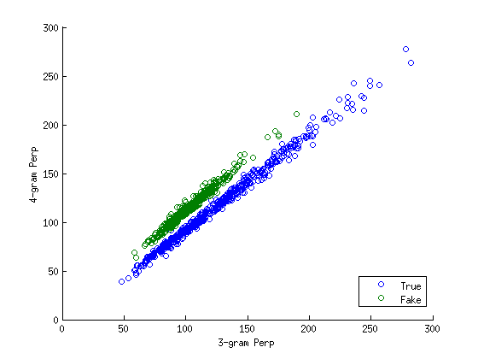
Perplexity distributions of 3- and 4-gram models for fake and real documents
No single model can separate fake and real documents, but two models can!
Notes:
It is the ratio between T

Slide 9
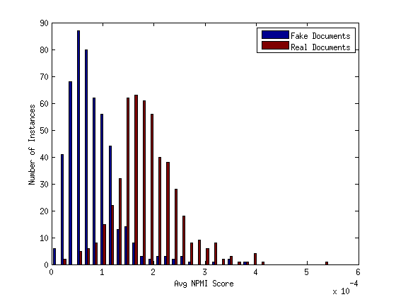
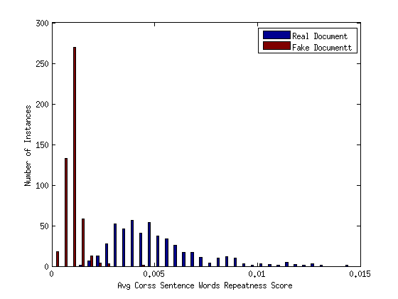
Word Occurrence Features
Point-wise Mutual Information
Average portion of repeated words

Slide 10
Accuracy vs. # Sentences
Accuracy
# sentences

Slide 11
Conclusions
Best Machine Learning Methods
Soft margin linear SVM
Logistic regression with the LASSO regularization
Features
Perplexities computed using n-gram models
No single n-gram model can detect fake sentences
Yet, two n-gram models are sufficient to classify accurately
Probability estimation may work better with all n-gram models
Additional data
Was probably helpful on the development set
Unsure about unseen data
No feature works well for short sentences
Syntactical parsing scores were not helpful

Slide 12
Questions?

