Slide 1
Doodle Detector
By: Hunter Kalinoski

Slide 2
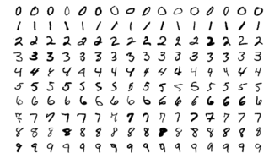

MNIST and QuickDraw
MNIST
MNIST is digits ( 0–9 )
QuickDraw is simple objects (345 categories)
The ones I used:
- circle, star, triangle, umbrella, basketball, fish, house, cat
QuickDraw

Slide 3
The Model
Convolutional Neural Network
Trained to a high accuracy (~90-98%),
But bad in practice

Slide 4
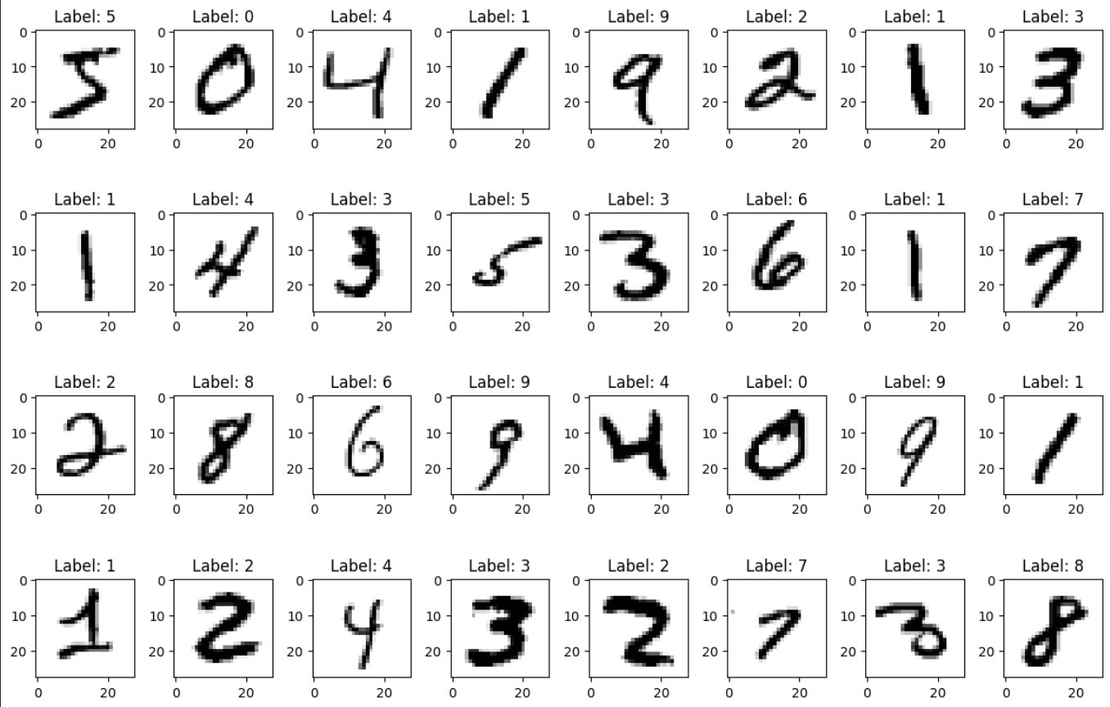
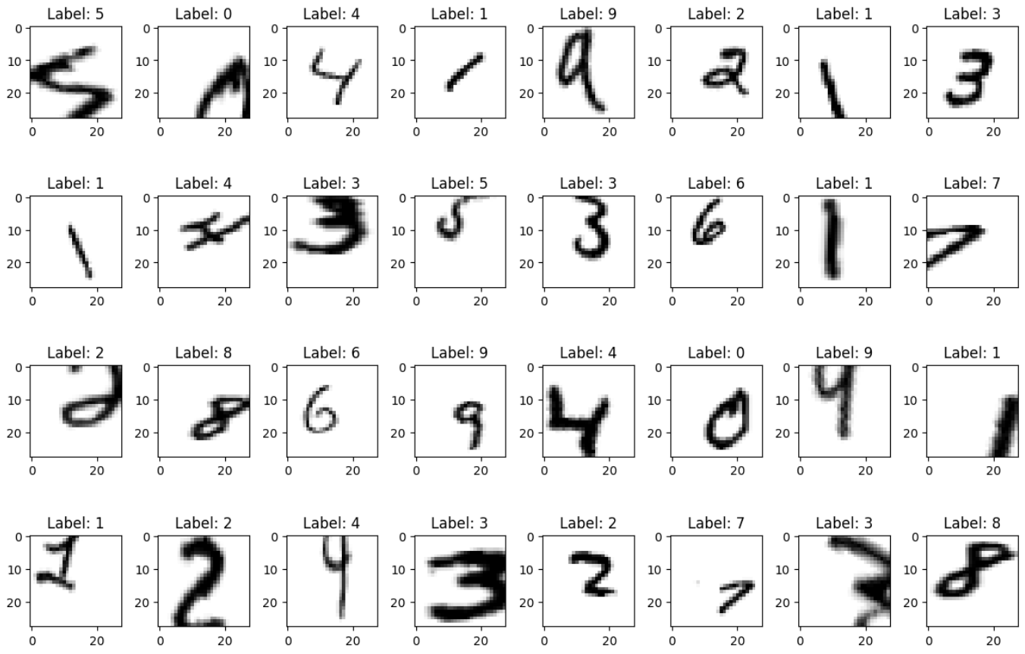

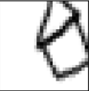
Augmentation
Randomly mutate input images
rotation, scale, translation
0-30% range
*QuickDraw data is also augmented

Slide 5
Results
Good
Accuracy on the test set was similar
Accuracy in practice significantly better
Further improvements were made to the model by adjusting layers.

Slide 6
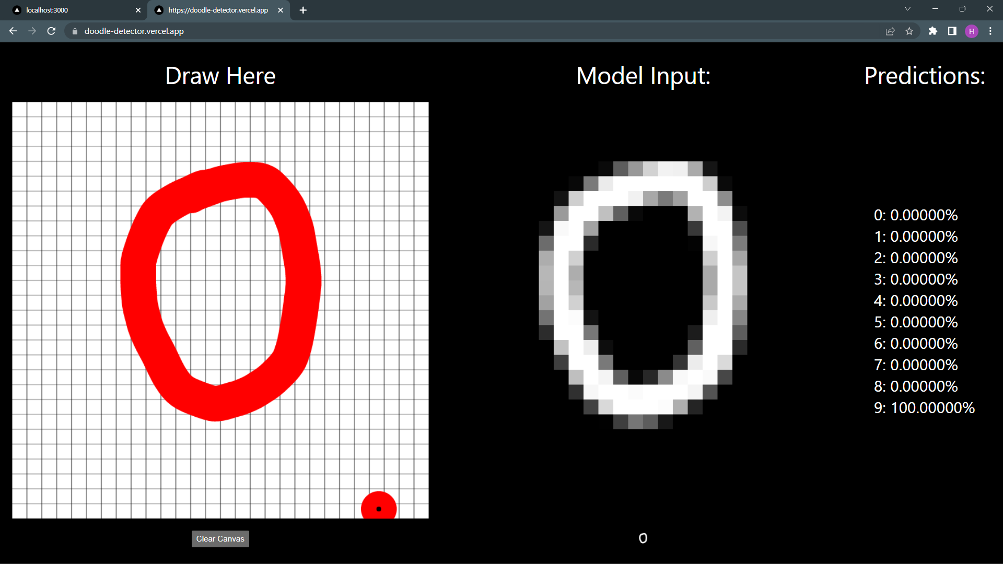
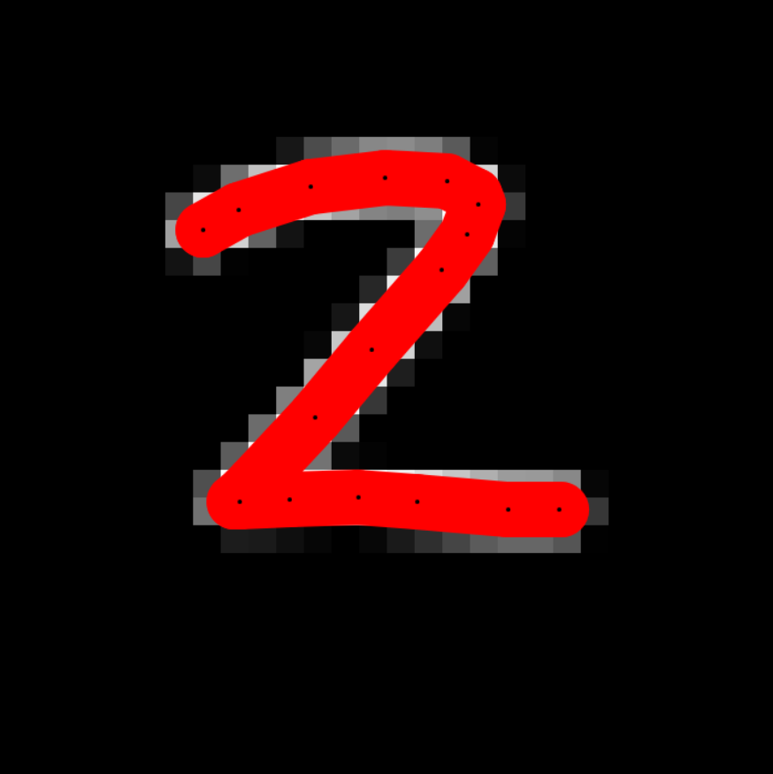
The Canvas

