Slide 1
A New Approach to Detecting Frame Deletion in H.264 Encoded Digital Video
By: Hunter Kippen
Advisor: Dr. Matthew Stamm
Drexel University

Slide 4
Video Frame Deletion
Video frame deletion is a video editing operation.
Frame deletion occurs when a frame or sequence of frames are removed from a video.
This can alter the context surrounding events captured in the video.

Slide 5
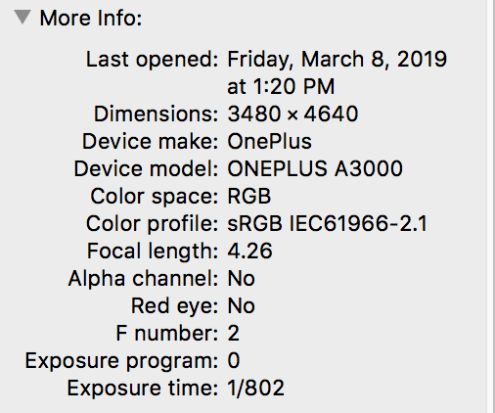
Video Forgery Detection
Detecting frame deletion is a problem in video forgery detection.
Subset of media forgery detection
Media forgery detection is a well researched problem in Digital Media Forensics.

Slide 6
Video Forgery Detection
Fingerprints are hard to extract from video:
Digital videos contain large amounts of information.
Individual frames are low quality due to high compression.
Video frame deletion leaves fingerprints because of the video compression process.
Original fingerprints formulated for use on MPEG-2 video.

Slide 7
Objectives
In this thesis:
Examine relevancy of MPEG-2 Fingerprints
Propose new method to extract fingerprints on H.264 Encoded Video
Propose new classification framework
Conduct experiments to evaluate detector performance

Slide 8
Video Compression

Slide 9
By the Numbers
Uncompressed 1080p Video:
2,073,600 pixels per frame
~6 Megabytes of storage required per frame
24 Frames per second
142.4 Megabytes of storage required per second
A 1 TB HDD can only hold about 2 hours of uncompressed video
When compressed, 350 hours!

Slide 10
Spatial Redundancy
Video frames are still images
Can compress a frame like a JPEG Image
Early video compression did this: Motion-JPEG
Doesn’t compress nearly enough

Slide 11
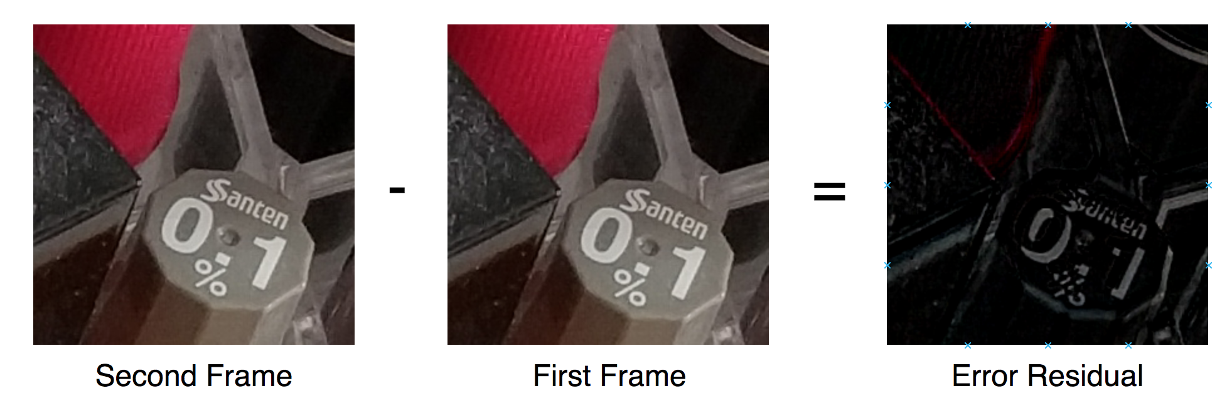
Temporal Redundancy
Most video is low motion
The current frame is a good prediction for the next frame
Known as inter-frame prediction

Slide 12
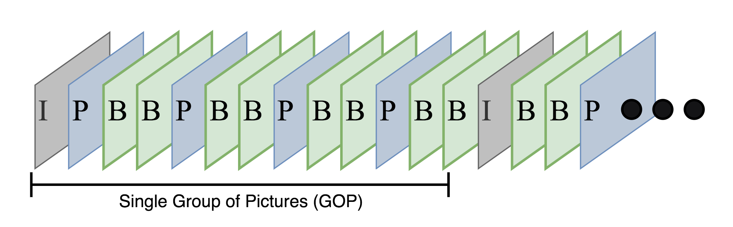
GOPs
Can’t just make predictions from the previous frame
Need index frames to lower prediction error
Frames are arranged into Groups of Pictures (GOPs)

Slide 13
GOPs
I-frames are index frames.
Encoded using a JPEG like process
P-frames are predicted frames.
Predicted from previous I or P-frame
B-frames are bi-directional frames.
Predicted from a previous and future frame
I and P-frames are known as anchor frames

Slide 14
Inter-Frame Prediction
Motion in video is not always in one direction
Video frames are divided into subsections called macroblocks
In MPEG-2: 16x16 Pixels

Slide 15
Video Frame Deletion Detection
Video frame deletion detection uses fingerprints left by the inter-frame prediction process used in encoding digital video
To date, most methods for detecting frame deletion were formulated for use on MPEG-2 encoded video.
Modern video codecs such as MPEG-4 and H.264 use more advanced frame prediction methods.
It is unclear as to whether the traces used to detect frame deletion on MPEG-2 are expressed in modern video.

Slide 16
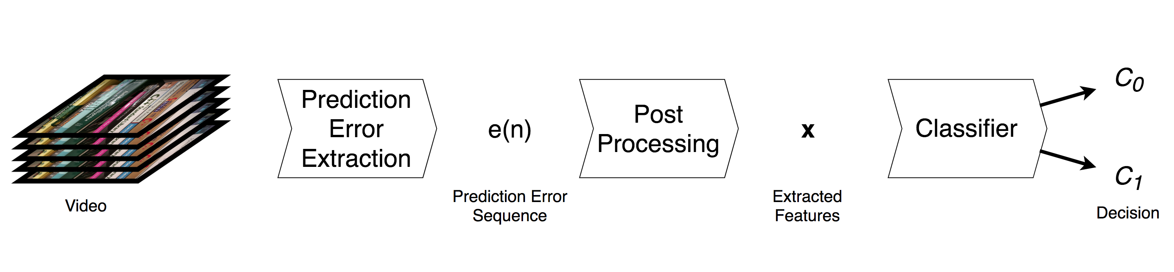
General Approach to Frame Deletion Detection

