Slide 1
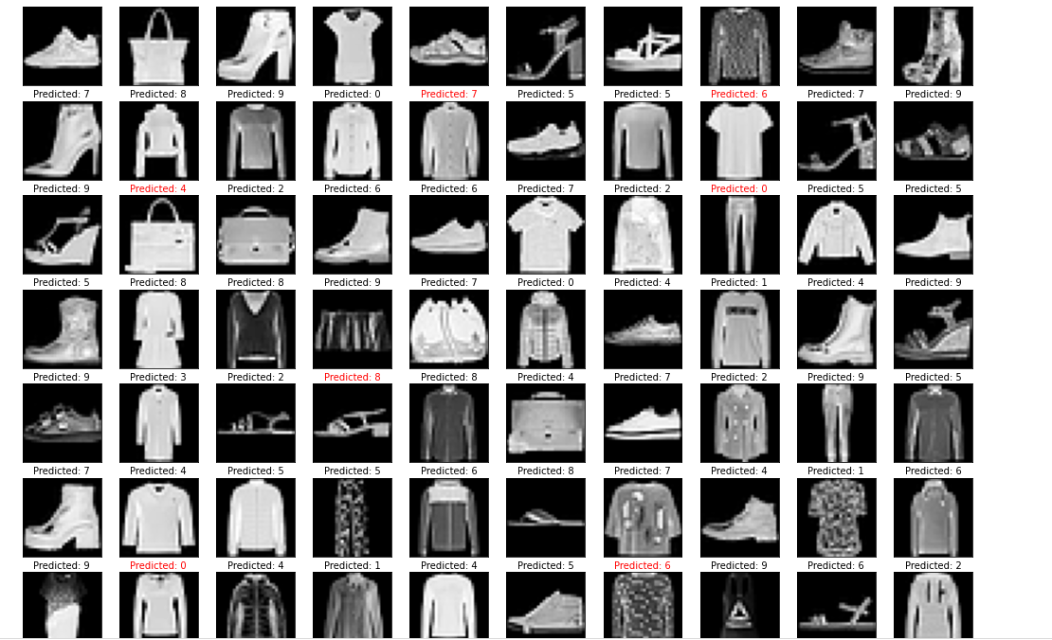
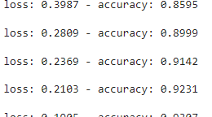
Clothing detection with deep learning
Hunter Nelson
Hood College
Introduction
In this project I used deep learning to take a dataset and train and test my deep learning program, it can now be used and implemented whenever and wherever
Detection
In the dataset there are 10 categories pre-made, these categories are:
Shirt
Pants
Hoodie
Dress
Jacket
Sandal
Shirt
Sneaker
Bag
Boots
Implementation
This project can be used in the future to help visual impaired individuals sort out their clothes in order to find what to wear for that day. It could be turned into an app and using a camera would learn the Individuals clothing and what they are.
Conclusion
After evaluating the results, we have learned that an app to help the visual impaired is not just feasible but accomplishable. Given more time and resources an individual could create this software that helps the visual impaired.
Dataset
I used the fashion-mnist dataset, it has approximately 60,000 images for training and 10,000 for testing.
This dataset was already normalized and ready to be used, all I had to do was import it and begin coding.
Results
Through trial and error, I was able to get my project up to 93% accuracy with only 5 epochs. Adding more epochs can easily get the program up closer to 99%.
Future Work
Anyone looking to further this concept could try 1 or many of these things:
- real time detection with cameras
- different deep learning methods
- training boosters
- variety of training epochs
Data Processing
In this project I used an output to display the first 10 images in the data set and what it was categorized as, this gave me some indication of whether my project was headed in the correct direction.
References
Fashion Mnist - https://github.com/zalandoresearch/fashion-mnist
Classification of clothes - https://www.tensorflow.org/tutorials/keras/classification
Fashion mnist by zalandoresearch

