Slide 1
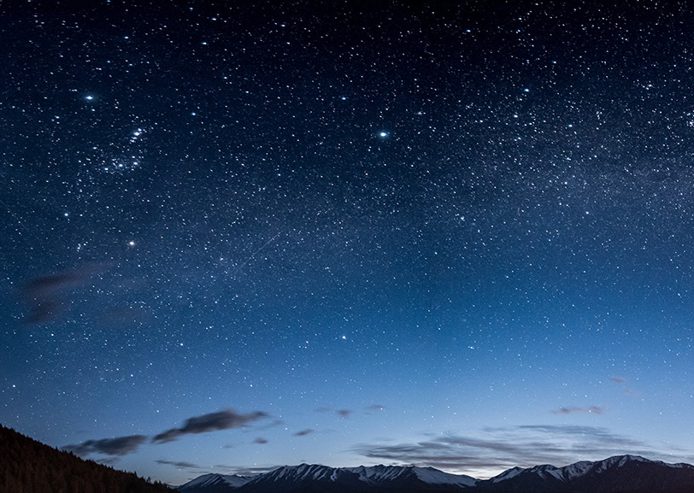
Clothing detection with machine learning
Hunter Nelson

Slide 2
My Goals
3 main goals
Easy model
Fast training time
High accuracy

Slide 3
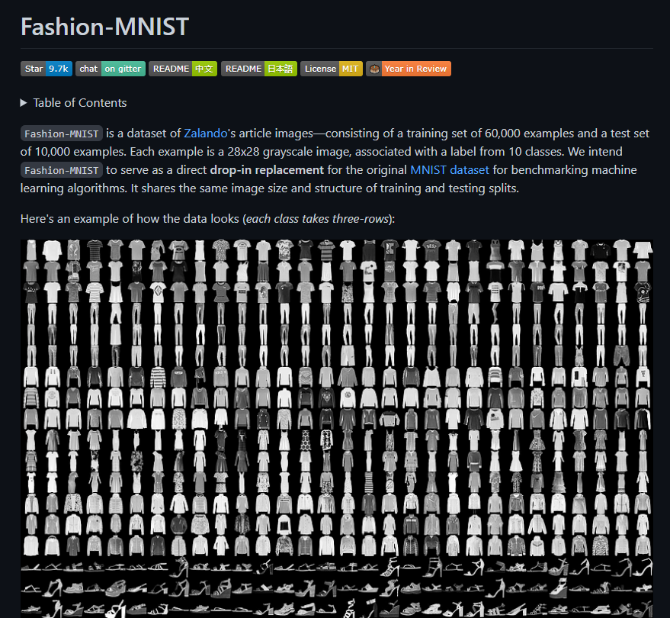
Dataset
Fashion-MNIST
10 types of categories
60,000 examples in the training set
10,000 examples in the test set

Slide 4
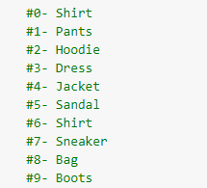
Categories
Categories all come with thousands of images
Provides me with many
different examples for each option

Slide 5
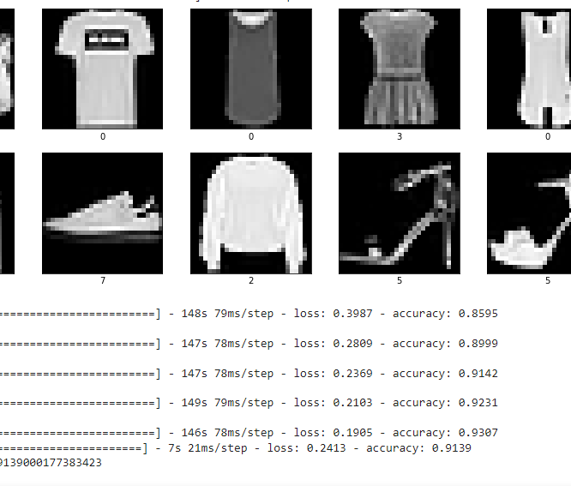
Data Processing
Dataset already normalized
Black and white images
28 x 28 greyscale image

Slide 6
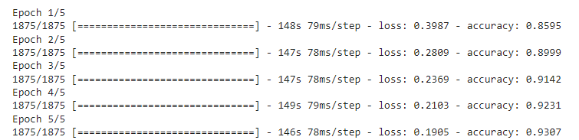
Training
When choosing how to train my program I wanted something fast with an accuracy over 90%, I found that by doing 5 passes of 1875 images.
You can easily increase the images or passes to boost the accuracy, but you will also increase the time it takes to train

Slide 7
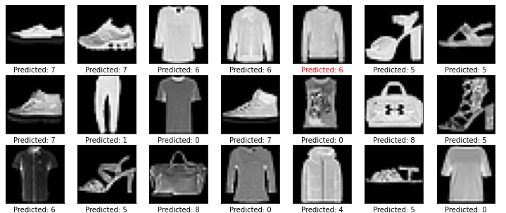
Display
I was able to output the test images and their predictions, the red names are the ones the code predicted wrong
In this example the code thought the sweater was as shirt

Slide 8
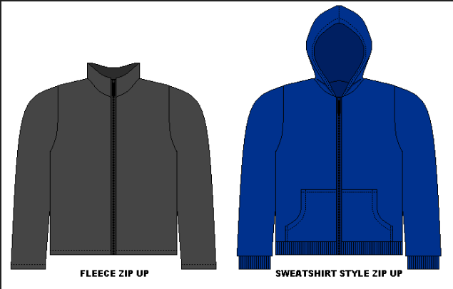
Challenges
Clothing that looks the same
Shirts vs hoodies
Boots vs sneakers

Slide 9
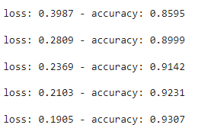
Results
I was able to get my project up to 93% accuracy with only 5 passes. Adding more passes we can easily get the program up closer to 99%.

Slide 10
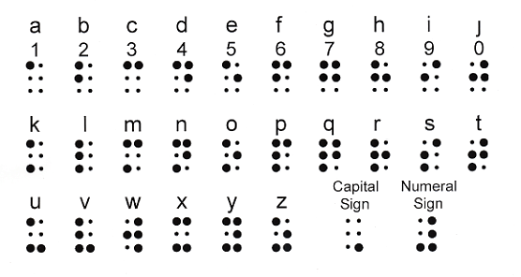
Implementations
Visual impaired individuals
Through an app and cameras apply it to the real world
Add in a color option to tell the individual what color it is

Slide 11

Conclusion
Given more time and resources an individual could create a software that helps the visual impaired with picking out clothes.

Slide 12
References
1. Fashion Mnist - https://github.com/zalandoresearch/fashion-mnist
2. Basic Classification - https://www.tensorflow.org/tutorials/keras/classification

Slide 13

Questions?
Thank
You!

