Slide 1

STUDENT CASE
SeatGate
Using a sandboxed ticketing bot to teach digital trust and IT audit
Students act as junior IT auditors testing whether SeatGate’s stated controls actually operate during limited ticket drops.
SeatGate IT Audit Case
01

Slide 2
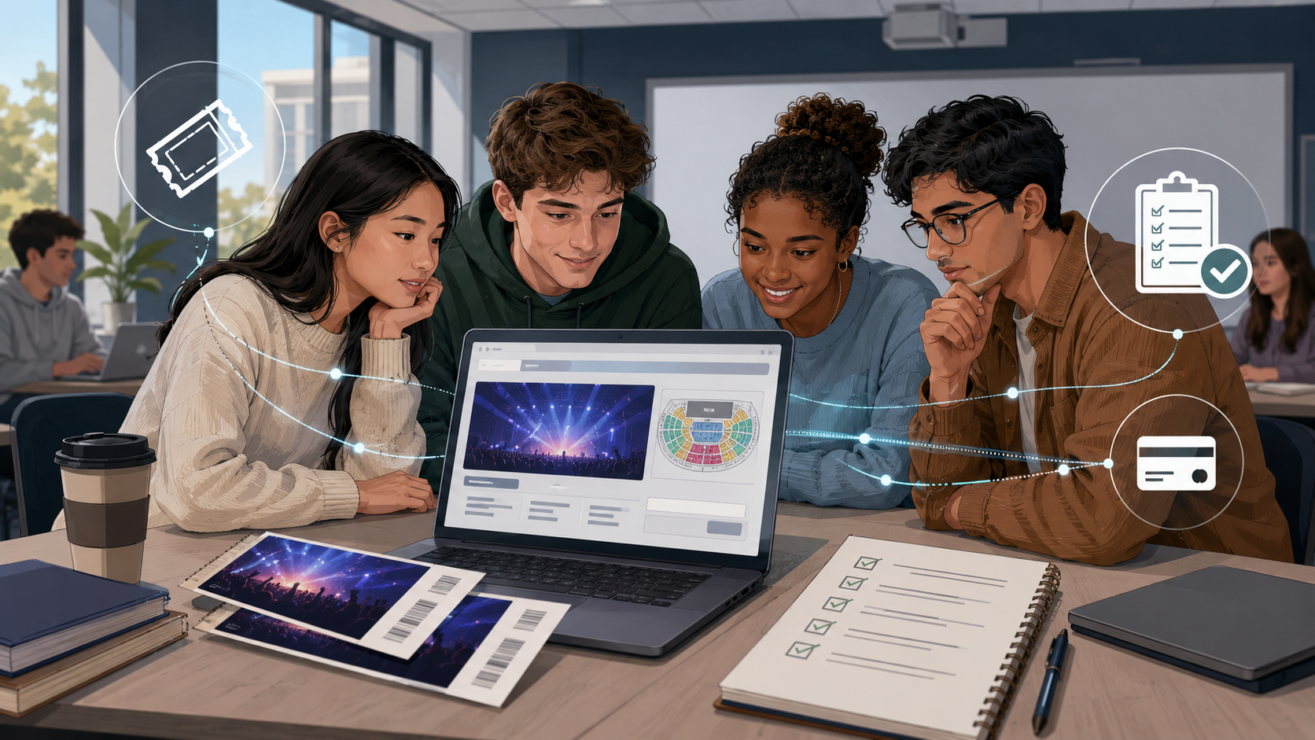
Why this case exists
What happened in real life? United States v. Live Nation Entertainment
1
FTC alleged that Ticketmaster publicly claimed to protect fans from brokers
2
Brokers used thousands of accounts and proxy IP addresses to buy large volumes of tickets
3
These “scalpers” resold them on Ticketmaster’s resale platform at substantial markups
Could an IT audit have made a difference?
SeatGate IT Audit Case
02

Slide 3
Audit framing: AS 2201, COSO, and COBIT
The case links an audit standard to a general control framework and an IT-control framework.
PCAOB AS 2201
Audit standard: frames the control-testing task and the need for evidence.
COSO
Internal-control lens: risk assessment, control activities, information and communication, monitoring.
COBIT
IT-control lens: access, application processing, logging, exception monitoring, and management review.
SeatGate
Students test whether stated policies are enforced by system behavior and backend evidence.
Controls tested:
Access
Application
Logging
Exception review
Monitoring
SeatGate IT Audit Case
03

Slide 4

SeatGate audit scenario
Rogers & Rogers LLP is engaged to evaluate whether SeatGate’s controls are designed and operating effectively.
Stated policies to test
1
One ticket per user per event
2
Only valid users can purchase
3
Inventory updates after each sale
4
Suspicious behavior is logged
5
Exception reports are reviewed
6
Admin functions are restricted
Audit question: Are these policies supported by actual system behavior and sufficient audit evidence?
SeatGate IT Audit Case
04

Slide 5
Flow of the classroom case
Students move from ordinary users to IT auditors evaluating evidence.
1
2
3
4
5
6
7
Audit setting
Trial event
Event 1
Events 2 & 3
Backend evidence
Control review
Debrief
Students act as junior IT auditors.
Log in, buy free tickets, inspect page behavior.
Manual ticket drop under scarcity.
Refine strategy or AI-assisted code.
Instructor reveals logs, reports, automation.
Groups identify weaknesses and controls.
Present findings and audit conclusions.
Deliverables: Table 1 ticket-drop notes • Table 2 website discovery • Table 3 control review matrix
SeatGate IT Audit Case
05

Slide 6
Requirement 1: Participate in and inspect the ticket drop
The trial event is for learning, inspecting, and testing without grade consequences.
1
Trial event first
Free tickets; 9,999 released; learn the transaction flow.
2
Inspect during trial
Identify page elements used in the purchase process and start Table 2.
3
Test before graded drops
AI-assisted code should be tested on the trial event, not the graded drops.
4
Then compete in three graded events
Buy one valid ticket per event, regardless of tier.
A valid purchase is any one tier: pre-general, general admission, or early bird.
SeatGate IT Audit Case
06

Slide 7
Ticket-drop rules
The scarcity is intentional: it makes control issues visible.
Budget and purchase limits
1
$3 budget
Each student starts with three dollars.
2
$1 per ticket
Each graded ticket costs one dollar.
3
One ticket per event
Do not buy multiple tiers for the same event.
4
Three graded events
Full credit requires one valid ticket in each event.
5
Instructor controls release
Tickets may be released from the backend in any controlled fashion.
Event 1: manual baseline. Events 2 and 3: time to refine strategy or test AI-assisted code.
SeatGate IT Audit Case
07

Slide 8
Table 2: Website transaction discovery
Students document the visible page elements and why they matter for control testing.
Page area
Observed
What it does
Control issue
Audit relevance
Concerts page
Lists events
Inventory display may be misleading
How purchase process begins
Event card
Shows name/date/price
Incomplete or manipulated data
Completeness and accuracy
Quantity field
Chooses number
May exceed purchase limit
Purchase-limit controls
Purchase button
Submits order
Bot can repeatedly trigger purchases
Authorization and processing
Messages
Confirms or blocks
Recorded ≠ authorized
Evidence of controls
Do not just name elements. Explain how each element affects authorization, limits, logging, or monitoring.
SeatGate IT Audit Case
08

Slide 9
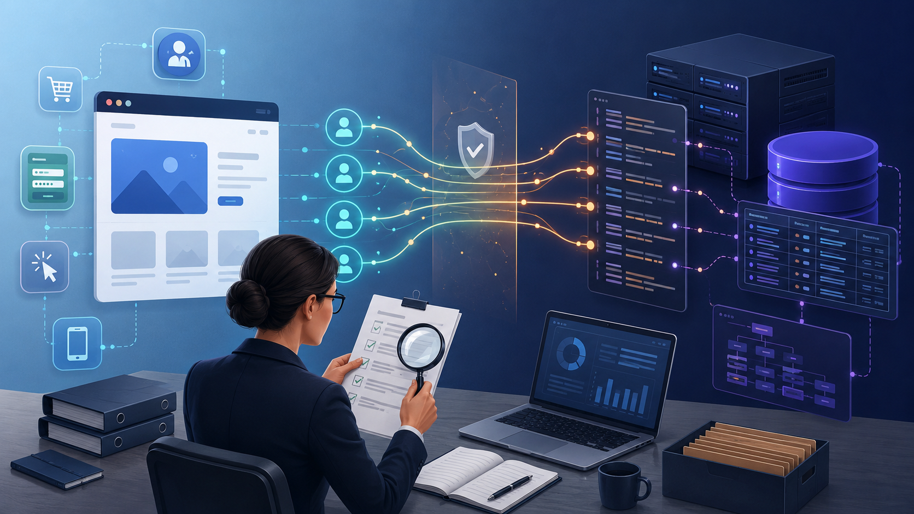
Requirement 2: Controlled automation demonstration
The script is a teaching device: it reveals control exposure, not a scalping lesson.
1
Instructor reveals the script
Students observe how automated interaction can target predictable page elements.
2
Compare speed and behavior
What did the script do faster than a human user?
3
Check control response
Did SeatGate block, slow, log, or flag the behavior?
4
Tie to backend evidence
Logs and reports show what management could actually review.
Key distinction: automation is the event; control testing is the audit objective.
SeatGate IT Audit Case
09

Slide 10

Requirement 3: Internal-control review
Groups translate observations into audit findings.
Complete the matrix
1
Observed weakness
What failed or appeared weak?
2
Evidence
What did you see in logs, reports, or behavior?
3
Recommended control
What preventive or detective control would address it?
4
Control type
Preventive, detective, or both?
Possible findings: weak server-side validation, no rate-limiting, incomplete audit trail, weak exception review.
SeatGate IT Audit Case
10

Slide 11
CLASS DEBRIEF
What should an IT auditor conclude?
Discuss these two questions:
1
Most important weakness
What control weakness did the ticket-drop exercise reveal most clearly?
2
Evidence needed
What evidence would prove whether stated policies were actually enforced?
A transaction can be recorded by the system and still fail the control objective.
SeatGate IT Audit Case
11

