Slide 1

STUDENT CASE
SeatGate
Using a sandboxed ticketing bot to teach digital trust and IT audit
Students act as junior IT auditors testing whether SeatGate’s stated controls actually operate during limited ticket drops.
SeatGate IT Audit Case
01

Slide 2
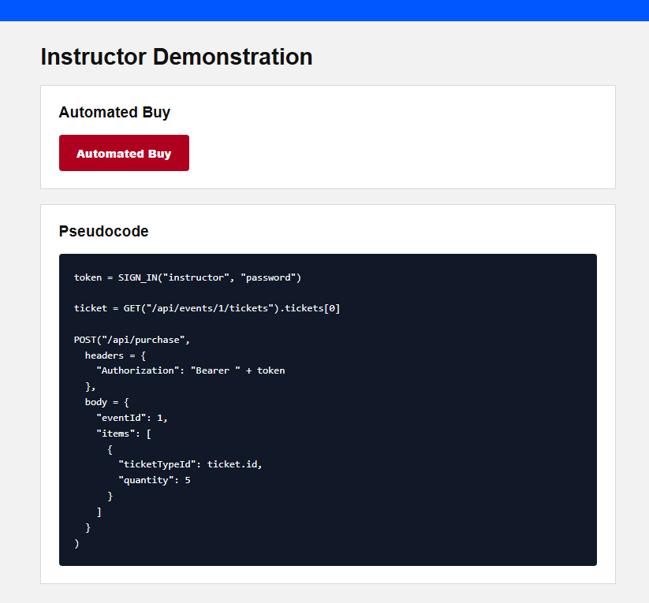
SeatGate is a ticketing company engaged by the school
The school has an upcoming popular sports event, and SeatGate has been contracted to sell tickets to students. However, tickets were snapped up very quickly and many students couldn’t buy.
1
Many students reportedly logged in at the release time but couldn’t buy.
2
Students reported the problem to the school and the school reported it to SeatGate
3
SeatGate now has hired IT auditors to check if their system has an issue
Could an IT audit have made a difference?
SeatGate IT Audit Case
02

Slide 3
Audit framing: AS 2201, COSO, and COBIT
The case links an audit standard to a general control framework and an IT-control framework.
PCAOB AS 2201
Audit standard: frames the control-testing task and the need for evidence.
COSO
Internal-control lens: risk assessment, control activities, information and communication, monitoring.
COBIT
IT-control lens: access, application processing, logging, exception monitoring, and management review.
SeatGate
Students test whether stated policies are enforced by system behavior and backend evidence.
Controls tested:
Access
Application
Logging
Exception review
Monitoring
SeatGate IT Audit Case
03

Slide 4
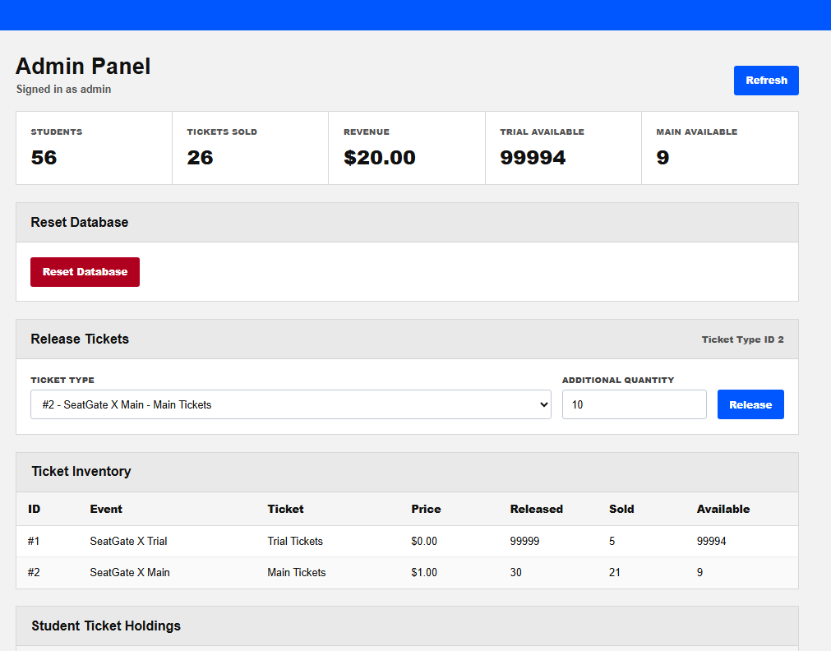
SeatGate audit scenario
Rogers & Rogers LLP is engaged to evaluate whether SeatGate’s controls are designed and operating effectively.
Stated policies to test
1
One ticket per user per event
2
Only valid users can purchase
3
Inventory updates after each sale
4
Suspicious behavior is logged
5
Exception reports are reviewed
6
Admin functions are restricted
Audit question: Are these policies supported by actual system behavior and sufficient audit evidence?
SeatGate IT Audit Case
04

Slide 5
Flow of the classroom case
Students move from ordinary users to IT auditors evaluating evidence.
1
2
3
4
5
Audit setting
Trial event
Instructor Demo
Main Event
Debrief
Students act as junior IT auditors.
Log in, buy free tickets, inspect page behavior.
It is possible to automate buying of tickets
Groups compete to see who can buy the most tickets
Present findings and audit conclusions.
SeatGate IT Audit Case
05

Slide 6
Debrief questions: what did the evidence show?
Move from what the interface promised to what the backend actually enforced.
Questions for the audit team
1
Which stated controls were actually enforced?
2
What evidence supports valid-user access?
3
Did inventory reconcile after every sale?
4
Were scripted purchases prevented or only logged?
5
Who reviewed exceptions, and how quickly?
6
What should management change before launch?
For each answer, cite a screenshot, transaction result, inventory change, or log entry.
SeatGate IT Audit Case
06
Notes:
[Sources]
- User-provided SeatGate case deck and classroom exercise.

Slide 7
Suggested answers: separate design from operation
A control can exist in policy or on screen and still fail at the API boundary.
Evidence-based conclusions
1
One-ticket policy failed: the instructor bought five.
2
Valid credentials were required; role access worked.
3
Inventory fell by five and holdings rose by five.
4
Automation was permitted up to the five-ticket cap.
5
Logs existed; review was not a preventive control.
6
Add server rules, alerts, and pre-launch testing.
Overall conclusion: preventive controls were incomplete; detective evidence required active review.
SeatGate IT Audit Case
07
Notes:
[Sources]
- User-provided SeatGate case deck, admin screenshot, and instructor demonstration.

Slide 8
How inspection turns one purchase into automation
Browser-only friction is bypassed when a script sends the same authorized request directly to the server.
INSPECT
Open DevTools → Network and inspect page code to identify login, ticket lookup, and purchase calls.
SIGN IN
token = SIGN_IN("instructor", "password")
DISCOVER
ticket = GET("/api/events/1/tickets").tickets[0]
AUTOMATE
POST("/api/purchase", Bearer token, eventId: 1, ticketTypeId: ticket.id, quantity: 5)
Controls tested:
Access
Authorization
Rate limits
Logging
Monitoring
SeatGate IT Audit Case
08
Notes:
[Sources]
- User-provided SeatGate application behavior and instructor pseudocode screenshot.

Slide 9
Admin panel provides a control-level snapshot
Use the screen as evidence, then trace the displayed numbers back to holdings and logs.
What the screenshot shows
1
56 seeded user accounts
2
26 tickets sold in total
3
$20 of recorded revenue
4
99,994 Trial Tickets available
5
9 Main Tickets available
6
Admin-only release and reset controls
This is evidence of system state—not proof that every underlying control operated.
SeatGate IT Audit Case
09
Notes:
[Sources]
- User-provided admin-panel screenshot: codex-clipboard-2d0c45cd-128f-479c-ab47-33c6facd94eb.png.

Slide 10
Instructor view makes the bypass reproducible
The demonstration exposes the same request sequence a script follows while keeping the classroom cap at five tickets.
1
Authenticate and receive a Bearer token.
2
Read the live ticket type before purchasing.
3
Send one purchase request with quantity five.
The browser button and an external script call the same backend endpoint.
SeatGate IT Audit Case
10
Notes:
[Sources]
- User-provided instructor screenshot: codex-clipboard-538550ff-27dc-4ef0-b9a1-587e59f1d9f8.png.

