Slide 1
Integration Test Framework

Slide 2
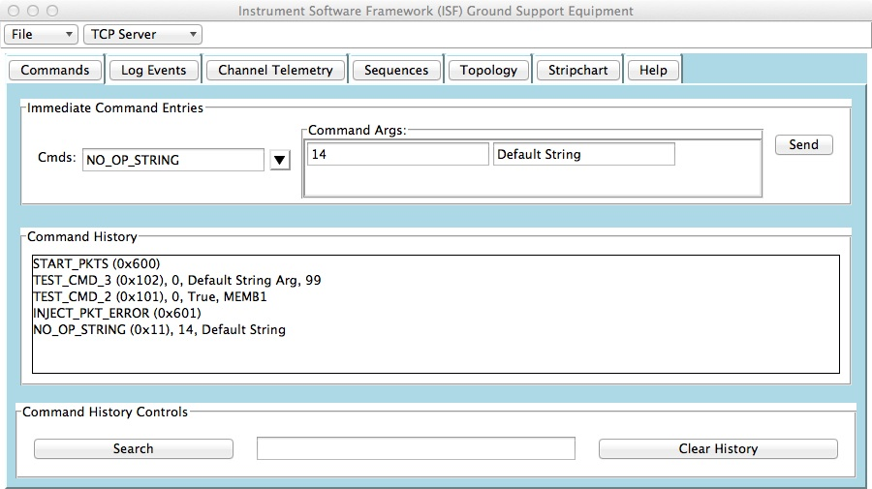
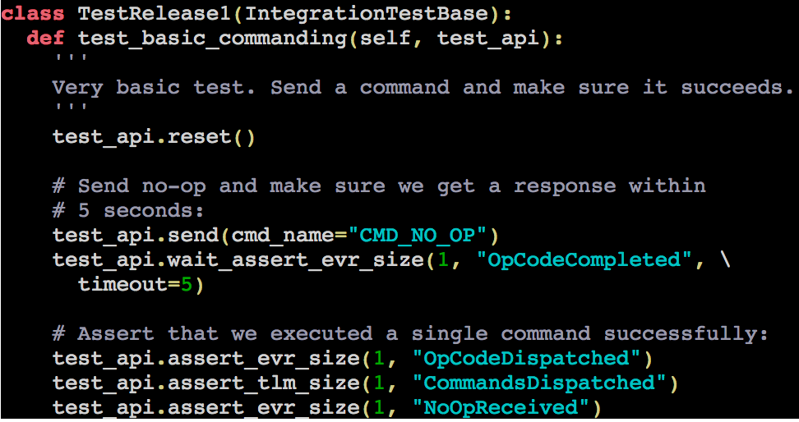
Overview
Integration Test Framework
Flight Software Topology
SocketGndIf
ThreadedTCPServer.py
socket
Gse.py
socket
socket
ports
gse_api.py
test_history.py
function calls
FSW Topology
function calls
test_api.py
function calls
test.py

Slide 3
Test History
Flight Software Topology
SocketGndIf
ThreadedTCPServer.py
socket
test_history,py, test_api.py, gse_api.py
ports
TLM History
tlmName1 : [value1, value2]
tlmName2 : [value1]
tlmName3 : [value1]
EVR History
evrName1 : [[arg1]]
evrName2 : [[arg1, arg2]]
evrName3 : [[arg1],[arg2]]
EVR6
FIFO Queue
EVR5
TLM5
FSW Topology

Slide 4
Test API Distilled
assert_evr_size(n, name=None, filterFunc=None) – assert that n events of type name exist in the event history
assert_evr(value, name=None, index=ALL) – assert that the arguments of event type name at index is equal to value in the event history
wait_assert_evr_size(n, name=None, filterFunc=None, timeout=5) - wait a maximum of 5 seconds until n events of type name exist in the event history, assert on timeout
wait_assert_evr(value, name=None, index=ALL, timeout=5) – wait a maximum of 5 seconds until the arguments of event type name at index is equal to value
update() – update the telemetry and event histories with whatever is sitting in the queue right now
clear() – clear the telemetry and event histories
reset() – clear the telemetry and event histories and the queue
*This list represents a small sampling of the commands available in the test_api.py. Run pydoc Gse/src/utils/test_api for the full manual.

Slide 5
Simple Example

Slide 6
Other Notes
ASTERIA is running the framework using pytest but projects can use any framework they want (ie. nose) as long as it supports native python asserts.
ASTERIA has developed an extension to read “com files” into histories so that tests can be run on stored telemetry files in addition to the live stream.
ASTERIA has developed integration tests that exercise many of the core components including ActiveLogger, CmdDispatcher, SequenceFileLoader, SequenceRunner. It may be a good idea to maintain these tests within ISF for future projects.

