Slide 1
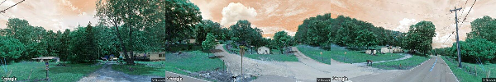
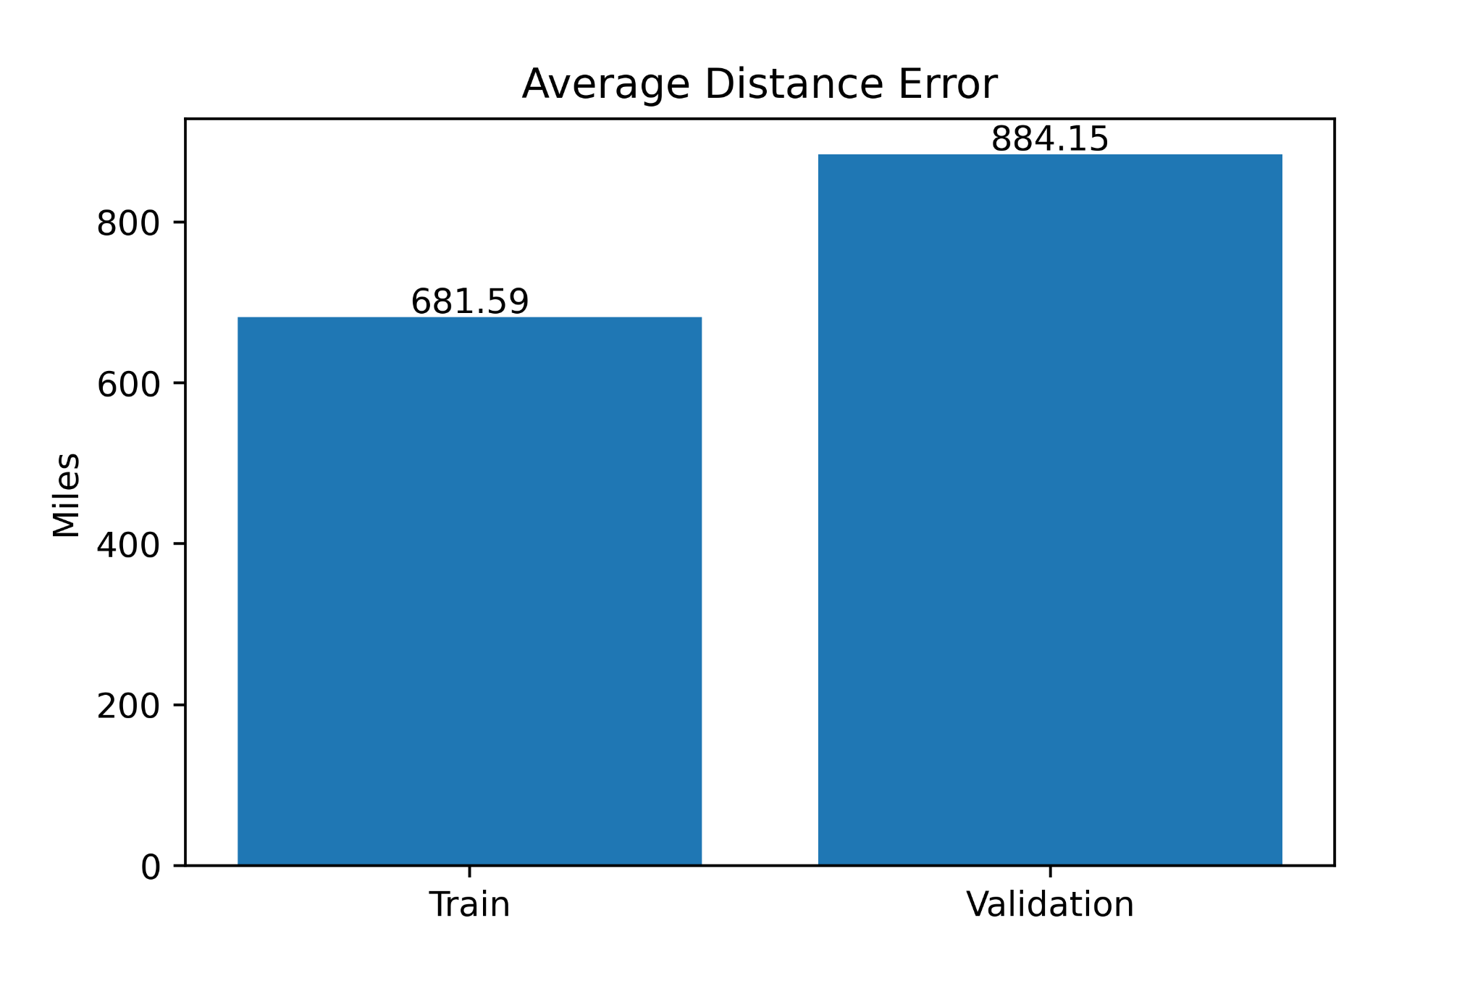
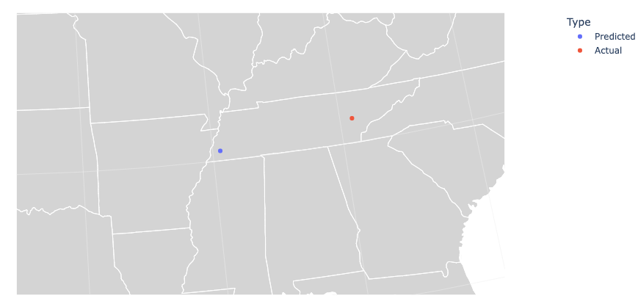
Distributed Deep Learning Network to Predict Location of Google Street View Data
Elijah Berberette, Hunter Price
Abstract/Motivation
Create a neural network that can predict the latitude and longitude values of a location based on 3 different images of separate directions at the given position.
Seeked to create a model to broadly identify any location in the United States
Using this technology, one could predict the location where a given event took place, such as a crime or a major historical occurrence based on the features within the images.
Introduction
We sought out to improve on past work by using a regression model whereas others use classification.
Scraped images from Google Street View API of different segments of the US with apache spark and saved metadata such as location and heading..
Trained a Deep Convolutional Recurrent Network to roughly predict the location of the images with regression.
Qualitatively analyzed the predictions produced by the trained network.
Results
Trained the model for 250 epochs with an adaptive learning rate scheduler.
Used Mean Squared Error as the loss function and ended training with a final training loss of 135.93.
The average validation distance error between prediction and actual was 884.15 miles.
Improved on average distance error from past work that used classification of location grids rather than using regression.
Sample Data
Conclusion
Satisfied with the outcome of the model with the given restraints of the dataset and computational resources.
Improved upon past results by a large margin.
Concluded that in order to improve the model, a custom loss function must be created.
Future Work
Integrate geospatial distance metrics into loss function such as haversine distance.
Collect more global data to better improve the model.
Train a larger model for longer.
Example Prediction
Average Distance Error

