Slide 1

Trexure
A unified treasury API that makes private Stellar payments accounting-ready.
Notes:
Hi, we're [team name], and we built Trexure — a treasury API for Stellar. In three minutes we'll show a private $2,500 payroll payment that's invisible on the public ledger, gets decrypted with the company's own key, auto-reconciles against a real bank payout, and turns into an accounting-ready receipt. Everything runs against a real Stellar testnet stack, not a slide animation.

Slide 2

Public by default. Useless to finance.
• Crypto rails are public by default
• Every payroll & vendor payment is exposed
• Privacy tools only hide the transaction
• No reconciliation, no receipts for finance
Notes:
A company running payroll over Stellar exposes every amount, recipient, and timing in plain text on a public ledger — visible to competitors and contractors. Existing privacy tools stop at hiding the transaction; they don't tell finance 'this on-chain transfer became this bank deposit,' and can't produce anything an accountant can file. Private payment in, clean reconciled receipt out — that gap is what Trexure closes.

Slide 3
Solution: Decrypt. Reconcile. Receipt.
Shield: ZK-proof payloads — the ledger sees noise
Reconcile: worker matches legs by intentId, automatically
Receipt: Stripe-style JSON + branded PDF for accounting
Notes:
One sentence: we decrypt your own private Stellar payments, reconcile them against the real payout automatically, and hand you a receipt. Three differentiators nobody combines: genuine on-chain privacy via a real Groth16 proof (not a mock); a reconciliation worker matching two independent event streams; and an output format built for finance, not block explorers.

Slide 4
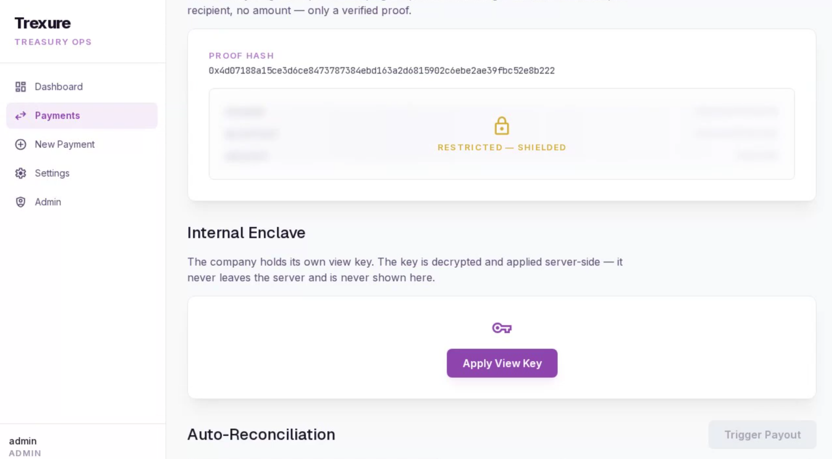
Demo: one payment's life, live
Notes:
Hitting Demo Replay: first the public view, nothing readable; then I apply our view key and the real payload appears — contractor, USDC, $2,500; then I trigger the payout and the reconciliation row stitches the on-chain hash to the bank reference in real time; then the receipt, exported to PDF on the spot. If a judge wants proof, 'Verify proof on-chain' checks a real ZK proof via a smart contract on Stellar testnet, live.

Slide 5
How it works: real crypto, real plumbing
ZK: Circom + snarkjs Groth16, verified on-chain (Soroban)
Not mocked — native BLS12-381 pairing in our contract
AES-256-GCM, argon2id, CSRF, multi-tenant isolation
192 passing tests across 58 files
Notes:
The privacy layer is a real Circom circuit, proved with snarkjs, verified by a Soroban contract we wrote that does actual BLS12-381 pairing checks on-chain — real cryptography, not a flag. And the worker reconciles two independent asynchronous event streams (chain events + fiat webhooks) — the unglamorous, critical part most payout products skip. 192 tests cover both.

Slide 6
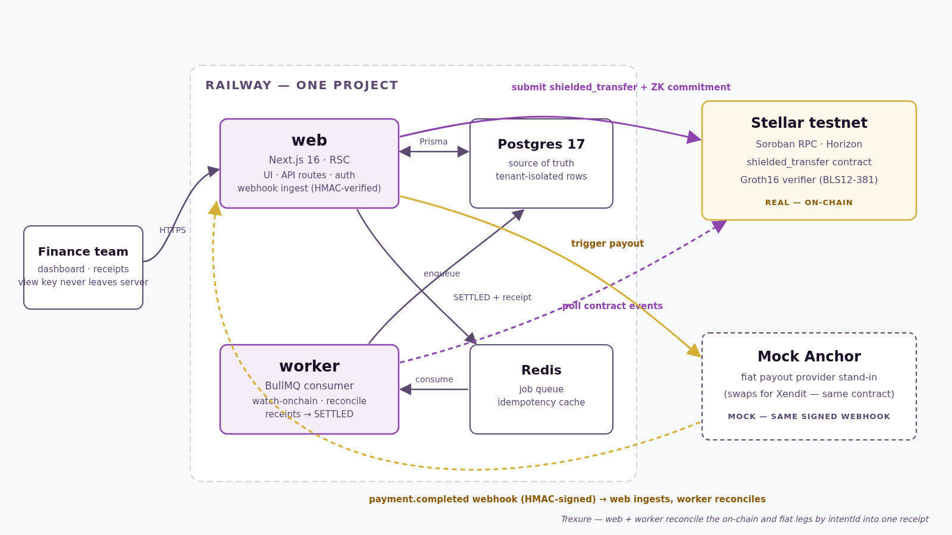
How it works: architecture
[Architecture diagram— web / worker / Postgres / Redis + Stellar testnet + Mock Anchor]
Notes:
A standard modern stack — Next.js, Prisma, BullMQ — doing two genuinely hard things well. Three Railway-deployable services: web, worker, and managed Postgres/Redis.

Slide 7
Impact & market
Buyers: stablecoin payroll & vendor payments (USD→PHP first)
Why now: category growing fast; tooling stops at 'send'
Only Trexure: Stellar-native + ZK-private + reconciled
Notes:
Anyone running payroll or vendor payments over Stellar in stablecoins is the immediate buyer — a fast-growing category. Stripe can't do crypto or privacy; crypto privacy tools stop at 'the transaction is hidden.' Nobody combines genuine on-chain privacy with automatic reconciliation and an accounting-ready receipt — that's the wedge. [inferred positioning]

Slide 8
What's next
Deploy shielded_transfer pool contract (verify already live)
Richer ZK: note-based balances + nullifiers
Swap Mock Anchor → live provider (e.g. Xendit)
Multi-corridor support + admin/ops hardening
Notes:
We shipped the hard, easy-to-fake parts for real: the privacy proof and the reconciliation engine. What's left is mostly integration breadth. Biggest item: deploy a full privacy-pool transfer contract so new payments submit on-chain like our seeded demo already does end-to-end. Then a live anchor and more currency corridors.

Slide 9
Thank you!
mh@neri.ph (Artisam Labs)
Built for Stellar Hacks: Real-World ZK
Notes:
That's Trexure — a real zero-knowledge proof verified on-chain, a real reconciliation engine, and a receipt finance teams can actually use, all on Stellar testnet today. Thanks for watching — happy to walk through the code or the contract live.

