Slide 1
The (body) language of social interactions
By: Abdullahi, Hunter, Jess, Linden, Marufi, Necdet, Ryan
Pavlova, Group 2
Notes:
Linden

Slide 2
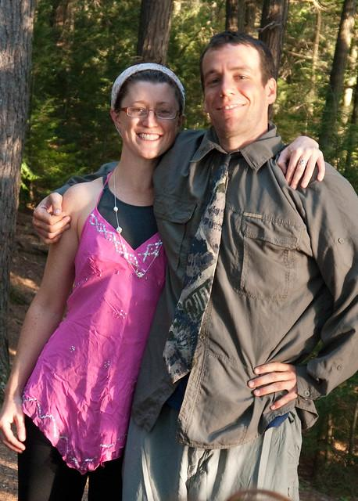
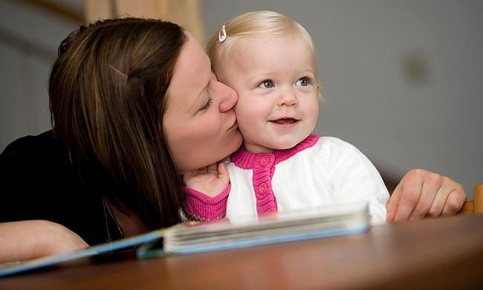
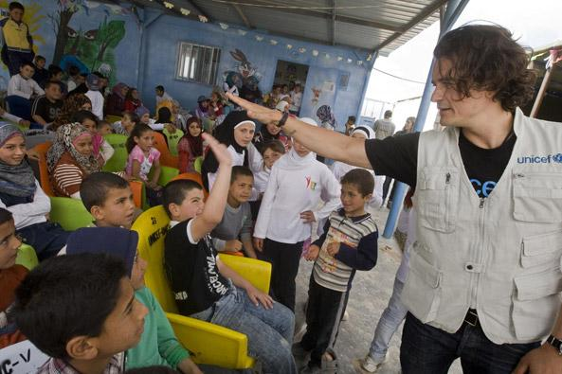
Introduction
Research question: can social interactions be predicted from body language?
Experiment 1 (body language to social interactions):
training on combinations of individuals’ posture (e.g., stand, crouch) and motion (e.g., still, walk, crawl)
fine-tuning to predict social interactions
Experiment 2 (object detection to social interactions):
using pre-trained weights from an object detection model
fine-tuning to predict social interactions
Experiment 3 (direct prediction of social interactions):
training on social interactions to predict social interactions
kiss
hug
high five
Body language of social interactions
Notes:
Linden
We used a combination of computer vision and transfer learning to examine whether social interactions could be predicted from training on body language
Here on the right, you can see three example images including their social interactions
We setup 3 experiments. Our primary experiment trained on combinations of peoples posture and motion, which were also annotated in the dataset, before transferring those weight to predict social interactions
We also had 2 supporting experiments; one that involved transferring a object detection model to predict social interactions (we will explain this in more detail later) and another that involve training to predict social interactions directly.

Slide 3
Introduction
Research question: can social interactions be predicted from body language?
Experiment 1 (body language to social interactions):
training on combinations of individuals’ posture (e.g., stand, crouch) and motion (e.g., still, walk, crawl)
fine-tuning to predict social interactions
Experiment 2 (object detection to social interactions):
using pre-trained weights from an object detection model
fine-tuning to predict social interactions
Experiment 3 (direct prediction of social interactions):
training on social interactions to predict social interactions
kiss
Hypothesized effect:
Performance → Experiment 3 > Experiment 1 > Experiment 2
hug
high five
Body language of social interactions
Notes:
Linden
Our hypothesis was that prediction performance would follow this pattern, wherein in training to predict social interaction directly would perform best (experiment 3), followed by training on body language and transferring to social interactions (experiment 1), which in turn would be greater than using a pre-trained object detection model (experiment 2)
In this way, we asked to what extent training on body language improved transfer learning beyond a object detector model, and whether it approach the performance observed from training to directly predict social interactions

Slide 4
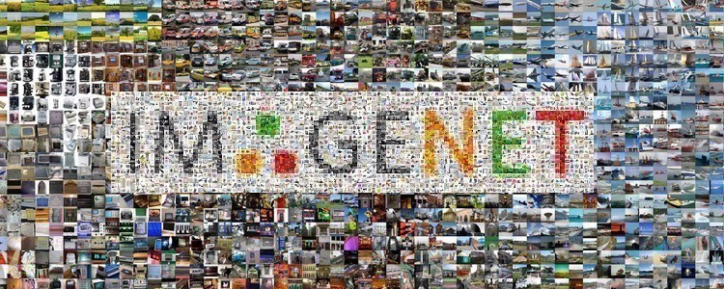
ResNet-50
A method for avoiding the “vanishing gradients problem”
when building deeper networks that is commonly observed
in plain and VGG-based networks.
Uses “stacked” layers of 1x1, 3x3 (bottleneck), and 1x1 and
layer skips that contain ReLU and batch normalization in between.
Parameter-free shortcuts allow for similar computational time to standard networks with a dramatic increase in prediction accuracy.
1,281,167 Training Images
50,000 Validation Images
1,000 Categories
150GB
Deep Residual Learning for Image Recognition
https://ieeexplore.ieee.org/document/7780459
Body language of social interactions
Notes:
Ryan

Slide 5
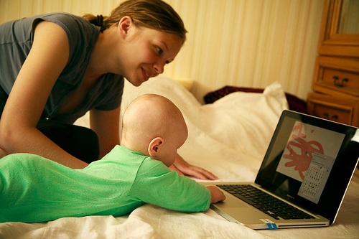
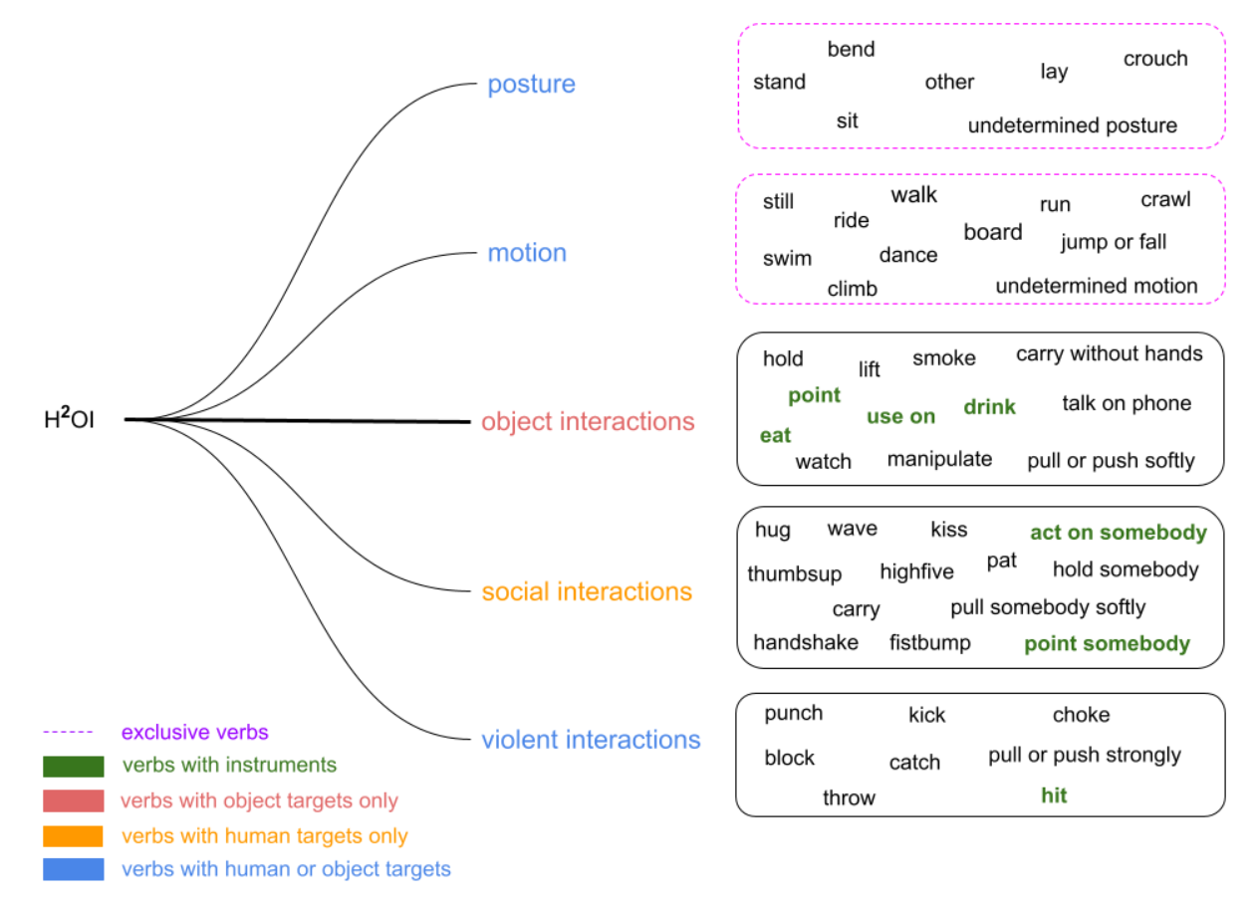

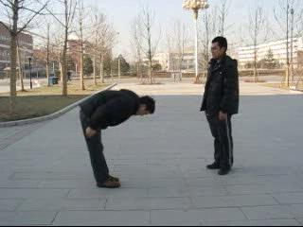
Methods
Our Dataset
Motion
5 posture
6 motion
13 social interaction
H²0 Social Interaction Dataset
15,000 images
5 categories
51 verbs
Social Interaction
Posture
Body language of social interactions
Notes:
Ryan
We take advantage of a pre-trained model called ResNet50 because of the resource limitations we have and also pre-trained models’ outstanding results.
ResNet50 stands for residual networks. It is a convolutional network that 50 layers deep. (you can point out the architecture). ResNet50 is a variant of ResNet model which has 48 Convolution layers along with 1 MaxPool and 1 Average Pool layer.
A pretrained version of the network trained on more than a million images from the ImageNet database. The pretrained network can classify images into 1000 object categories, such as keyboard, mouse, pencil, and many animals. As a result, the network has learned rich feature representations for a wide range of images. The network has an image input size of 224-by-224.

Slide 6
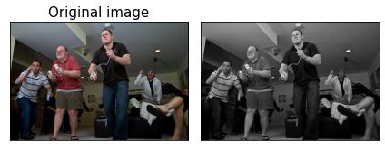
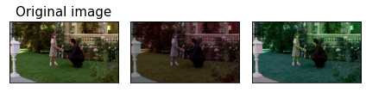
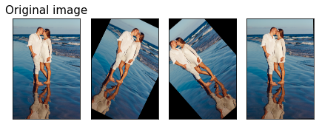
Data augmentation
Grayscale
Grayscale
Color Jitter
Gaussian Blur
Resize
Horizontal Flip
Rotation
Normalize
Color jitter
Rotation
Body language of social interactions
Notes:
Necdet

Slide 7
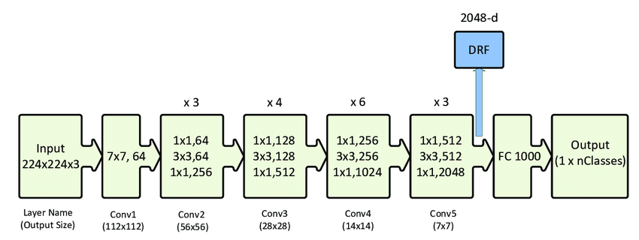
Methods
Experiment 1
fine-tuned on social interaction
Hyperparameters
Dropout rate: 10%
Learning rate = 0.001
Batch size = 64
re-trained on posture & motion
Experiment 2
fine-tuned on social interaction
Experiment 3
default pre-trained weights of ResNet50
re-trained on social interactions
Body language of social interactions
Notes:
Necdet
Drop out (rate) = 10%
Learning rate = 1e-3
Batch size = 64

Slide 8
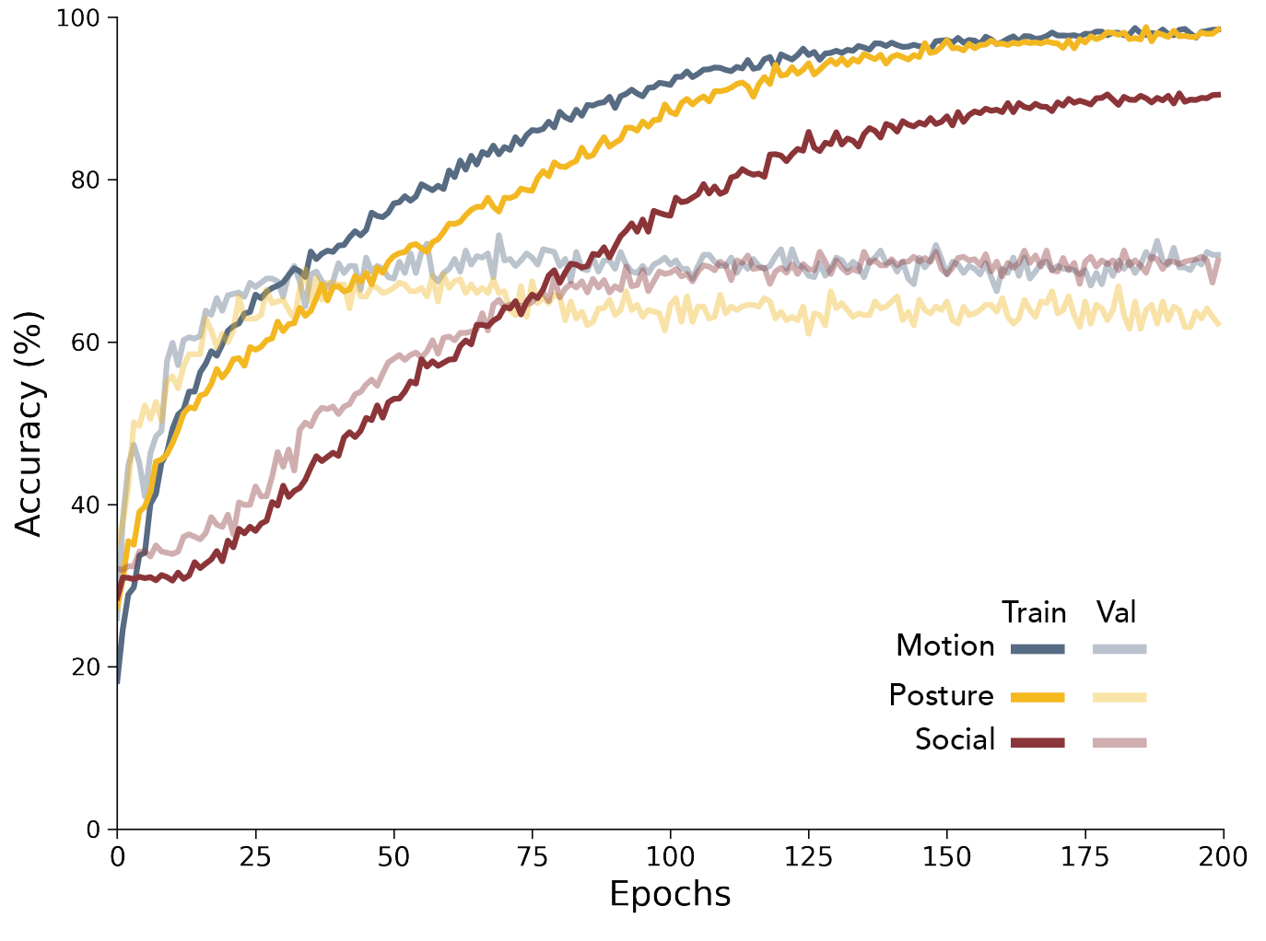
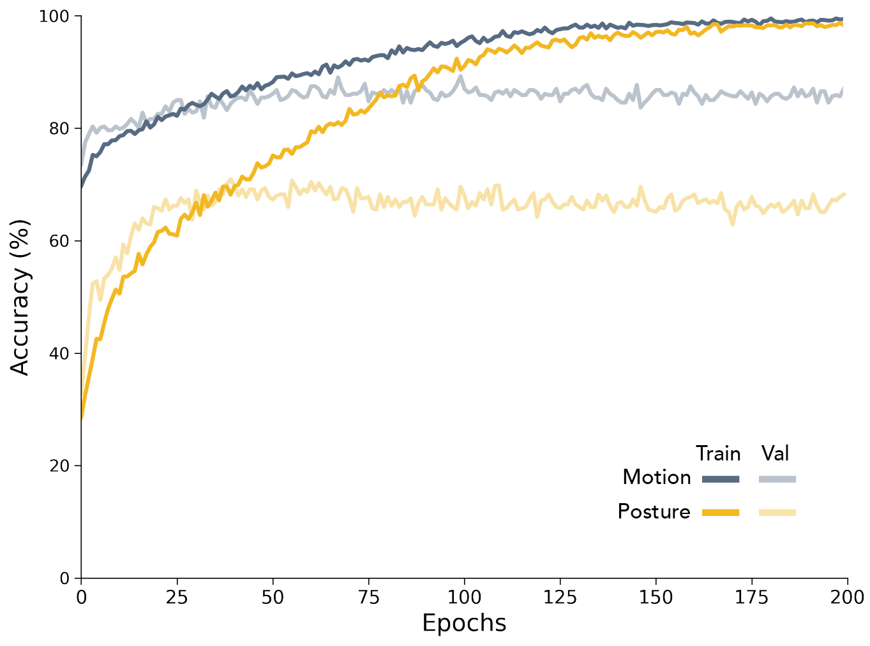
Results
Learning Actions
Train X → Predict X
Single label
Multilabel
Body language of social interactions
Notes:
Marufi
Slide 4: results/methods hybrid (train/validation curves)
After fine-tuning the final fully connected layer, we trained our model and the learning curves showed changes in learning performance over time in terms of experience.
The training score of the model is greater than the validation score
Using the following hyperparameters (learning rate: g, epochs: h, batch size: k, data size: v) increased generalization for the respective cases (motion only, posture only, motion and posture, ImageNet, model re-trained to predict social interactions)

Slide 9
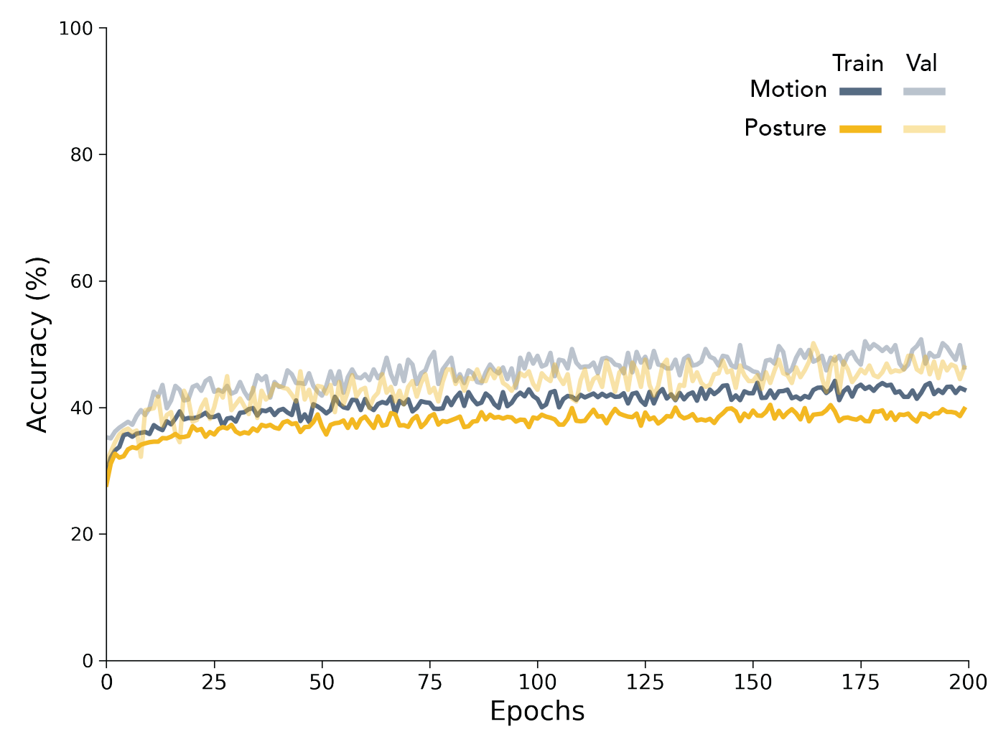
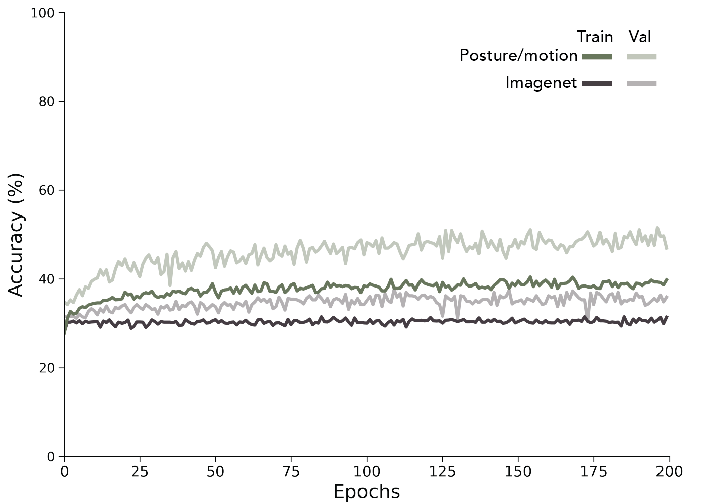
Results
Transfer Learning
Train X → Predict Social
Body language of social interactions
Notes:
Marufi
Slide 4: results/methods hybrid (train/validation curves)
After fine-tuning the final fully connected layer, we trained our model and the learning curves showed changes in learning performance over time in terms of experience.
The training score of the model is greater than the validation score
Using the following hyperparameters (learning rate: g, epochs: h, batch size: k, data size: v) increased generalization for the respective cases (motion only, posture only, motion and posture, ImageNet, model re-trained to predict social interactions)

Slide 10
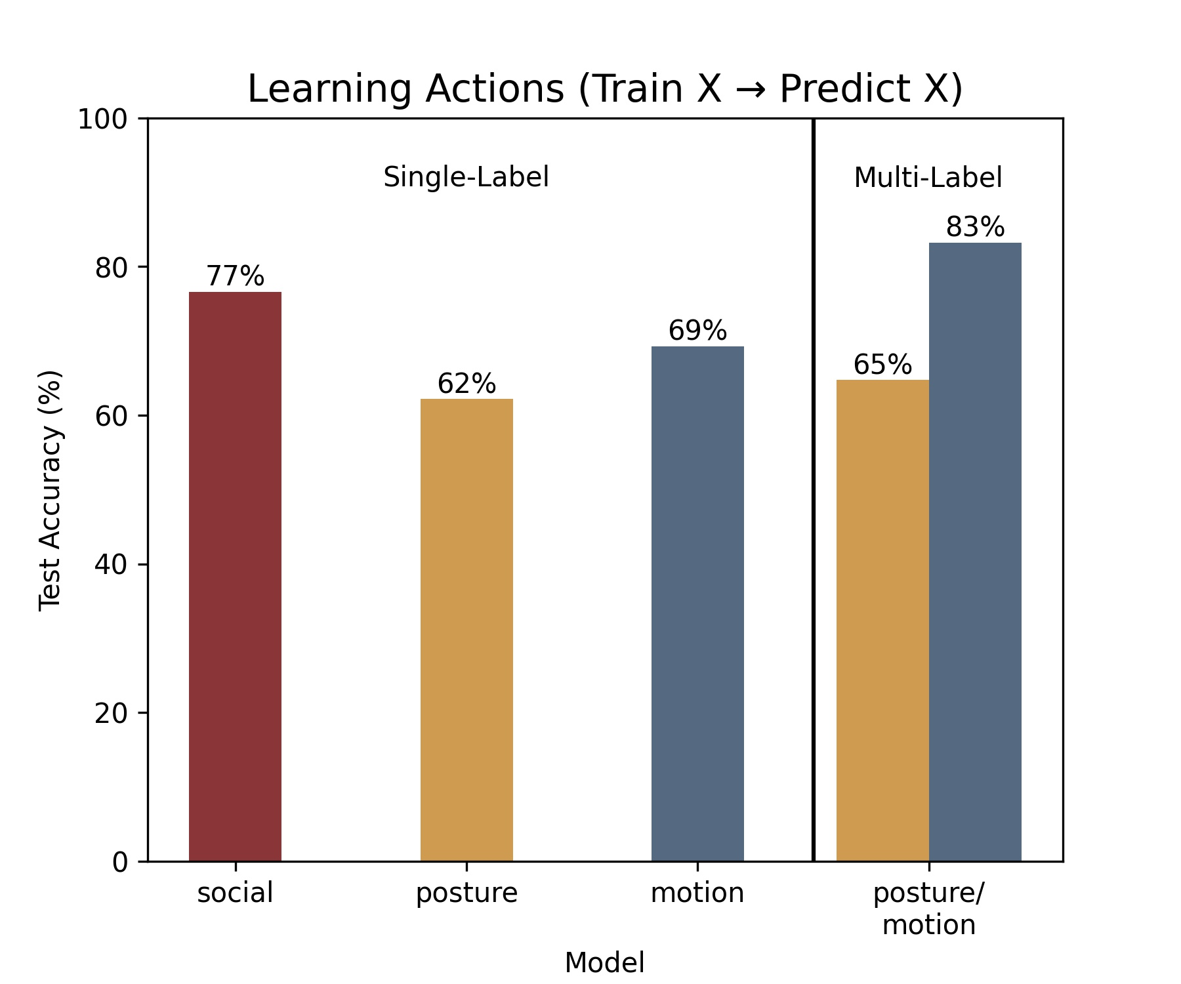
Results
Body language of social interactions
Notes:
Jess
Slide 5: results (test set accuracy: X, Y, Z)
In Figure x. We compared the prediction accuracy of models trained on body language to the one pre-trained on ImageNet. We observed that social interactions were better predicted by models trained on body language (motion only: X1%, posture only: X2%, motion and posture: X3%) compared to one pre-trained on ImageNet (Y%).
In Figure y. We compared the prediction accuracy of models trained on body language to a model re-trained to predict social interactions. We observed that a model re-trained to predict social interactions performed (Z%) better than our transfer learning model.
Together, our results show that while CNNs can learn to predict social interactions from body language, prediction performance is superior when models are trained directly on social interactions.

Slide 11
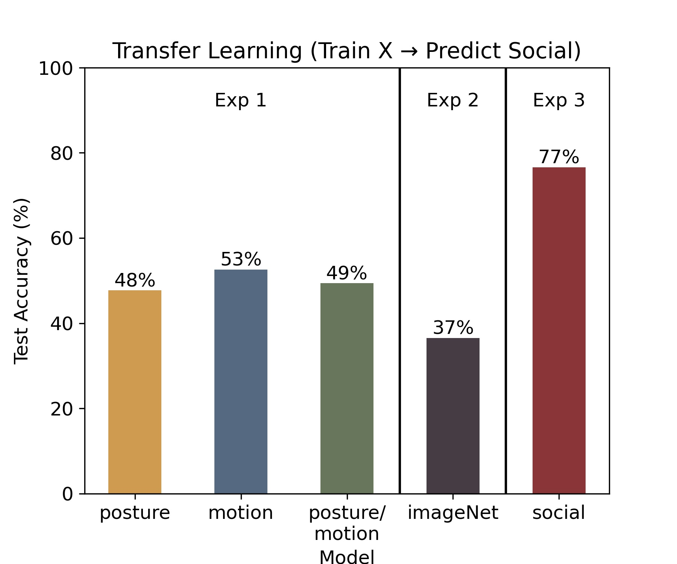
Results
Body language of social interactions
Notes:
Jess
Slide 5: results (test set accuracy: X, Y, Z)
In Figure x. We compared the prediction accuracy of models trained on body language to the one pre-trained on ImageNet. We observed that social interactions were better predicted by models trained on body language (motion only: X1%, posture only: X2%, motion and posture: X3%) compared to one pre-trained on ImageNet (Y%).
In Figure y. We compared the prediction accuracy of models trained on body language to a model re-trained to predict social interactions. We observed that a model re-trained to predict social interactions performed (Z%) better than our transfer learning model.
Together, our results show that while CNNs can learn to predict social interactions from body language, prediction performance is superior when models are trained directly on social interactions.

Slide 12
Summary
Hypothesis:
Experiment 3 > Experiment 1 > Experiment 2
Conclusion
As hypothesized, a model trained on body language (Exp 1) predicts social interactions better than a model trained on object detection (Exp 2), but not as well as a model trained directly on social interactions (Exp 3).
Limitations & Future Directions
Dataset was limited and imbalanced (e.g., p(stand) > p(bend)).
Are social interactions better predicted by video data?
Do results generalize beyond the Resnet architecture?
Body language of social interactions
Notes:
Jess
As expected, we found a pattern of results that suggest a model retrained on motion/posture did a better job transferring to predict social interactions than simply fine-tuning an object detector. This is reflected by the fact that performance from our first experiment exceeded our second experiment
But, a model trained to predict social interactions directly (experiment 3) performed better than either of these models.
Together, our results show that while CNNs can learn to predict social interactions from body language, prediction performance is superior when models are trained directly on social interactions. This suggests that neural networks may leverage more than peoples’ body language to detect the nature of social interactions.
Limitations & future directions
Generalization of these results may be hindered by the limited number of annotated classes within our dataset and by an imbalance towards more certain motion/posture annotations (e.g., standing).
Additional testing is required to determine if these findings generalize beyond the Resnet architecture.
The classes predicted by our model are often dynamic and thus may be better suited for prediction from video data.

