Slide 1
Learning React
…

Slide 2
What is React
A JavaScript library for building user interfaces.
It was developed by Facebook.
It uses virtual DOM concept to update the DOM elements.
It is view library, it reacts to state changes.
If you want to implement routing or rest api’s calling then we need to import respective modules to achieve those functionalities.

Slide 3
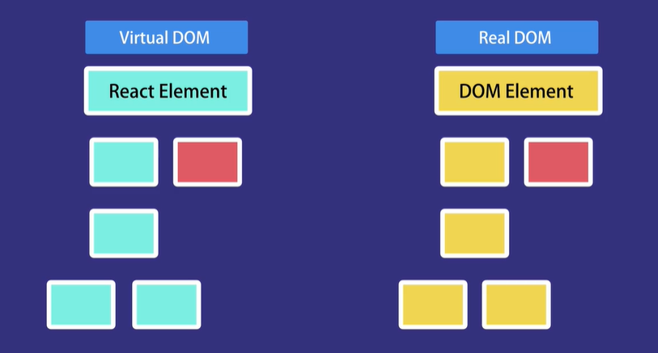
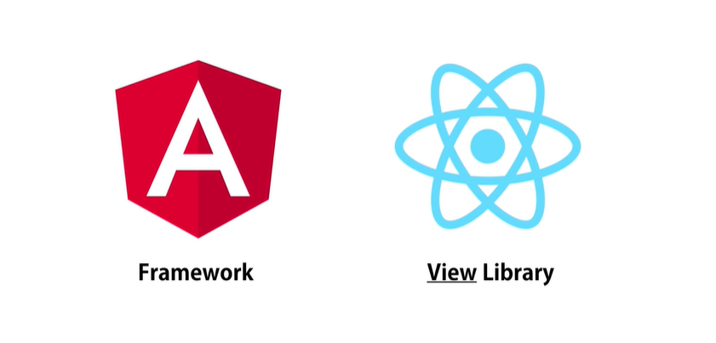

Slide 4
Components
By using react, will design a entire website into small component.
Component is nothing but a piece of the UI.
We have 2 types of components:
Class Components
Functional components.

Slide 5
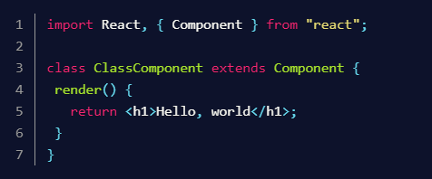
Class Components
A class component, you have to make a class that extends React.Component.

Slide 6
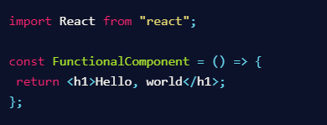
Functional Component
A functional component is a function that returns JSX elements.

Slide 7
State and Props
State:
Components can create and manage their own data with state
State data can be modified by its own component, but is private (cannot be accessed from outside)
Modifying state should happen with the setState ( ) method
Props:
Components receive data from outside with props
Props are used to pass data, whereas state is for managing data
Data from props is read-only, and cannot be modified by a component that is receiving it from outside
Props can only be passed from parent component to child (unidirectional flow)

Slide 8
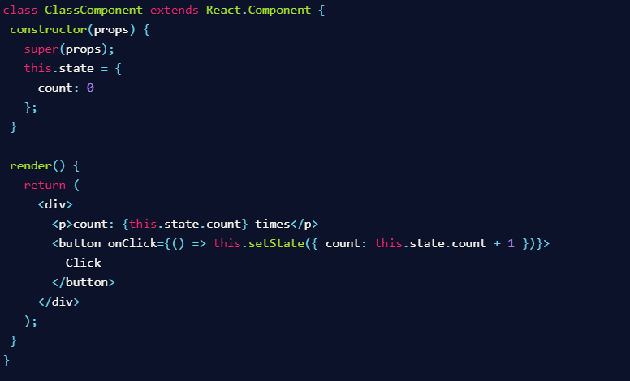
Managing state in class comp

Slide 9
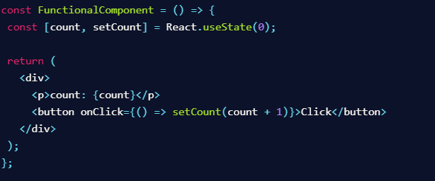
Managing State in functional component:

Slide 10

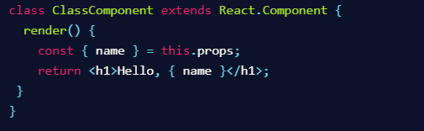

Accessing Props to class components
Accessing props in functional component

Slide 11
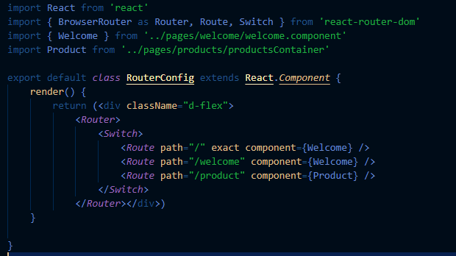
Defining routes in react

Slide 12
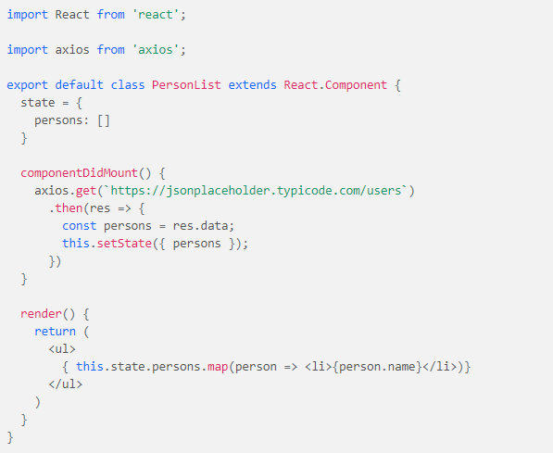
Rest api’s calling in react

