Slide 1

Web Scraping Yahoo Finance
Hunter Rogers

Slide 2
Timeline
0-15
Searching for APIs or free downloads
15-50
Web-scrapping with YouTube tutorials on free version of Yahoo Finance
50-90
Web-scrapping on my own with Selenium on Yahoo Finance Plus account
90-110
110-120
Feature Engineering
Cleaning and combining the data

Slide 3
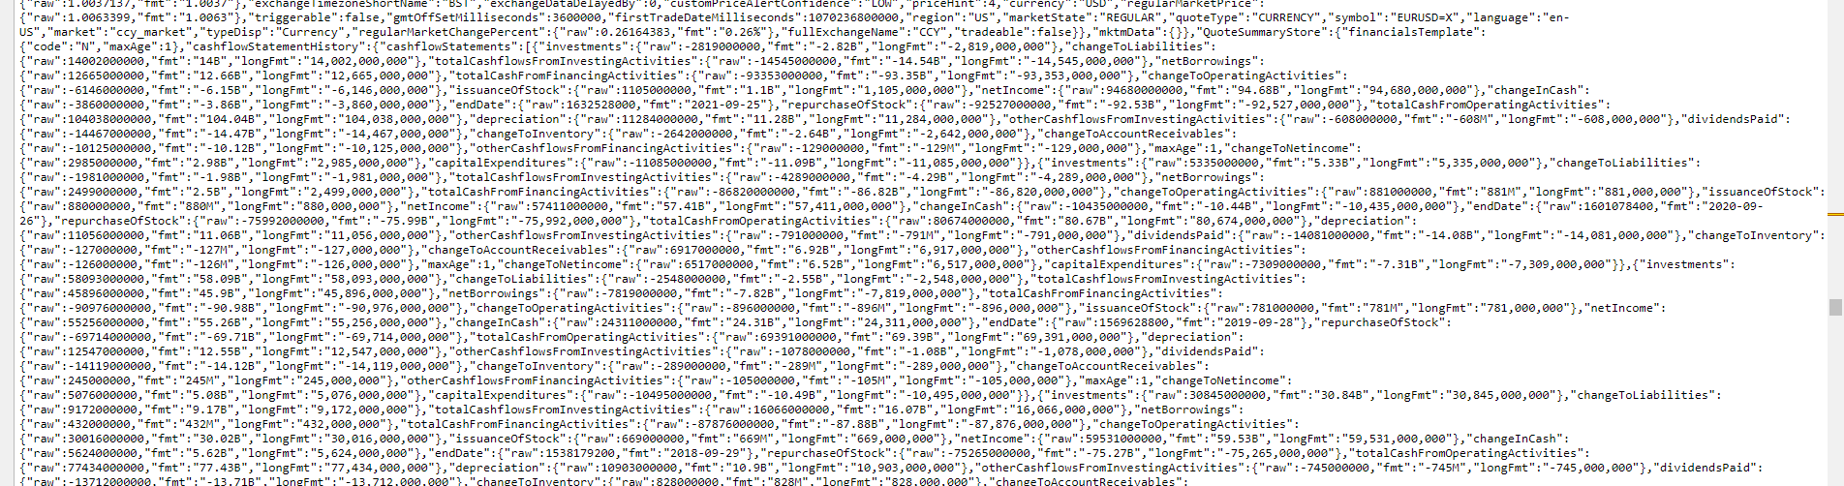
Parsing HTML

Slide 4
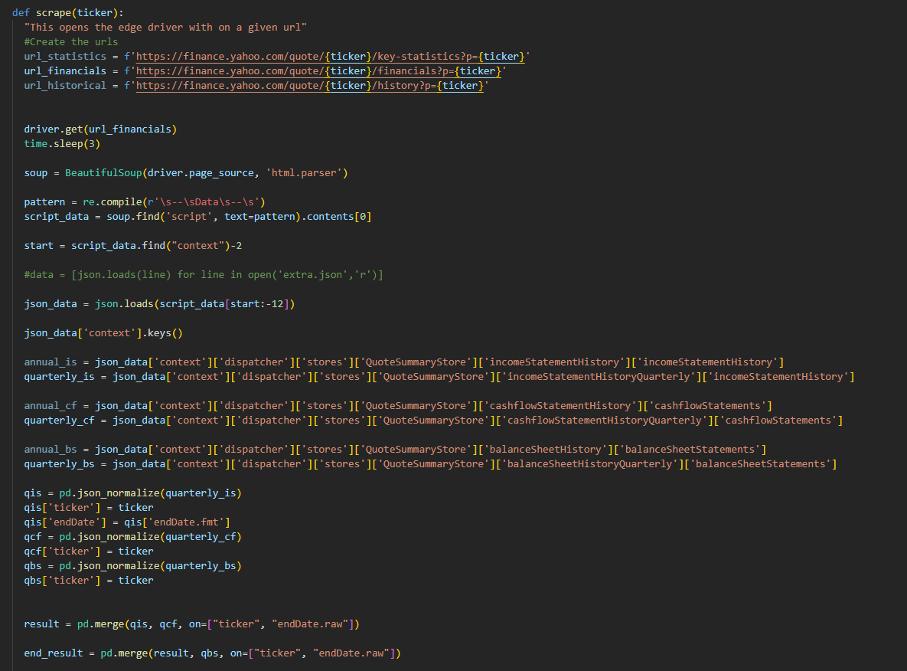



Slide 5
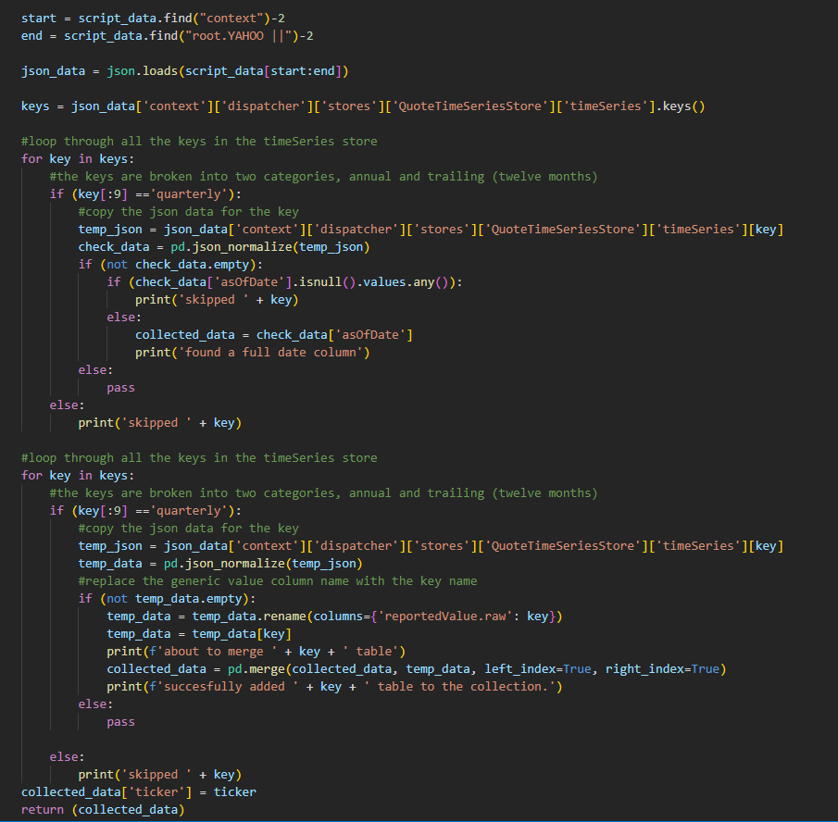
Main Differences
JSON is formatted differently
Learning was slower
Quarterly for finance
Annual for valuation
Current year for prices

Slide 6
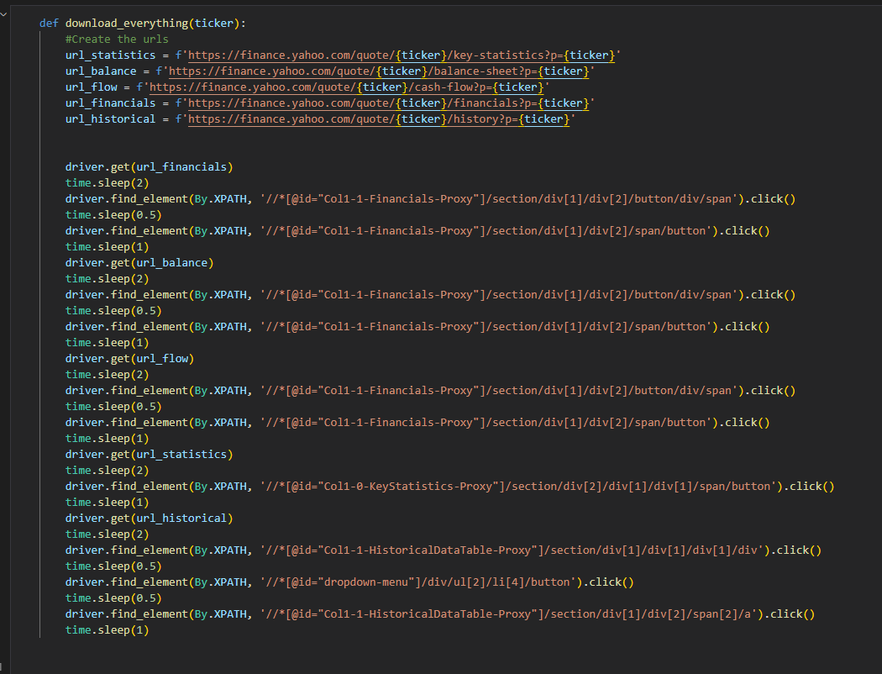
Manual Method
Go to each URL
Click buttons to customize
Download CSV

Slide 7
The easy way
Valuations + Price = Mediocre dataset

Slide 8
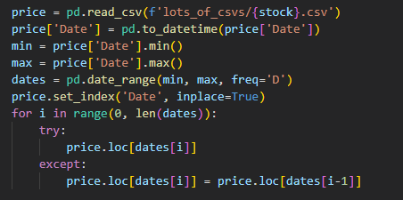
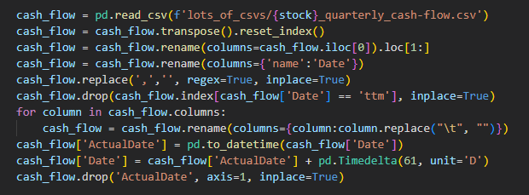


Some logic challenges
Compensating for accounting delay
Filling non-business days

Slide 9
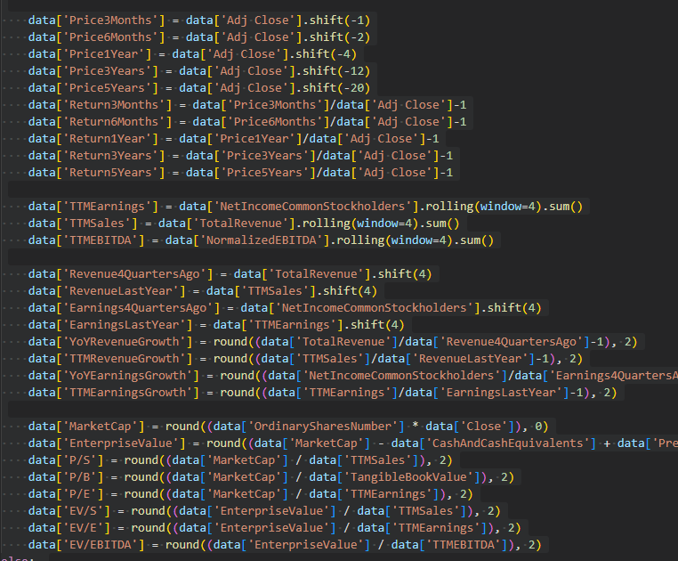
Special skills learned
Rolling windows in pandas
Shifting rows

Slide 10
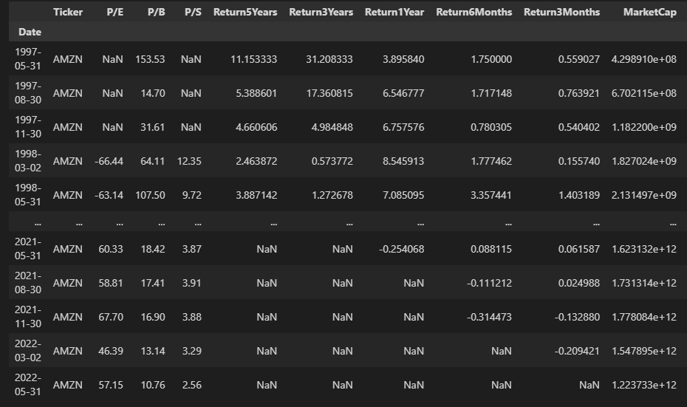

Final Result
for just 500 companies

Slide 11
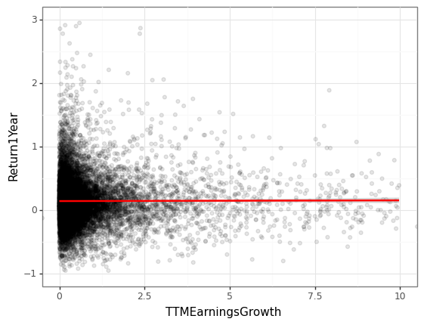
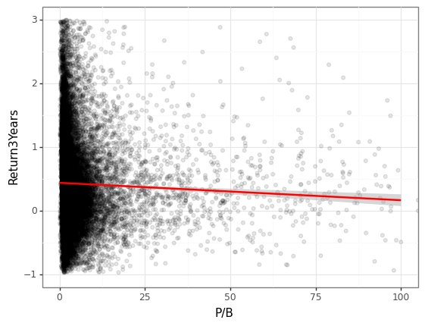
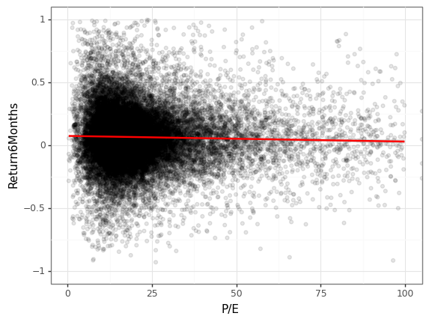
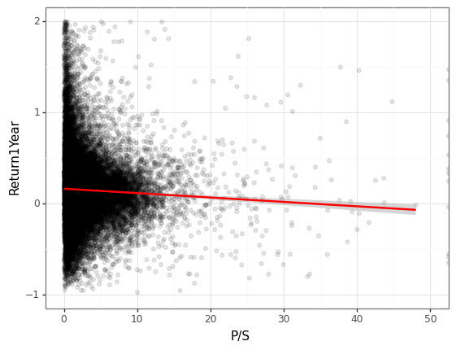
Stock market professionals do their best to price in all future information

Slide 12

Phase 2
Fill out the dataset with daily values as opposed to once quarterly. Expand my feature engineering to more accurately value a company. Perform linear regression and machine learning for predictive purposes.

