Slide 1

Pypsm
Hunter Thompson

Slide 2
Background
What is propensity score matching (PSM)?
Technique to construct artificial control group by matching treatment group with non-treatment group of similar characteristics
Why PyPSM?
Lack of simple interface option for researchers with less experience in python to create control groups through PSM

Slide 3
Use Cases
PyPSM offers a simple interface (single function) with that creates a control group, returns it, and optionally outputs it to a csv file
Intended for people with less experience in coding who want to quickly create a control group and see the effects of a specific treatment
Ex: Policy makers determining the effectiveness of a new program, clinical trials where blind study unable to be performed (smoking, lifestyle choices, etc.)
No simple way to do propensity score matching in packages such as scikit-learn

Slide 4
DEMO

Slide 5
Design
Split into two main parts:
match.py = wrapper function that reads in data (as dataframe or csv) and calls Matcher to create matched group dataframe
Matcher.py = contains class Matcher that contains logic for matching
Create Logistic Regression -> Score Data -> Match Data based on Score

Slide 6
Design
Extensibility through wrapper function (easily add GUI and/or data cleaning)
Modularity also helps
Separate class for matching allows for easy to continue following separation of concerns on future iterations
Information hiding through private functions and hidden variables
EX: __create_logistic_regression, __match
Simple interface with only two required inputs for increased accessibility to users

Slide 7
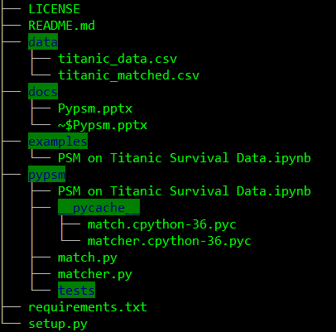
Project Structure

Slide 8
Lessons Learned & Future Work
User-oriented design
Figure out what exact functionality is needed
Write function headers
Future Work
GUI
Automatic Data Cleaning

